Slide 1

KMG060 – Exercise 1 Omics Data Analysis: RNA-seq Yeast Stress Responses
Cheewin Kittikunapong and Daniel Brunnsåker
10 September 2021

Slide 2
Learning objectives
By the end of this exercise, you should be able to:
Understand the effects of normalization on an RNA-seq dataset
Perform and interpret a “standard” differential gene expression analysis
Understand how fold-changes and p-values are used to select genes for further study
Map DE analysis results to biological processes (via GO terms)
Discern some of the pitfalls/caveats associated with RNA-seq analysis

Slide 3
Exercise Outline
Normalize and visualize gene counts data
Perform unsupervised clustering analysis (PCA)
Perform differential expression analysis of stress vs. control condition (using a negative binomial model)
Visualize and interpret results (using multiple methods)
Perform Gene Ontology Term (GO-Term) Enrichment Analysis to find biological processes associated with the stress condition

Slide 4
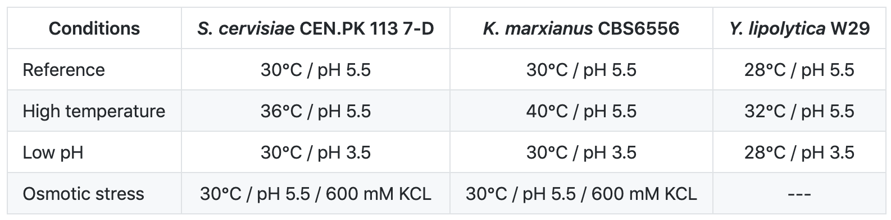
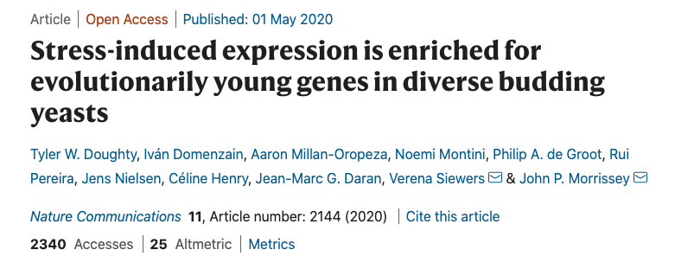
Response of S. cerevisae to various stress conditions
https://www.nature.com/articles/s41467-020-16073-3

Slide 5
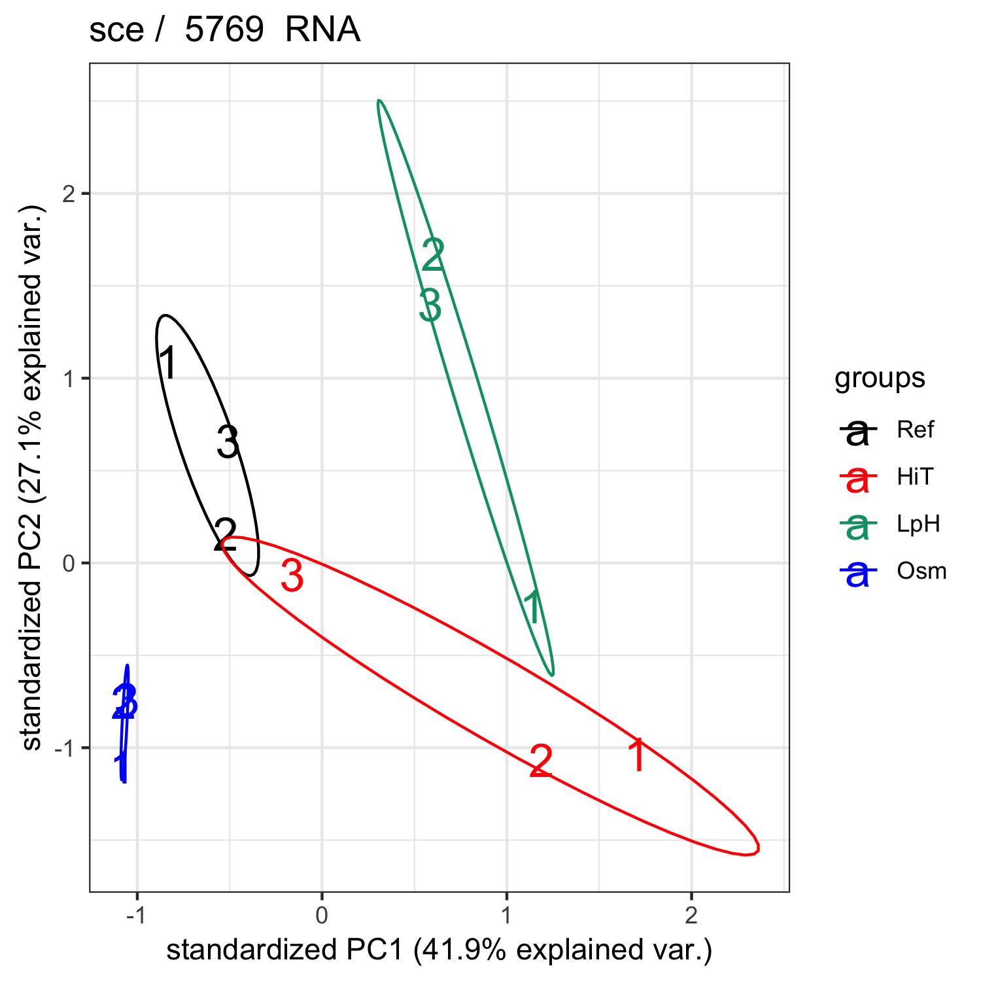
Response of S. cerevisae to various stress conditions
https://www.nature.com/articles/s41467-020-16073-3

Slide 6
Instructions
Perform a differential gene expression analysis for an RNA-seq dataset with multiple conditions and samples
Report which stress condition you chose, how different is the stress to the control condition (in terms of gene expression profile), and which and how many genes are differentially expressed
The report template (Exercise1_Report_template.docx) is available on the course Canvas website in Exercise 1. Use this format.
All the necessary MATLAB scripts and data for the exercise are available at: https://github.com/SysBioChalmers/KMG060-Systems-Biology-course
Download or clone the repository to your preferred working directory.

Slide 7
Normalization
Are these samples different?

Slide 8
Normalization
Are these samples different?
No. While the number of reads does differ, the same proportion is retained in expression between genes.

Slide 9
Normalization
Are these samples different?
No. While the number of reads does differ, the same proportion is retained in expression between genes.
This is handled with normalization – the total amount of reads in a sample has no biological meaning.

Slide 10
Challenges with Normalization
A few highly expressed and highly variable genes often make up a large part of the total transcriptome
This may skew the normalization
The mRNA molecules are fragmented before sequencing
longer genes give more fragments and thereby more counts
This can be handled by dividing counts by transcript length

Slide 11
Normalization Methods
Library size normalization (CPM, TPM, FPKM)
Linearly scales all samples to the same total counts
Easy to incorporate division by transcript length
Affected by a few highly expressed genes
Good when a good representation of the transcriptome for a given condition is desired
Not recommended for differential expression analyses

Slide 12
Normalization Methods
Library size normalization (CPM, TPM, FPKM)
Linearly scales all samples to the same total counts
Easy to incorporate division by transcript length
Affected by a few highly expressed genes
Good when a good representation of the transcriptome for a given condition is desired
Not recommended for differential expression
TMM (EdgeR), RLE (DeSeq), MRN
Assumption: Most genes are not DE
Effectively handles variation in a few highly expressed genes
Works on counts, difficult for some methods to divide by transcript length
Good for differential expression
MRN is used in the lab exercise!

Slide 13
MRN
Median of Ratios Normalization:
For simplicity, only use genes without zeros for normalization

Slide 14
MRN
 | S1 | S2 | S3
gene A | 4 | 6 | 3
gene B | 5 | 8 | 5
gene C | 1 | 2 | 1
gene D | 0 | 1 | 0
gene E | 0 | 0 | 0
gene F | 8 | 12 | 7
gene G | 2 | 3 | 1
 | S1 | S2 | S3
gene A | 4 | 6 | 3
gene B | 5 | 8 | 5
gene C | 1 | 2 | 1
gene F | 8 | 12 | 7
gene G | 2 | 3 | 1
Presence of zeros generates genes with a geometric mean of 0

Slide 15
MRN
Median of Ratios Normalization:
For simplicity, only use genes without zeros for normalization
Calculate a reference value for each gene as the geometrical mean across all samples

Slide 16
MRN
 | S1 | S2 | S3
gene A | 4 | 6 | 3
gene B | 5 | 8 | 5
gene C | 1 | 2 | 1
gene F | 8 | 12 | 7
gene G | 2 | 3 | 1
 | S1 | S2 | S3 | REF
gene A | 4 | 6 | 3 | 4.16
gene B | 5 | 8 | 5 | 5.85
gene C | 1 | 2 | 1 | 1.26
gene F | 8 | 12 | 7 | 8.76
gene G | 2 | 3 | 1 | 1.82

Slide 17
MRN
Median of Ratios Normalization:
For simplicity, only use genes without zeros for normalization
Calculate a reference value for each gene as the geometrical mean across all samples
For each sample, generate ratios for each gene against the reference value

Slide 18
MRN
What is the level of expression for a given gene in a given sample in comparison to its mean expression level?
 | S1 | S2 | S3
gene A | 4 | 6 | 3
gene B | 5 | 8 | 5
gene C | 1 | 2 | 1
gene F | 8 | 12 | 7
gene G | 2 | 3 | 1

Slide 19
MRN
What is the level of expression for a given gene in a given sample in comparison to its mean expression level?
 | S1 | S2 | S3
gene A | 4 | 6 | 3
gene B | 5 | 8 | 5
gene C | 1 | 2 | 1
gene F | 8 | 12 | 7
gene G | 2 | 3 | 1
 | S1 | S2 | S3 | REF
gene A | 4 | 6 | 3 | 4.16
gene B | 5 | 8 | 5 | 5.85
gene C | 1 | 2 | 1 | 1.26
gene F | 8 | 12 | 7 | 8.76
gene G | 2 | 3 | 1 | 1.82

Slide 20
MRN
What is the level of expression for a given gene in a given sample in comparison to its mean expression level?
 | S1 | S2 | S3
gene A | 4 | 6 | 3
gene B | 5 | 8 | 5
gene C | 1 | 2 | 1
gene F | 8 | 12 | 7
gene G | 2 | 3 | 1
 | S1 | S2 | S3 | REF
gene A | 4 | 6 | 3 | 4.16
gene B | 5 | 8 | 5 | 5.85
gene C | 1 | 2 | 1 | 1.26
gene F | 8 | 12 | 7 | 8.76
gene G | 2 | 3 | 1 | 1.82
 | S1 | S2 | S3
gene A | 0.96 | 1.44 | 0.72
gene B | 0.85 | 1.37 | 0.85
gene C | 0.79 | 1.59 | 0.79
gene F | 0.91 | 1.37 | 0.80
gene G | 1.10 | 1.65 | 0.55
Rescaled values

Slide 21
MRN
Median of Ratios Normalization:
For simplicity, only use genes without zeros for normalization
Calculate a reference value for each gene as the geometrical mean across all samples
For each sample, generate ratios for each gene against the reference value
Calculate a size factor as the median of the ratios for each sample – this gives a measure of how much higher the genes are expressed in the sample compared to the reference

Slide 22
MRN
 | S1 | S2 | S3
gene A | 0.96 | 1.44 | 0.72
gene B | 0.85 | 1.37 | 0.85
gene C | 0.79 | 1.59 | 0.79
gene F | 0.91 | 1.37 | 0.80
gene G | 1.10 | 1.65 | 0.55
 | S1 | S2 | S3
gene A | 0.96 | 1.44 | 0.72
gene B | 0.85 | 1.37 | 0.85
gene C | 0.79 | 1.59 | 0.79
gene F | 0.91 | 1.37 | 0.80
gene G | 1.10 | 1.65 | 0.55
Size factor | 0.91 | 1.44 | 0.79

Slide 23
MRN
Median of Ratios Normalization:
For simplicity, only use genes without zeros for normalization
Calculate a reference value for each gene as the geometrical mean across all samples
For each sample, generate ratios for each gene against the reference value
Calculate a size factor as the median of the ratios for each sample – this gives a measure of how much higher the genes are expressed in the sample compared to the reference
Divide all counts with the sample’s size factor – this will give a median fold change of 1 across genes for all samples, meaning that they are comparable.

Slide 24
MRN
What is the level of expression for a given gene in comparison to the rest of genes within the same sample?
 | S1 | S2 | S3
gene A | 0.96 | 1.44 | 0.72
gene B | 0.85 | 1.37 | 0.85
gene C | 0.79 | 1.59 | 0.79
gene F | 0.91 | 1.37 | 0.80
gene G | 1.10 | 1.65 | 0.55
Size factor | 0.91 | 1.44 | 0.79

Slide 25
MRN
What is the level of expression for a given gene in comparison to the rest of genes within the same sample?
 | S1 | S2 | S3
gene A | 0.96 | 1.44 | 0.72
gene B | 0.85 | 1.37 | 0.85
gene C | 0.79 | 1.59 | 0.79
gene F | 0.91 | 1.37 | 0.80
gene G | 1.10 | 1.65 | 0.55
Size factor | 0.91 | 1.44 | 0.79
 | S1 | S2 | S3
gene A | 0.88 | 2.08 | 0.57
gene B | 0.94 | 0.95 | 1.08
gene C | 0.87 | 1.10 | 1.00
gene F | 1.00 | 0.95 | 1.01
gene G | 1.21 | 1.14 | 0.69
Normalized values

Slide 26
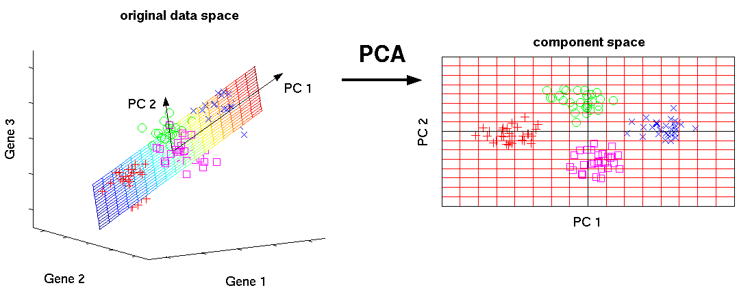
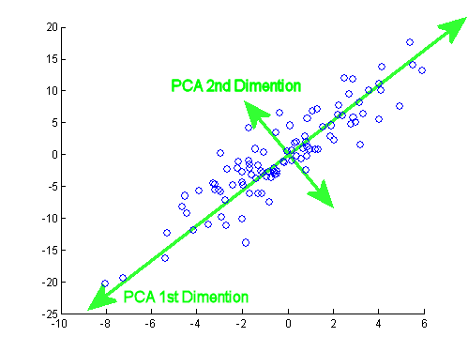
Principal Component Analysis
Each point is a sample

Slide 27
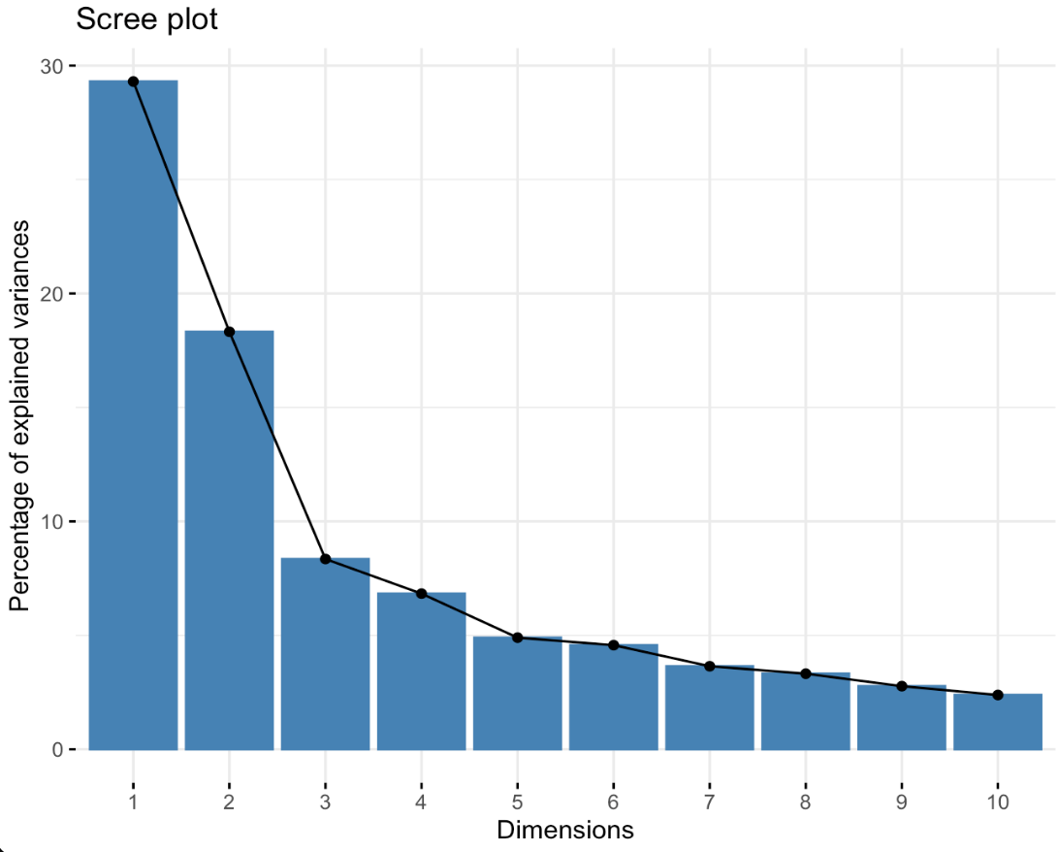
Principal Component Analysis
Each point is a sample
Each PC captures a decreasing amount of variance in the data
Dimensions/PCs

Slide 28
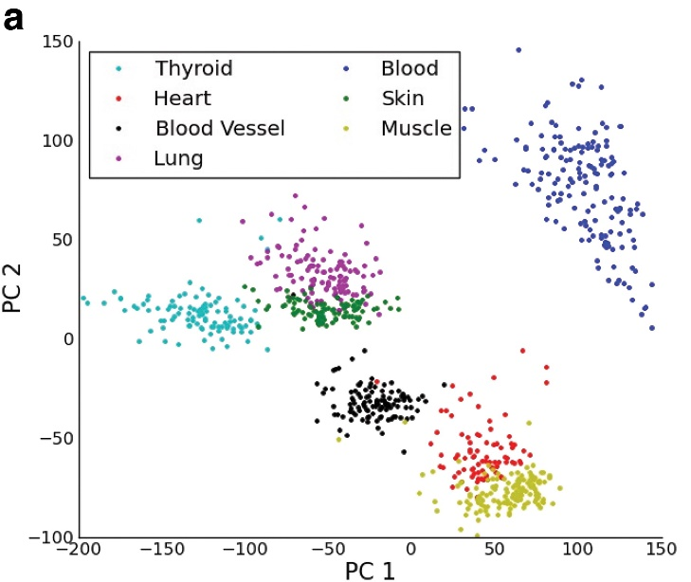
Principal Component Analysis
Each point is a sample
Each PC captures a decreasing amount of variance in the data
What does this look like using RNA-seq data?
https://www.liebertpub.com/doi/full/10.1089/cmb.2015.0085

Slide 29
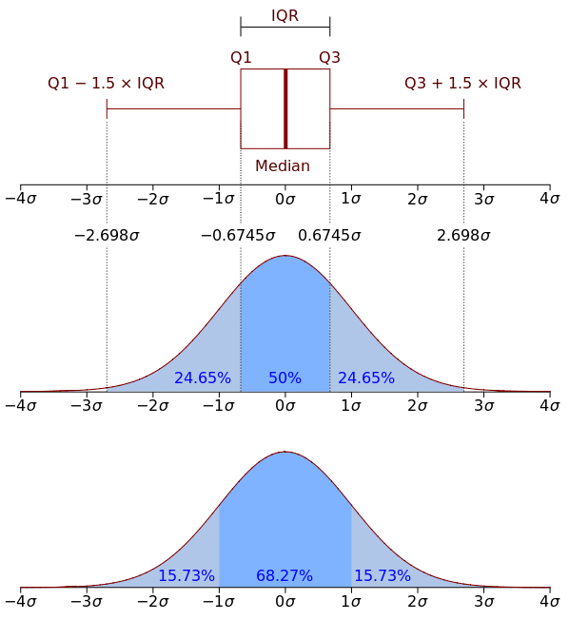
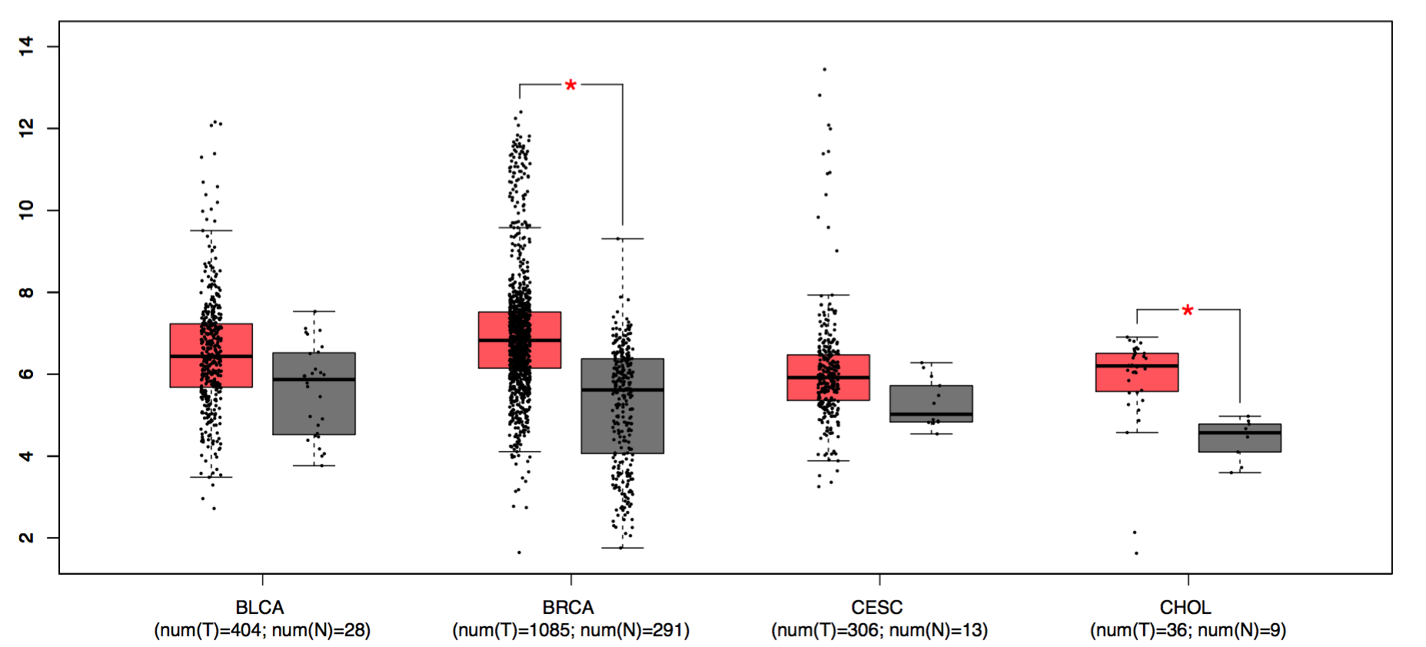
Boxplots
Statistically significant
Log₂(gene expression)

Slide 30
Expression and significance (Boxplots)
High significance, low differential expression
High significance, high differential expression
Stress
Control
Stress
Control
Stress
Control
Stress
Control
Low significance, low differential expression
Low significance, high differential expression

Slide 31
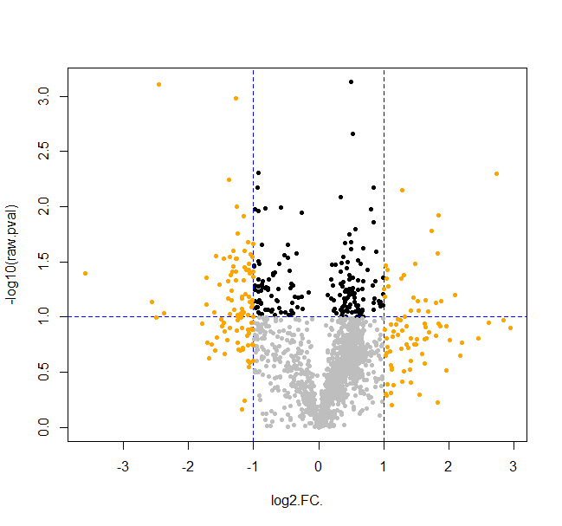
Expression and significance (Volcano plot)
Stress
Control

Slide 32
Expression and significance (Volcano plot)
What we are interested in
Note the negative
Stress
Control
Low
significance
Low DE

Slide 33
Gene Ontology Terms
Go Terms
Group genes together based on common characteristics
3 different types:
Process (e.g. Glycolysis)
Molecular function (e.g. Kinase)
Cellular components (e.g. Mitochondria)

Slide 34
Gene Ontology Terms
Go Terms
Group genes together based on common characteristics
3 different types:
Process (e.g. Glycolysis)
Molecular function (e.g. Kinase)
Cellular components (e.g. Mitochondria)

Slide 35
Go Term enrichment analysis
Calculate the enrichment that represents the amount to which the genes in the set are over-represented.
Estimate the statistical significance of the enrichment using a hypergeometric test
Adjust for multiple hypothesis testing for when a large number of gene sets are being analyzed at one time.

Slide 36
Correction for multiple testing
Two widely-used methods of correction:
FDR (False Detection Rate)
Corrects for false positive rate
“Find all genes associated with …”
Bonferroni
Corrects for total false positives
“Find one gene to study further for …”

Slide 37
Additional details
Consultation session: 17 September (15:15 – 17:00; KD1)
Hand-in deadline: 19 September at 23:59
Upload your report as .docx or .pdf formats
Please don’t forget to upload your code (.mlx file)
Optional material (courtesy of StatQuest):
https://www.youtube.com/watch?v=TTUrtCY2k-w (Normalization)
https://www.youtube.com/watch?v=FgakZw6K1QQ (PCA, Step-by-step)
https://www.youtube.com/watch?v=K8LQSvtjcEo (False detection rates)

