Slide 1
FINANCIAL FRAUD DETECTION
Data Cleaning, Exploratory Analysis & Model Evaluation
PMP Solutions | Standard Bank Hackathon — Data Science Track

Slide 2
Agenda
01
Dataset Overview
Scale, structure, and the core fraud problem
02
Data Cleaning
Missing values, duplicates, and what "clean" really means here
03
Exploratory Data Analysis
Class imbalance, transaction types, balance behaviour
04
Feature Engineering
Turning raw balances into fraud-revealing signals
05
Modelling & Evaluation
Decision Tree, Random Forest, XGBoost — and a hard look at the results
06
Findings & Recommendations
What we trust, what needs scrutiny, and next steps

Slide 3
THE DATA
Dataset Overview
636,262
11
849
0.133%
Transactions
Original Columns
Fraud Cases
Fraud Rate
Synthetic_Financial_Datasets_For_Fraud_Detection_resample.csv — modelled on the PaySim mobile-money simulation
Columns
Why this matters
step (time)
type
amount
nameOrig
oldbalanceOrg
newbalanceOrig
nameDest
oldbalanceDest
newbalanceDest
isFraud (target)
isFlaggedFraud
Fraud detection here means finding roughly 1 transaction in every 750 — a classic severe class-imbalance problem. This shapes every later decision: how we split data, how we evaluate models, and why plain accuracy is meaningless.

Slide 4
DATA CLEANING
Is the Data Actually Clean?
data_cleaning.py
What the checks found
print("Missing Values") df.isnull().sum() # -> 0 for every column print("Duplicate Rows:") df.duplicated().sum() # -> 0 (but nameOrig/nameDest are # near-unique IDs, so this test is weak) cols = ["step","type","amount","oldbalanceOrg", "newbalanceOrig","oldbalanceDest", "newbalanceDest"] df.duplicated(subset=cols).sum() # -> stricter check, ignores account IDs
No missing values
Confirmed by df.isnull().sum() across all 11 columns — a genuinely clean input.
No exact duplicate rows
But nameOrig/nameDest are near-unique IDs, so this test almost can't fail — it isn't testing much.
Zero balances ≠ missing data
Merchant destinations ("M..." accounts) never have tracked balances in this dataset — 0 is a business rule, not a defect.

Slide 5
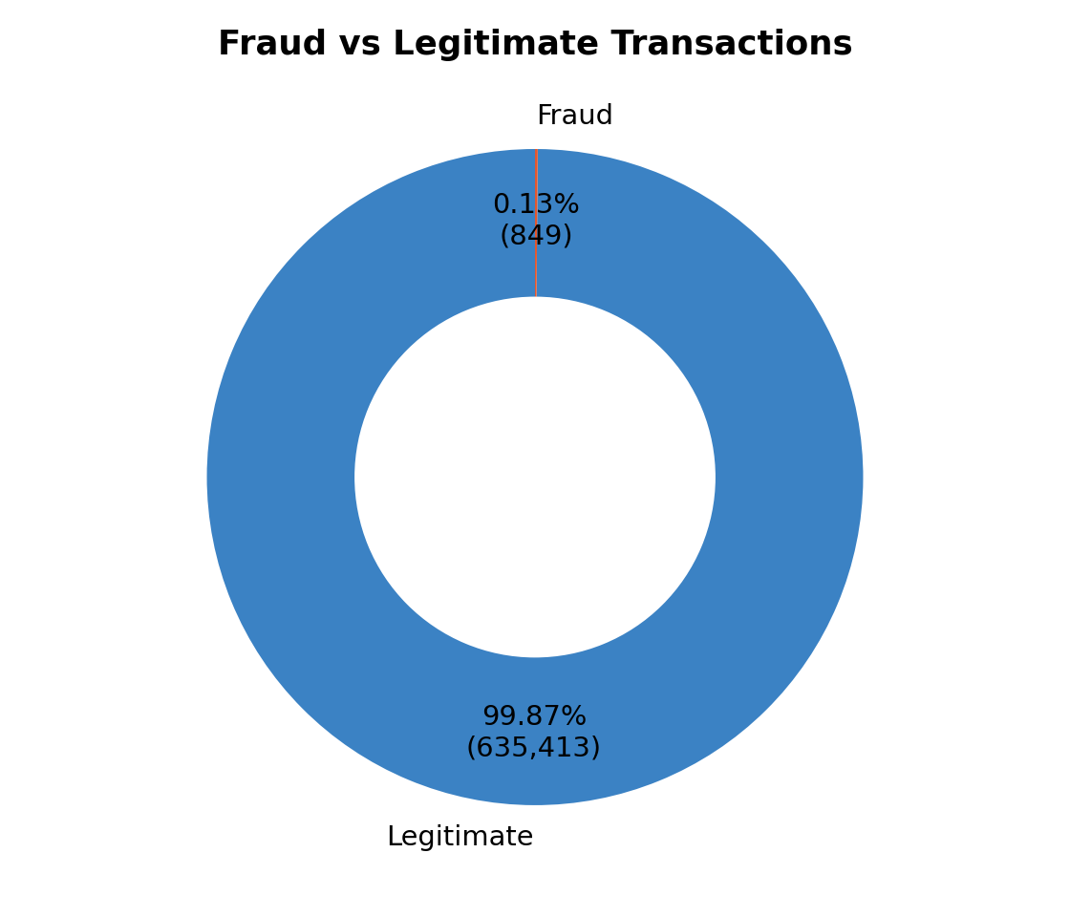
EDA
Class Imbalance: The Core Challenge
849
635,413
fraud cases
out of 636,262
legitimate
transactions
Why this drives every later decision
A model predicting "never fraud" would score 99.87% accuracy — accuracy is meaningless here.
We evaluate with Precision, Recall, F1, and ROC-AUC / PR-AUC instead.
SMOTE (synthetic oversampling) is applied to the training split only — never to the test split — to avoid leaking synthetic fraud patterns into evaluation.

Slide 6
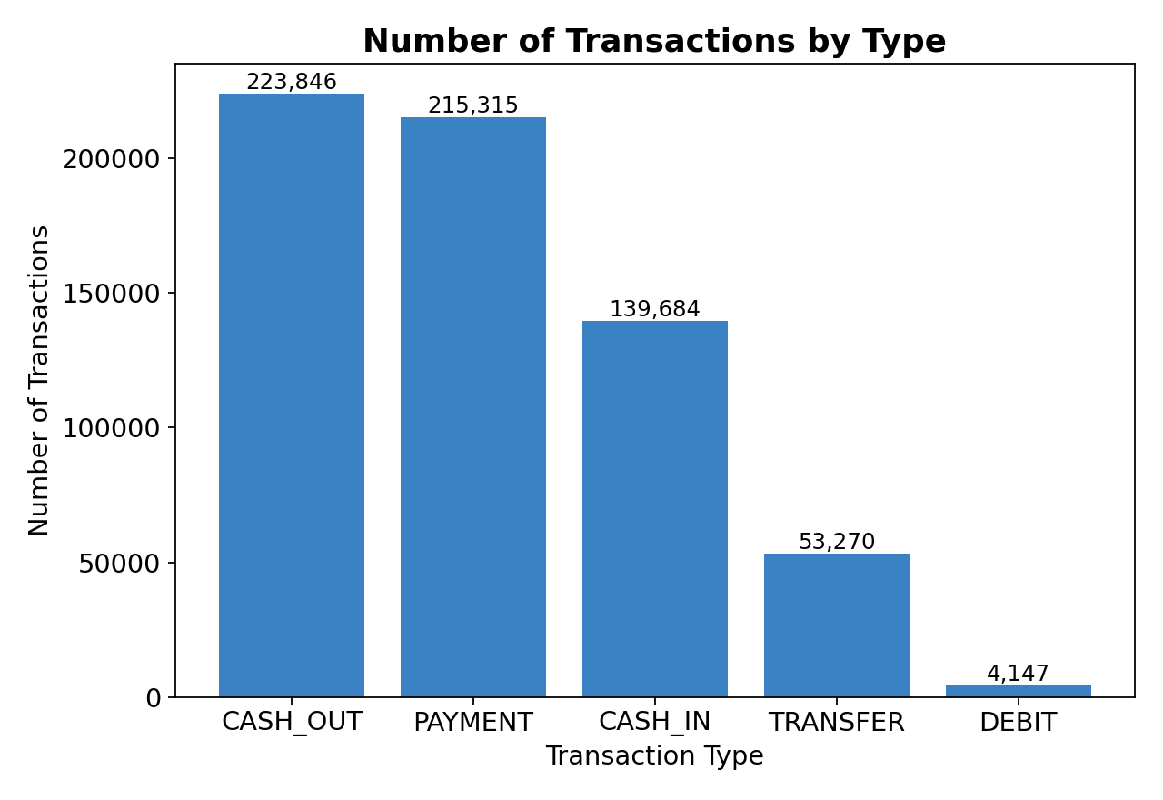
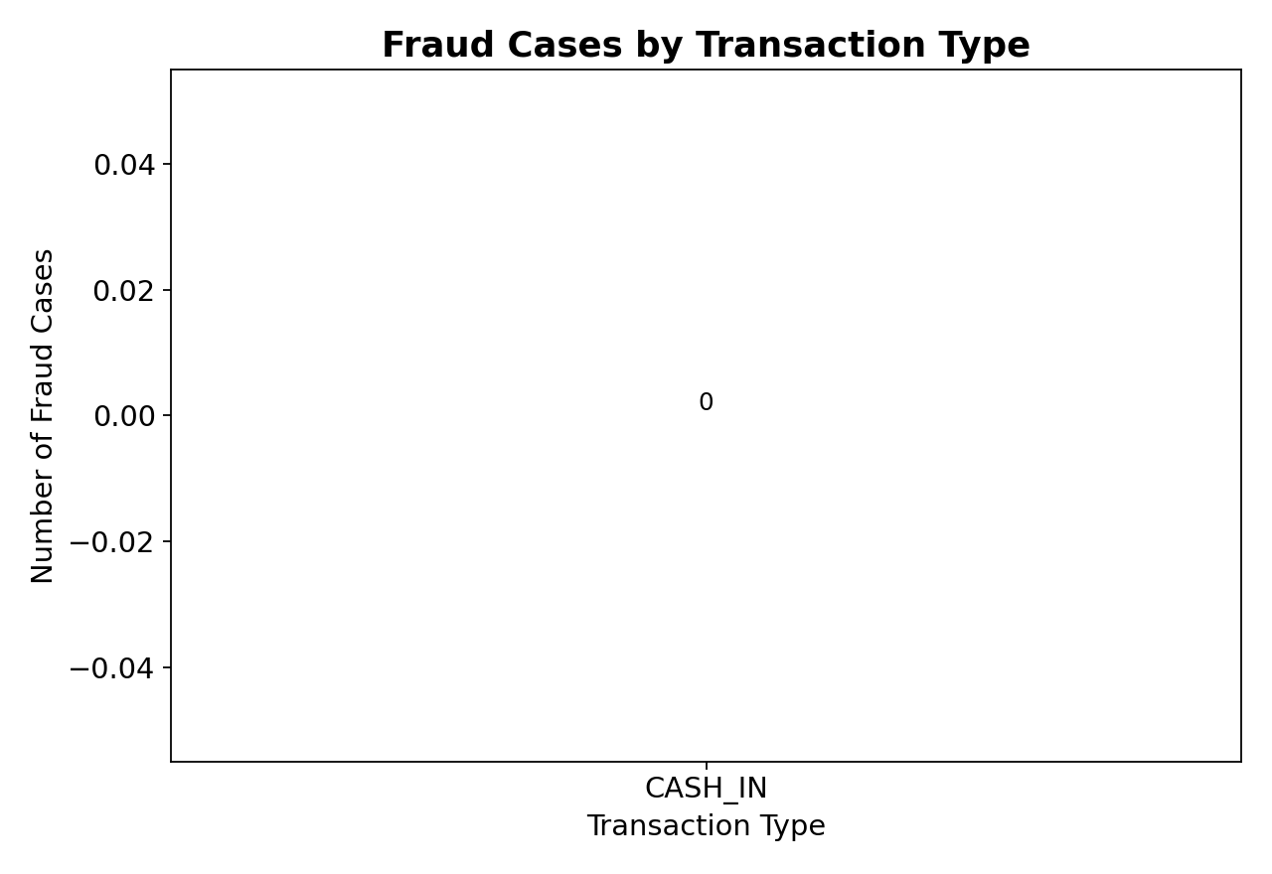
EDA
Transaction Types & Where Fraud Occurs
PAYMENT and CASH_OUT dominate transaction volume, but fraud is concentrated almost entirely in CASH_OUT (417 cases) and TRANSFER (432 cases) — CASH_IN, DEBIT, and PAYMENT show effectively zero fraud.

Slide 7
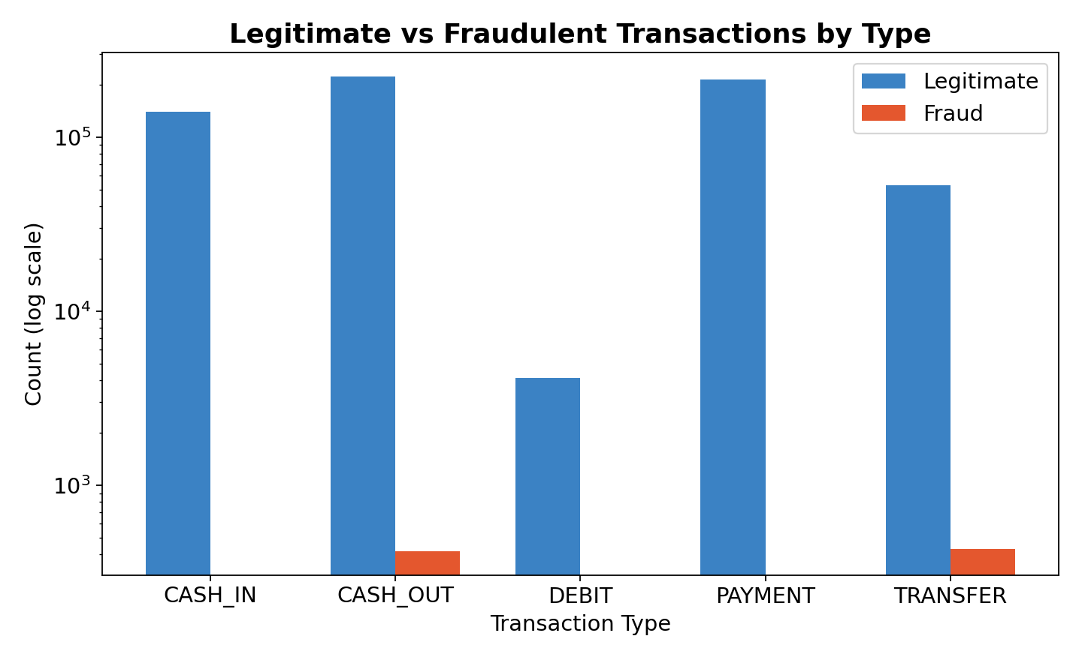
EDA
Key Insight: Fraud Is Type-Specific
A modelling shortcut hiding in plain sight
This is a known artifact of PaySim-style synthetic data, not necessarily how real-world fraud behaves.
type alone already rules out 3 of 5 categories almost perfectly.
Worth stating as a limitation: a model trained here may over-rely on this synthetic pattern.

Slide 8
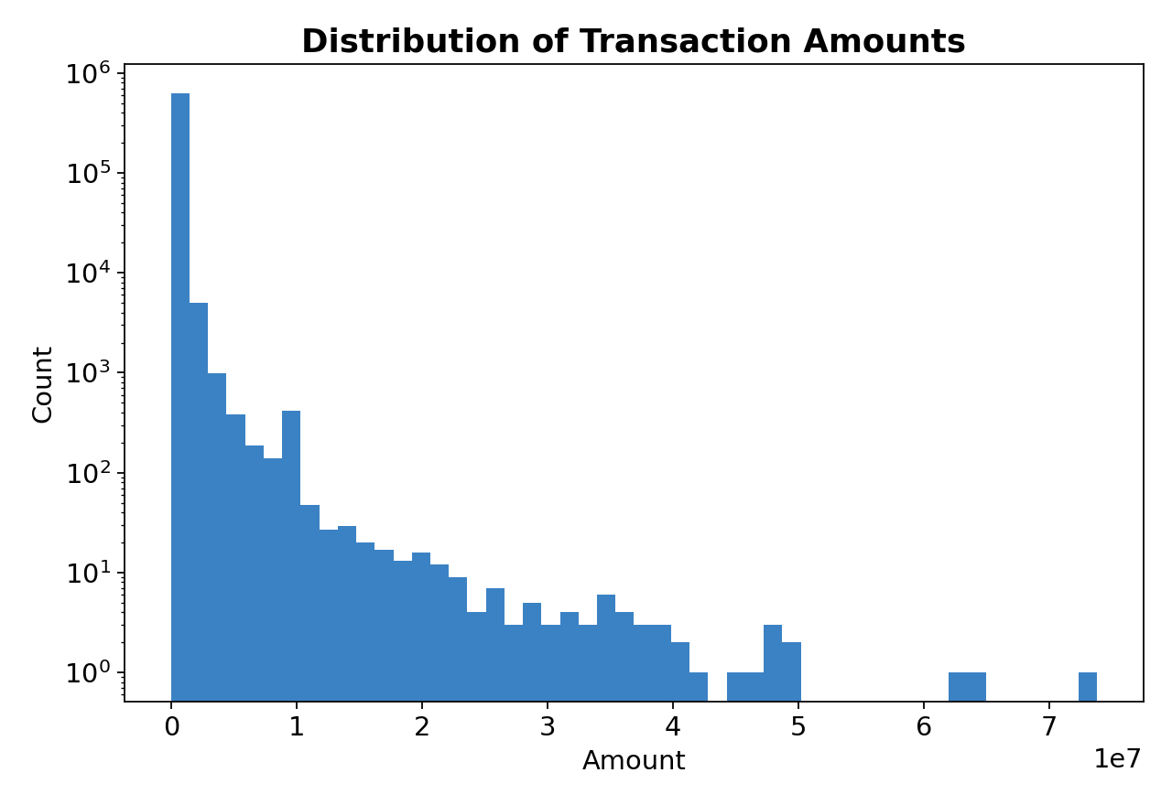
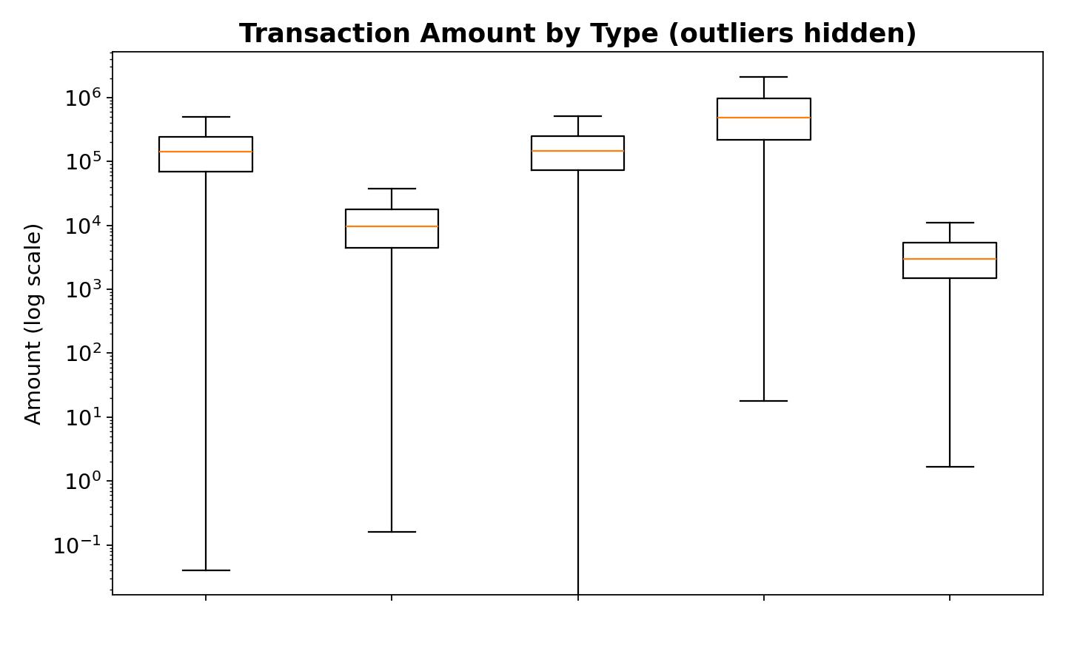
EDA
Transaction Amounts
Amounts are heavily right-skewed (log scale used above) — a small number of very large transfers and cash-outs dominate the tail, which is exactly where HighValueTransaction and AmountToBalanceRatio earn their keep as features.

Slide 9
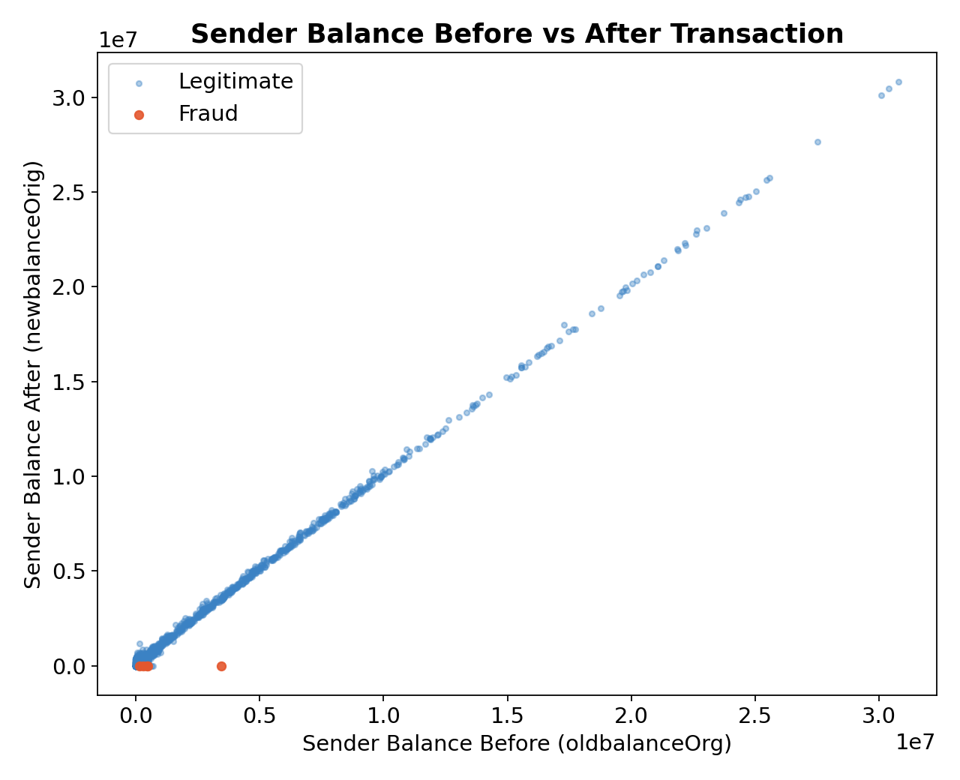
EDA
The Fraud Signature: Drained Accounts
What the scatter shows
Each point is a transaction: sender balance before (x) vs. after (y).
Legitimate transactions (blue) spread naturally along the diagonal.
Fraud cases (red) cluster on the x-axis — the sender's balance goes to exactly zero, almost every time.
This single behaviour — "the account gets fully drained" — is the strongest signal in the entire dataset, and it's what AccountEmptied and BalanceChangeOrig are built to capture.

Slide 10
FEATURE ENGINEERING
Turning Balances Into Signals
Nine engineered features, in plain terms
df_fe = df.copy() df_fe['BalanceChangeOrig'] = ( df_fe['oldbalanceOrg'] - df_fe['newbalanceOrig']) df_fe['AccountEmptied'] = ( df_fe['newbalanceOrig'] == 0 ).astype(int) df_fe['AmountToBalanceRatio'] = ( df_fe['amount'] / (df_fe['oldbalanceOrg'] + 1)) df_fe['RiskScore'] = (
amount_risk * 0.35 +
type_risk * 0.25 +
amount_ratio * 0.20 +
balance_ratio * 0.20)
BalanceChangeOrig / Dest
How much the sender's / receiver's balance actually moved.
AccountEmptied
Flags when the sender's balance hits exactly zero after the transaction.
AmountToBalanceRatio
Is the transaction close to the sender's entire balance? Fraud often ≈ 1.0.
RiskScore (0–100)
A hand-built composite of amount size, transaction type, and balance-drain ratio.
is_cash_out / is_transfer / …
One-hot flags — since fraud is concentrated in just two types.

Slide 11
PREPROCESSING
Removing Leakage & Selecting Features
leakage_cols = ['isFlaggedFraud'] df_prep = df_fe.drop( columns=leakage_cols) # nameOrig / nameDest excluded too # (~636K / ~457K unique IDs) X = df_prep[features] y = df_prep['isFraud']
isFlaggedFraud → dropped
It's PaySim's own rule-based flag (>R200,000 triggers it), not a raw transaction attribute — keeping it would mean partly learning from another detector's decision, not genuine behaviour.
nameOrig / nameDest → dropped
Hundreds of thousands of unique account IDs — encoding them risks the model memorising specific accounts instead of learning generalisable behaviour.
Train / test split: 80 / 20, stratified on isFraud, random_state=42 — so both splits keep the same ~0.13% fraud rate.

Slide 12
MODELLING
Three Models, Head to Head
rf = RandomForestClassifier( n_estimators=100, max_depth=10, min_samples_split=20, random_state=42) rf.fit(X_train, y_train) rf_pred = rf.predict(X_test)
Model | Accuracy | Precision | Recall | F1 | ROC-AUC
Decision Tree | 0.9999 | 0.9497 | 1.0000 | 0.9742 | 1.0000
Random Forest | 1.0000 | 1.0000 | 1.0000 | 1.0000 | 1.0000
XGBoost | 0.9997 | 0.8057 | 1.0000 | 0.8924 | 1.0000
⚠ Random Forest scored a perfect 1.0000 across every metric.
A perfect score on a real-world fraud task is a red flag, not a win — it usually means a feature is (unintentionally) encoding the label. We unpack this on the "Critical Finding" slide rather than taking it at face value.

Slide 13
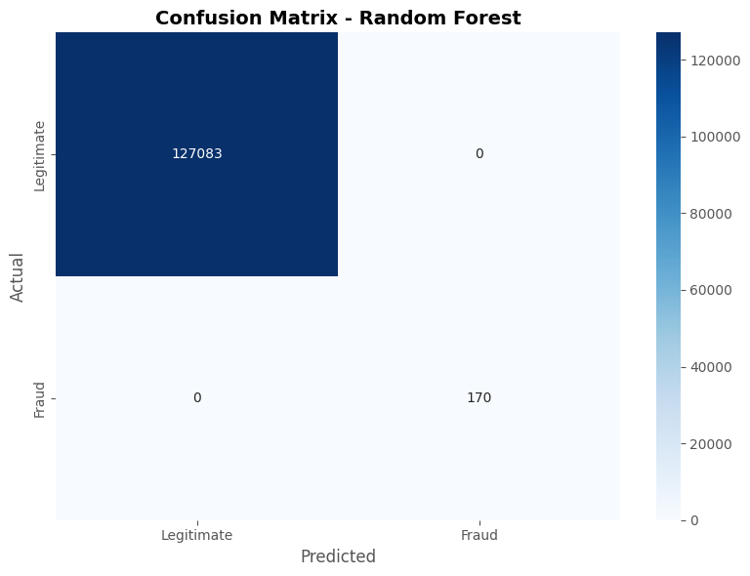
EVALUATION
Confusion Matrix — Random Forest
 | Predicted: Legit | Predicted: Fraud
Actual: Legit | 127,083 | 0
Actual: Fraud | 0 | 170
On the held-out test set (127,253 transactions): 0 false alarms, 0 missed fraud cases. Combined with the perfect metrics on the previous slide, this is the clearest signal that something in the feature set is separating the classes almost by construction — see the next slide.

Slide 14
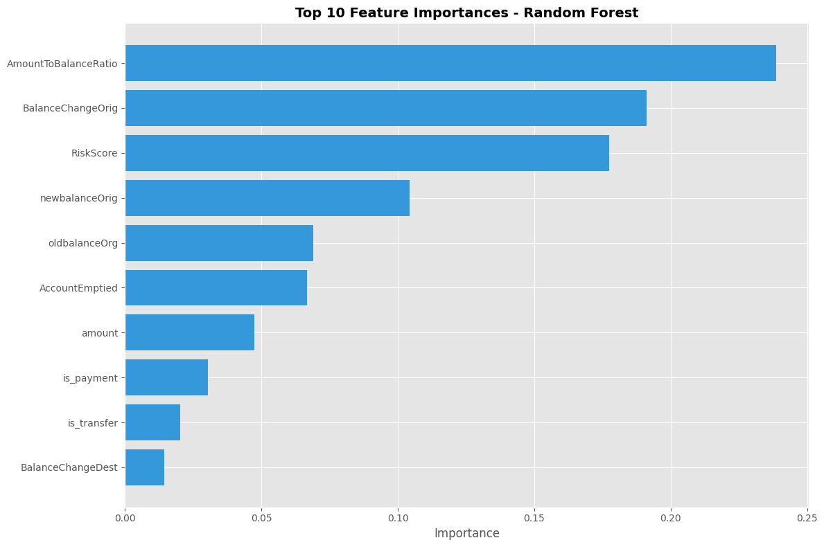
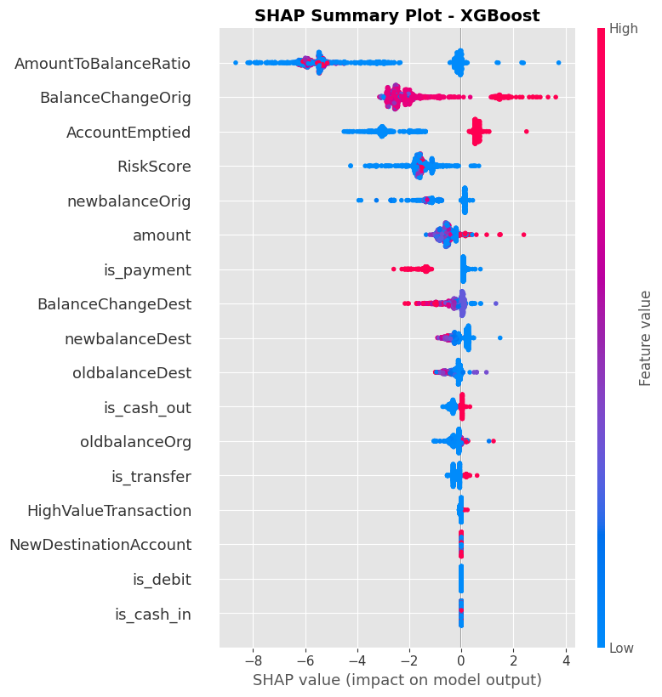
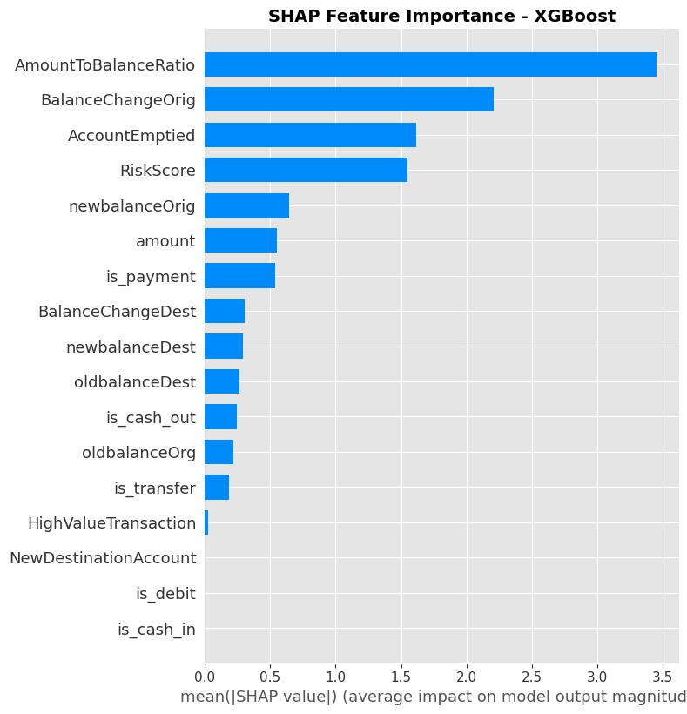
EVALUATION
What Is the Model Actually Using?
SHAP: which features push predictions toward "fraud"
AmountToBalanceRatio, BalanceChangeOrig, and RiskScore dominate — together accounting for over 60% of total feature importance. All three are built directly from amount and balance-drain patterns.

Slide 15
HONEST ASSESSMENT
Too Good To Be True?
A perfect model on a real fraud task deserves scrutiny before celebration.

Slide 16
HONEST ASSESSMENT
Why the Scores Are Suspiciously High
The synthetic data has a "tell"
In this dataset, fraudulent CASH_OUT / TRANSFER transactions almost always drain the sender's account completely (amount ≈ oldbalanceOrg, newbalanceOrig = 0). Real fraud is rarely this clean.
Engineered features encode that tell directly
AmountToBalanceRatio ≈ 1.0 and AccountEmptied = 1 are near-perfect proxies for this synthetic rule — the model isn't learning subtle behaviour, it's reading an artifact of how the data was generated.
RiskScore partially hard-codes domain rules
It's built from transaction type (TRANSFER/CASH_OUT weighted highest, matching exactly where fraud can occur) and balance-drain ratios — a composite that already "knows" the answer pattern before the model sees it.

Slide 17
CONCLUSION
Recommendations & Next Steps
1
Re-test without the composite features
Drop RiskScore and re-check whether AmountToBalanceRatio / AccountEmptied alone still separate classes this cleanly — isolates genuine signal from hard-coded rules.
2
Report PR-AUC alongside ROC-AUC
With 0.13% fraud, ROC-AUC is easy to inflate. Precision-recall curves and the confusion matrix tell the real story of false alarms vs. missed fraud.
3
Validate on held-out real-world data if possible
PaySim is a strong training ground, but a synthetic generation rule is not the same as real fraud behaviour — production deployment needs real transaction validation.
4
Tune the decision threshold, not just the model
In production, the cost of a false alarm (annoying a customer) vs. a missed fraud (financial loss) should set the classification cutoff — not the default 0.5.

Slide 18
Thank You
Questions & Discussion

