Slide 1
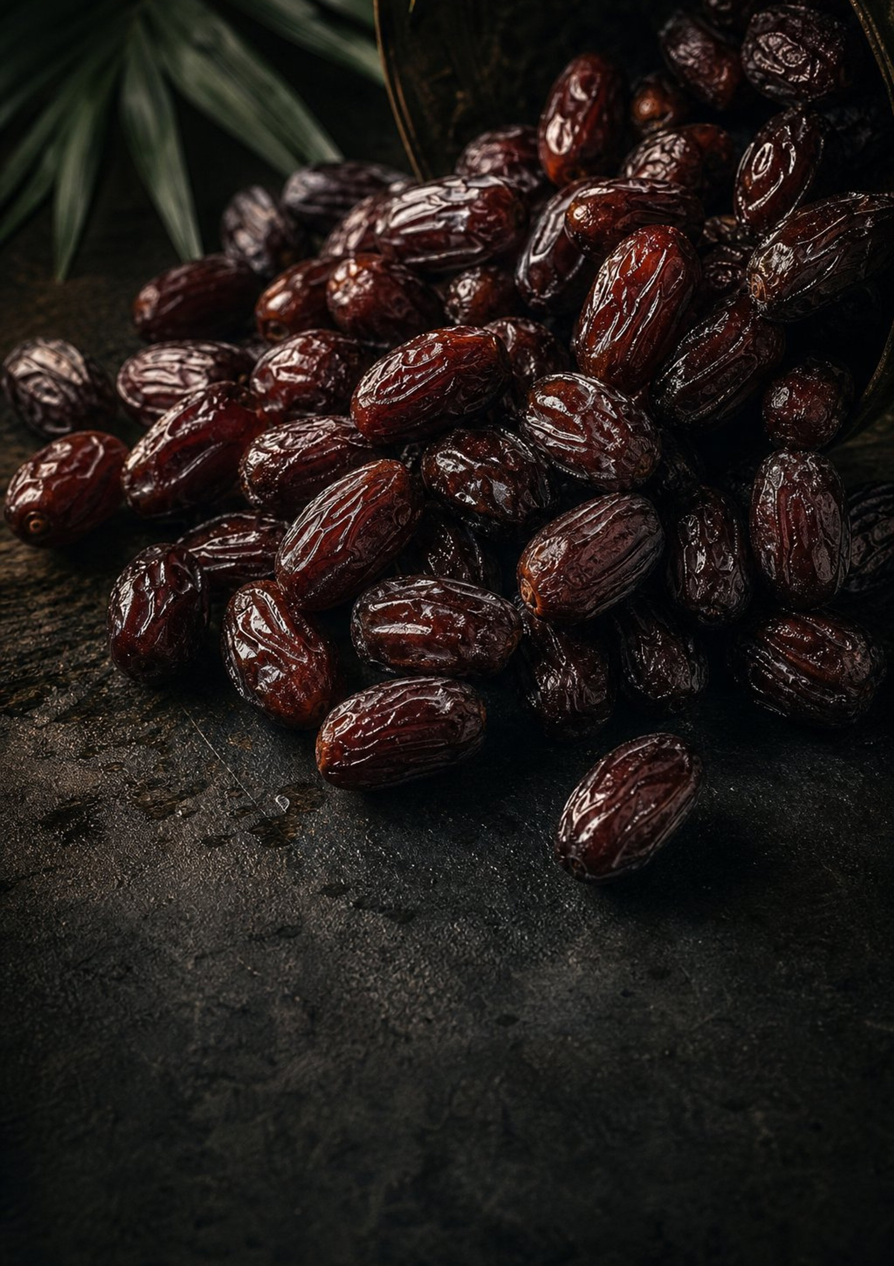



FARVAND
B2B EXPORT CATALOG
Premium Iranian Dates
[YEAR] · EDITION 01
Iran’s date harvest, packed for world buyers
Premium Iranian
Dates
FARVAND sources, grades and packs Iran’s finest export date varieties — from soft Mazafati to
dry Zahedi — for importers, wholesalers and distributors who buy by specification.
IMPORTERS · WHOLESALERS · DISTRIBUTORS
[WEBSITE] · [CONTACT EMAIL]

Slide 2
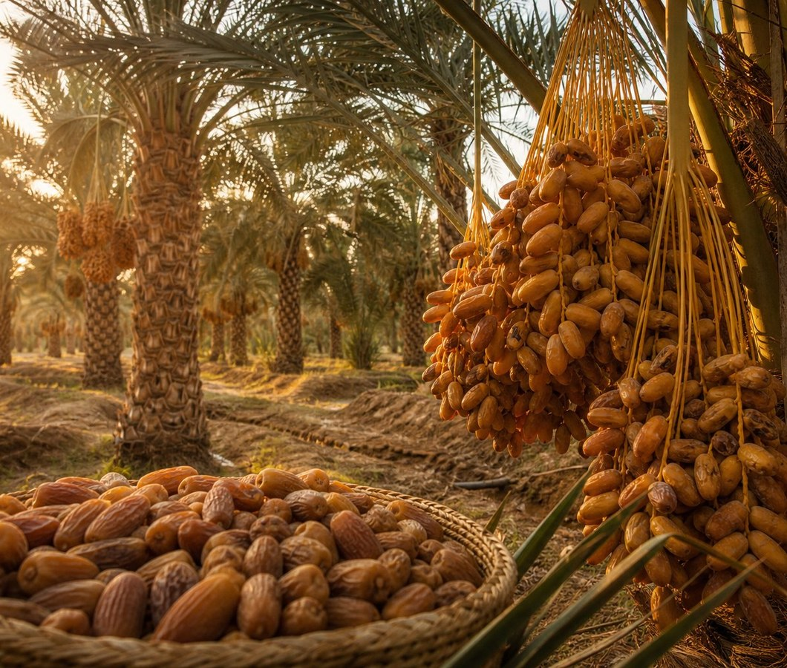
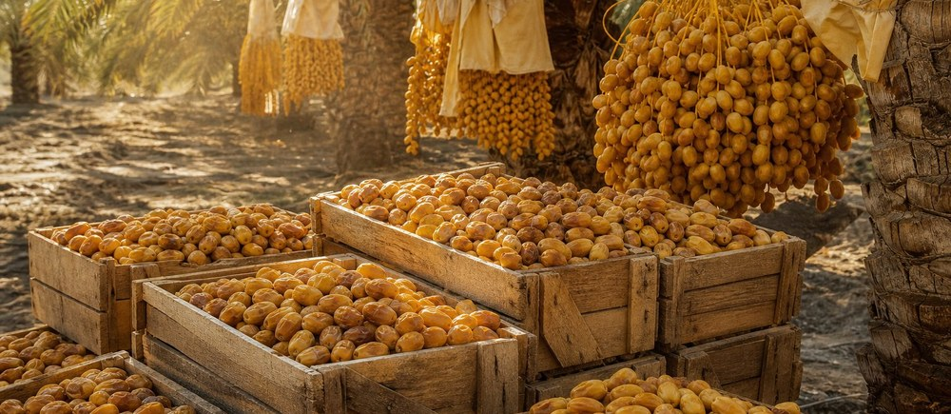
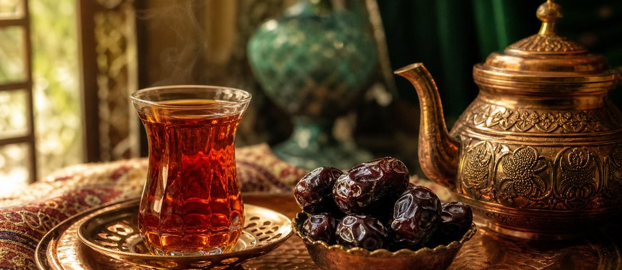
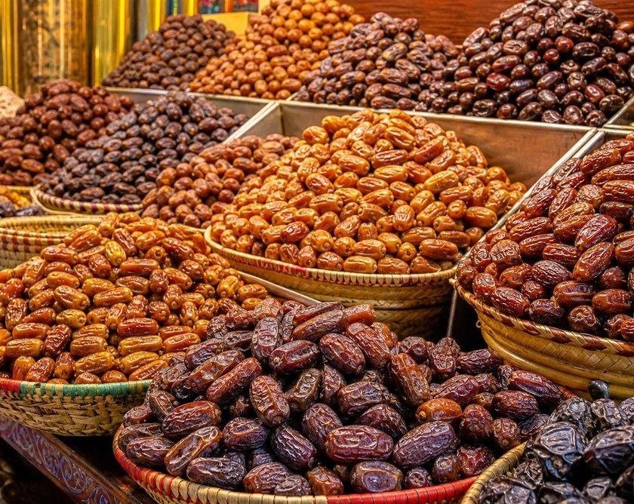

FARVAND
OUR STORY
02 / 12
01 — WHO WE ARE
Our Story
FARVAND is an Iranian date exporter built around one promise: the carton that arrives should be the carton that was
promised.
01
FARVAND began in [YEAR] in [CITY], [PROVINCE] — inside the belt where
Iranian dates are grown. What started as [ORIGIN OF THE BUSINESS] grew
into a focused export operation: [PRODUCER / PACKER / EXPORTER] of
Iranian dates for business buyers who buy by specification, not by
photograph.
WHAT WE STAND FOR
Traceable sourcing
Every lot is tied to a grower, a region and a harvest window, so a claim can be
checked rather than trusted.
02
Today we work with [GROWER PARTNERS / OWNED ORCHARDS] across
Kerman, Fars, Hormozgan, Sistan and Khuzestan to bring together the
varieties buyers reorder — and we pack them to the standard each market
expects.
Graded to order
Size, count and moisture are agreed before packing, and the same
specification is applied to every carton.
03
Our own operation covers [SCOPE: SOURCING / PROCESSING / PACKING /
SHIPPING]. Everything outside that — [LAB TESTING, CERTIFICATION,
FREIGHT] — is handled by named partners we will name on request.
Paperwork that clears
Invoices, packing lists and phytosanitary documentation are prepared with the
shipment, not after it.
MILESTONES
[YEAR]
[YEAR]
[YEAR]
Founded in [CITY] as [ORIGIN OF THE
BUSINESS].
First export shipment to [MARKET].
New packing and grading facility in
[CITY].
[YEAR]
[NEW MARKET, CAPACITY OR
CERTIFICATION].
We would rather tell you what we do not know yet than let you find it out at the
port.
— [FOUNDER / MANAGING DIRECTOR], [TITLE]
FARVAND · PREMIUM IRANIAN DATES
B2B EXPORT CATALOG · [YEAR]
02

Slide 3
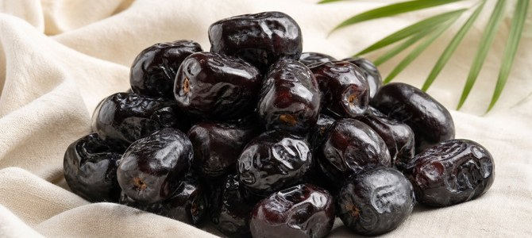
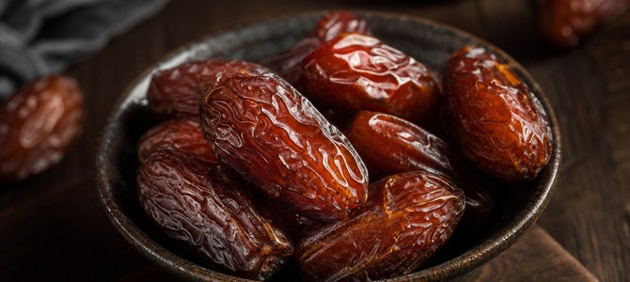
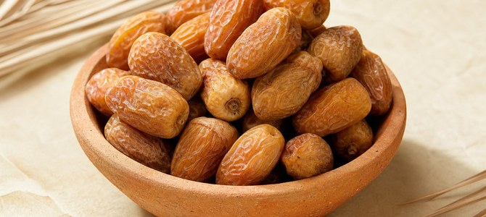
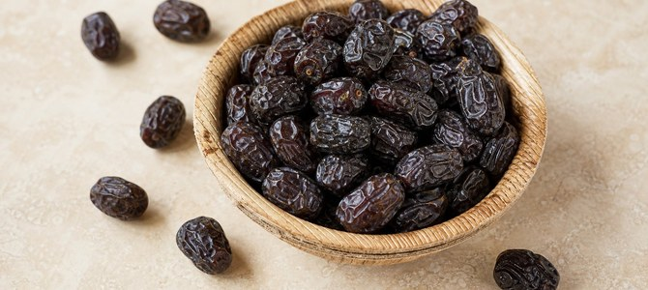
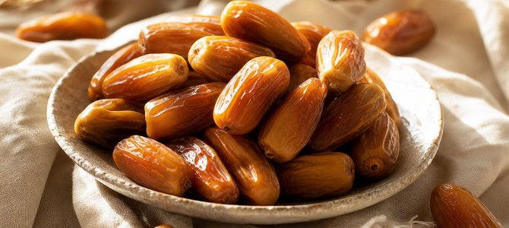
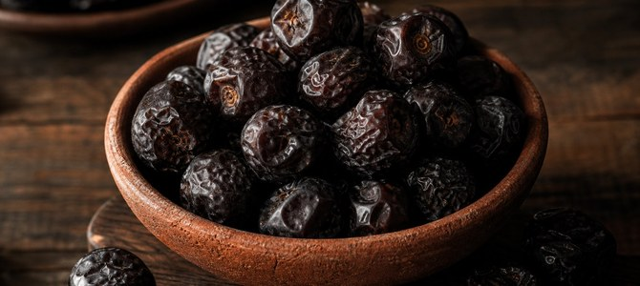
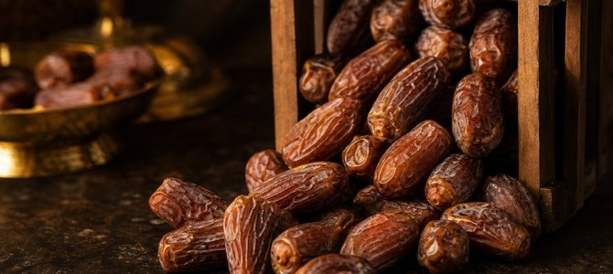
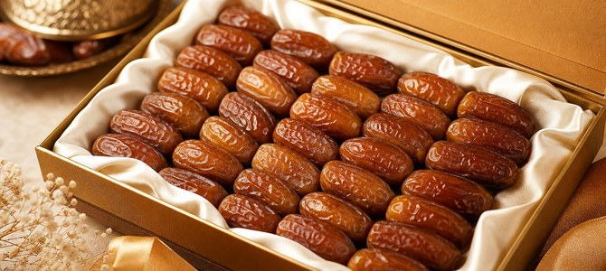


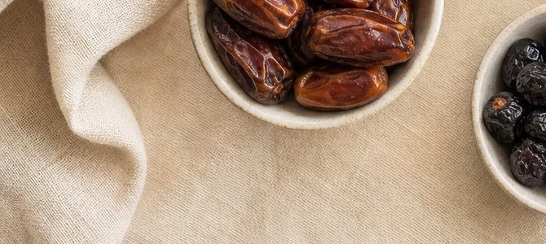
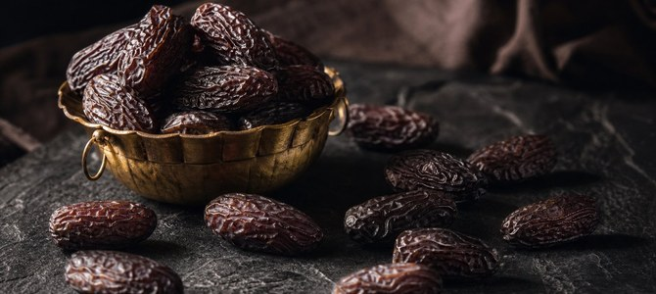
FARVAND
THE RANGE
03 / 12
02 — PRODUCT PORTFOLIO
The FARVAND Range
Twelve export varieties from Iran’s date belt — from Bam and Kerman to Fars, Hormozgan, Sistan and Khuzestan. Each one has its
own colour, texture and job on the shelf.
Mazafati
Medjoul
Zahedi
SOFT
SOFT
SEMI-DRY
BAM · KERMAN
BAM & SARAVAN · KERMAN / SISTAN
DASHTESTAN & KAZERUN · FARS
Dark, glossy and thin-skinned — the benchmark soft date
of Iran and the variety buyers reorder most.
Large, caramel-brown and very high in sugar. The
premium gifting date of the range.
Golden, wrinkled and firm with a long shelf life. The safe
choice for long-haul shipping.
Kimri
Shahani
Najafi
SOFT
SEMI-SOFT
SOFT
BAM · KERMAN
JIROFT & KAHNOJ · KERMAN
SARAVAN & BAM · SISTAN / KERMAN
Small, dark and intensely sweet. Packs densely, so carton
cost per kilo stays competitive.
Mid-size amber fruit with a delicate, tender skin and a
clean, mild sweetness.
Round, very dark and soft. A traditional cultivar with a loyal
following at home and abroad.
Lasht
Morki
Deglet en-Nour
SEMI-DRY
SEMI-DRY
SEMI-DRY
DASHTESTAN · FARS
KAZERUN & DASHTESTAN · FARS
ABADAN & KHORRAMSHAHR · KHUZESTAN
Brown, wrinkled and firm — the workhorse of Iranian
cooking and industrial processing.
Light brown and moderately dry, with a firm bite that holds
well in a mixed gift box.
Pale amber with a mild, honeyed flavour and a light skin
that eats easily.
Barhi
Harani
Piarom
SOFT
SOFT
SEMI-DRY
SARAVAN · SISTAN & BALUCHESTAN
JAHROM · FARS
HAJIABAD · HORMOZGAN
Round, soft and mild, with low fibre — a straightforward
snacking date.
Soft, amber and very sweet. A premium soft date sold in
smaller, higher-value packs.
Small, dark, dry and chewy — the date most often
described as the chocolate date.
Cultivar traits and growing regions are typical values that vary with season, irrigation and grade. Every FARVAND quotation states the confirmed origin of the lot being offered.
FARVAND · PREMIUM IRANIAN DATES
B2B EXPORT CATALOG · [YEAR]
03

Slide 4
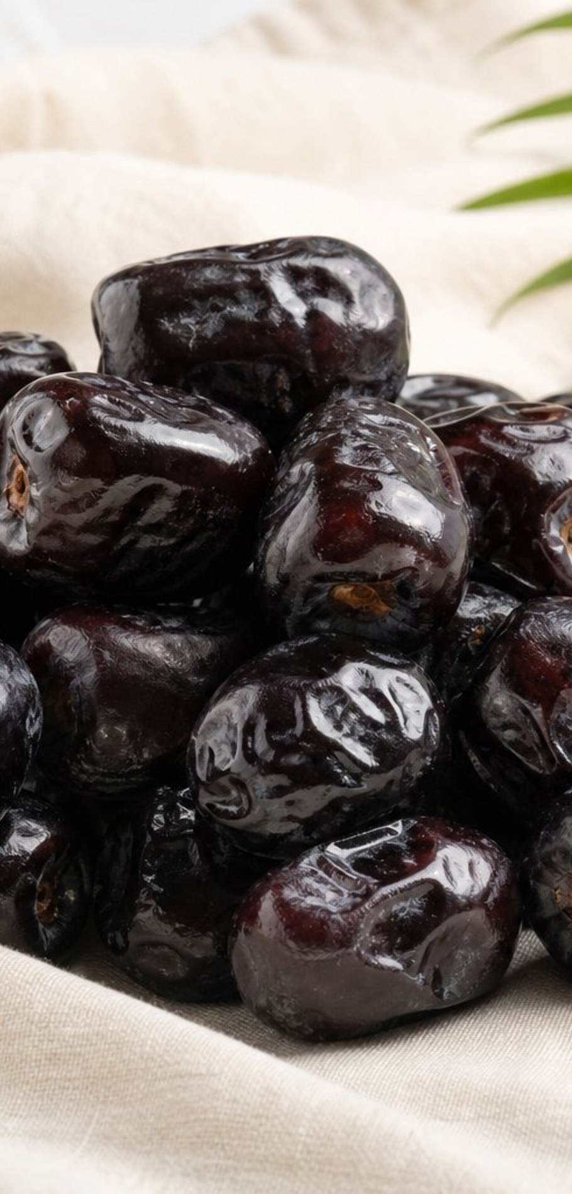
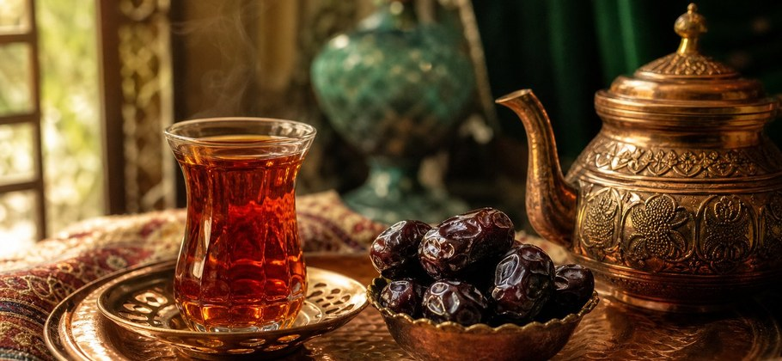
FARVAND
PRODUCT · MAZAFATI
04 / 12
03 — FLAGSHIP VARIETY
Mazafati
The most requested Iranian date in the world. Dark, glossy, thin-skinned and naturally sweet — and the
variety our buyers reorder most.
HARVEST REGION
Bam
Kerman — the home of Mazafati
AT A GLANCE
Mazafati
VARIETY
Soft (semi-moist)
TYPE
Dark brown to near-black
COLOUR
Thin and glossy
SKIN
Naturally sweet, caramel-like
CHARACTER
SPECIFICATION
SPECIFICATION
STATUS
To be supplied
Grade / size
[SIZE OR COUNT PER KG]
To be supplied
Moisture
[MOISTURE % — ONLY IF
LAB VERIFIED]
To be supplied
Packing
[RETAIL PACK + BULK
CARTON]
To be supplied
Shelf life
[SHELF LIFE IN MONTHS]
WHY BUYERS CHOOSE IT
Consistent grading and count — the specification is agreed before
packing, not after.
The strongest repeat-demand variety in India, the Gulf and East Africa.
Dense, dark fruit that keeps its retail look through the supply chain.
Ready for a Mazafati quote?
Send us the pack format, the target quantity and the destination
port. We will come back with a specification and an offer.
[CONTACT EMAIL]
Mazafati · Bam, Kerman · [SEASON] pack.
Mazafati — packed and graded for export.
FARVAND · PREMIUM IRANIAN DATES
B2B EXPORT CATALOG · [YEAR]
04

Slide 5
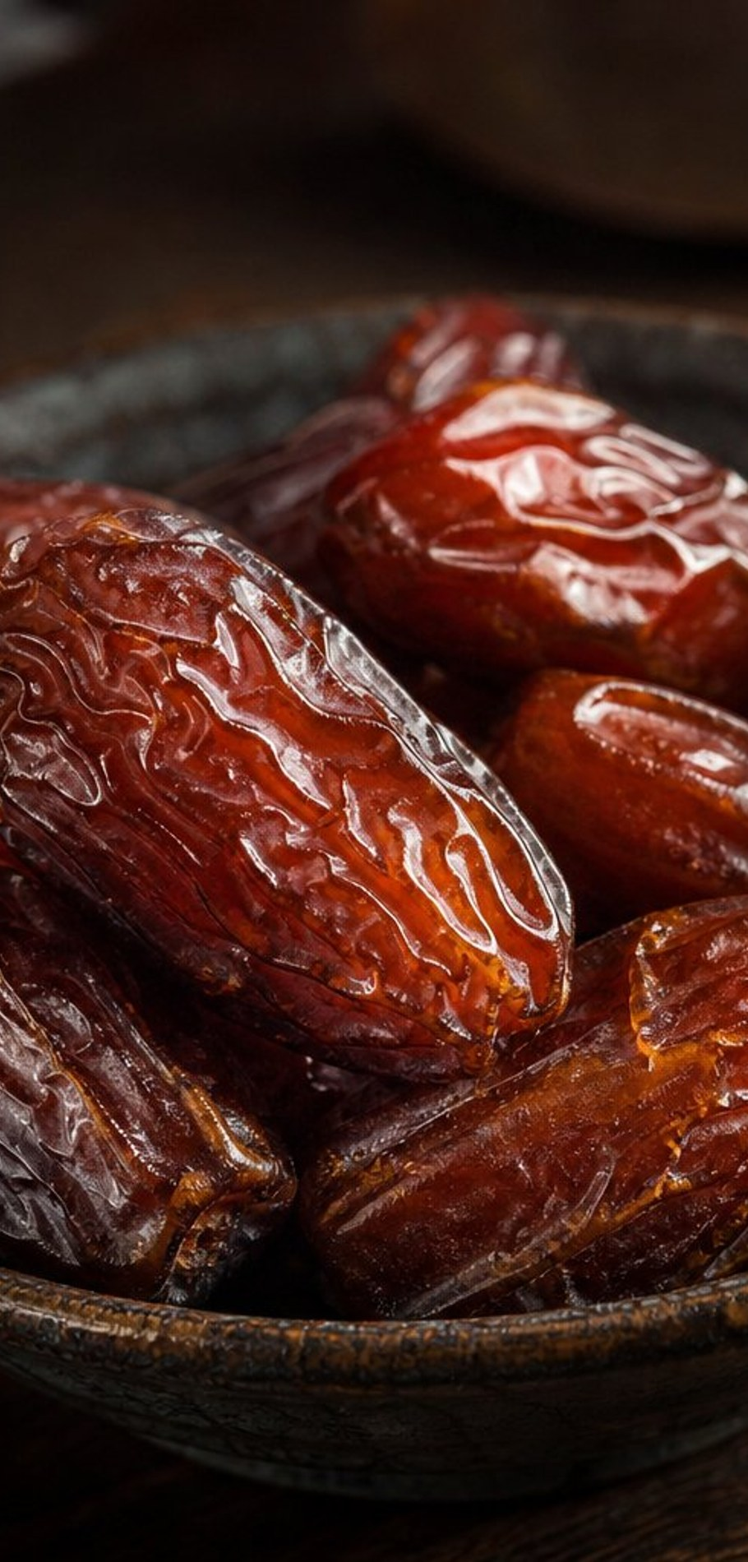
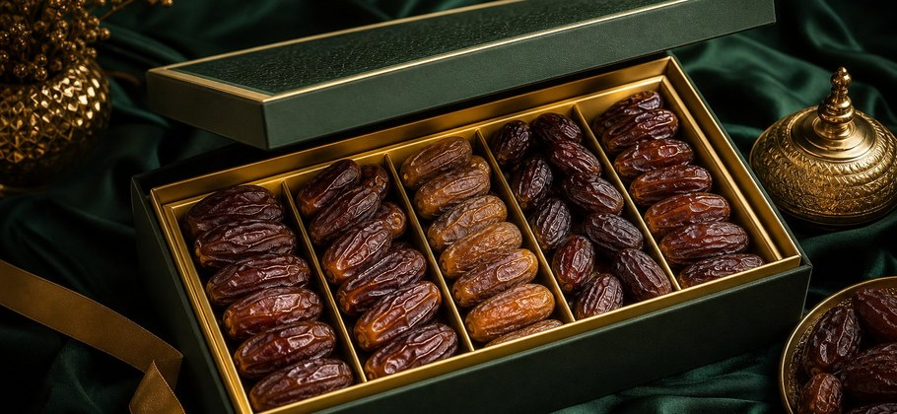
FARVAND
PRODUCT · MEDJOUL
05 / 12
04 — PREMIUM VARIETY
Medjoul
Large, amber-brown and very high in sugar. Medjoul is the gifting date of the range — larger fruit, higher
value per kilo, tighter margins.
HARVEST REGION
Bam & Saravan
Kerman / Sistan & Baluchestan
AT A GLANCE
Medjoul (Medjool)
VARIETY
Soft
TYPE
Amber to deep brown
COLOUR
Thick and wrinkled
SKIN
Very sweet, caramel and fig-like
CHARACTER
SPECIFICATION
SPECIFICATION
STATUS
To be supplied
Grade / size
[COUNT PER KG: LARGE /
EXTRA LARGE]
To be supplied
Moisture
[MOISTURE % — ONLY IF
LAB VERIFIED]
To be supplied
Packing
[TRAY / CLAMSHELL / GIFT
BOX]
To be supplied
Shelf life
[SHELF LIFE IN MONTHS]
WHY BUYERS CHOOSE IT
The highest value per kilo in the range — priced for gifting and seasonal
packs.
Large, uniform fruit that presents well in clamshell and gift-box formats.
Sorted by count so premium retail shelves get an even grade, not a mixed
one.
Ready for a Medjoul quote?
Tell us the grade, the pack and the quantity. We will confirm what
the current harvest supports and quote from there.
[CONTACT EMAIL]
Medjoul · Bam & Saravan · [SEASON] pack.
Medjoul — packed and graded for export.
FARVAND · PREMIUM IRANIAN DATES
B2B EXPORT CATALOG · [YEAR]
05

Slide 6
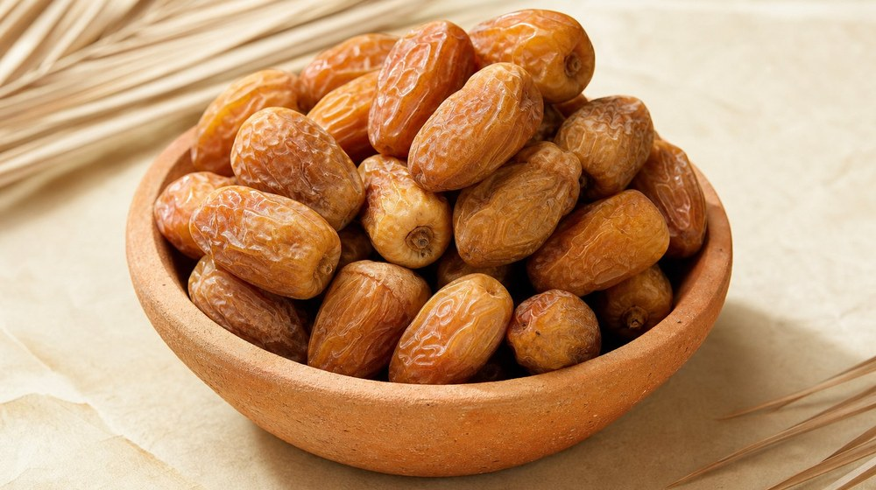
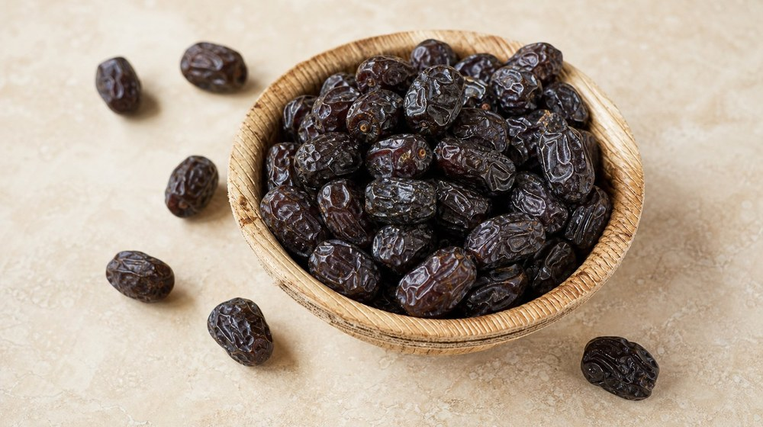


FARVAND
PRODUCT · ZAHEDI & KIMRI
06 / 12
05 — TWO MORE STAPLES
Zahedi & Kimri
One dry, one soft — and both in constant demand. Zahedi travels; Kimri sells by volume. Buyers often take them in
the same order.
Zahedi
Kimri
HARVEST REGION
HARVEST REGION
Dashtestan & Kazerun
Bam
SEMI-DRY
SOFT
Fars
Kerman
Golden, wrinkled and firm, with a long shelf life and a nut-like bite. Zahedi is
the workhorse for long-haul shipping and industrial buyers.
Small, dark and intensely sweet, with a thin skin and a dense, uniform size.
Kimri is the value pack of the range and the easiest to grade consistently.
SPECIFICATION
SPECIFICATION
To be supplied
To be supplied
Grade / size
[SIZE OR COUNT PER KG]
Grade / size
[COUNT PER KG]
To be supplied
To be supplied
Moisture
[MOISTURE % — ONLY IF LAB
VERIFIED]
Moisture
[MOISTURE % — ONLY IF LAB
VERIFIED]
To be supplied
To be supplied
Shelf life
[SHELF LIFE IN MONTHS]
Shelf life
[SHELF LIFE IN MONTHS]
Dates are not one product. They are a range.
From the snack shelf to the dessert kitchen, each variety earns its place by what it does — not by
what it costs per tonne.
BAKERY & DESSERT
GIFTING
RETAIL SNACKING
FOOD MANUFACTURING
Serving suggestion — Zahedi and Kimri in the pastry kitchen.
FARVAND · PREMIUM IRANIAN DATES
B2B EXPORT CATALOG · [YEAR]
06

Slide 7
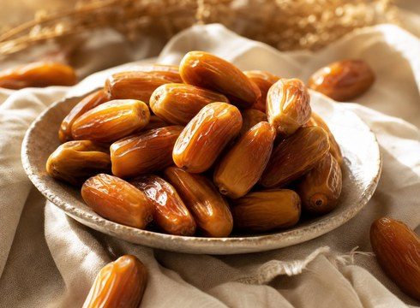
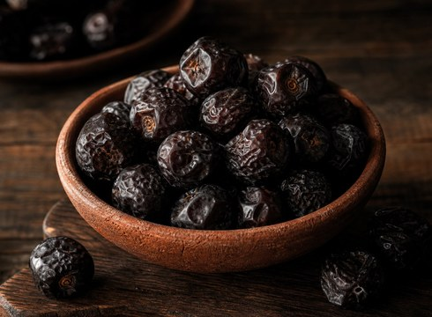
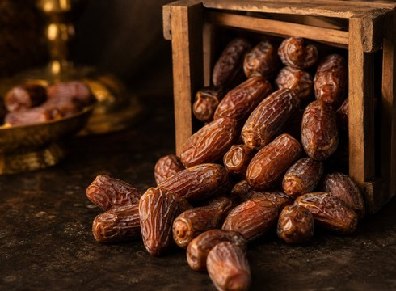
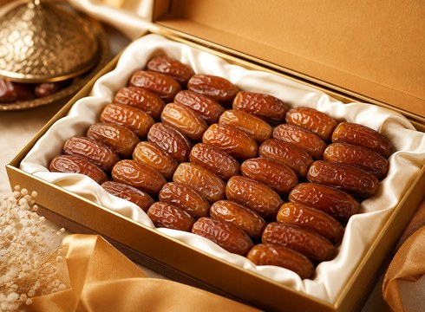
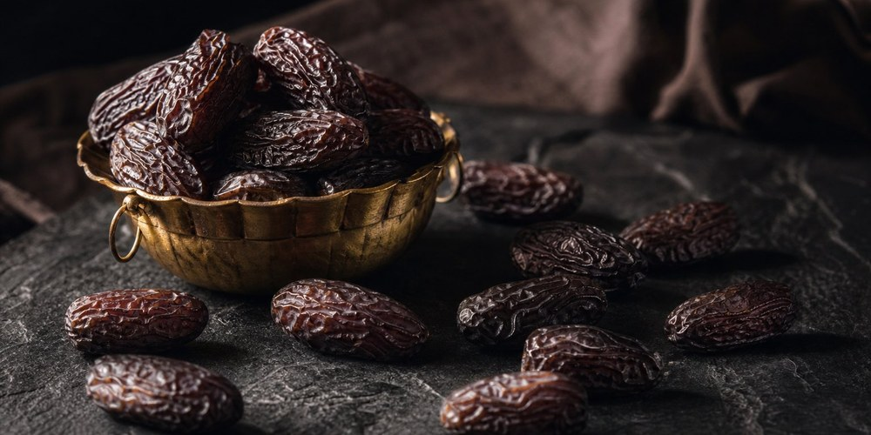

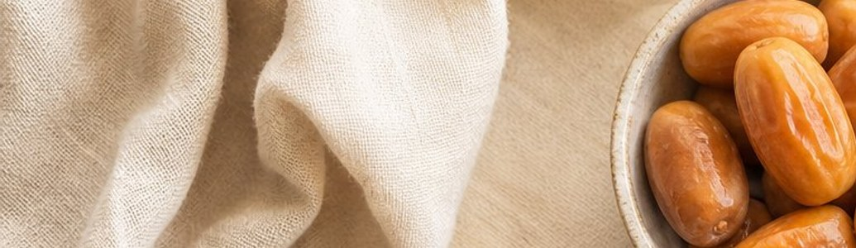

FARVAND
PRODUCT · FURTHER VARIETIES
07 / 12
06 — FURTHER VARIETIES
Shahani, Najafi, Lasht & Beyond
Eight more Iranian cultivars for the mixed retail box, the processing line and the premium gift tray — each with its own growing
region.
Shahani
Najafi
Lasht
SEMI-SOFT
Morki
SOFT
SEMI-DRY
JIROFT & KAHNOJ · KERMAN
SARAVAN & BAM · SISTAN / KERMAN
DASHTESTAN · FARS
SEMI-DRY
Mid-size amber fruit with a delicate, tender
skin and a clean, mild sweetness.
Round, very dark and soft. A traditional
cultivar with a loyal following at home and
abroad.
Brown, wrinkled and firm — the workhorse
of Iranian cooking and industrial
processing.
KAZERUN & DASHTESTAN · FARS
Light brown and moderately dry, with a
firm bite that holds well in a mixed gift box.
Retail trays, bakery and dessert supply
Retail, traditional food processing
Bulk shipments, industrial processing, cooking
Gift boxes, retail, catering and hospitality
Piarom
SEMI-DRY
HARVEST REGION
Hajiabad
Hormozgan
Small, dark, dry and chewy — the date most often described as the chocolate date.
Known in export markets as the chocolate date — dark, chewy and lower in moisture than
the soft varieties.
Harani
SOFT
HARVEST REGION
Jahrom
Fars
Soft, amber and very sweet. A premium soft date sold in smaller, higher-value packs.
A softer, sweeter table date that sells best in smaller packs aimed at gifting and hospitality.
Deglet en-Nour
Barhi
SEMI-DRY · ABADAN & KHORRAMSHAHR,
KHUZESTAN
SOFT · SARAVAN, SISTAN & BALUCHESTAN
Pale amber with a mild, honeyed flavour and a light skin that eats easily.
Round, soft and mild, with low fibre — a straightforward snacking date.
Availability of every variety depends on the harvest window — confirm before ordering.
FARVAND · PREMIUM IRANIAN DATES
B2B EXPORT CATALOG · [YEAR]
07

Slide 8
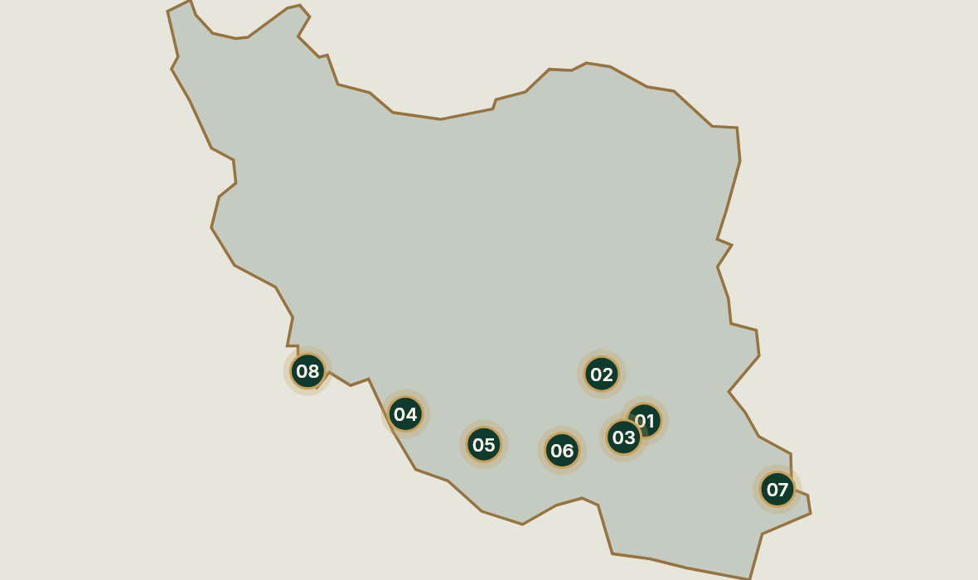
FARVAND
TECHNICAL SUMMARY
08 / 12
07 — TECHNICAL SUMMARY
Variety Comparison & Origins
A quick reference for buyers comparing the range — with the growing region of each cultivar. Values are typical figures; the
quotation governs.
VARIETY
TYPE
COLOUR
HARVEST REGION
TYPICAL USE
Mazafati
Soft
Dark brown to near-black
Bam, Kerman
Retail packs, gifting, food manufacturing
Medjoul
Soft
Amber to deep brown
Bam & Saravan, Kerman / Sistan
Premium gifting, retail, seasonal gift packs
Zahedi
Semi-dry
Light golden brown
Dashtestan & Kazerun, Fars
Long-haul shipping, bulk, cooking and processing
Kimri
Soft
Dark brown
Bam, Kerman
Retail pouches, value packs, high-volume orders
Shahani
Semi-soft
Light amber brown
Jiroft & Kahnoj, Kerman
Retail trays, bakery and dessert supply
Najafi
Soft
Dark brown to black
Saravan & Bam, Sistan / Kerman
Retail, traditional food processing
Lasht
Semi-dry
Medium brown
Dashtestan, Fars
Bulk shipments, industrial processing, cooking
Morki
Semi-dry
Light to medium brown
Kazerun & Dashtestan, Fars
Gift boxes, retail, catering and hospitality
Deglet en-Nour
Semi-dry
Pale golden brown
Abadan & Khorramshahr, Khuzestan
Mixed retail boxes, bakery and confectionery
supply
Barhi
Soft
Golden brown
Saravan, Sistan & Baluchestan
Retail snacking, food manufacturing
Harani
Soft
Amber brown
Jahrom, Fars
Premium retail and corporate gifting
Piarom
Semi-dry
Deep brown to black
Hajiabad, Hormozgan
Snacking, premium bulk, gifting
WHERE OUR DATES GROW
Bam & Kerman
01
Mazafati · Kimri · Medjoul · Shahani · Najafi
Dashtestan & Kazerun, Fars
02
Zahedi · Lasht · Morki · Harani
Hajiabad, Hormozgan
03
Piarom
Saravan, Sistan & Baluchestan
04
Medjoul · Barhi · Najafi
Abadan & Khorramshahr, Khuzestan
05
Deglet en-Nour
Jiroft & Kahnoj, Kerman
06
Shahani · Najafi
Jahrom, Fars
07
Harani
Kerman city
08
Typical growing regions of each cultivar. The confirmed origin of your lot is stated in the quotation.
Shahani
FARVAND · PREMIUM IRANIAN DATES
B2B EXPORT CATALOG · [YEAR]
08

Slide 9
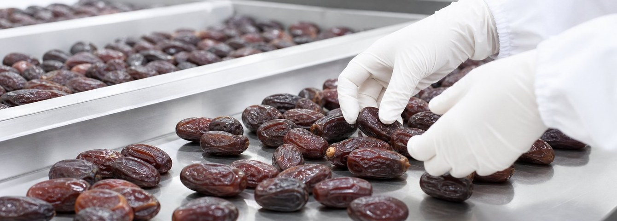
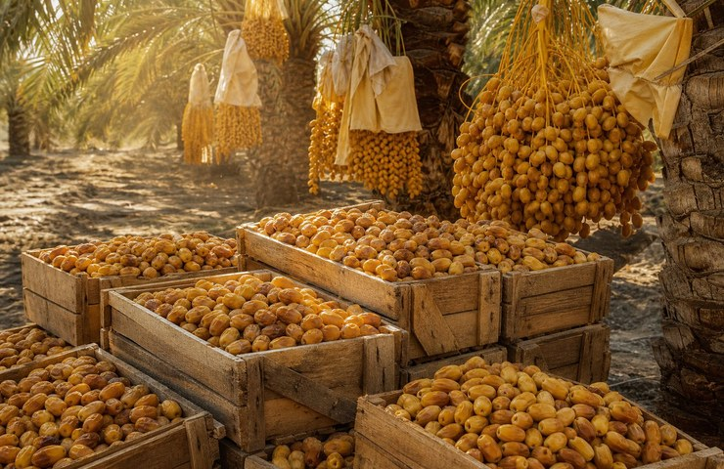
FARVAND
QUALITY
09 / 12
08 — HOW WE WORK
Quality Assurance
Six checkpoints stand between the grove and the container. Each one is recorded, and each one can be shown to a
buyer or an inspector.
01
02
Incoming inspection
Sorting and grading
Every incoming lot is checked for condition, colour and foreign matter before
it enters the line. Findings are recorded per lot.
Fruit is sorted by size, colour and condition. The grade agreed for the order is
separated and rejected fruit leaves the line.
03
04
Moisture and condition control
Controlled packing
Moisture and condition are monitored where the variety requires it. Only
lab-verified figures are quoted in the specification.
Packing happens under controlled conditions, with pack format, net weight
and count set by the purchase order.
05
06
Lot coding and traceability
Pre-shipment check
Each carton carries a lot code that ties it back to its region, source, packing
date and inspection record.
A final check on count, weight, carton condition and labelling runs before the
container is closed and sealed.
DOCUMENTS WE WORK WITH
The exact document set depends on the destination and the incoterm. The list below is
the usual export pack — confirm the current requirement for your market with us.
Commercial invoice
Packing list
Phytosanitary certificate
Certificate of origin
Fumigation / treatment certificate
Transport documents per incoterm
[EXPORT DOCUMENTS CONFIRMED PER DESTINATION]
Sorting and grading at [FACILITY NAME], [CITY] — [DESCRIBE THE LINE].
FARVAND · PREMIUM IRANIAN DATES
B2B EXPORT CATALOG · [YEAR]
09

Slide 10
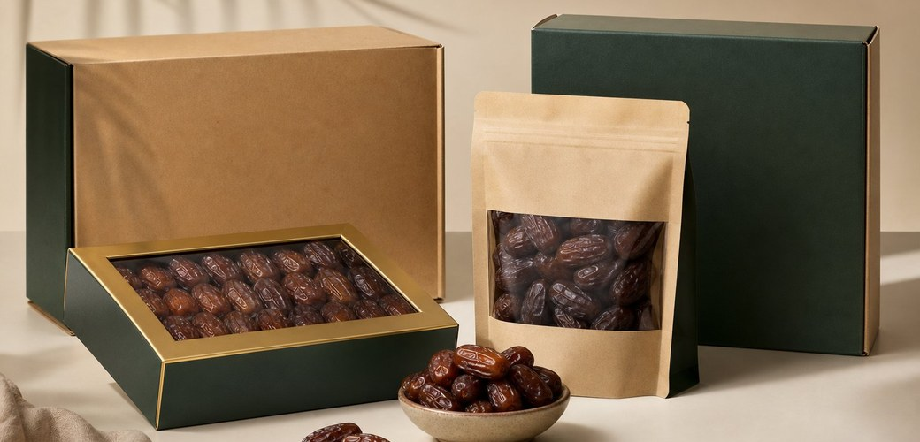
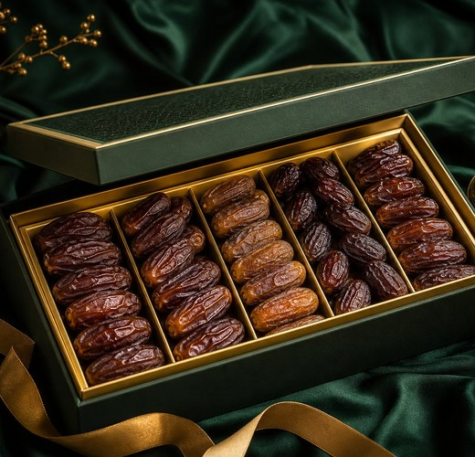
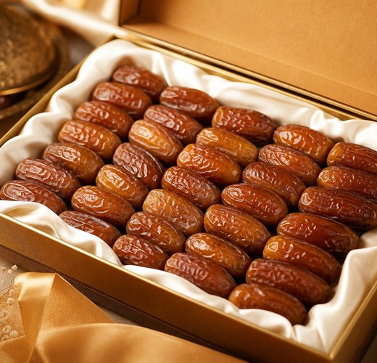
FARVAND
PACKAGING
10 / 12
09 — HOW IT ARRIVES
Packaging Options
Dates are fragile and moisture-sensitive. The pack format is chosen for the destination, the shelf and the retailer’s planogram — not
for the factory that filled it.
Retail tray + film
Clamshell box
Pouch / doypack
Sealed tray over-wrap, stacked and cartonised.
Clear-lidded box for premium retail and gifting.
Stand-up pouch for value and high-volume retail.
Net weight
Net weight
Net weight
[NET WEIGHT]
[NET WEIGHT]
[NET WEIGHT]
Units per carton
Units per carton
Units per carton
[UNITS]
[UNITS]
[UNITS]
Carton size
Carton size
Carton size
[L × W × H]
[L × W × H]
[L × W × H]
BULK AND PRIVATE LABEL
Bulk carton
Private label
Pallet & container
Standard export carton for wholesale buyers.
Your brand, our pack house.
How the shipment is built.
Net weight
[NET WEIGHT]
Minimum run
[MINIMUM RUN]
Pallet size
Units per carton
[PALLET SIZE]
[UNITS]
Label artwork
[BUYER ARTWORK]
Container
Carton size
[20FT / 40FT / 40HC]
[L × W × H]
Lead time
[LEAD TIME]
Load plan
[LOAD PLAN]
CARTON AND PALLET DATA
To be supplied
Standard export carton
[L × W × H] · [NET WEIGHT] · [UNITS PER CARTON]
Retail carton
[L × W × H] · [UNITS PER CARTON]
To be supplied
Pallet / container load
[PALLET DIMENSIONS] · [20FT / 40FT / 40HC] · [PALLETS PER CONTAINER]
To be supplied
HOW A PRIVATE LABEL RUN WORKS
01
Send artwork
02
Approve the proof
03
Production
04
Print-ready label files, or we propose a
format you can adapt.
We print a physical proof for your sign-off
before production.
Packing to your artwork, with the agreed
net weight and count.
Documents
Carton marks, labels and paperwork issued
with the shipment.
FARVAND · PREMIUM IRANIAN DATES
B2B EXPORT CATALOG · [YEAR]
10

Slide 11

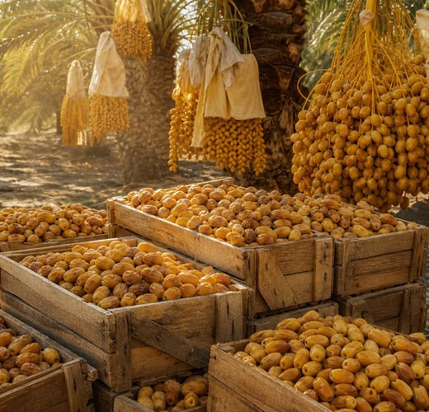
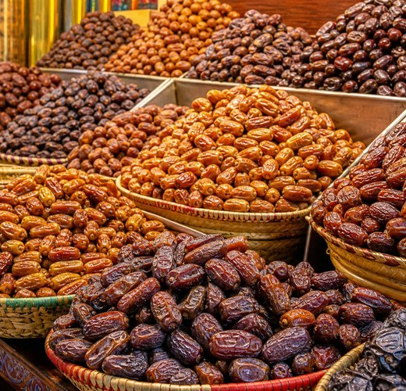
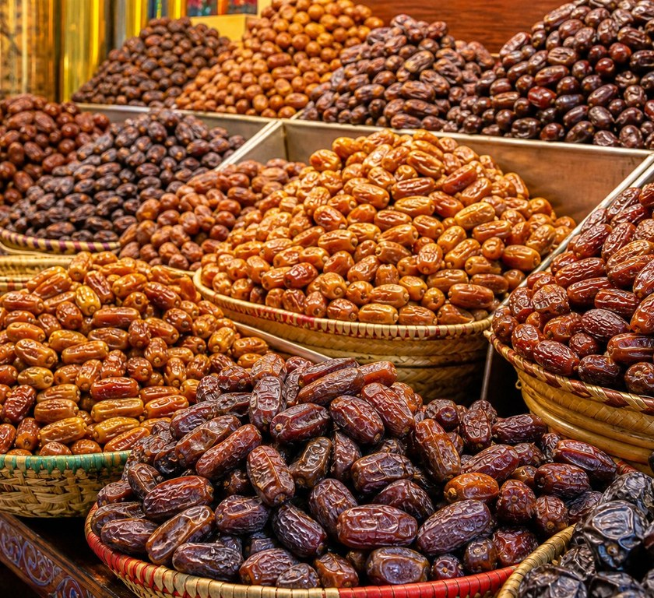

FARVAND
EXPORT & LOGISTICS
11 / 12
10 — COMMERCIAL TERMS
Export & Logistics
The commercial terms are the part of a date business that decides whether an order works. Everything below is agreed in writing
before production.
MINIMUM ORDER QUANTITY
ANNUAL SUPPLY CAPACITY
LEAD TIME
INCOTERMS
[MOQ]
[CAPACITY] MT
[LEAD TIME]
[EXW / FOB / CIF]
To be supplied
To be supplied
To be supplied
To be supplied
PORT OF LOADING
PAYMENT TERMS
CONTAINER LOADING
SAMPLE POLICY
[PORT OF LOADING]
[PAYMENT TERMS]
[20FT / 40FT / 40HC]
[SAMPLE POLICY]
To be supplied
To be supplied
To be supplied
To be supplied
TARGET MARKETS
India
[MARKET 2]
[MARKET 3]
[MARKET 4]
[MARKET 5]
India is our priority market. We work with importers, wholesale distributors and retail
chains — and we quote against the specification they already sell, not ours.
SHIPPING & DOCUMENTS
Every shipment is accompanied by the documents your customs
broker asks for, issued before the container is sealed. [ADD:
SHIPPING POLICY, INSURANCE, TEMPERATURE OR CARE
REQUIREMENTS FOR SOFT DATES.]
HOW AN ORDER RUNS
01
Inquiry
02
Specification & quotation
03
Production & packing
04
Variety, pack, quantity and destination
port.
Grade, count, moisture and price, in
writing.
Sourcing, sorting, packing and lot coding.
Documents & shipment
Export papers issued, container sealed,
vessel loaded.
Serving buyers in India and beyond.
Terms shown in brackets are agreed with the buyer before order confirmation. We do not publish figures we cannot
honour — the quotation is the commitment, and it is written to be kept.
FARVAND · PREMIUM IRANIAN DATES
B2B EXPORT CATALOG · [YEAR]
11

Slide 12

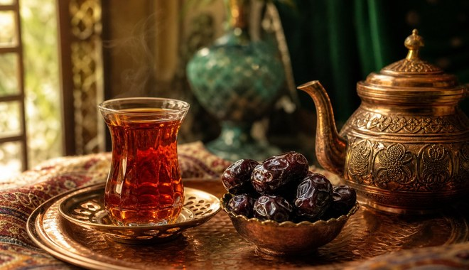

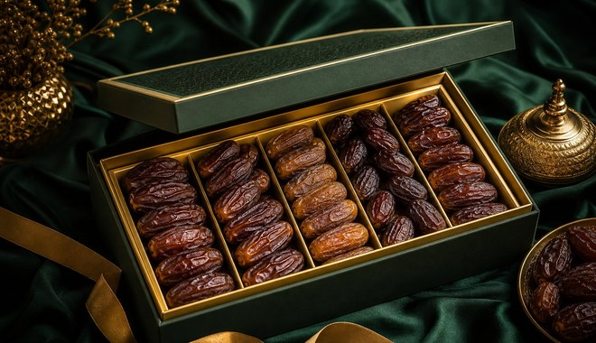
FARVAND
Premium Iranian Dates
11 — NEXT STEP
Request a Quotation
Tell us the variety, the pack format, the quantity and the destination port. We will reply
with a specification and an offer — and with anything we cannot do this season stated
plainly.
EMAIL
WHATSAPP
WEBSITE
[CONTACT EMAIL]
[WHATSAPP NUMBER]
[WEBSITE]
OFFICE
ADDRESS
HOURS
[COMPANY LEGAL NAME]
[STREET, CITY, POSTAL CODE, COUNTRY]
[WORKING HOURS · TIME ZONE]
WHAT TO INCLUDE
SCAN FOR THE FULL RANGE
Variety and grade, or the shelf you are filling
Pack format and net weight
Quantity, in cartons or tonnes
[QR CODE]
Destination port and incoterm
Target delivery date
[WEBSITE]
FARVAND
Thank you for considering FARVAND.
Premium Iranian Dates · Export catalogue · [YEAR]
[CONTACT EMAIL] · [WHATSAPP NUMBER] · [WEBSITE]
Kind regards, the FARVAND team — [CITY], [COUNTRY]

