Slide 1



The Rendering Equation
Direct (local) illumination
  Light directly from light sources
  No shadows
Indirect (global) illumination
  Hard and soft shadows
  Diffuse interreflections (radiosity)
  Glossy interreflections (caustics)

Slide 2
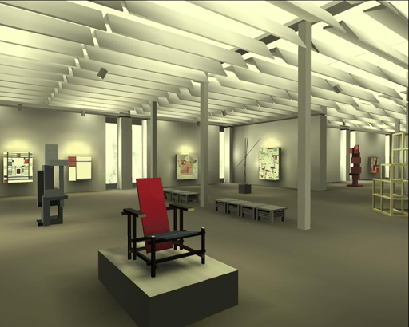
Early Radiosity

Slide 3
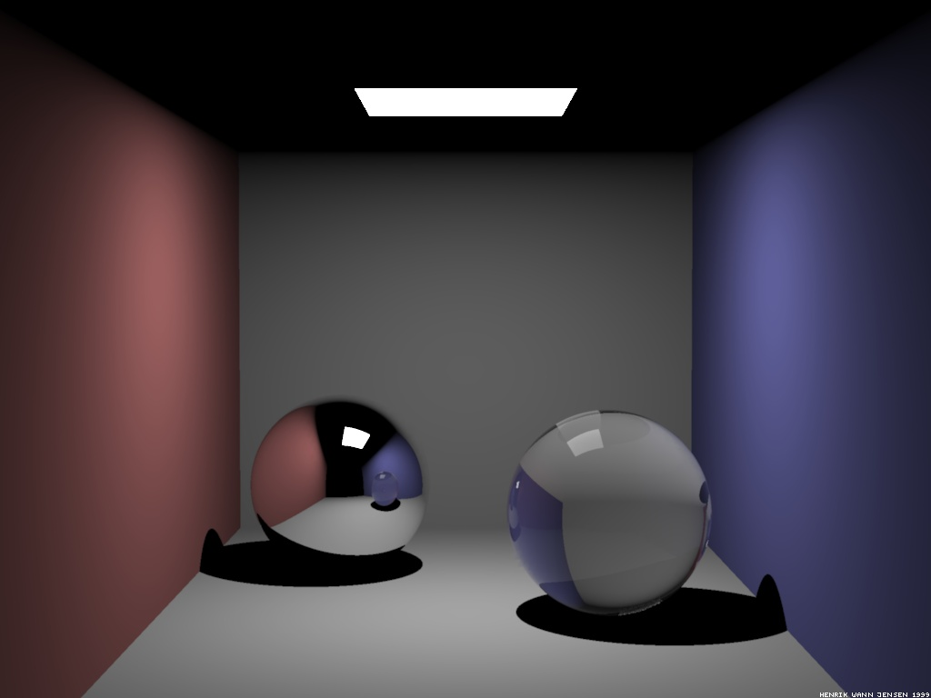
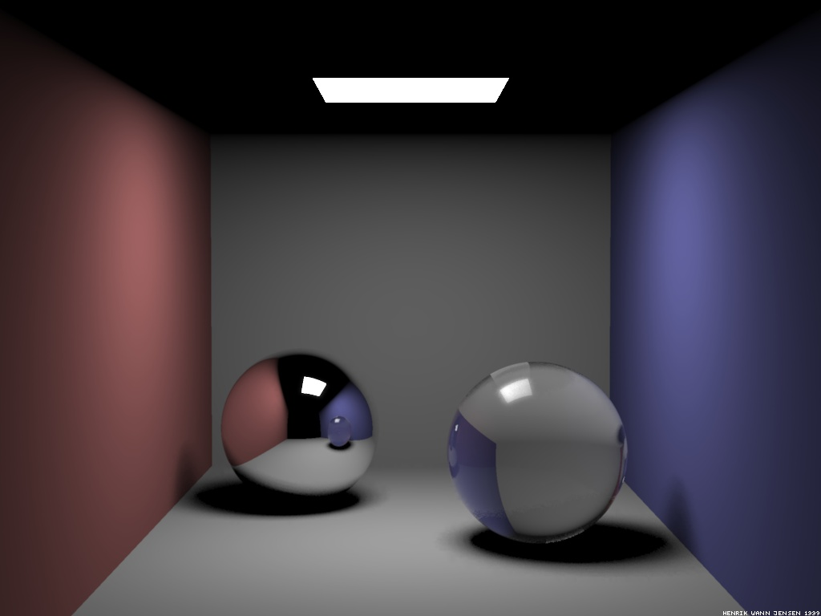
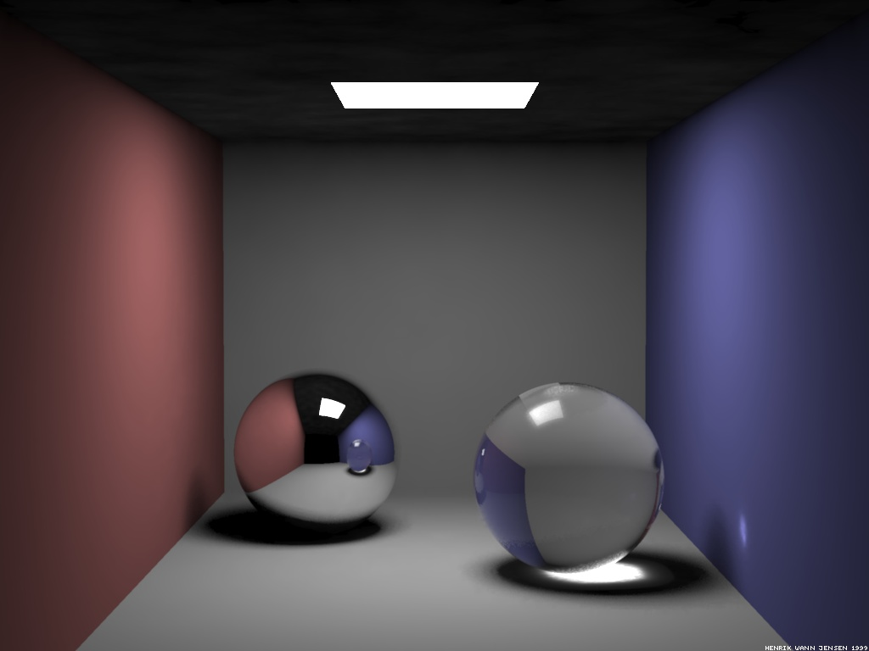
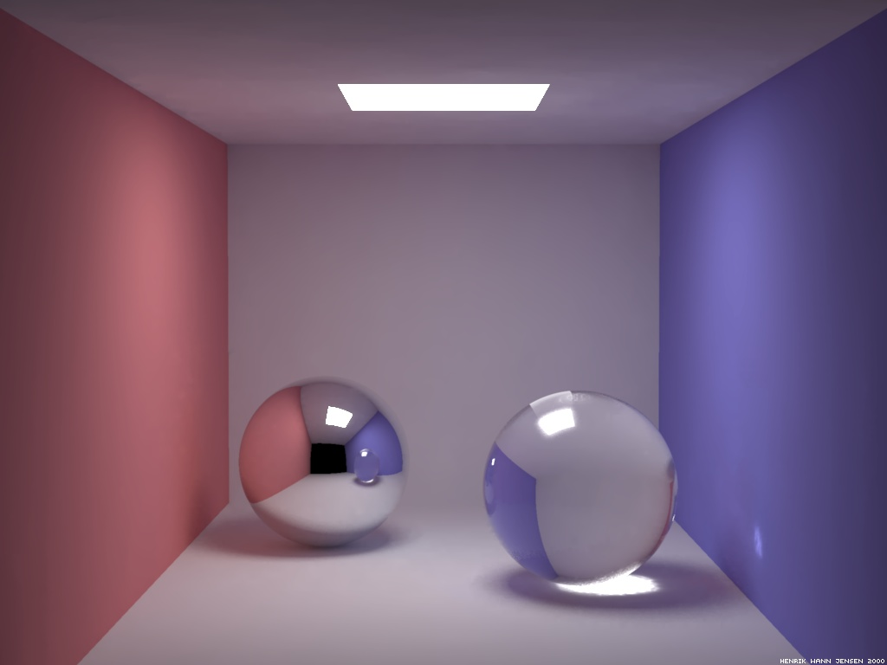
Lighting Effects
Hard Shadows
Soft Shadows
Caustics
Indirect Illumination

Slide 4
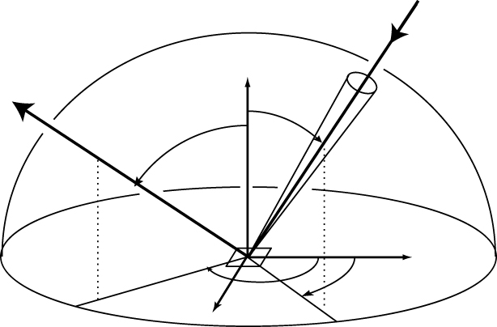

Challenge
To evaluate the reflection equation the incoming radiance must be known
To evaluate the incoming radiance the reflected radiance must be known

Slide 5

To The Rendering Equation
Questions
1. How is light measured?
2. How is the spatial distribution of light energy described?
3. How is reflection from a surface characterized?
4. What are the conditions for equilibrium flow of light in an environment?

Slide 6
The Grand Scheme
Light and Radiometry
Energy Balance
Surface
Rendering Equation
Volume
Rendering Equation
Radiosity Equation

Slide 7

Balance Equation
Accountability
  [outgoing] - [incoming] = [emitted] - [absorbed]
Macro level
  The total light energy put into the system must equal the energy leaving the system (usually, via heat).
Micro level
  The energy flowing into a small region of phase space must equal the energy flowing out.

Slide 8
Surface Balance Equation
[outgoing] = [emitted] + [reflected]

Slide 9
Direction Conventions
BRDF
Surface vs. Field Radiance

Slide 10
Surface Balance Equation
[outgoing] = [emitted] + [reflected] + [transmitted]
BTDF

Slide 11
Two-Point Geometry
Ray Tracing

Slide 12
Coupling Equations
Invariance of radiance

Slide 13
The Rendering Equation
Directional form
Transport operator
i.e. ray tracing
Integrate over
hemisphere of
directions

Slide 14
The Rendering Equation
Surface form
Geometry term
Integrate over
all surfaces
Visibility term

Slide 15
The Radiosity Equation
Assume diffuse reflection
1.
2.
Notes:
Question: How to incorporate directional light sources into this framework

Slide 16
Integral Equations
Integral equations of the 1st kind
Integral equations of the 2nd kind

Slide 17
Linear Operators
Linear operators act on functions like matrices act on vectors
They are linear in that
Types of linear operators

Slide 18
Rendering Operators
Scattering operator
Transport operator

Slide 19
Solving the Rendering Equation
Rendering Equation
Solution

Slide 20
Formal Solution
Neumann series
Verify

Slide 21
Successive Approximations
Successive approximations
Converged

Slide 22

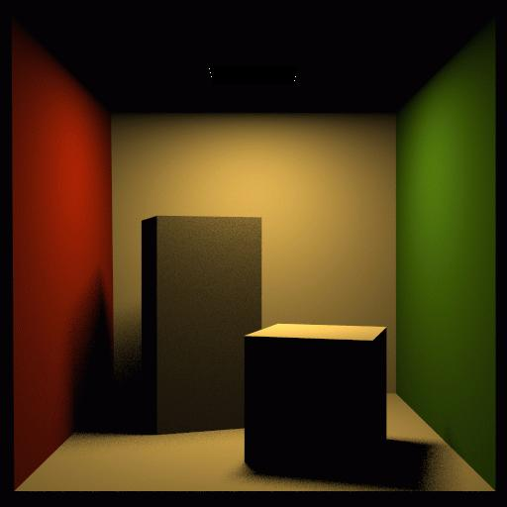
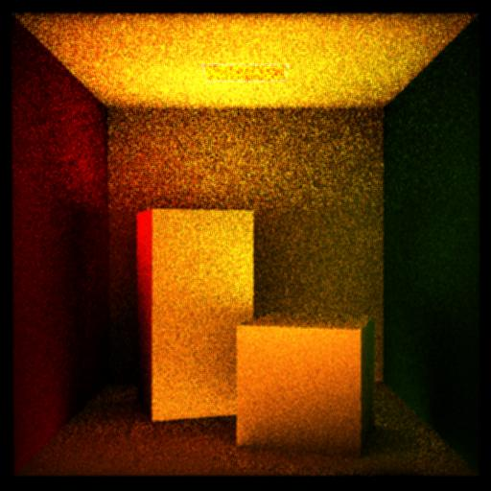
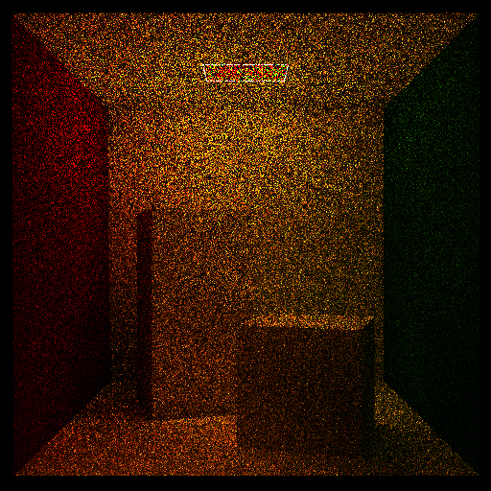
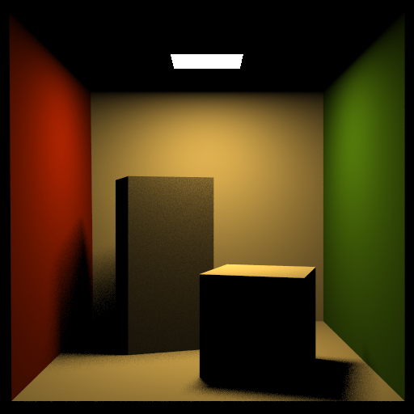
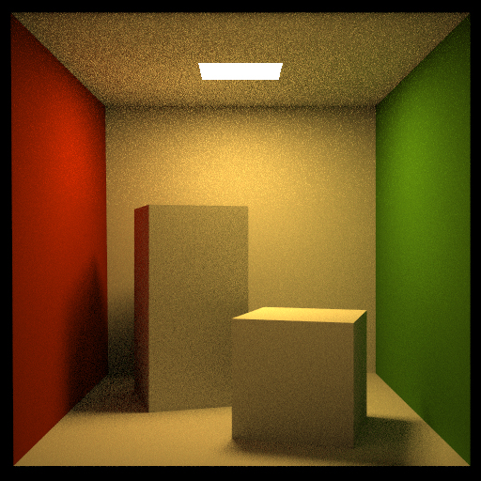
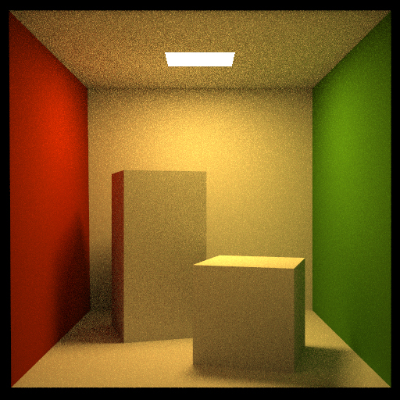
Successive Approximation

Slide 23
Light Path

Slide 24
Light Path

Slide 25
Light Paths

Slide 26
Light Transport
Integrate over all paths of all lengths
Question:
  How to sample space of paths?

Slide 27
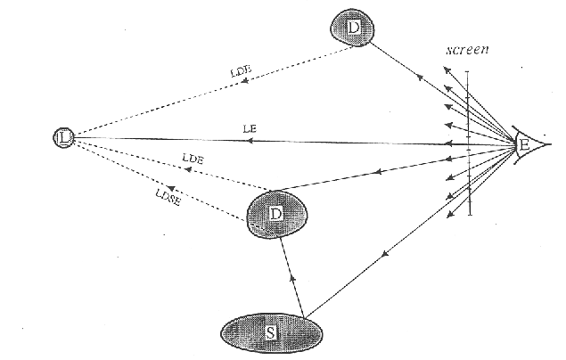
Classic Ray Tracing
From Heckbert
Forward (from eye): E S* (D|G) L

Slide 28
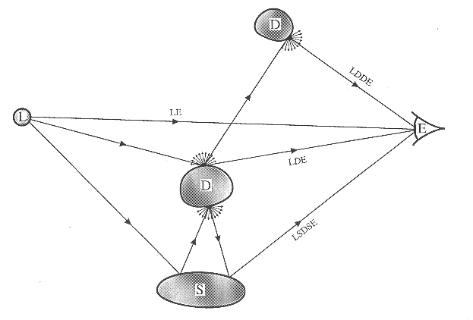
Photon Paths
Radiosity
Caustics
From Heckbert

Slide 29
How to Solve It?
Finite element methods
  Classic radiosity
    Mesh surfaces
    Piecewise constant basis functions
    Solve matrix equation
  Not practical for rendering equation
Monte Carlo methods
  Path tracing (distributed ray tracing)
    Randomly trace ray from the eye
  Bidirectional ray tracing
  Photon mapping

