Slide 1
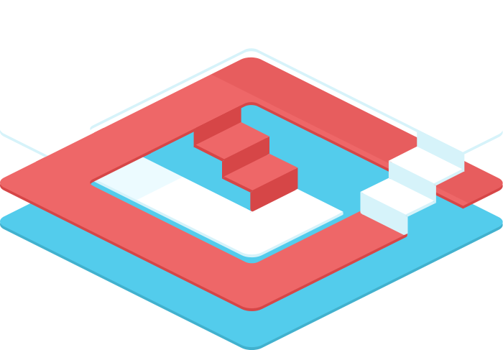

Scaling Scala to the Database
Jan Christopher Vogt, EPFL
Stefan Zeiger, Typesafe

Slide 2

1 Overview / Key Concepts

Slide 3
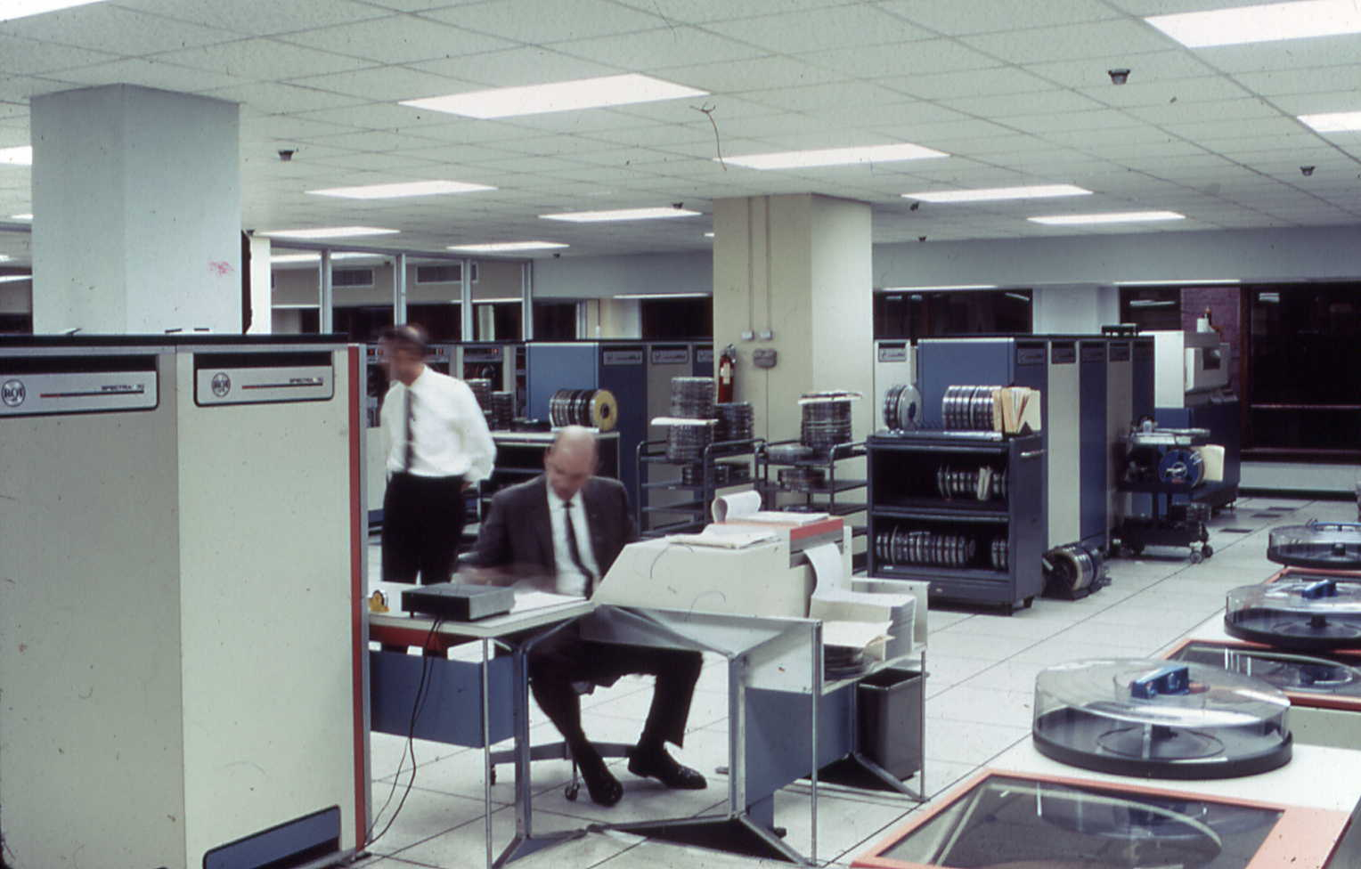

WE WRITE SQL SO YOU DON'T HAVE TO
http://toto.lib.unca.edu/findingaids/photo/national_climatic_data_center/NCDC_interior.htm
NOAA's National Climatic Data Center is the source of this image and it is used by permission

Slide 4
Write database code in Scala
Instead of SQL, JPQL, Criteria API, etc.
for { p <- persons } yield p.name
select p.NAME from PERSON p

Slide 5
(for {
p <- persons.filter(_.age < 20) ++
persons.filter(_.age >= 50)
if p.name.startsWith("A")
} yield p).groupBy(_.age).map { case (age, ps) =>
(age, ps.length)
}
select x2.x3, count(1) from (
select * from (
select x4."NAME" as x5, x4."AGE" as x3
from "PERSON" x4 where x4."AGE" < 20
union all select x6."NAME" as x5, x6."AGE" as x3
from "PERSON" x6 where x6."AGE" >= 50
) x7 where x7.x5 like 'A%' escape '^'
) x2 group by x2.x3
Notes:
This approach scales

Slide 6

Scala Language Integrated Connection Kit
Database query and access library for Scala
Successor of ScalaQuery
Developed at Typesafe and EPFL
Open Source

Slide 7
Supported Databases
Closed-Source Slick Extensions (with commercial support by Typesafe):
Oracle
DB/2
SQL Server
PostgreSQL
MySQL
H2
Hsqldb
Derby / JavaDB
SQLite
Access

Slide 8
Components
Lifted Embedding
Direct Embedding
Plain SQL
Session Management
Schema Model

Slide 9
2 Compared to ORMs

Slide 10
Impedance Mismatch: Retrieval
Colombian
French_Roast
Espresso
Colombian_Decaf
French_Roast_Decaf
Espresso
Price: 9.99
Supplier: The High Ground
select COF_NAME from COFFEES
select c.*, s.SUP_NAME from COFFEES c, SUPPLIERS s where c.COF_NAME = ? and c.SUP_ID = s.SUP_ID

Slide 11
Impedance Mismatch: Retrieval
+ " " + c.price
def getAllCoffees(): Seq[Coffee] = …
def printLinks(s: Seq[Coffee]) {
for(c <- s) println(c.name )
}
def printDetails(c: Coffee) {
println(c.name)
println("Price: " + c.price)
println("Supplier: " + c.supplier.name)
}
Colombian
French_Roast
Espresso
Colombian_Decaf
French_Roast_Decaf
Espresso
Price: 9.99
Supplier: The High Ground

Slide 12
O/R Mapper
Mapping low-level programming (OOP) to high-level concepts (relational algebra)
Not transparent (but pretends to be)

Slide 13
Better Match: Functional Programming
Relation
Attribute
Tuple
Relation Value
Relation Variable
case class Coffee(name: String,
supplierId: Int, price: Double)
= Set(
Coffee("Colombian", 101, 7.99),
,
Coffee("Espresso", 150, 9.99)
)
Coffee("French_Roast", 49, 8.99)
val coffees
- mutable state in the DB

Slide 14
Functional-Relational Mapping
Embraces the relational model
No impedance mismatch
Composable Queries
Explicit control over statement execution
Stateless

Slide 15
3 Live Coding Demo

Slide 16
4 Under The Hood

Slide 17

APIs
Lifted Embedding
Direct Embedding
Scala Compiler
Scala AST
Slick AST
Slick Macros
DB
Query Compiler
Slick AST
Executor
Result

Slide 18
Lifted Embedding
Query[ (Column[String], Column[String]), (String, String) ]
val q = for {
c <- coffees if c.price < 9.0
s <- c.supplier
} yield (c.name, s.name)
val result = q.run
TableQuery[Coffees]
ColumnExtensionMethods.<
Coffees
Suppliers
ConstColumn(9.0)
(Column[String], Column[String])
Seq[ (String, String) ]
Column[Double]

Slide 19
Direct Embedding (experimental)
Queryable[ (String, String) ]
val q = for {
c <- coffees if c.price < 9.0
s <- c.supplier
} yield (c.name, s.name)
val result = q.run
Queryable[Coffee]
Double.<
Coffee
Supplier
9.0: Double
(String, String)
Seq[ (String, String) ]
Double

Slide 20
Query Compiler
Immutable ASTs
Types can be mutated until they are observed
Immutable compiler state
containing AST + phase output state
Phases transform compiler state
using mutable state locally
Drivers provide their own compilers

Slide 21
Compiler Phases: SQL
Clean Up
inline
assignUniqueSymbols
expandTables
inferTypes
createResultSetMapping
forceOuterBinds
Flatten Columns
expandRefs
replaceFieldSymbols
rewritePaths
relabelUnions
pruneFields
assignTypes
SQL Shape
resolveZipJoins
convertToComprehensions
fuseComprehensions
fixRowNumberOrdering
hoistClientOps
Generate Code
codeGen (driver-specific)

Slide 22
Compiler Phases: MemoryDriver
Clean Up
inline
assignUniqueSymbols
expandTables
inferTypes
createResultSetMapping
forceOuterBinds
Flatten Columns
expandRefs
replaceFieldSymbols
rewritePaths
relabelUnions
pruneFields
assignTypes
Prepare for Interpreter
codeGen

Slide 23
Compiler Phases: Scheduling
Clean Up
inline
assignUniqueSymbols
Distribute
distribute (to other drivers' compilers)
Clean Up II
expandTables
inferTypes
createResultSetMapping
forceOuterBinds
e.g. H2
Query Compiler
MySQL
Query Compiler
…
Query Compiler
Flatten Columns
expandRefs
replaceFieldSymbols
rewritePaths
relabelUnions
pruneFields
assignTypes
Prepare for Interpreter
codeGen

Slide 24
5 Outlook

Slide 25
Outlook
NoSQL support
Other data sources
Async / Reactive API

Slide 26




slick.typesafe.com
@cvogt @StefanZeiger

