Slide 1
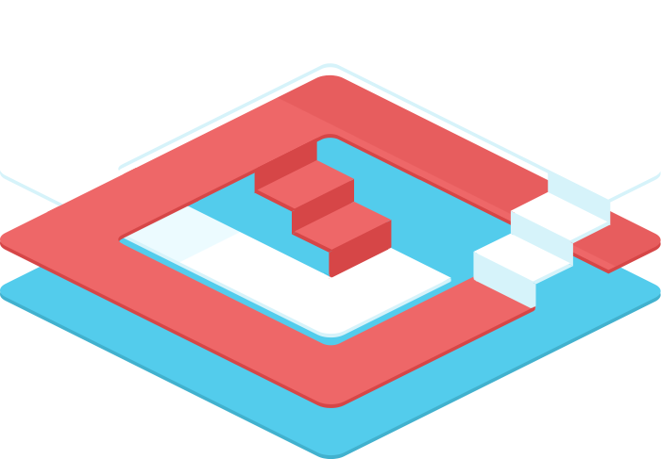

Slick SQL Interaction in Scala
Jan Christopher Vogt, EPFL
Slick Team

Slide 2

(vs. ORM)
Functional-Relational Mapper
natural fit (no impedance mismatch)
declarative
embraces relational
stateless
Slick is to ORM what Scala is to Java

Slide 3

8 Reasons for using Slick

Slide 4
1 Scala collection-like API

Slide 5
Scala collection-like API
for ( d <- Devices;
if d.price > 1000.0
) yield d.acquisition
Devices
.filter(_.price > 1000.0)
.map(_.acquisition)
Device
id: Long price: Double acquisition: Date

Slide 6
2 Predictable SQL structure

Slide 7
Predictable SQL structure
Devices
.filter(_.price > 1000.0)
.map(_.acquisition)
.selectStatement
select x2."ACQUISITION" from "DEVICE" x2 where x2."PRICE" > 1000.0

Slide 8
3 Type-safety

Slide 9

Compile-Time Safety
Spelling mistake in column name?
Wrong column type?
Query doesn’t match the result type?
scalac sees it all!

Slide 10

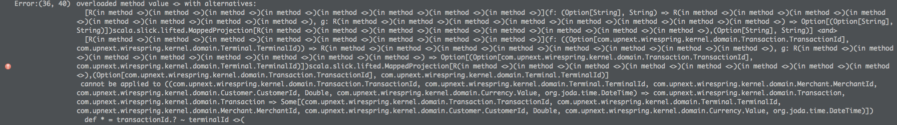
Caution: Error messages can be bad
Error messages can destroy the illusion

Slide 11
Enforce schema consistency
Generate DDL from table classes
Slick 2.0: Generate table classes and mapped classes from database

Slide 12
4 Small configuration using Scala code

Slide 13
Table description
class Devices(tag: Tag)
extends Table[(Long, Double, Date)](tag,"DEVICE") {
def id = column[Long] ("ID", O.PrimaryKey)
def price = column[Double]("PRICE")
def acquisition = column[Date] ("ACQUISITION")
def * = (id, price, acquisition)
}
def Devices = TableQuery[Devices]
can be auto-generated in Slick 2.0

Slide 14
Connect
import scala.slick.driver.H2Driver.simple._
val db = Database.forURL(
"jdbc:h2:mem:testdb", "org.h2.Driver")
db.withTransaction { implicit session =>
// <- run queries here
}

Slide 15
5 Explicit control over execution and transfer

Slide 16
Execution control
val query = for { d <- Devices
if d.price > 1000.0
} yield d.acquisition
db.withTransaction { implicit session =>
val acquisitonDates = query.run
}
Device
id: Long price: Double acquisition: Date
(session)
no unexpected behavior,
no loading strategy configuration,
just write code

Slide 17
6 Loosely-coupled, flexible mapping

Slide 18
Table description
class Devices(tag: Tag)
extends Table[(Long, Double, Date)](tag,"DEVICE") {
def id = column[Long] ("ID", O.PrimaryKey)
def price = column[Double]("PRICE")
def acquisition = column[Date] ("ACQUISITION")
def * = (id, price, acquisition)
}
val Devices = TableQuery[Devices]

Slide 19
case class mapping
case class Device(id: Long,
price: Double,
acquisition: Date)
class Devices(tag: Tag)
extends Table[Device](tag,"DEVICE") {
def id = column[Long] ("ID", O.PrimaryKey)
def price = column[Double]("PRICE")
def acquisition = column[Date] ("ACQUISITION")
def * = (id, price, acquisition) <> (Device.tupled,Device.unapply)
}
val Devices = TableQuery[Devices]

Slide 20
Custom mapping
def construct : ((Long,Double,Date)) => CustomType
def extract: CustomType => Option[(Long,Double,Date)]
class Devices(tag: Tag)
extends Table[CustomType](tag,"DEVICE") {
def id = column[Long] ("ID", O.PrimaryKey)
def price = column[Double]("PRICE")
def acquisition = column[Date] ("ACQUISITION")
def * = (id, price, acquisition) <> (construct,extract)
}
val Devices = TableQuery[Devices]

Slide 21
7 Plain SQL support

Slide 22
Plain SQL support
import scala.slick.jdbc.{GetResult, StaticQuery}
import StaticQuery.interpolation implicit val getDeviceResult =
GetResult(r => Device(r.<<, r.<<, r.<<))
val price = 1000.0
val expensiveDevices: List[Device] =
sql"select * from DEVICE where PRICE > $price" .as[Device].list

Slide 23
8 composable / re-usable queries

Slide 24
Composable, re-usable queries
def deviceLocations (companies: Query[Companies,Company])
: Query[Column[String],String] = {
companies.computers.devices.sites.map(_.location)
}
val apples = Companies.filter(_.name iLike "%apple%")
val locations : Seq[String] = { deviceLocations(apples)
.filter(_.inAmerica: Column[String]=>Column[Boolean])
.run
}
re-use joins
re-use queries
re-use user-defined operators
execute exactly one, precise query

Slide 25
Live Demo

Slide 26
Slick app design

Slide 27
Mental paradigm shift
Non-composable executor APIs (DAOs)
DevicesDAO
.inPriceRange( 500.0, 2000.0 ) : List[Device]
Composable query libraries
devices
.inPriceRange( 500.0, 2000.0 ) : Query[_,Device]
executes
composes

Slide 28
Suggested Slick app architecture
View
Controller
Database Session
Table classes
Companies
Computers
Devices
Sites
…
Composable
Query Library
def byId( Column[Long] )
: Query[…,Computers]
def withComputers
: Query[…,(…,Computers)]
def iLike( Column[String] )
: Column[Boolean]
…
Non-composable
Executor API / DAO
def byId( id:Long ) : Device
def withComputers
: Map[…,Seq[Computer]]
…

Slide 29
Relationships / Associations
Via composable queries using foreign keys!
companies.withComputers : Query[…,(Company,Computer)]
Not object references within query results
Not executor APIs

Slide 30
Auto joins (only in play-slick sample app)
implicit def autojoin1 = joinCondition[Sites,Devices] (_.id === _.siteId)
implicit def autojoin2 = joinCondition[Devices,Computers] (_.computerId === _.id)
sites.autoJoin(devices).further(computers) : Query[_,(Site,Computer)]
sites.autoJoin(devices).autoJoinVia(computers)(_._2) : Query[_,((Site,Device),Computer)]
Device
id: Long price: Double acquisition: Date siteId: Long
Computer
Id: Long Name: String companyId: Int
Site
id: Long name: String
1
n
n
1

Slide 31
Other features

Slide 32
Other features
inserts += ++=, updates query.update(…)
user defined column types, e.g. type-safe ids
user defined database functions
…

Slide 33
Outlook

Slide 34
2.0 is around the corner
code-generation based type providers
hlists and custom shapes (no 22-col limit, easy integration with shapeless, etc.)
distributed queries (over multiple dbs)
improved pre-compiled queries

Slide 35
Current experiments
improved macro-based api (simpler types)
macro-based type providers
schema manipulation api
migration/version management tool
extended for-comprehensions (order, group)
Thanks to @amirsh @clhodapp @nafg

Slide 36

Thank you
slick.typesafe.com
@cvogt
@StefanZeiger
http://slick.typesafe.com/talks/
https://github.com/cvogt/play-slick/

