Slide 1

Personalized Book Recommendation System
Using Collaborative Filtering, Content-Based Filtering, and Meta-Models
Seth Born

Slide 2

Introduction and Goal
Introduction to the Problem: With so many books online, finding the right one is hard. Personalized suggestions can help by recommending books you’ll love.
Project Goal: Develop a book recommendation system using various algorithms to make accurate and satisfying recommendations.

Slide 3
Agenda
Data Overview
Data Preprocessing
Workflow Diagram – Post Preprocessing
Collaborative Filtering Model
Content-Based Filtering Model
Meta Model
Takeaways, Analysis, Observations
Future Steps

Slide 4

Data Overview
Books.csv

Slide 5
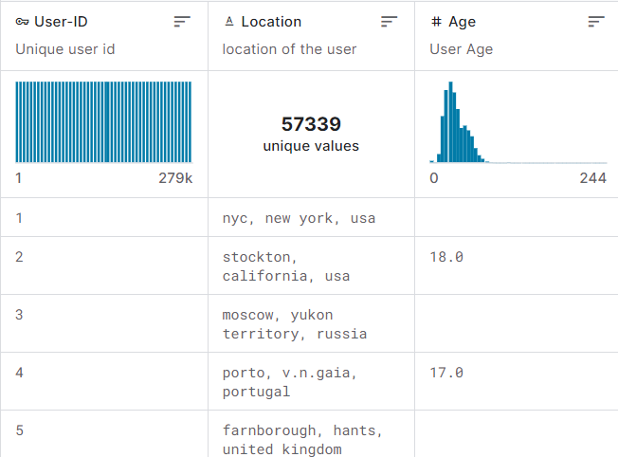
Data Overview
Users.csv

Slide 6
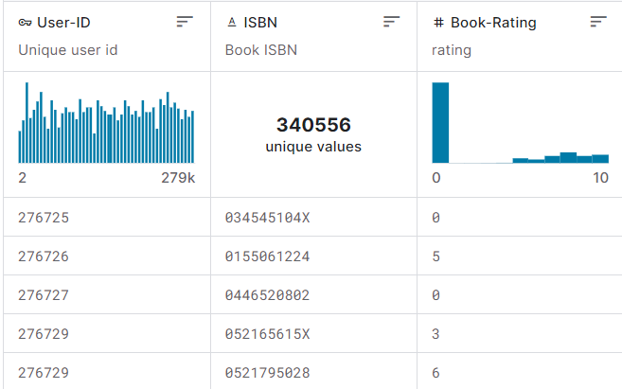
Data Overview
Ratings.csv

Slide 7
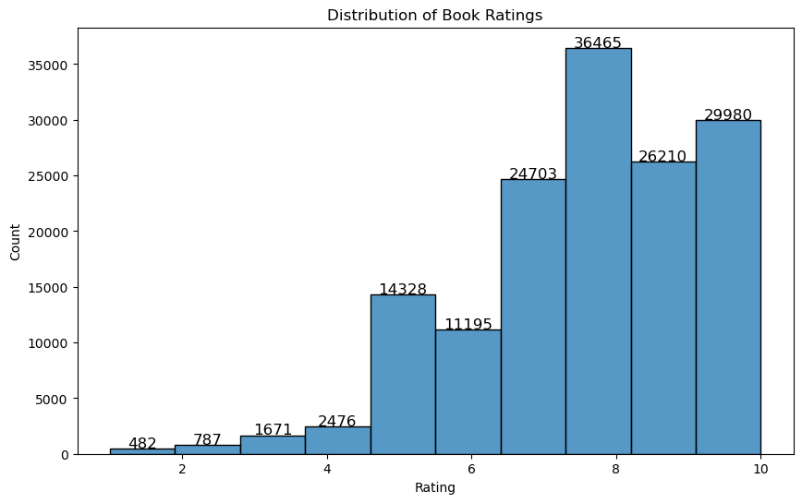
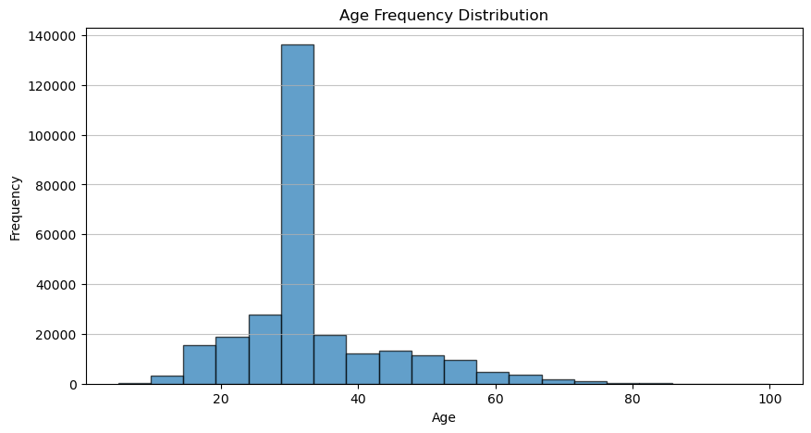
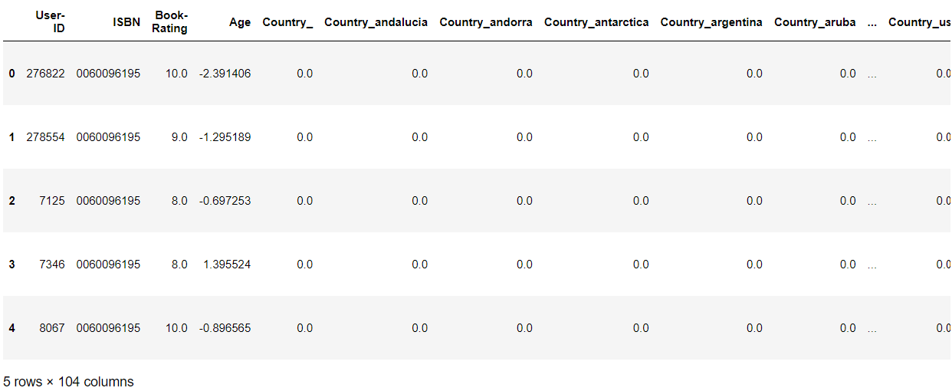
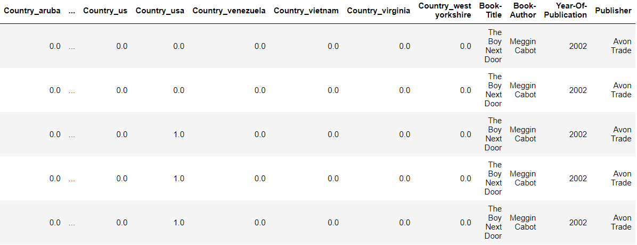
Data Preprocessing
143005 x 104
Handling Missing Values
Removing Unnecessary Columns
Data type Conversion
Filtering Data
Feature Scaling and Encoding
Merging Data

Slide 8
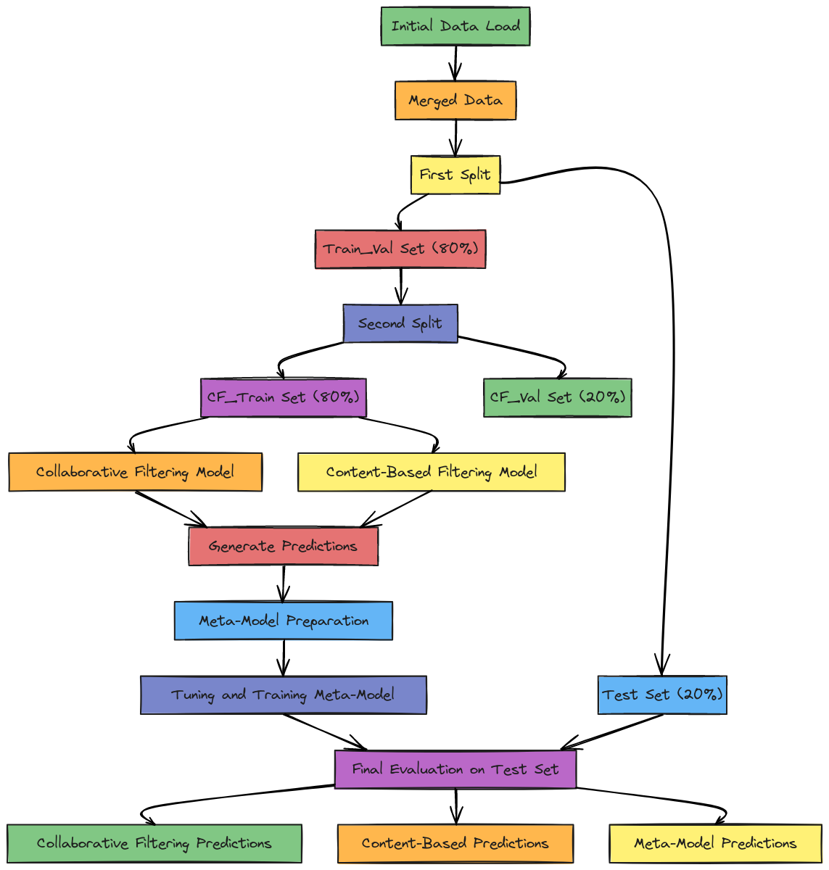
Workflow Diagram Post Preprocessing

Slide 9
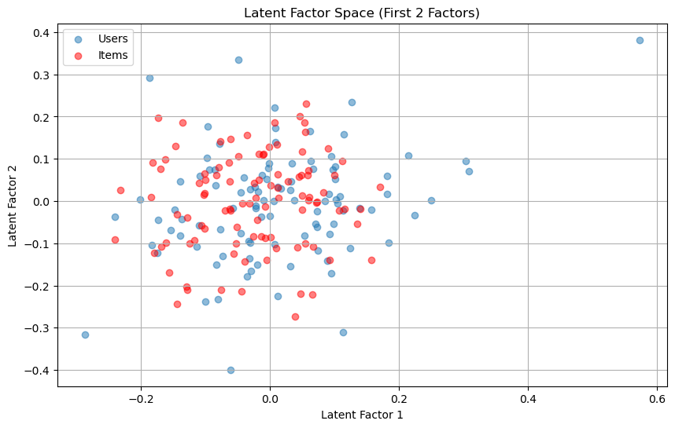
Collaborative Filtering Model (SVD) - Description
Collaborative filtering uses user-item interactions to predict ratings
Features used
User ID, ISBN, Rating
This project utilizes a technique called Singular Value Decomposition (SVD) to factorize the user-item matrix into latent factors and create the collaborative filtering model.

Slide 10
Collaborative Filtering - Training Process and Validation Results
Hyperparameters:
Number of factors: 100
Regularization terms: 0.02 (both for user and item)
Used SVD from the surprise library.
Performed 5-fold cross-validation to evaluate the model.
Final model trained on the full training data.

Slide 11

Content-Based Filtering - Description
Utilizes item features to predict ratings.
Focuses on the attributes of items rather than user-item interactions.
Features used:
Book Title, Book Author, Publisher
Model Used: TF-IDF and Truncated SVD
TF-IDF (Term Frequency-Inverse Document Frequency):Converts text features into numerical vectors. Measures the importance of a word in a document relative to a collection of documents (corpus).
Truncated SVD (Singular Value Decomposition):Reduces the dimensionality of these vectors. Captures the most important components, simplifying the data while retaining its essential features.

Slide 12
Content-Based Filtering – Training Process and Validation Results
Hyperparameters:
Number of components for SVD: 50
Cross-Validation:
Performed 5-fold cross-validation to evaluate the model.

Slide 13
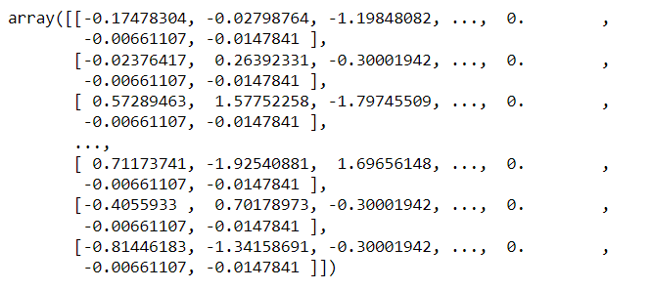
Meta Model - Description
Features:
Output predictions from Collaborative and Content Models
Age
Location
Model Structure:
Dense Layers with varying units (32-512)
Dropout Layers with varying rates (0.0-0.5)
Output Layer with a single neuron
Hyperparameters:
Units in Dense Layers
Dropout Rates
Optimizer: Adam
Loss Function: Mean Squared Error (MSE)

Slide 14
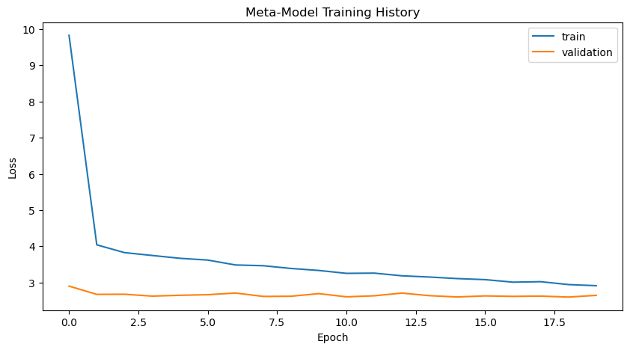
Meta Model – Training and Results
Hyperparameter Tuning:
Used RandomSearch with 10 trials and 3 executions per trial.
Best hyperparameters selected based on the validation loss.
Model Architecture:
Best model built with the selected hyperparameters:.
Training Process:
Model trained on the full training data with 20% validation split.
Number of epochs: 20
Batch size: 32

Slide 15
Workflow Diagram Post Preprocessing

Slide 16
Evaluation of Test Results
Collaborative Filtering Model Test RMSE: 1.6011446092401238
Collaborative Filtering Model Test MAE: 1.2310292210279983
Content-Based Filtering Model Test RMSE: 1.8241191575069182
Content-Based Filtering Model Test MAE: 1.4453357433546494
Meta-Model (Neural Network) Test RMSE: 1.6094613833207148
Meta-Model (Neural Network) Test MAE: 1.250418618027053

Slide 17
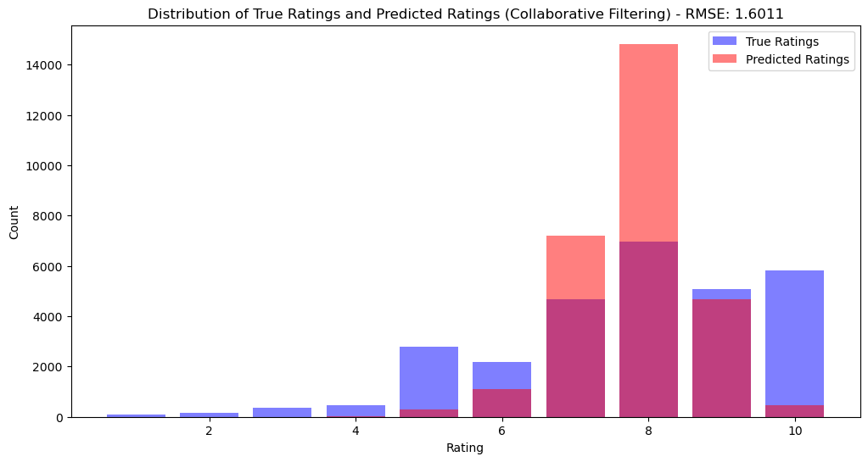
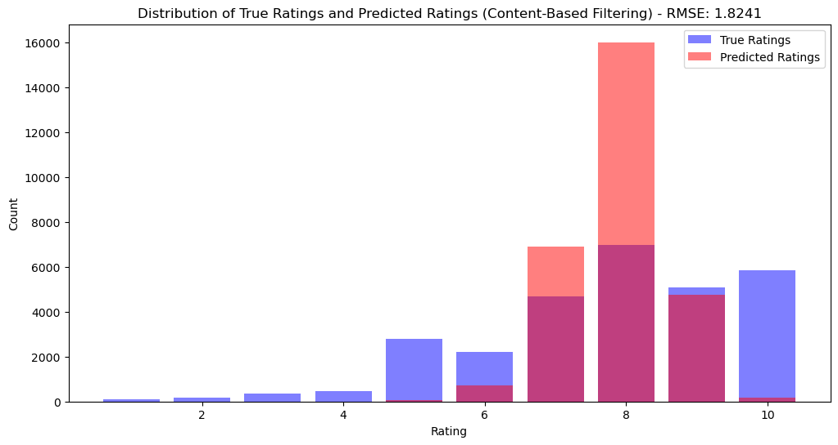
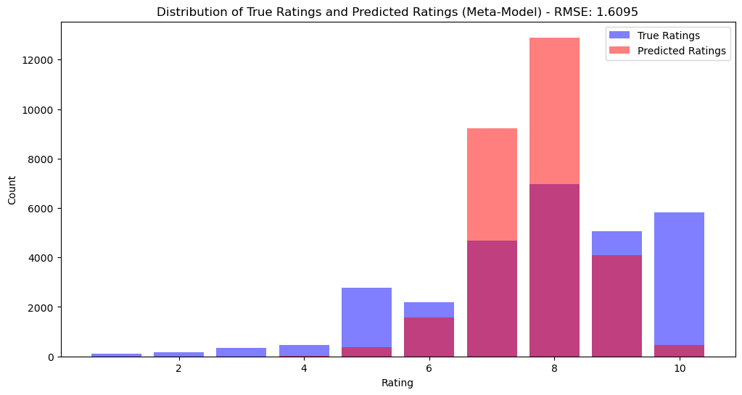
Evaluation of Test Results

Slide 18
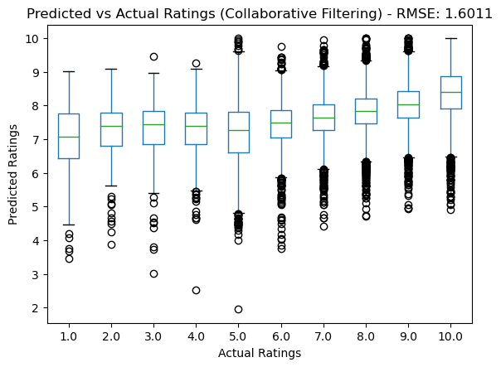
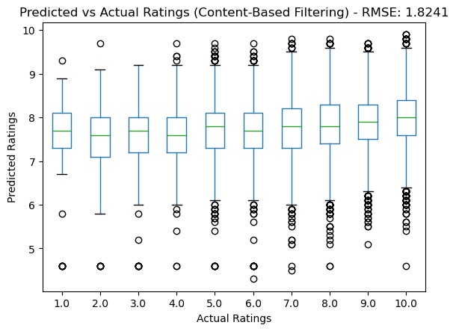
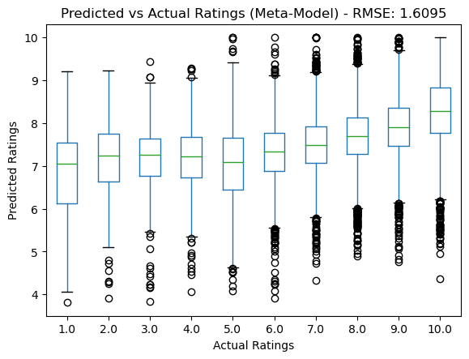
Evaluation of Test Results

Slide 19
Collaborative Model Takeaways
The collaborative filtering model performs well in predicting user ratings based on past interactions. It uses only the interaction data between users and items.
Strengths:
Utilizes user-item interactions, capturing collaborative patterns.
Effective for scenarios with dense interaction data.
Weaknesses:
Limited by the sparsity of user-item interaction matrix.
Cannot make predictions for new items or users without sufficient interaction data.

Slide 20
Content Based Model Takeaways
The content-based model uses TF-IDF and Truncated SVD to create a feature-rich representation of items. It predicts user preferences based on the content of the items.
Strengths:
Can make predictions for new items based on their features.
Does not rely on user-item interaction data.
Weaknesses:
Does not capture collaborative patterns.
Performance depends on the quality and relevance of the content features.

Slide 21
Meta Model Takeaways
The meta-model combines predictions from collaborative filtering and content-based models, along with user demographic data (age and country), to make final predictions.
Strengths:
Integrates multiple sources of information (interaction data, content features, user demographics).
Can capture more complex patterns and interactions.
Weaknesses:
More complex and computationally intensive.
Requires careful tuning of hyperparameters for optimal performance.

Slide 22
Analysis
Collaborative Filtering has the lowest RMSE and MAE among the models, indicating that it provides the most accurate predictions for our dataset. This suggests that user-item interaction data is highly valuable for predicting ratings in this context.
Content-Based Filtering has the highest RMSE and MAE, showing that relying solely on item content features might not be as effective in capturing user preferences compared to collaborative filtering.
Meta-Model achieves a good balance by leveraging both collaborative filtering and content-based predictions, along with user demographics. It slightly improves upon the collaborative filtering model alone, demonstrating the benefit of combining multiple approaches.

Slide 23
Overall Observations
The integration of different models and additional features (such as user demographics) can enhance the overall prediction accuracy.
Collaborative filtering remains a strong baseline for recommendation systems, particularly when there is ample interaction data.
Content-based filtering can be useful for making predictions on new items but might need further tuning and additional content features to improve accuracy.
Meta-models offer a promising approach to combine multiple prediction sources, but they require careful tuning and validation.
Models were not good at predicting high or low ratings

Slide 24
Future Steps
Better Data Preprocessing
Further optimize the meta-model by exploring additional features and more advanced architectures.
Investigate other hybrid models and ensemble methods to combine predictions from different models.
Explore techniques to handle data sparsity and improve cold-start recommendations for new users and items.
Implement explainability techniques to understand and interpret the predictions made by the models, providing more transparency and trust in the recommendation system.

