Slide 1
United States Housing Market
Data Analytics Bootcamp – Project 1
November 12, 2024
Amy Johnson
Seth Carter
Eduardo Camacho
Rafaela Peterson

Slide 2

What are the trends with the housing market?
Datasets were analyzed to determine trends and examine relationships between United States Median House Price and:
Median Household Income
Inflation Rate
Interest Rates
Population Growth
Housing Inventory
Unemployment Rate

Slide 3
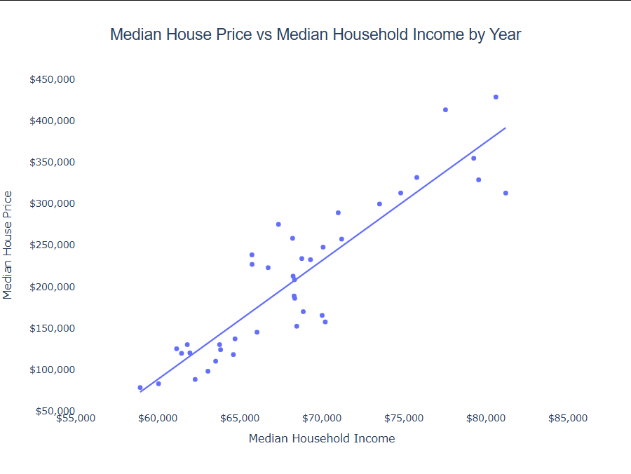
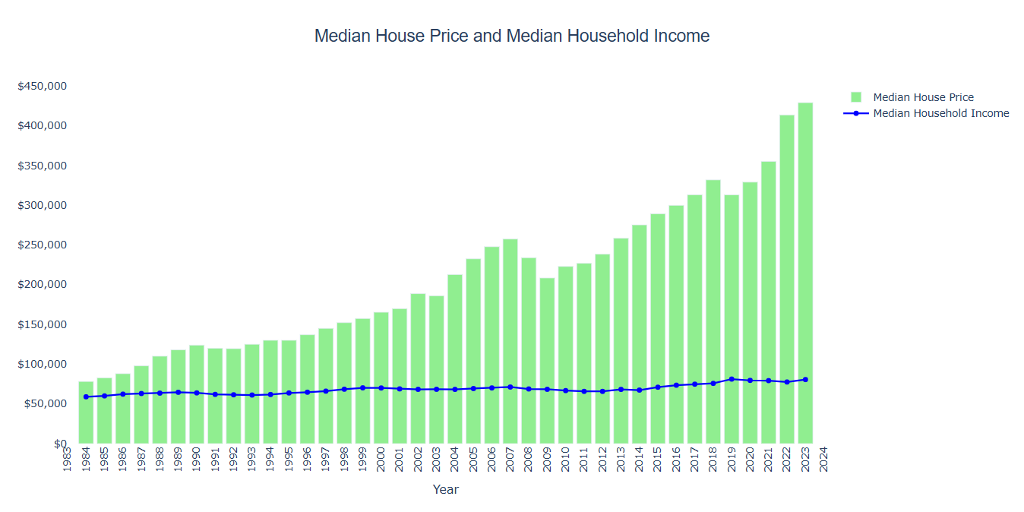
United States Median House Price vs Median Household Income
comments
comments

Slide 4
United States Median House Price plus Inflation
comments
comments

Slide 5
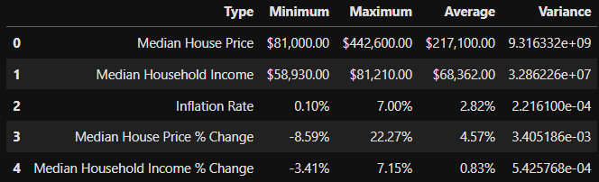
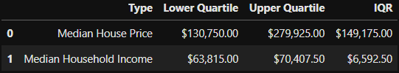

Slide 6
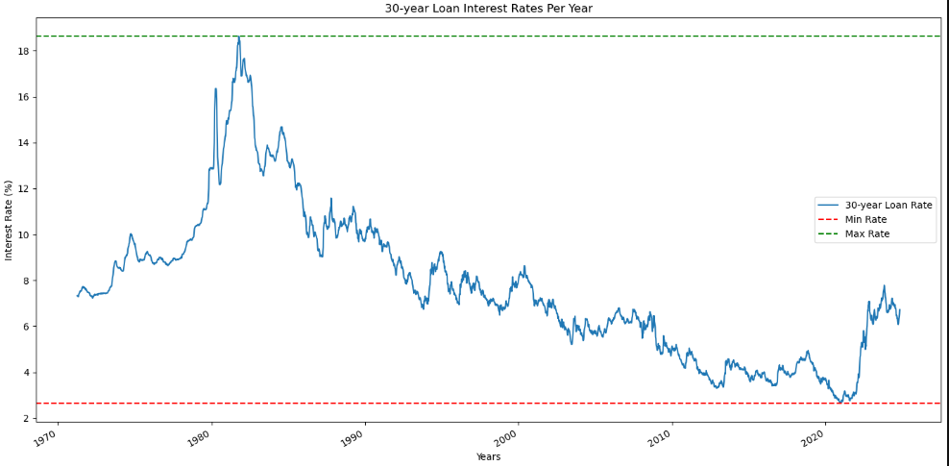
United States Home Interest Rates
Highest Rate:
10/9/1981: 18.63%
Lowest Rate:
1/7/2021: 2.65%

Slide 7
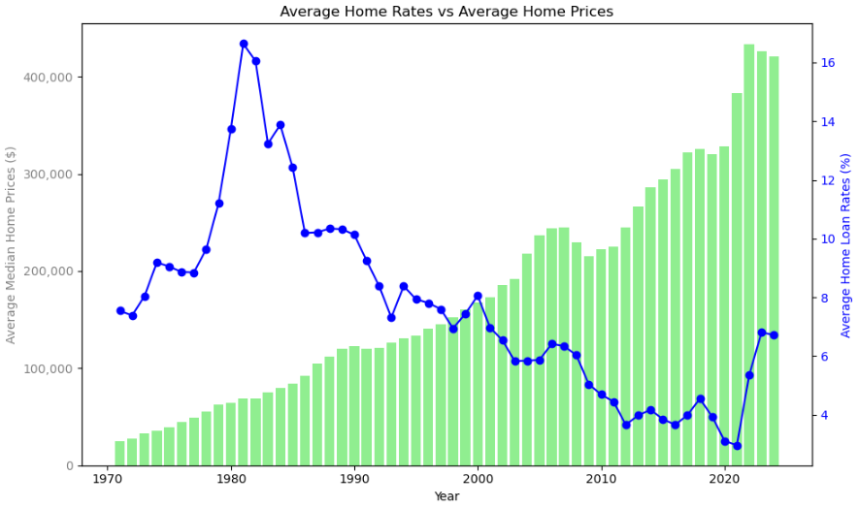
United States Median House Price vs Interest Rates

Slide 8
United States Median House Price vs Population Growth

Slide 9
United States Median House Price vs Unemployment

