Slide 1
United States Housing Market
Data Analytics Bootcamp – Project 1
November 12, 2024
Amy Johnson
Seth Carter
Eduardo Camacho
Rafaela Peterson

Slide 2
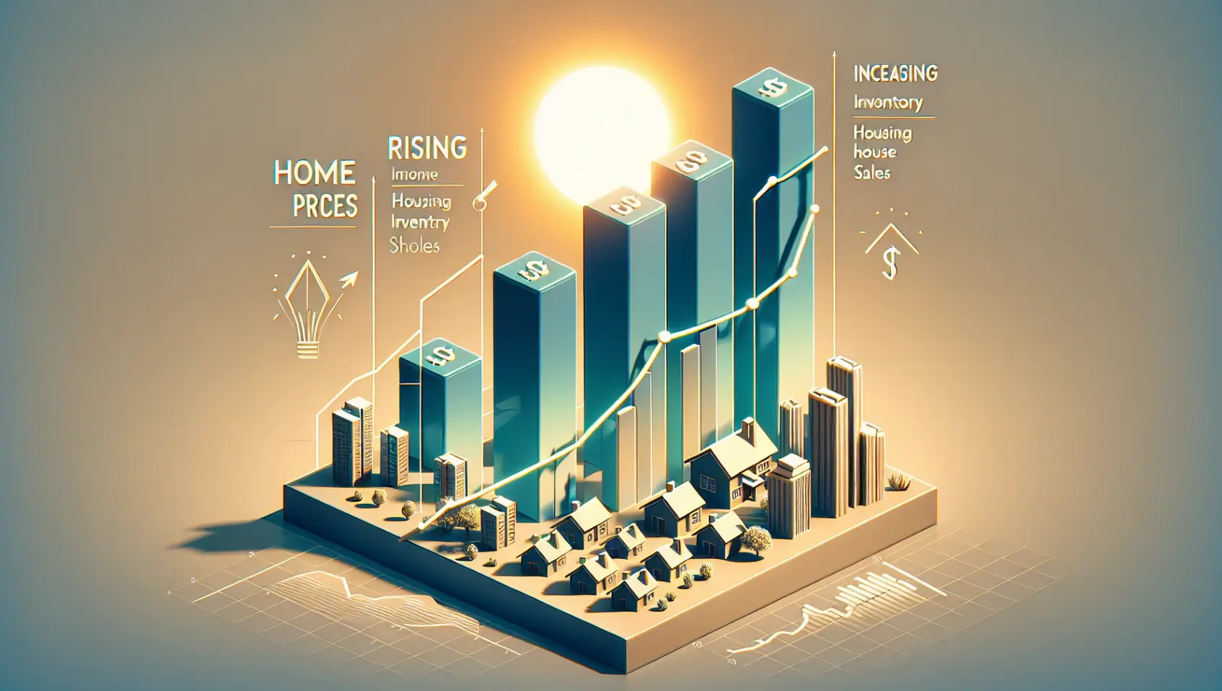
What are the trends with the housing market?
Datasets were analyzed to determine trends and examine relationships between United States Median House Price and:
Median Household Income
Inflation Rate
Interest Rates
Population Growth
Housing Inventory
Unemployment Rate

Slide 3
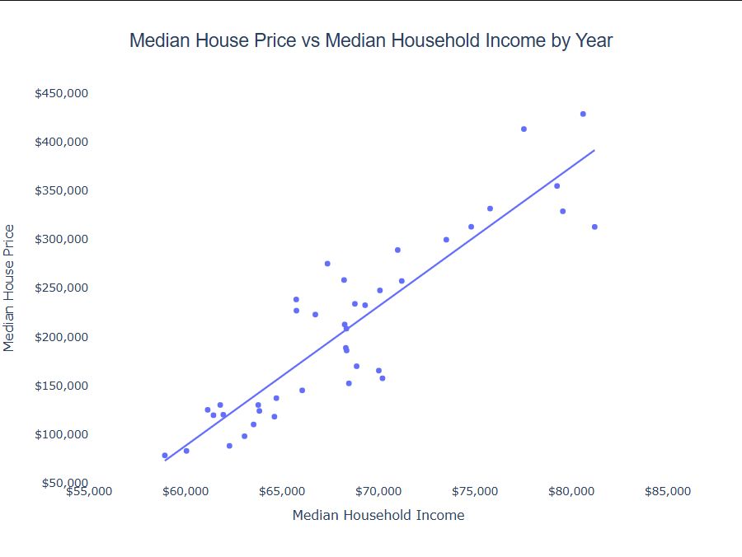
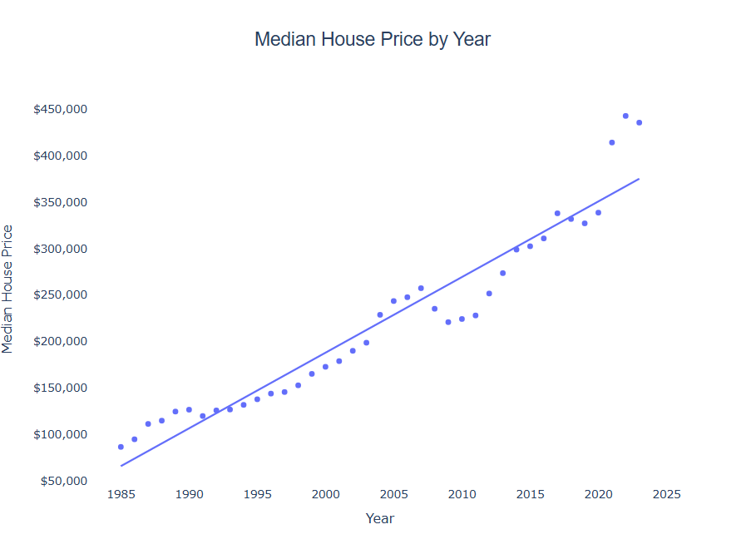
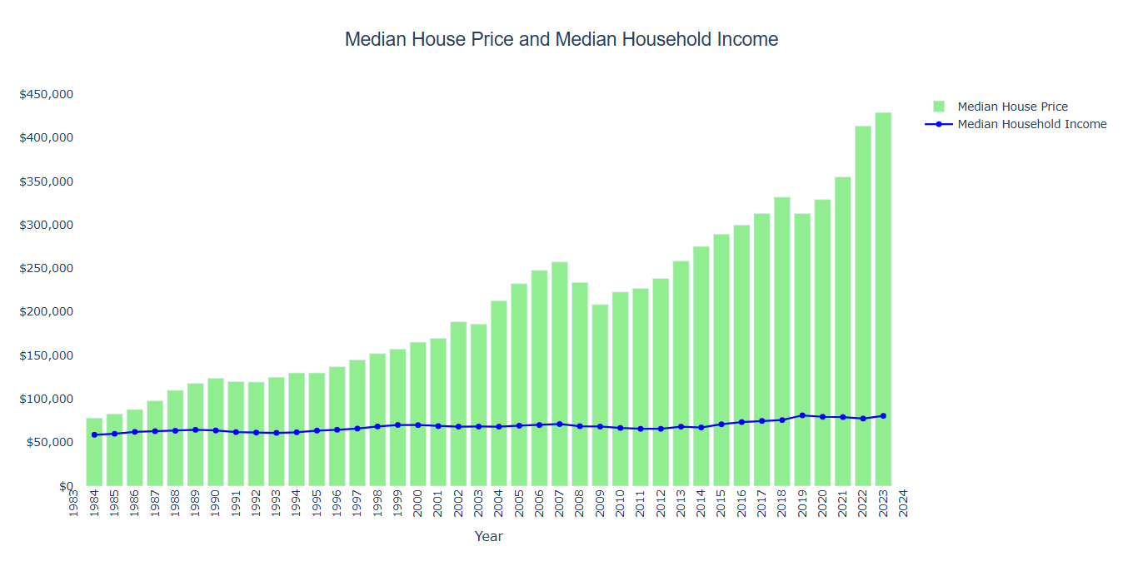
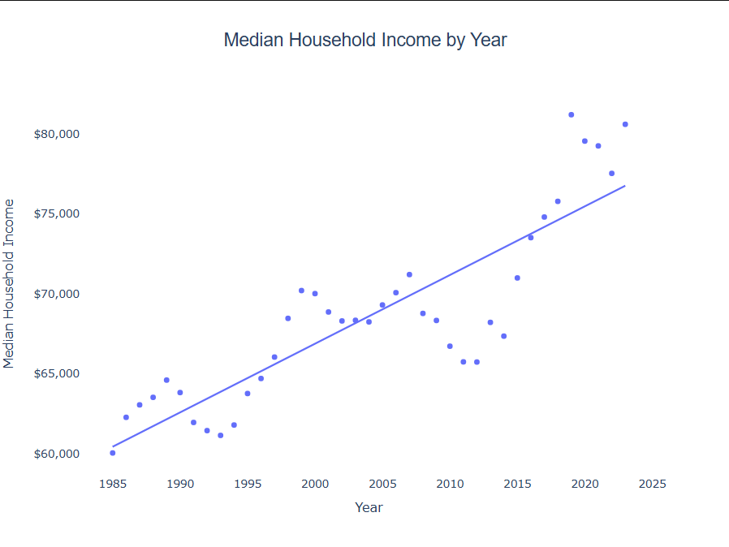
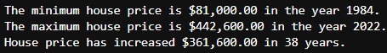

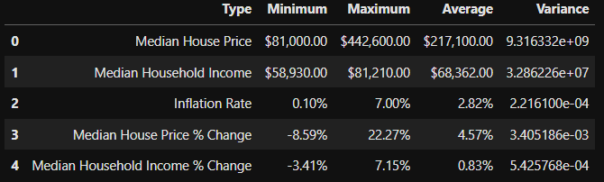
United States Median House Price vs Median Household Income
There is a positive relationship with Median House Price and Median Household Income in the United States.
As Median House Price increases, so does the Median Household Income year over year.
Median Household Income does not increase at the same rate as Median House Price in the United States year over year
Median House Prices may dip slightly from time to time, but looking at the greater picture overall, it always trends upwards
Median Home Prices increase year over year and then dips a bit just for a couple of years like in years 2008-2009 and 2018-2019
It seems that we may be seeing that same trend in 2023-2024 since Median House Prices started to dip from 2022
Seeing how that trend has repeated itself, I’d assume that in 2024-2025 would be a good time to buy a house

Slide 4
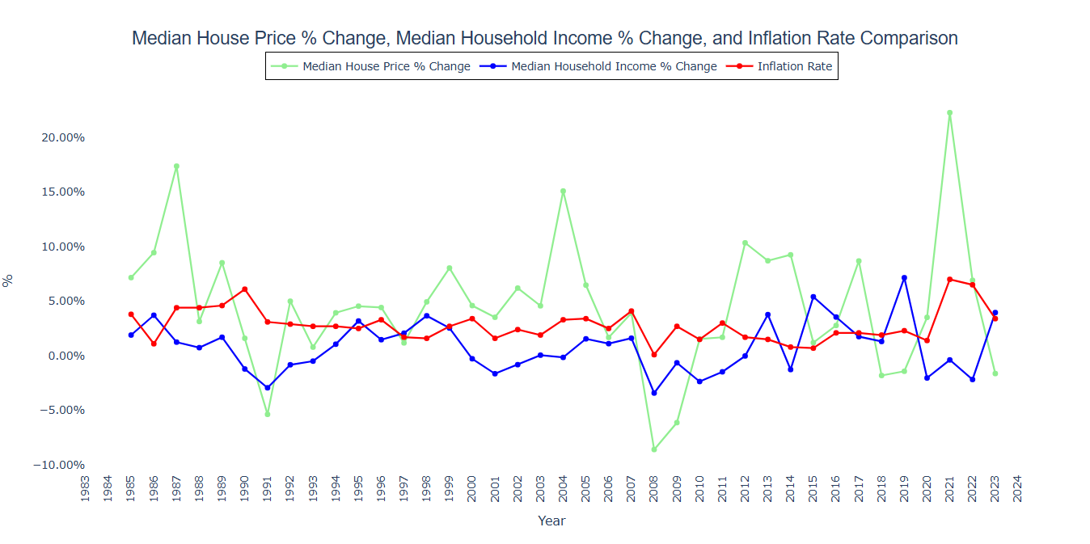
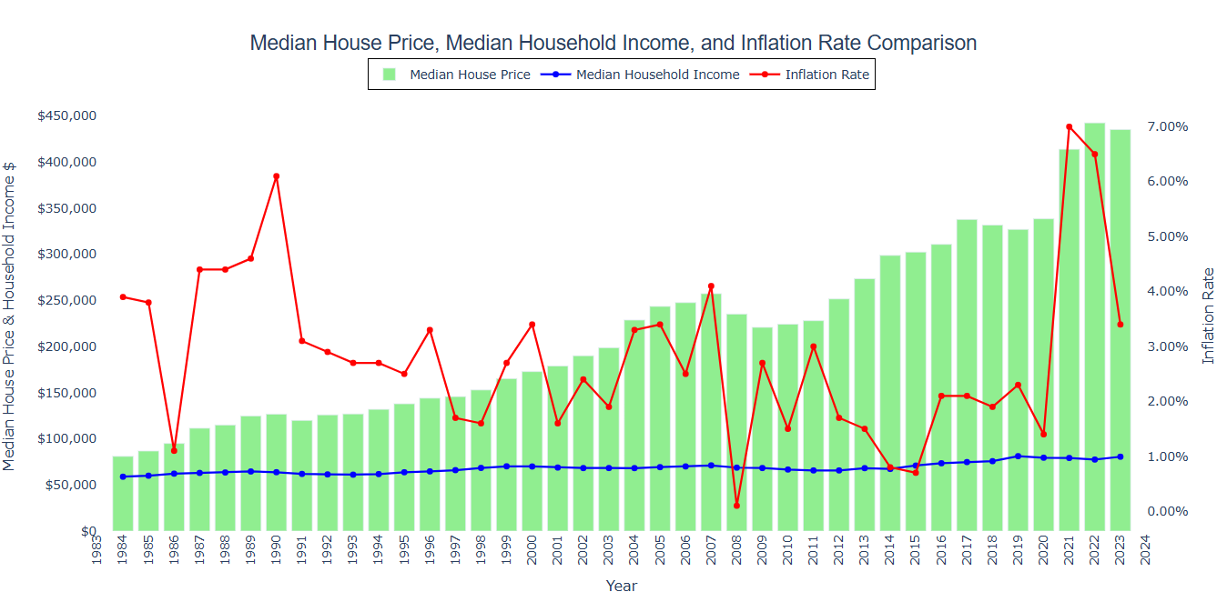
United States Median House Price plus Inflation
Median House Price % Change fluctuates quite a bit year to year, majority of the time still a positive % increase
Median Household Income % Change also fluctuates a bit, but has more minimal change year to year than Median House Price
There were a lot more years where the Median Household Income decreased from the previous year than compared to the Median House Price which tells us that even though the Household Income went down, House Prices still increased in many years.
For example, between the years 2020-2021, the Median Household Income decreased -2.03%, but Median House Prices increased 3.52%.
However, both follow the same positive or negative trend majority of the time.
This graph is the same as the graph showing the trend in Median House Price and Median Household Income year over year, but each year's inflation rate is added
Inflation rate varies significantly from year to year and there is no pattern with the trend like there is for Median House Price and Median Household Income
The lowest the inflation rate has ever been was 0.10% in 2008 and the highest was 7.00% in 2021 with an average from 1984-2023 of 2.82%.

Slide 5
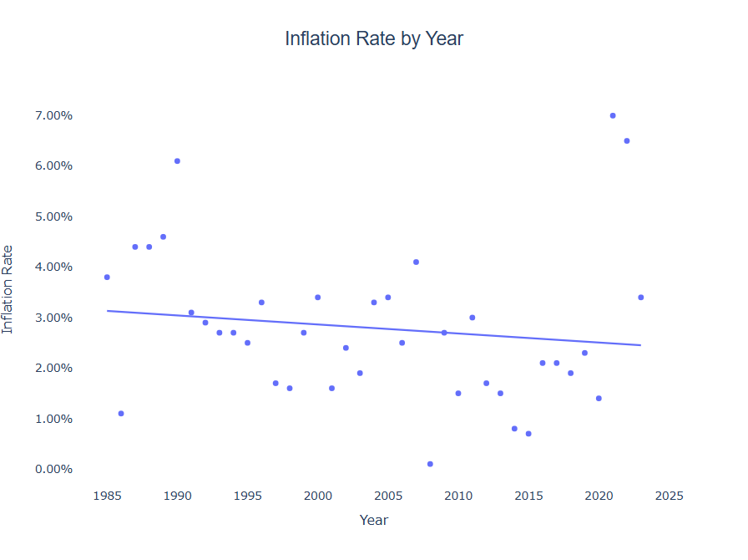
Backup Data
There is a VERY strong analysis with Median House Price and Year and a slight ongoing pattern of increasing for a few years and then decreasing the following years before increasing again
Median Household Income by Year also shows a similar trend, but not as strong
There is actually a slight negative relationship with Inflation Rate and Year, but not very strong and quite a few outliers

Slide 6
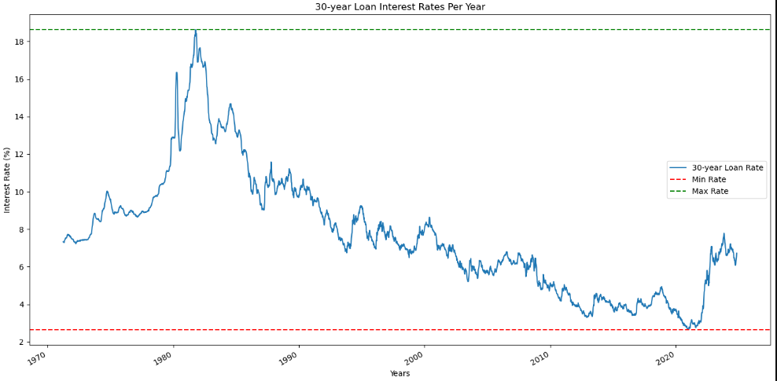
United States Home Interest Rates
Highest Rate:
10/9/1981: 18.63%
Lowest Rate:
1/7/2021: 2.65%

Slide 7
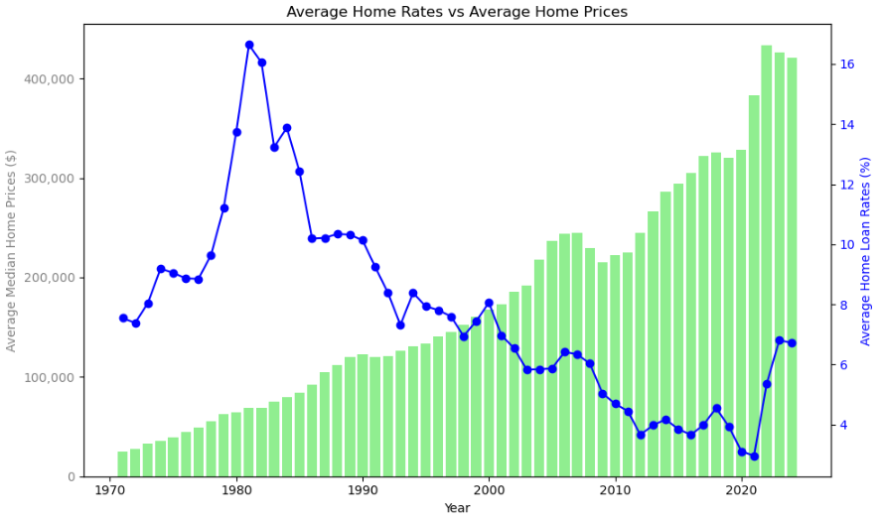
United States Median House Price vs Interest Rates

Slide 8
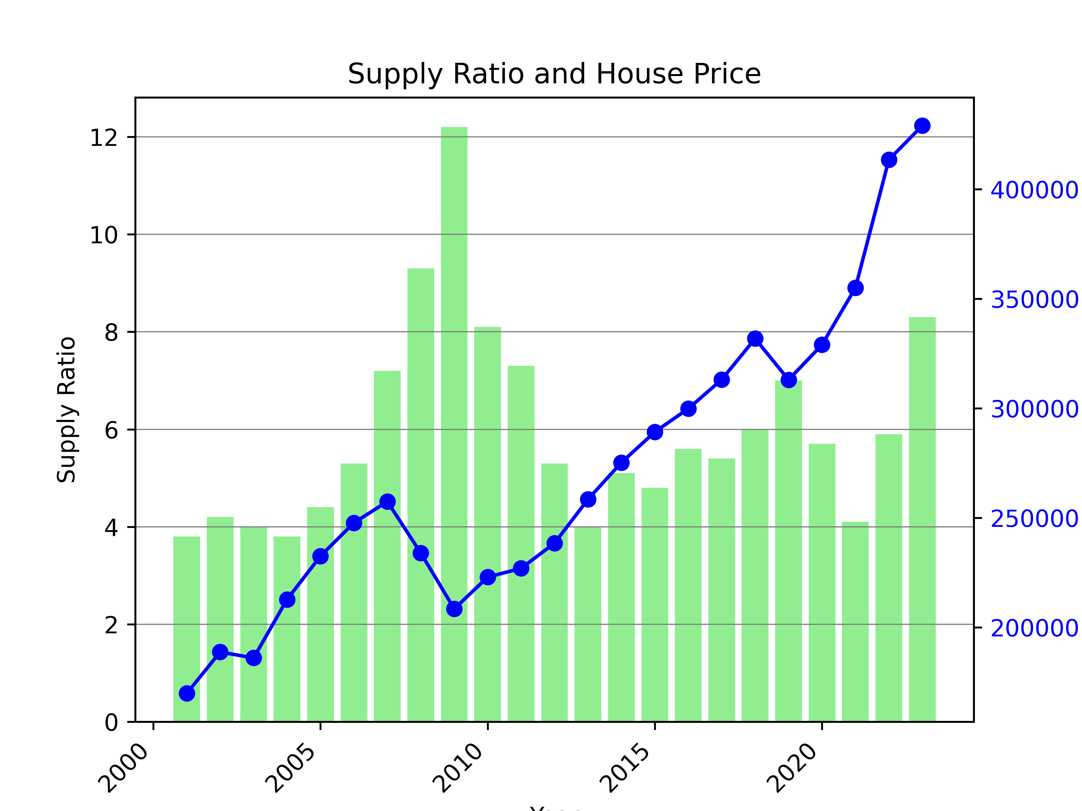
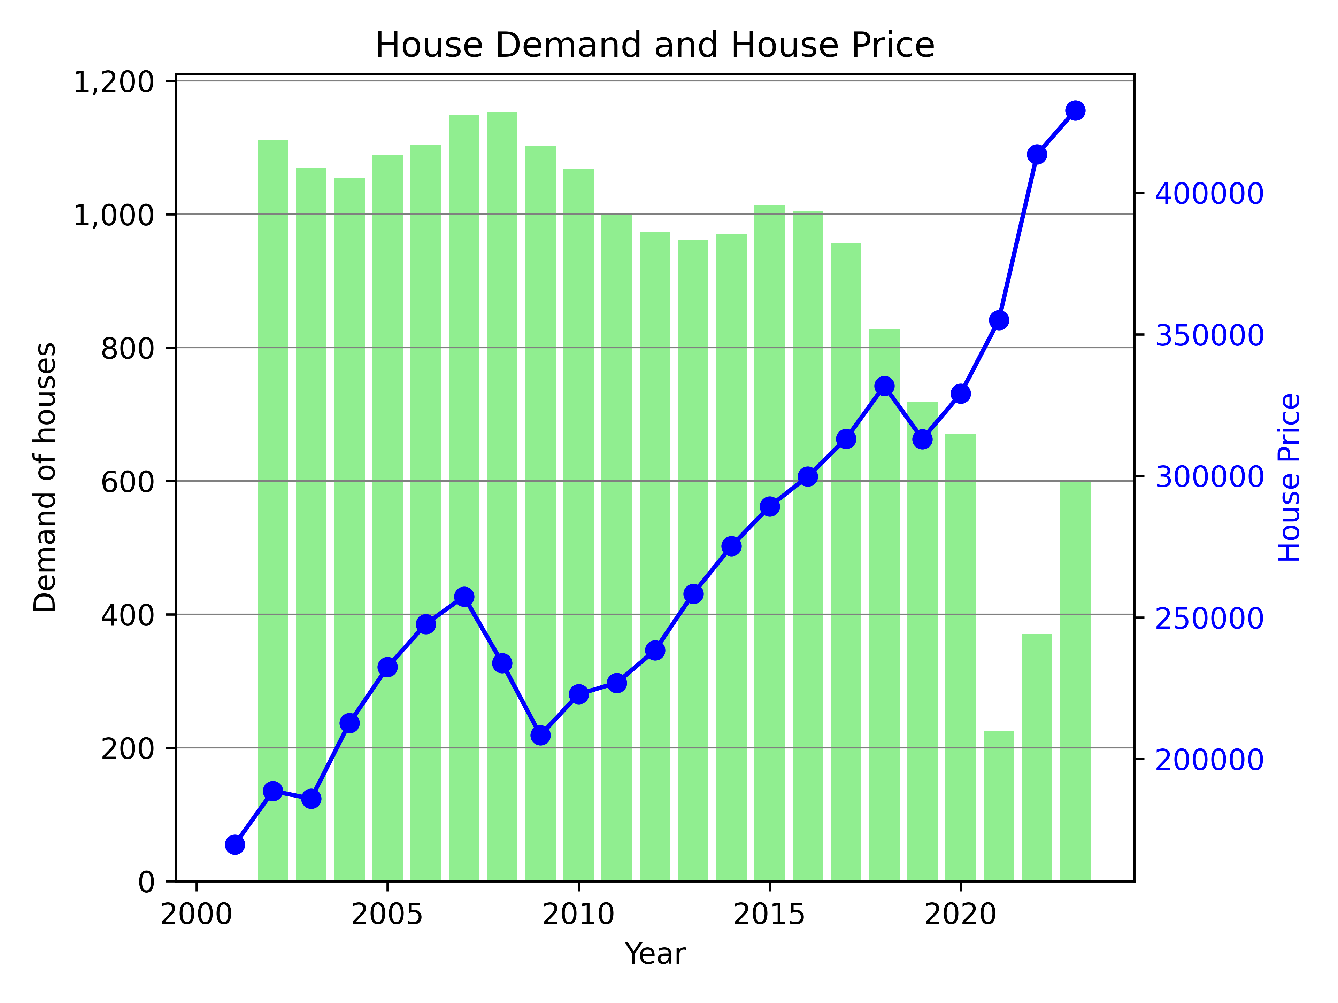
House Price vs Supply and Demand
Demand was calculated using the difference in population divided by the average household size.
As seen in 2008, Demand lowering resulted in house prices lowering as well.
The Supply ratio is the number of new houses for sale to new houses sold.
In 2021, supply had dropped significantly due to the pandemic, partially resulting in the large rise in house price for 2022.

Slide 9
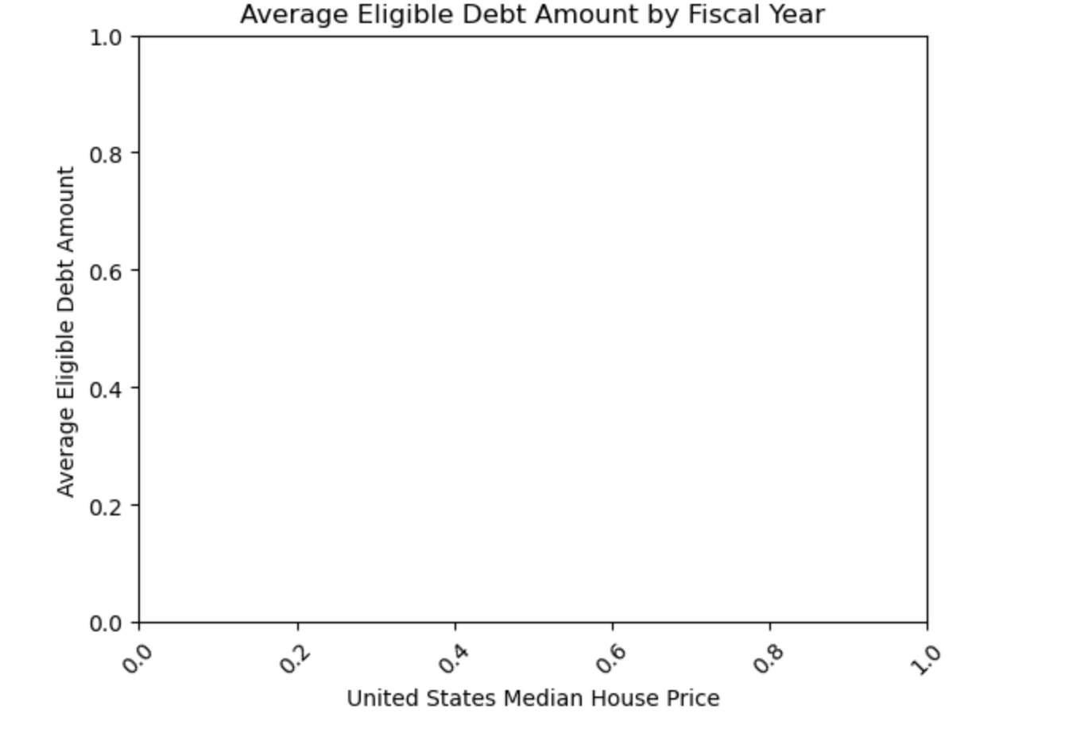
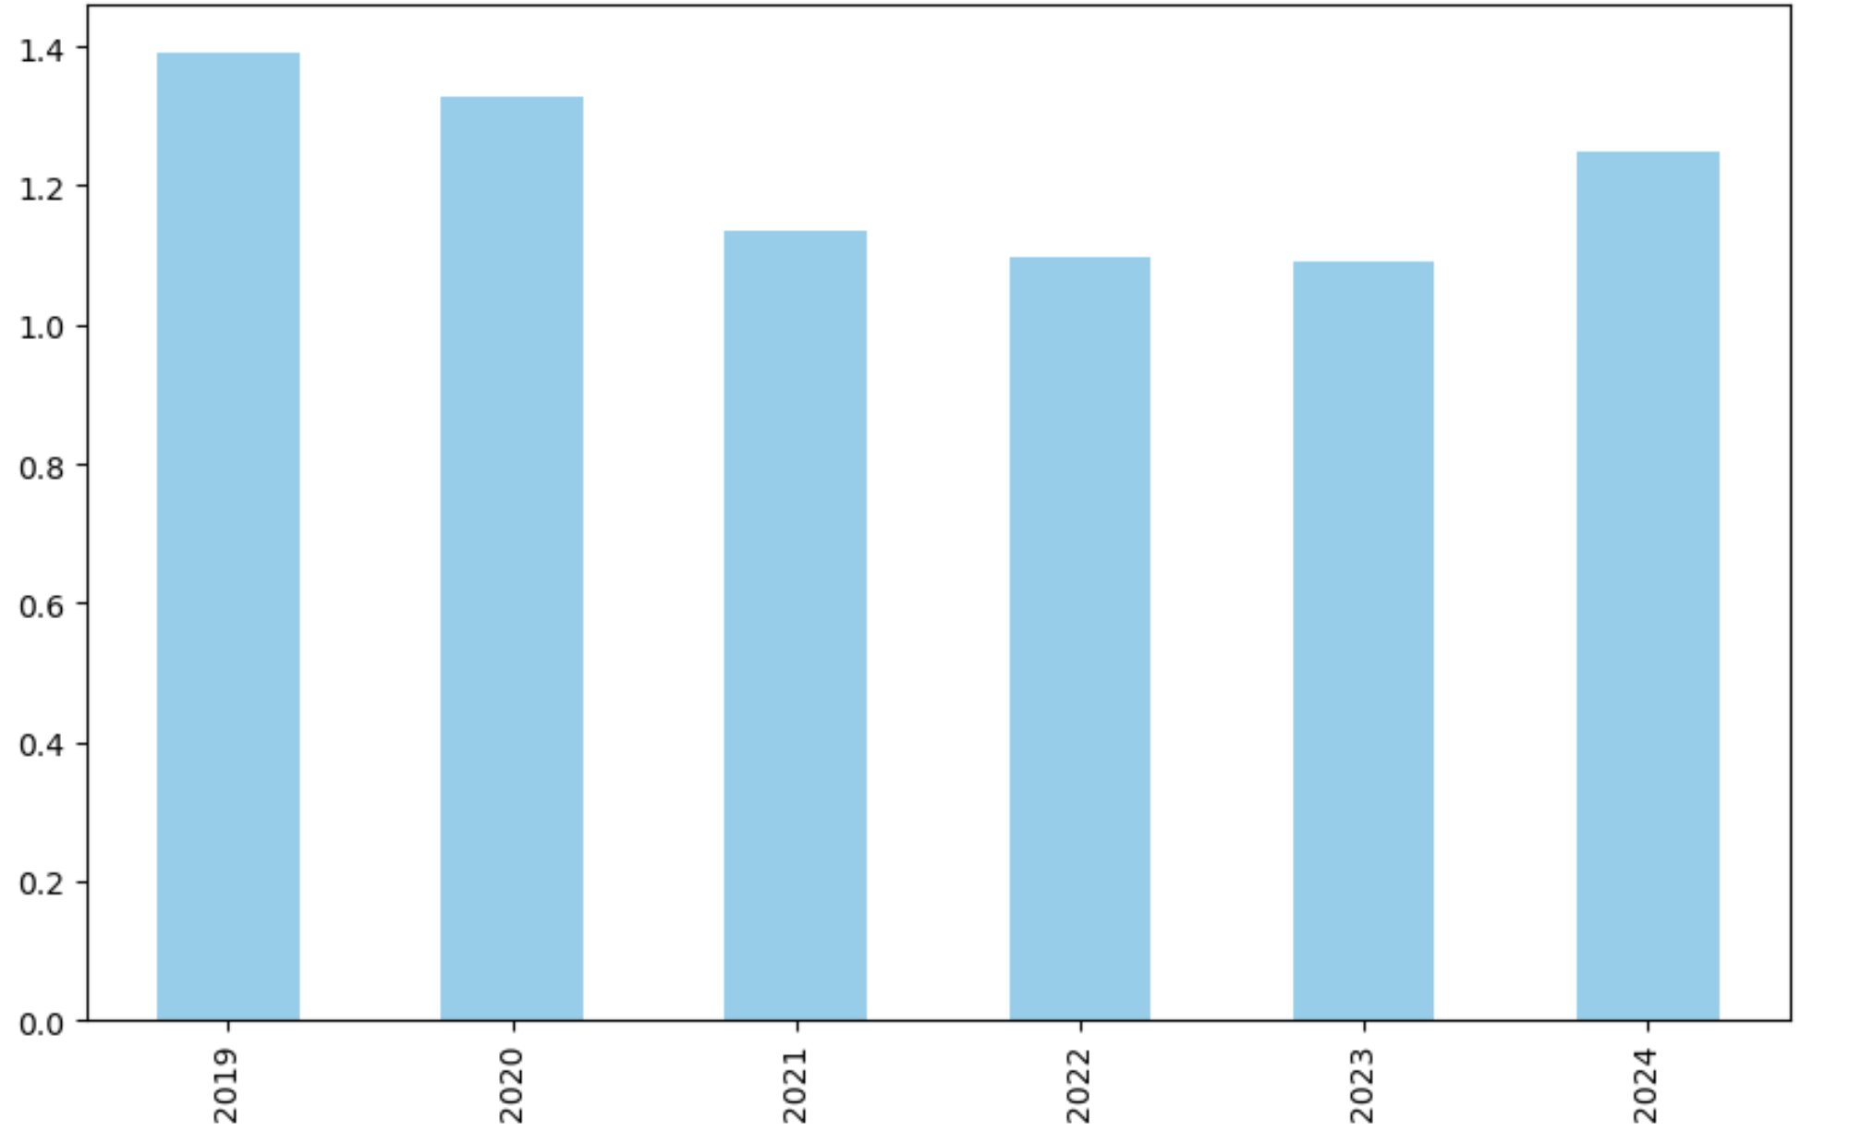
United States Median House Price vs Unemployment

Slide 10
Should you buy a house today?
Maybe.
Household Income is steadily increasing but so is house price.
Interest Rates are average.
Demand is increasing but so is supply.
May be easier to afford as unemployment rate drops.

