Slide 1
Selenium
Wattegedara S. L.
IT18135862

Slide 2

Selenium
Selenium is a free automated testing tool for Web Applications.
Allows for developing functional tests in the browser.
It allows to record the workflows, so that they can prevent future regressions of code
It works on any browser that
supports JavaScript.

Slide 3
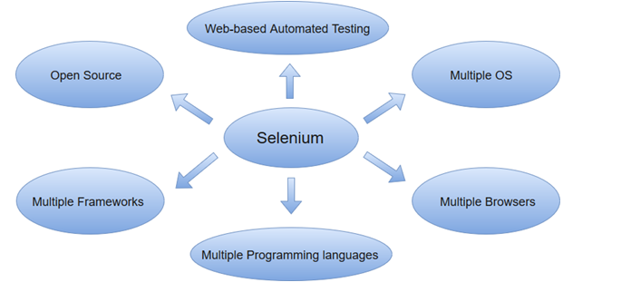
Features of Selenium
Supports for cross-browser testing.
Supports several languages including Java, C#, PHP, and Python.
Provides an efficient way of comparing expected and actual results.
Inbuilt reporting mechanism.

Slide 4
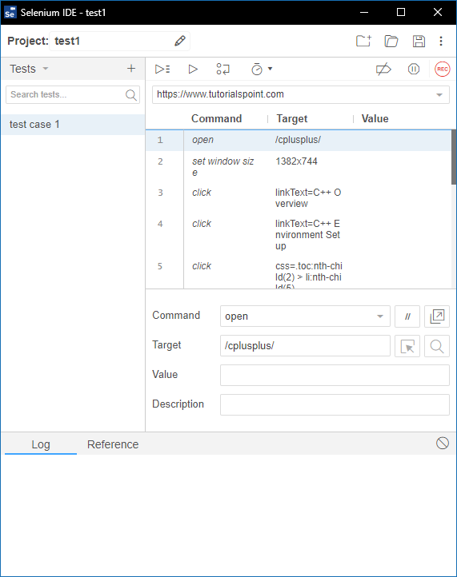
Selenium IDE
Selenium Integrated Development Environment (IDE) is one of the simplest components in the Selenium automation testing suite.
It does not require any programming logic to write its test scripts rather you can simply record your interactions with the browser to create test cases.
Subsequently, you can use the playback option to re-run the test case

Slide 5
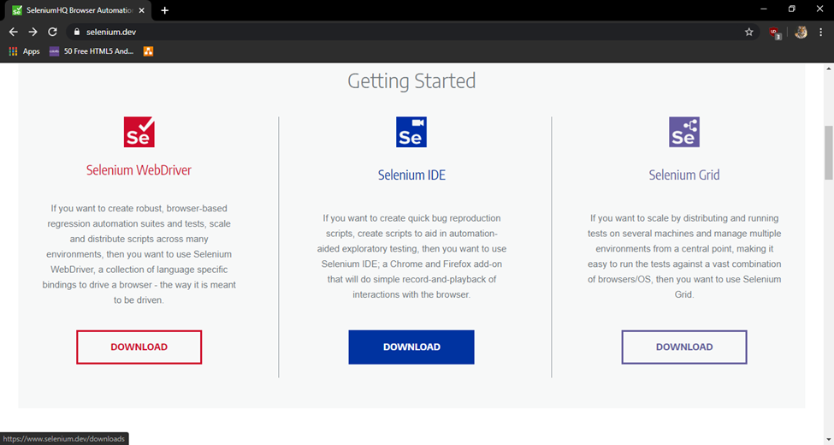
Installation Details
Reference: https://www.seleniumhq.org//
Download IDE from the SeleniumHQ official downloads page.

Slide 6
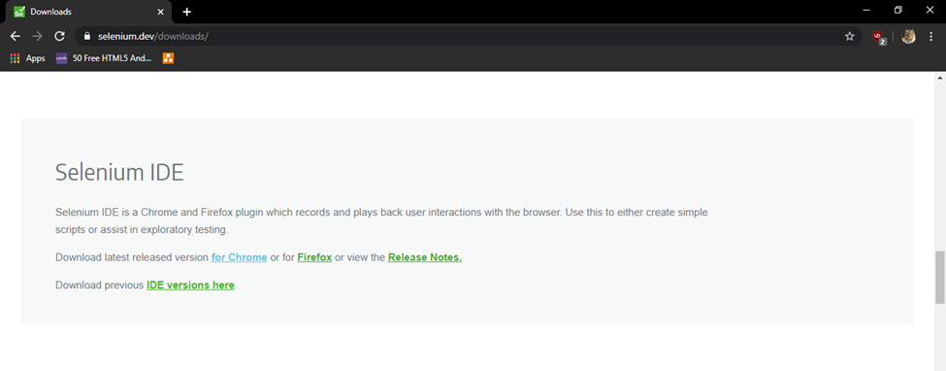
2. For chrome select “for chrome” link

Slide 7
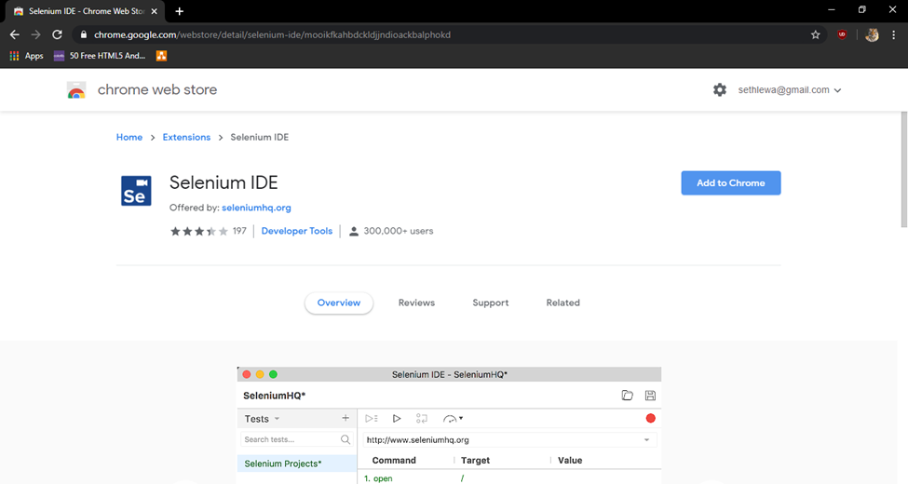
3. Click on “Add to chrome” button

Slide 8
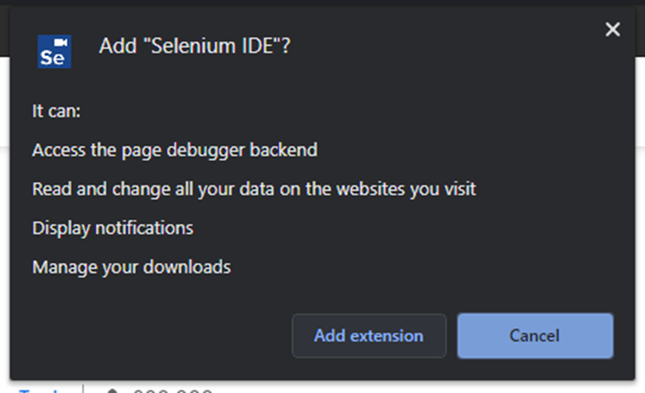
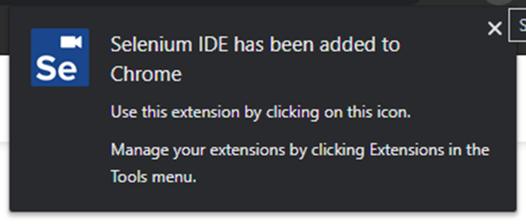
4. Click on “Add extension” button
5. Then Chrome Add-ons window will
pop up to show that you have
added Selenium IDE to Chrome

Slide 9
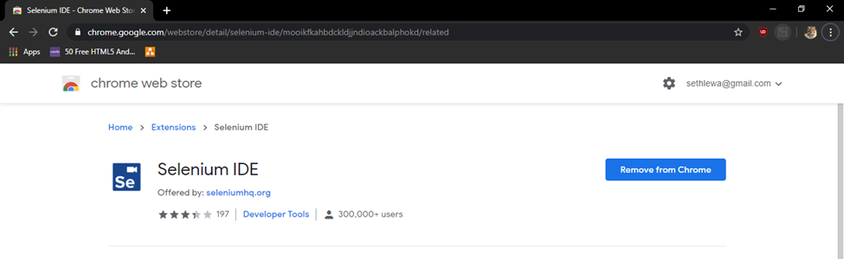
6. Run Selenium by clicking on the “Selenium” icon which appears near the search bar of the browser

Slide 10

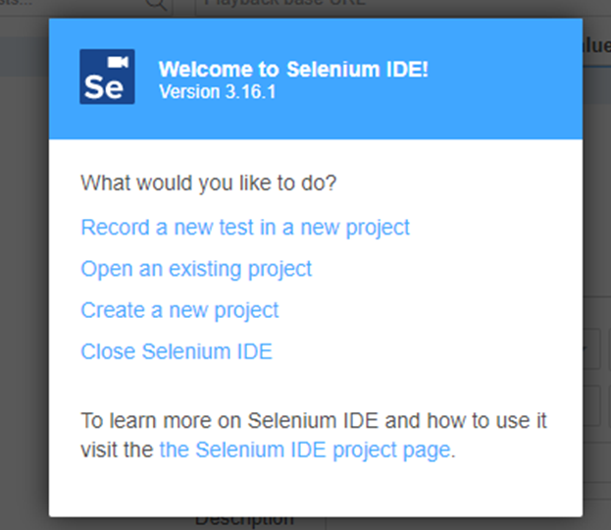
Working with a Selenium Test case
Open a web browser
Open Selenium IDE by clicking on
the Selenium icon
Click on “Record a new test in a new project”

Slide 11
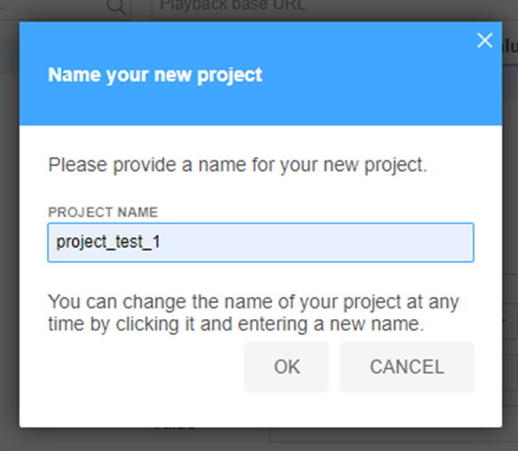
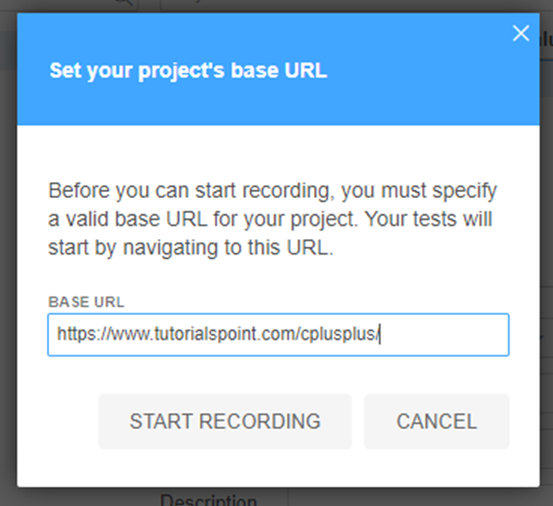
Give a name for the project and Then click “OK”.
Give the web address that you want to monitor , then Click on “Start Recording”.

Slide 12
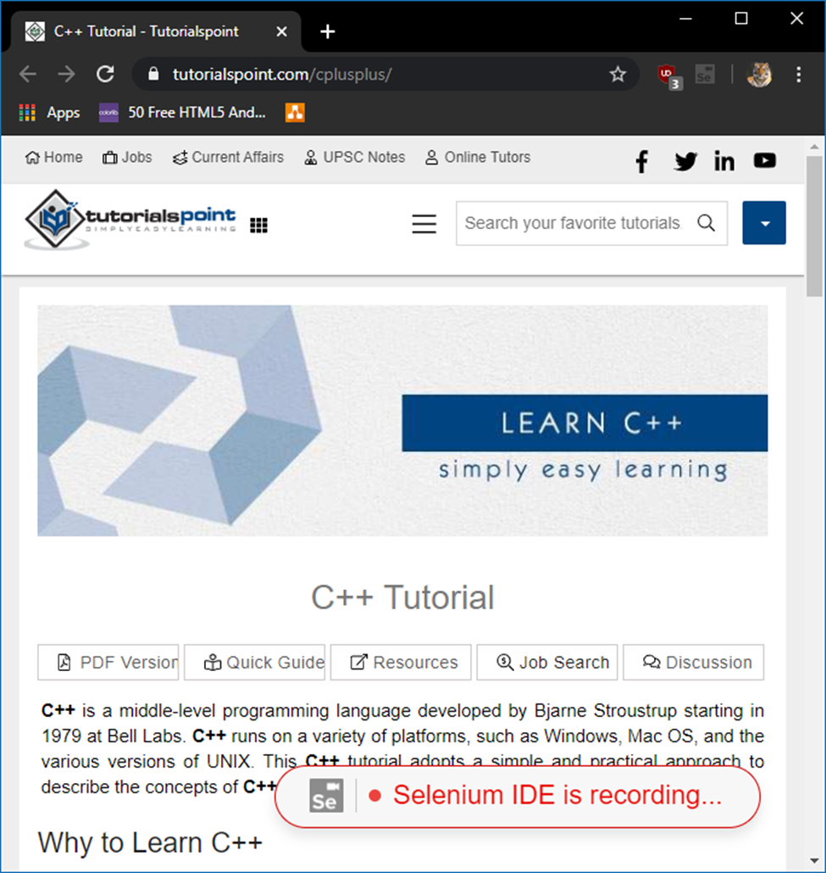
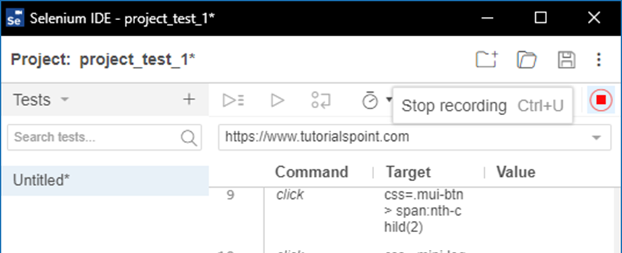
Now the web address will be opened, and recording will get started. You can navigate through different tabs of the webpage.
Click on “Stop Recording” button.

Slide 13
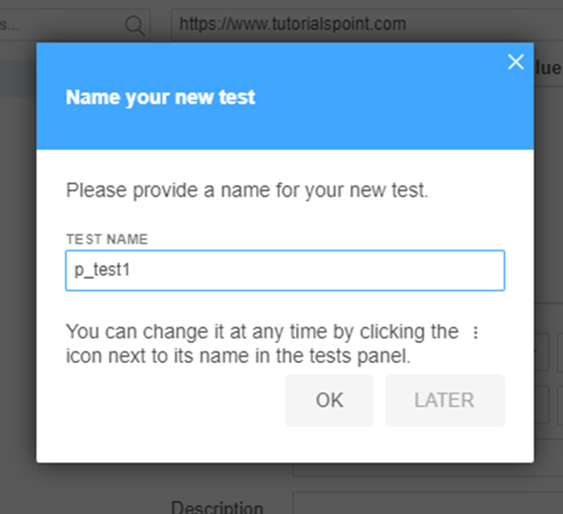
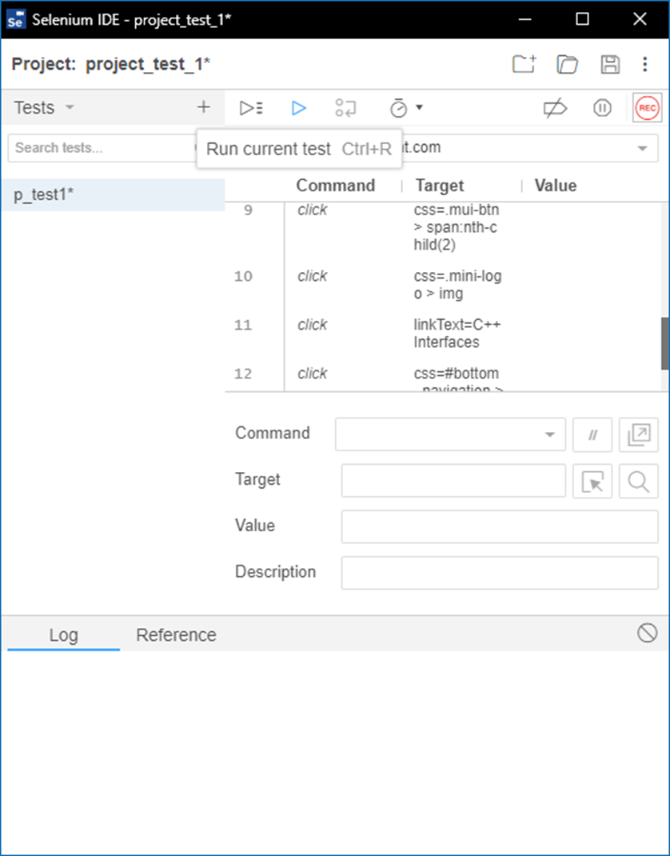
Give a name to your test case and click “OK” .
Click on the save button to save the test case and save it in a specific location / folder.
Save

Slide 14
You can open the saved test case in future and create a new project using the icons in the toolbar of the Selenium IDE.
Based on your choice you can either execute one test case at a time or all the test cases together .

Slide 15
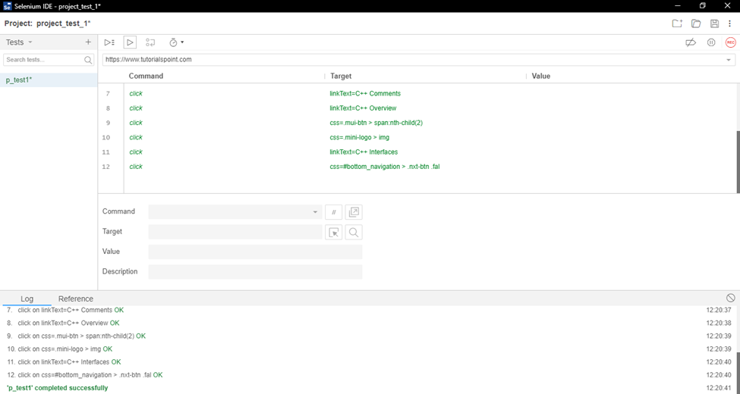
You can monitor the commands and issues related to all the test cases.

