Slide 1

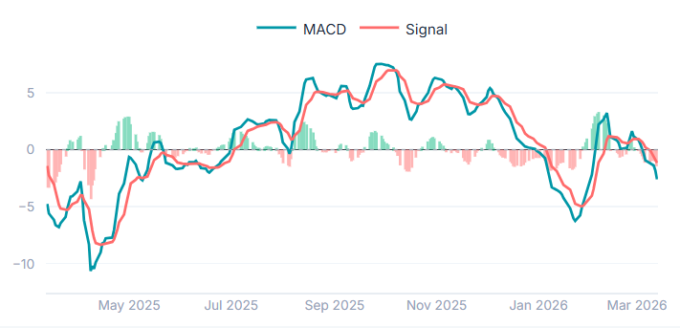
Chart Title
Chart

