Slide 1
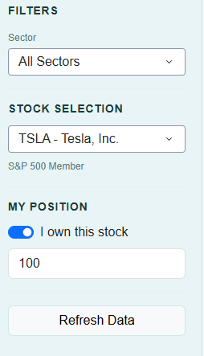

Filter Panel
Remove this, doesn’t add much value
Change the font and the borders and other format to something like this: action this for all the filter options
At the bottom write in italics under the box, saying ‘Average Price’

Slide 2
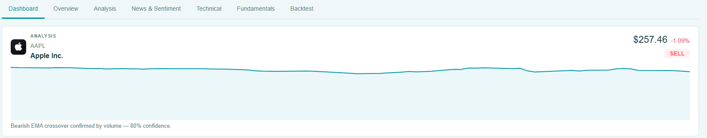
Dashboard tab
Remove these
Add the price, and the percentage change here
The chart doesn’t seem correct, it doesn’t have the x and y axis. And it looks too long and expanded
Remove this comment, and give a comment on the general trend, e.g. if we see a contunous decline then say like it seems to be declining since xx, date vice versa, if it fluctuating say something appropriate to that, basically analyse the recent trend comparing with the bigger pciture
Add something like this, at the bottom of the chart showing the percentage changes, and when you click it, it the above chart changes to that relevant period

Slide 3
Dashboard tab
Just below the previous ones, add a box, to say sector and industry amd does it belong to the S&P 500 index or not, and then the company description

Slide 4
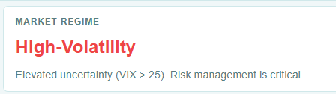
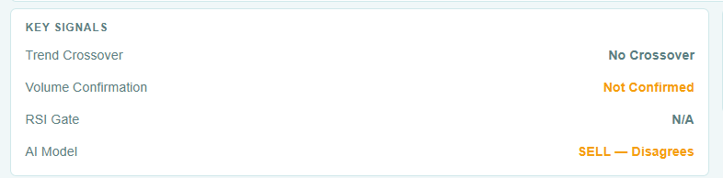
Dashboard Tab
The boxes that are just below the chart, in the first left hand side, put the market regime. Then in big highlighting way put the signal and the consifence of the singnal in %, and then the 4 components.
Make sure keep them of symmetry height.
Buy/Sell/Hold Signal
Confidence %

Slide 5
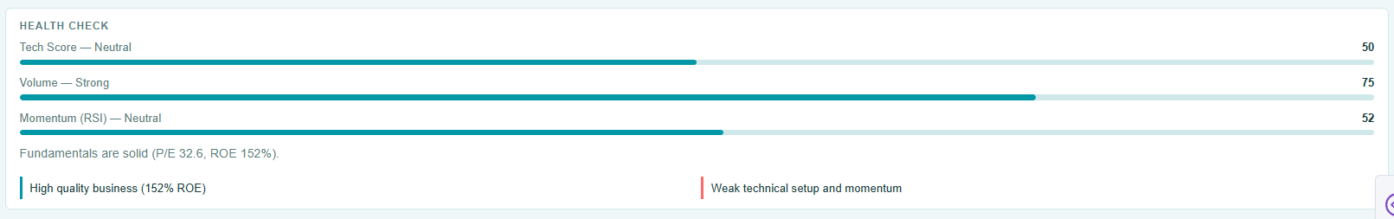
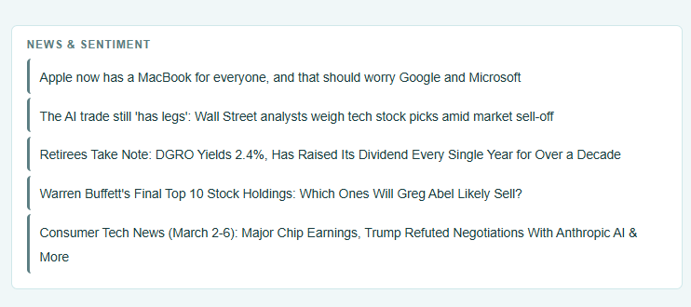
Dashboard Tab
Add these two just below the previous ones, remove the chart. And then add the financial health and then the news and sentiment segments

Slide 6
Overview tab
Remove this

