Slide 1
Project Overview – Placement Tracker
🎯 Objective:
To build a web app that tracks student placement readiness using simulated academic and behavioral data.
🛠️ Tools & Tech:
- Python
- Streamlit (dashboard)
- SQLite (DB)
- Faker (simulated data)
🧩 Key Features:
- Real-time placement dashboard
- Student performance summary
- Placement status logic
- Batch-wise analysis
🔄 Data Flow:
Faker → DB Tables → Eligibility Logic → Streamlit Dashboard
📂 Database Tables:
students, Programming, Soft-Skills, Mock-Interview, Placement-Table

Slide 2
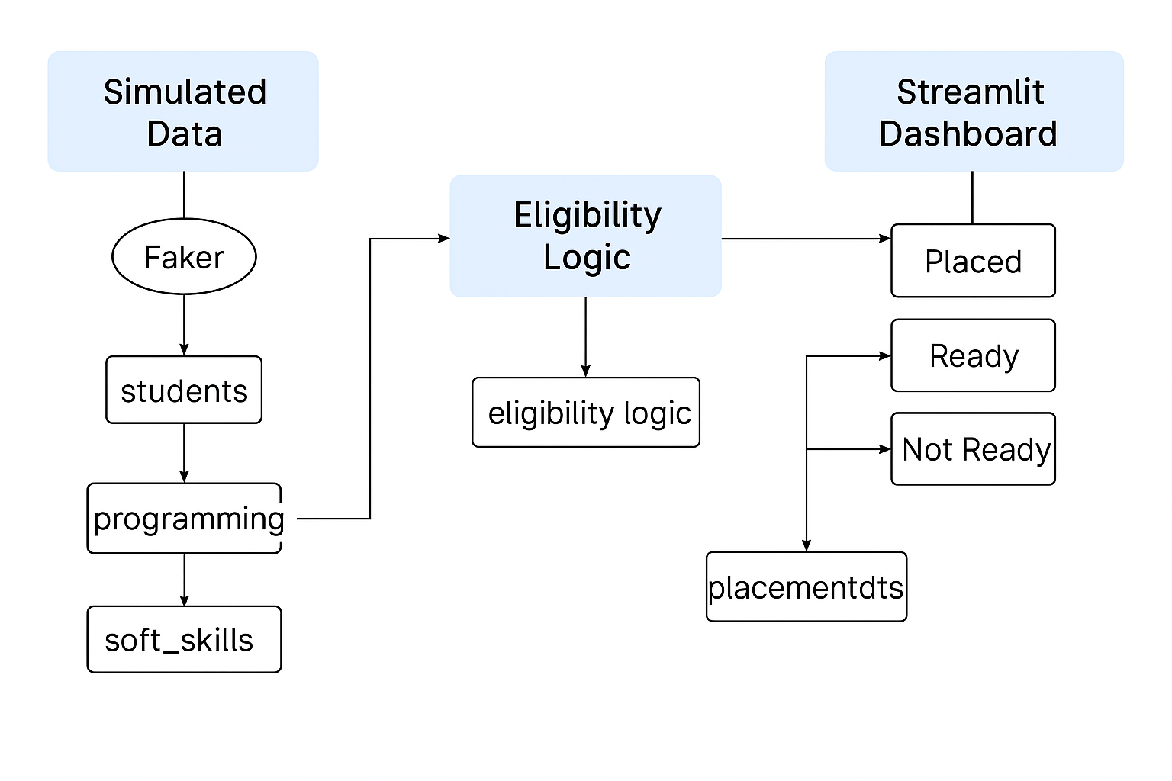
Flow Chart

Slide 3
Dashboard & Insights
📊 Dashboard Features:
- Student filters & batch-wise view
- Status: Placed / Ready / Not Ready
- Performance breakdown by skills
- Batch-level performance table
🧮 Eligibility Logic:
Weighted scores from programming, soft skills & interview
✅ Insights:
- Real-time tracking
- Top students & batches
- Visual status indicators

