Slide 1

QR MALL CONNECT:YOUR DIGITAL MALL GUIDE
SETHULAKSHMI K
MES24MCA-2050
Department of Computer Applications
MES College of Engineering, Kuttippuram
20/08/2025

Slide 2
PRODUCT OWNER Mrs.RESHMI K ASSISTANT PROFESSOR DEPARTMENT OF COMPUTER APPLICATIONS MES COLLEGE OF ENGINEERING, KUTTIPPURAM

Slide 3
TABLE OF CONTENTS
Introduction
Objective
Existing System
Proposed System
Motivation
Functionalities
Module Description
Developing Environment
Sprint Backlog
Product Backlog
User Story
Project Plans
Data Flow Diagrams
ER Diagram

Slide 4
1.INTRODUCTION
.QR-Based Access: Shoppers scan a single QR code to instantly access all product info, including prices, offers, and locations in the mall.
.User-Friendly: Built using HTML, CSS, JS (frontend), Python with Django (backend), and SQLite database, offering real-time product search.
.Simplifies finding particular product, saves time, and improves shopper satisfaction while enabling mall admins to manage and update store data easily. Users can share reviews, helping others make better shopping decisions.

Slide 5
2.OBJECTIVES
Provide instant access to product information through a single QR code scan
Quickly find products using the search function.
Allow real-time updates of product details, prices, and offers via an admin panel.
Reduce time and confusion for shoppers in locating products.
Enhance user experience with reviews.

Slide 6
3.EXISTING SYSTEM
Shoppers rely on mall directories, signboards, and manual assistance to find store locations.
Product details and pricing require physically visiting each store.
Offers and promotions are usually displayed on posters or brochures, which can be outdated.

Slide 7
4.PROPOSED SYSTEM
A QR-based digital mall guide for quick and easy access to product information.
Centralized online platform displaying product details, offers, and location in real time.
Search features to quickly find products, or floors.
Enhance user experience with reviews, and sharing options.

Slide 8
5.MOTIVATIONS
To simplify and speed up access to store information and offers inside malls.
To reduce confusion for shoppers by providing clear digital navigation.
To minimize manual effort in finding products, or offers.
To improve the overall shopping experience through instant, QR-based access.

Slide 9
6.FUNCTIONALITIES
QR Code Scanning – Shoppers scan a QR code placed at
mall locations to instantly access product details.
Special Offers & Discounts – Displays ongoing sales and
exclusive deals in real time.
.Share reviews to help other shoppers.

Slide 10
.Search Functionality – Enables quick search for
products within the mall.
Admin Panel – Mall management can update product
details, offers, easily.

Slide 11
7.MODULE DESCRIPTION
1.Admin Module
Login– Enables admins to securely log in and access management features.
Product Management – Admins can add, update, or delete product details such as name, price, rack no, floor and location.
Offer Management – Allows admins to create and manage offers or discounts linked to products.
Data Accuracy – Ensures that all product and offer information displayed to users is up-to-date.

Slide 12
2. User Module
QR Code Access – Users scan a single mall QR code to access the product information system.
Product Viewing – Displays product details including name, price and location.
Offer Viewing – Users can see current offers and discounts available on products.
Search – Allows users to quickly find products by entering product name.
Review Option – Users can add product reviews with their name and description (no login required).

Slide 13
8.DEVELOPING ENVIRONMENT
Operating System: Windows 10
Front End: HTML, CSS, JavaScript
Back End: Python (Django Framework)
Database: SQLite/MYSQL
Framework: Django
IDE / Code Editor: VS Code
QR Code Generation Library: Python qrcode

Slide 14
9.SPRINT PLAN
Backlog tem | Status And Completion Date | Original Estimation in Hours | Day 1 hrs | Day 2 hrs | Day 3 hrs | Day 4 hrs | Day 5 hrs | Day 6 hrs | Day 7 hrs | Day 8 hrs | Day 9 hrs | Day 10 hrs
SPRINT1
Abstract & Problem Statement | 06/08/2025 | 2 | 1 | 1 | 0 | 0 | 0 | 0 | 0 | 0 | 0 | 0
Literature Review | 15/08/2025 | 3 | 1 | 1 | 1 | 0 | 0 | 0 | 0 | 0 | 0 | 0
Requirement Analysis & Use Cases | 24/08/2025 | 3 | 1 | 1 | 1 | 0 | 0 | 0 | 0 | 0 | 0 | 0
SPRINT 2
UI Design | 02/09/2025 | 7 | 1 | 1 | 1 | 1 | 1 | 1 | 1 | 0 | 0 | 0
Tech Stack Documentation | 11/09/2025 | 7 | 1 | 1 | 1 | 1 | 1 | 1 | 1 | 0 | 0 | 0

Slide 15
SPRINT PLAN
Backlog tem | Status And Completion Date | Original Estimation in Hours | Day 1 hrs | Day 2 hrs | Day 3 hrs | Day 4 hrs | Day 5 hrs | Day 6 hrs | Day 7 hrs | Day 8 hrs | Day 9 hrs | Day 10 hrs
SPRINT3
Database Setup | 20/09/2025 | 7 | 1 | 1 | 1 | 1 | 1 | 1 | 1 | 0 | 0 | 0
Backend Coding | 29/09/2025 | 7 | 1 | 1 | 1 | 1 | 1 | 1 | 1 | 0 | 0 | 0
SPRINT 4
Feature Integration (QR + Search + Admin) | 08/10/2025 | 7 | 1 | 1 | 1 |  | 1 | 1 | 1 | 0 | 0 | 0
Testing & Final Report/PPT | 12/10/2025 | 7 | 1 | 1 | 1 | 1 | 1 | 1 | 1 | 0 | 0 | 0
TOTAL |  | 50 | 9 | 9 | 8 | 6 | 6 | 6 | 6

Slide 16
10.PRODUCT BACKLOG
ID | NAME | PRIORITY <high/medium/low> | ESTIMATE (Hours) | STATUS <Planned/In progress/Completed>
1 | PROJECT SETUP | High | 4 | IN PROGRESS
2 | DATABASE SETUP | High | 8 | IN PROGRESS
3 | LOGIN | High | 6 | IN PROGRESS
4 | QR CODE SCANNING | High | 6 | IN PROGRESS
5 | PRODUCT INFORMATION DISPLAY | MEDIUM | 10 | IN PROGRESS

Slide 17
G
ID | NAME | PRIORITY <high/medium/low> | ESTIMATE (Hours) | STATUS <Planned/In progress/Completed>
6 | SEARCH | High | 7 | IN PROGRESS
7 | ADMIN PANEL | High | 8 | IN PROGRESS
8 | UI DESIGN | High | 6 | IN PROGRESS
9 | INTEGRATION | High | 6 | IN PROGRESS
10 | SYSTEM TESTING AND DEBUGGING | MEDIUM | 4 | IN PROGRESS
Department of Computer Applications
17

Slide 18
11.USER STORY
User Story ID | As a type of User | I want to <Perform some task> | So that i can <Achieve Some Goal>
1 | ADMIN | Login securely | Manage mall data safely and prevent unauthorized access
2 | ADMIN | Add/Edit/Delete product information | Keep store details accurate and up-to-date
3 | ADMIN | Upload product listings and prices | Provide users with real-time product info
4 | ADMIN | Generate QR codes for mall entry points | Let users scan and instantly access product information.

Slide 19
User Story ID | As a type of User | I want to <Perform some task> | So that i can <Achieve Some Goal>
5 | USER | Scan a QR code at the mall entrance | Instantly get product information
6 | USER | Browse product names | Quickly find the type of product I need
7 | USER | Search for a product | Save time and avoid confusion while shopping
8 | USER | View product offers and promotions | Take advantage of discounts and deals

Slide 20
12.PROJECT PLAN
User Story ID | Task Name | Start Date | End Date | Hours | Status
1,2 | Sprint 1 | 06/08/2025 | 15/08/2025 | 10 | Completed
3 | Sprint 1 | 16/08/2025 | 19/08/2025 | 4 | Completed
4,5 | Sprint 2 | 23/08/2025 | 05/09/2025 | 14 | Completed
6,7 | Sprint 3 | 07/09/2025 | 20/09/2025 | 14 | Completed
8,9,10 | Sprint 4 | 24/09/2025 | 07/10/2025 | 14 | Completed

Slide 21
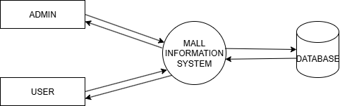
13.DATA FLOW DIAGRAM
LEVEL 0

Slide 22
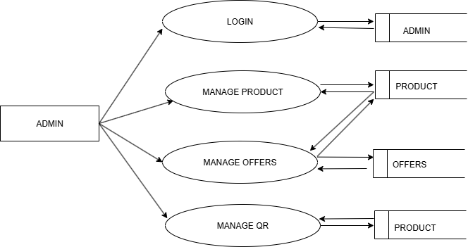
DATA FLOW DIAGRAM
Level 1.1

Slide 23
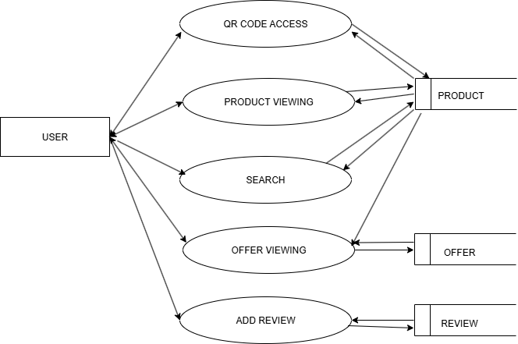
DATA FLOW DIAGRAM
Level 1.2

Slide 24
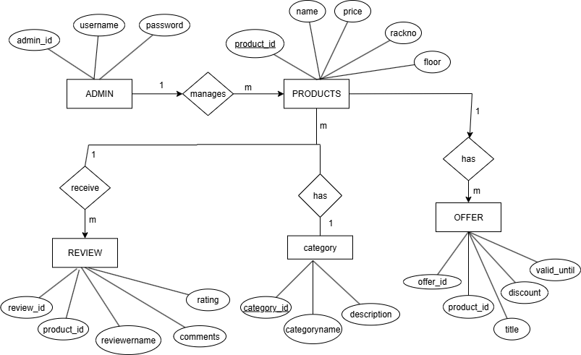
14.ER DIAGRAM

Slide 25
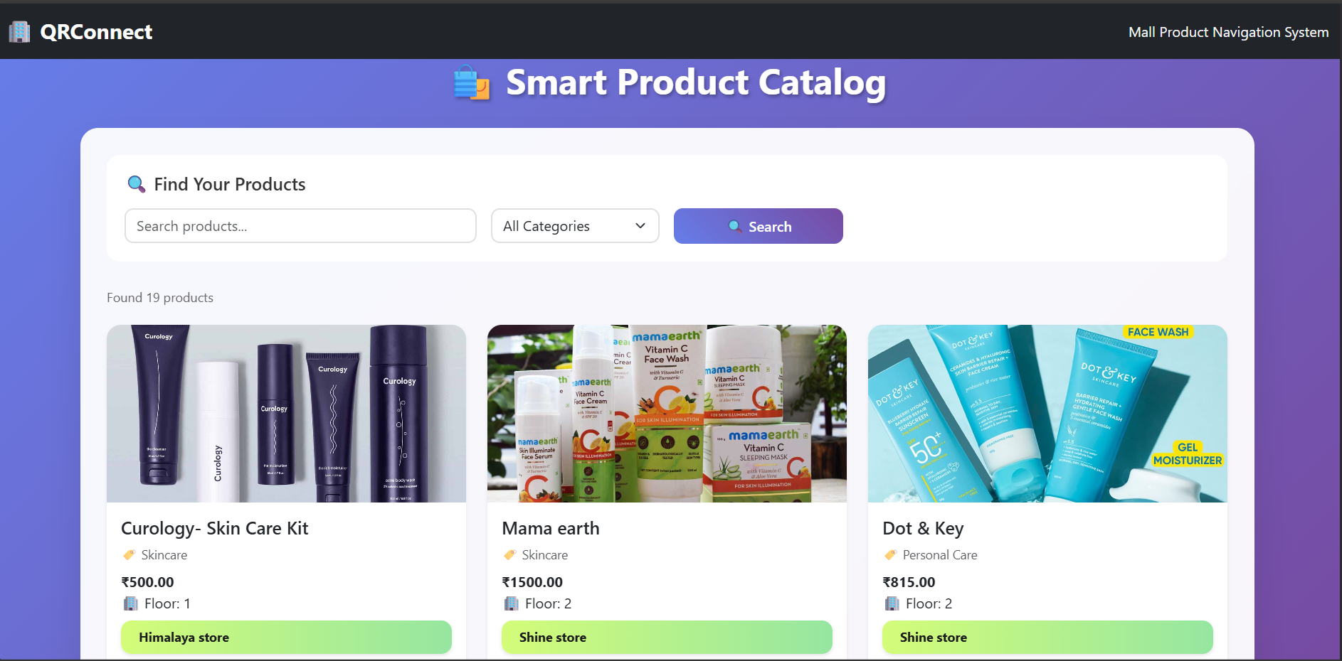
RESULTS
HomePage

Slide 26
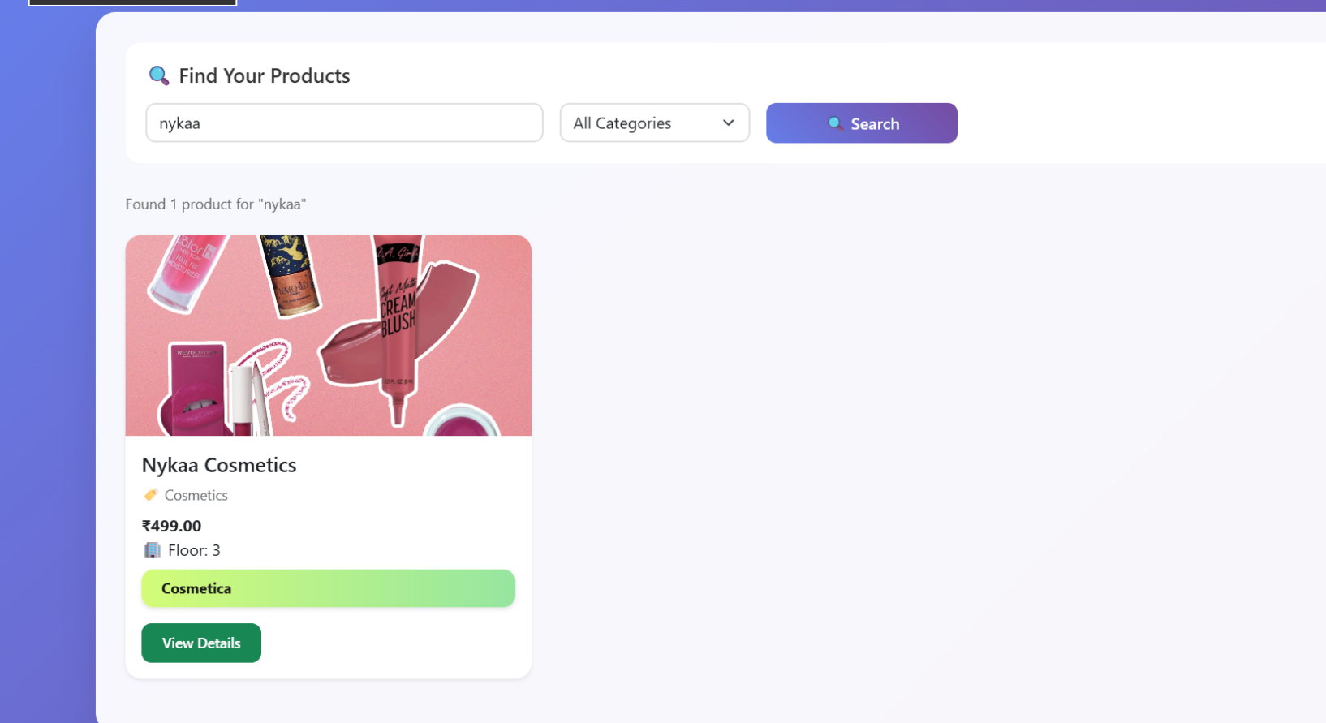
Search Option

Slide 27
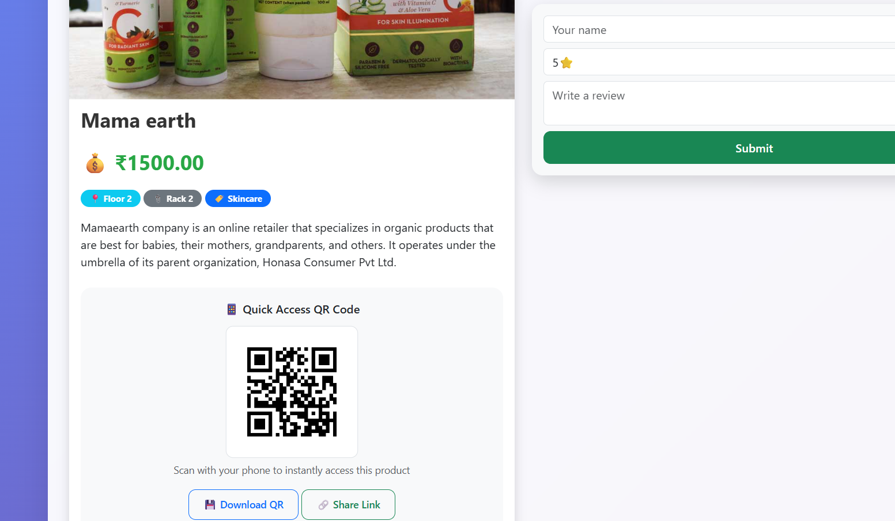
View Product Details

Slide 28
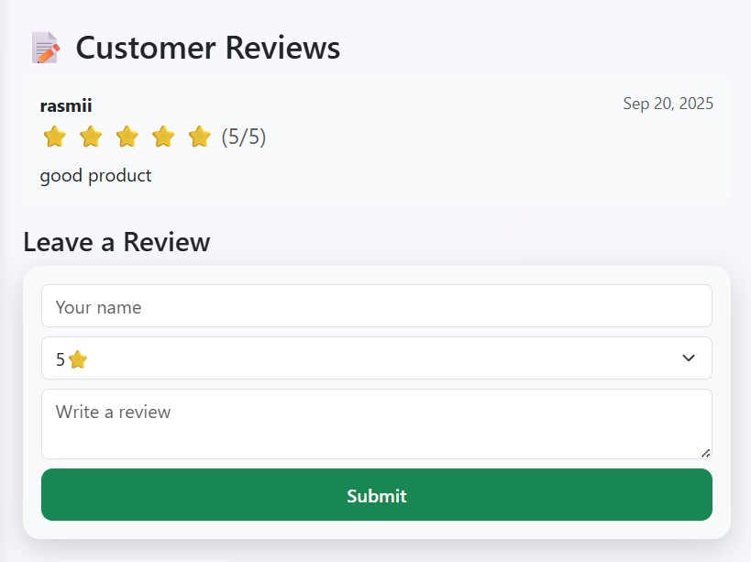
Review Option

Slide 29
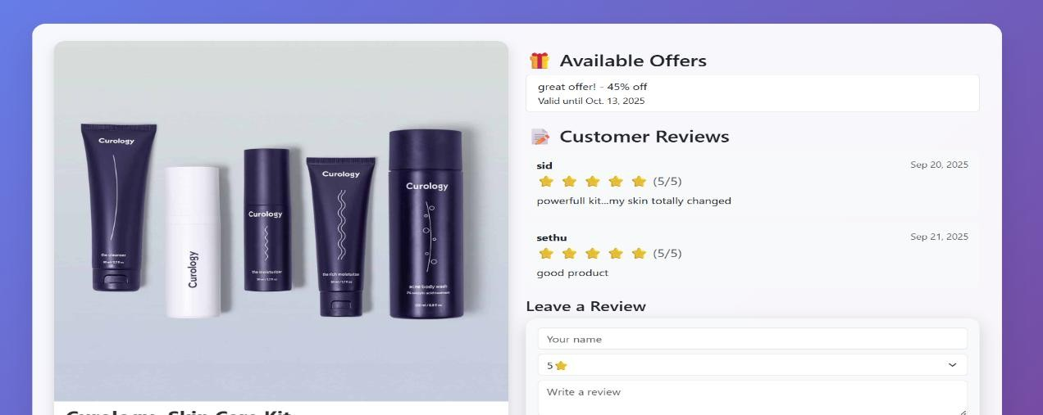
Available Offers

Slide 30
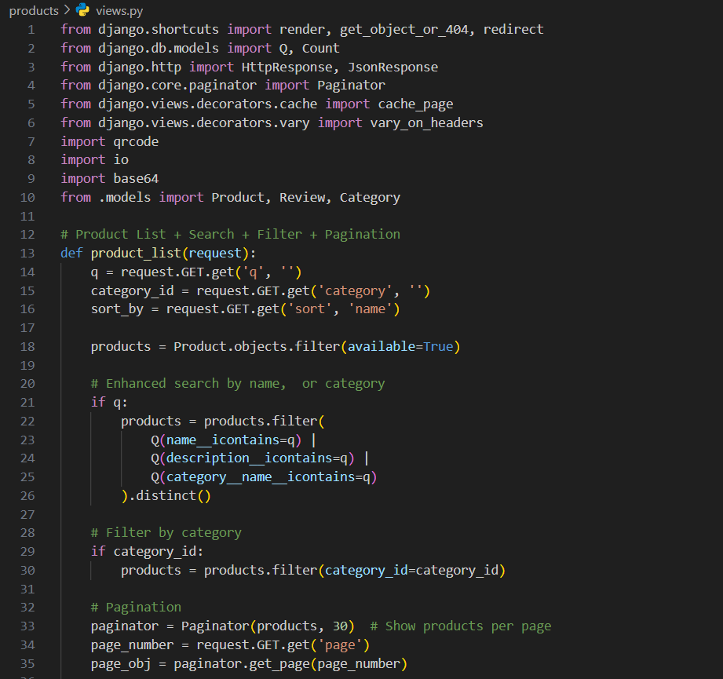
Source Code- Views.py

Slide 31
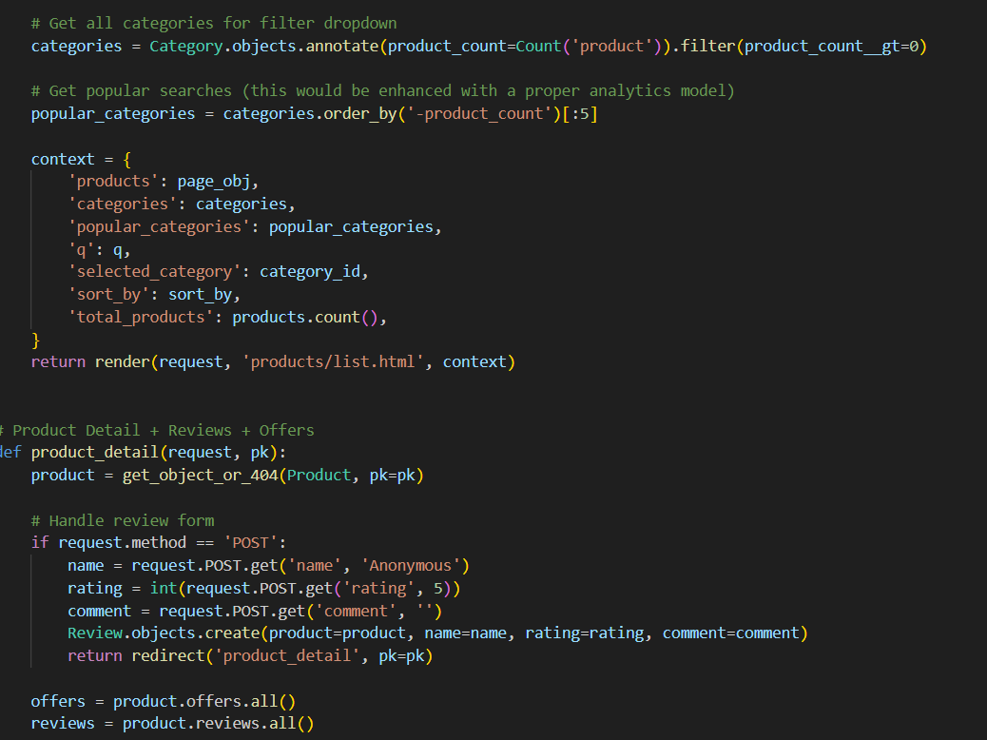

Slide 32
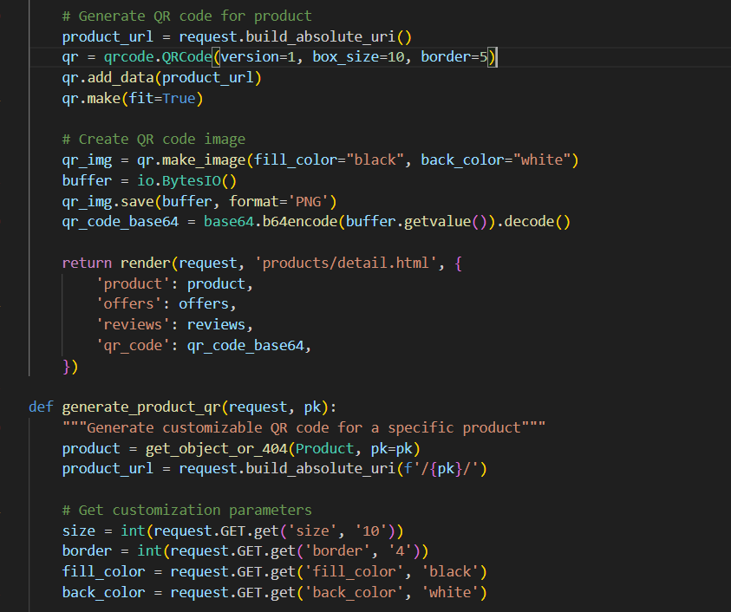

Slide 33
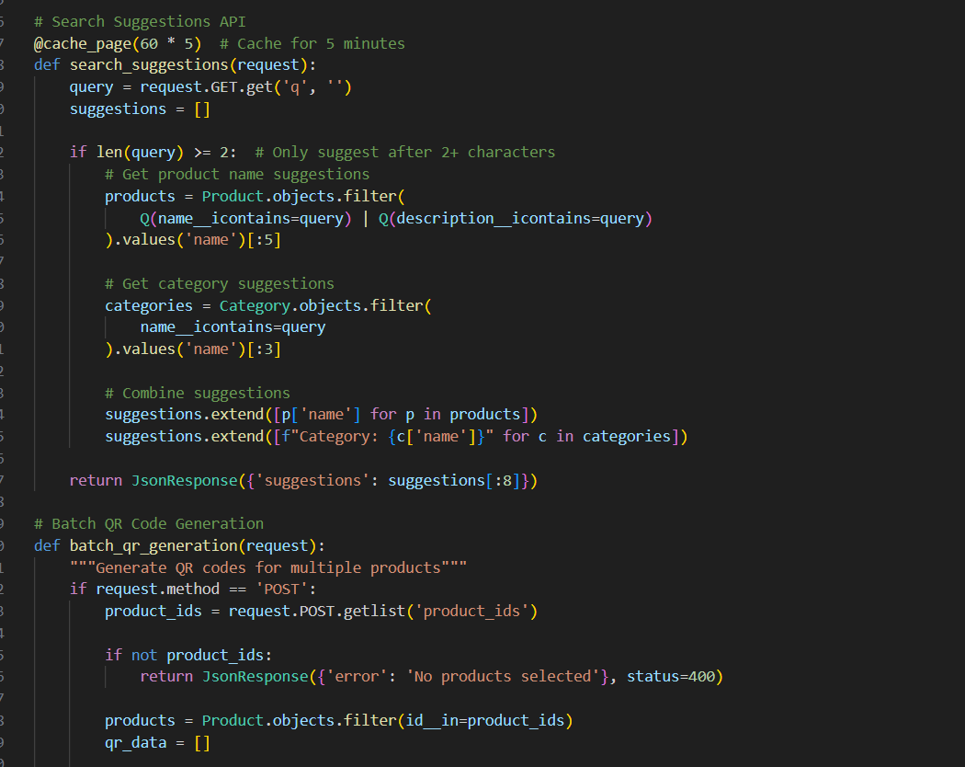

Slide 34
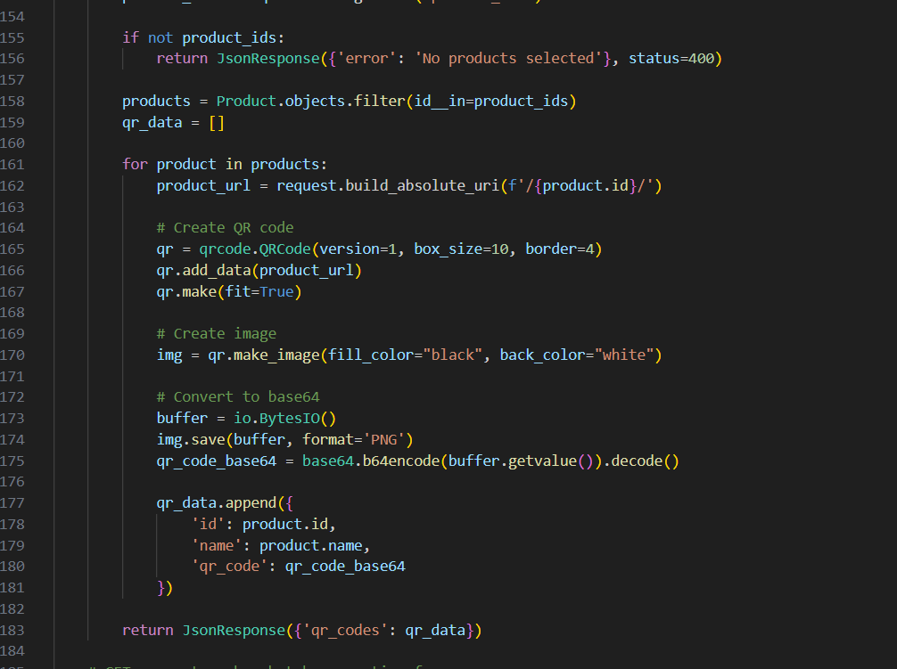
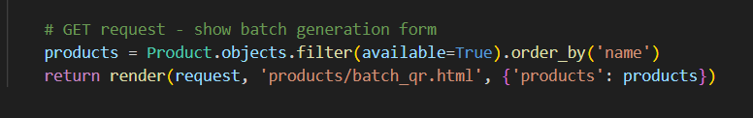

Slide 35
THANK YOU

