Slide 1
Capstone Project - 2
Supervised – ML – Bike Sharing Demand Prediction Team Members Sethupathy M Sri harish A

Slide 2
Contents
1) Addressing the problem statement
2) EDA
3) Feature Engineering
4) Preparing dataset for modelling
5) Applying Model
6) Model Validation
7) Feature Importance
8) Model Performance
9) Conclusion

Slide 3
Addressing the problem
The purpose of this project is to try a machine learning approach for predicting bike sharing demand in Seoul by given the hour, day, and information about the weather. This project contains: Exploratory data analysis, feature engineering, choosing appropriate features, cross algorithms, cross validation, tuning the algorithms, analysis of feature importance, analysis of model performance. The given dataset is from years 2017 and 2018. The predictions of future use could help for a better management of the service. Another point of view is to test the machine learning algorithms how good are at solving this problem.

Slide 4
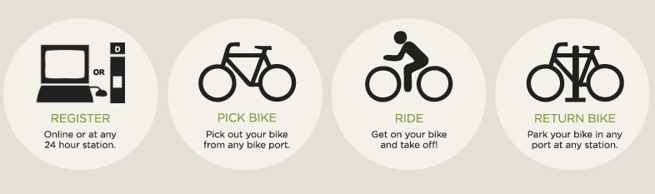
Addressing the problem
How Bike sharing works?
Step 1 : Register through bike share app or at any bike station.
Step 2 : Pick out your bike from any bike port.
Step 3 : Get on your bike and take off.
Step 4 : Park your bike in any port at any station.

Slide 5
Reasons bike sharing is beneficial:
• Reduces traffic congestion - Overall, traffic congestion costs reduces. - The average commuter spends 50 hours every year stuck in traffic. • Improving public health through exercise - The average person loses 13 lbs. their first year of commuting by bike. - At least 30 minutes of exercise is recommended at least 5 days a week. • Potentially reducing greenhouse gas emissions and air pollution - A short, four-mile round trip by bicycle keeps about 15 pounds of pollutants out of the air. - By 2032 traffic delays will more than double and CO2 emissions traced to congestion will reach 60 million tons.

Slide 6
Features Summary
Independent variables:
Date - year-month-day.
Hour - Hour of the day.
Temperature - Temperature in Celsius.
Humidity - Humidity in percentage.
Windspeed - Windspeed in m/s.
Visibility - Visibility in meters.
Dew point temperature - The dew point is the temperature at which air is saturated with water vapor.(Celsius)
Solar radiation - Solar radiation is the heat and light and other radiation given off by the Sun.(MJ/m2)
Rainfall – Rainfall in mm.

Slide 7
Features Summary (continued)
Independent variables:
Snowfall – Snowfall in cm
Seasons - Winter, Spring, Summer, Autumn
Holiday - Holiday/No holiday
Functional Day - NoFunc(Non Functional Hours), Fun(Functional hours)
Dependent variable:
Rented Bike count - Count of bikes rented at each hour.

Slide 8
Outliers
An outlier is an extremely high or extremely low data point relative to the nearest data point and the rest of the neighboring co-existing values in a data graph or dataset you're working with.
Ways to detect outliers:
Interquartile range
Box plot
Scatter plot
Z – score
In the given dataset we have used Box plot to detect outliers.

Slide 9
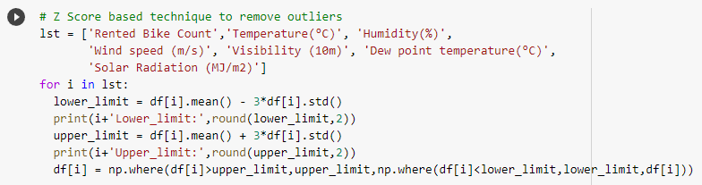
Outliers (continued)
Z–Score – To handle outliers.

Slide 10
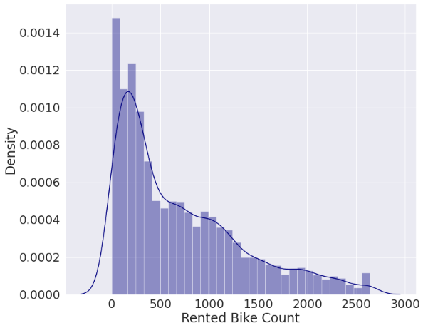
Exploratory Data Analysis (continued)
Distribution plot for dependent variable.

Slide 11
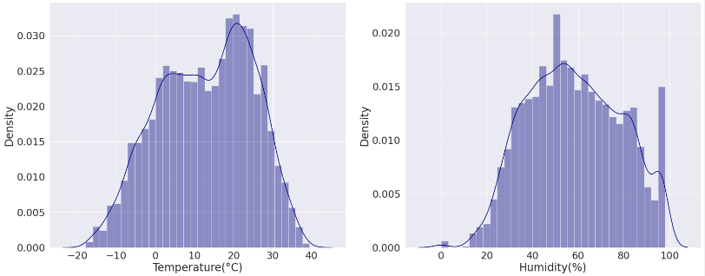
Exploratory Data Analysis
Distribution plot for independent variables.

Slide 12
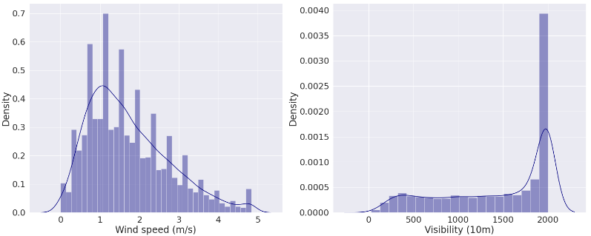
Exploratory Data Analysis (continued)
Distribution plot for independent variable.

Slide 13
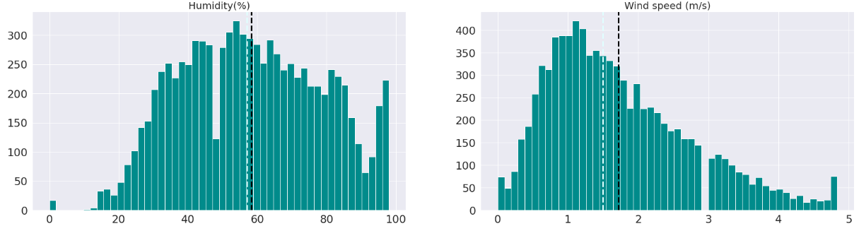
Exploratory Data Analysis (continued)
Mean and Median plot for independent variables.

Slide 14
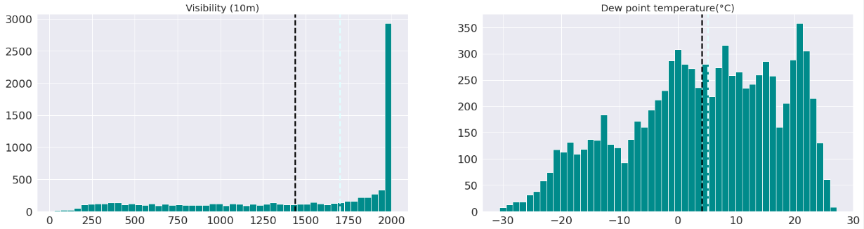
Exploratory Data Analysis (continued)
Mean and Median plot for independent variables.

Slide 15
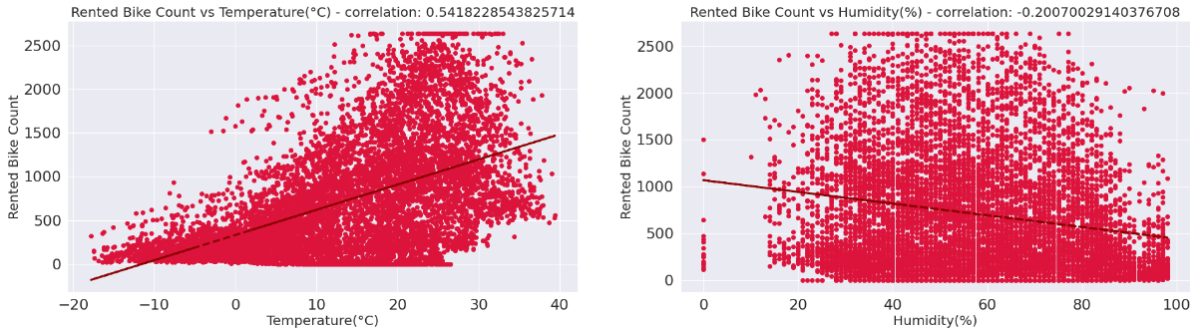
Exploratory Data Analysis (continued)
Scatter and Correlation plot for independent variables

Slide 16
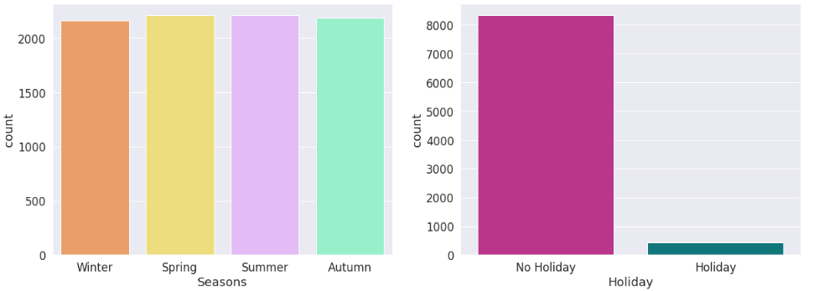
Exploratory Data Analysis (continued)
Count plot for independent categorical variables.

Slide 17
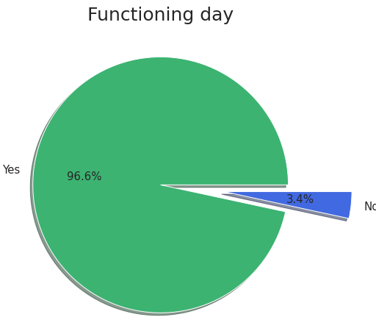
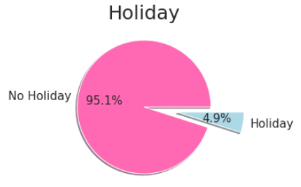
Exploratory Data Analysis (continued)
Pie chart for independent categorical variables

Slide 18
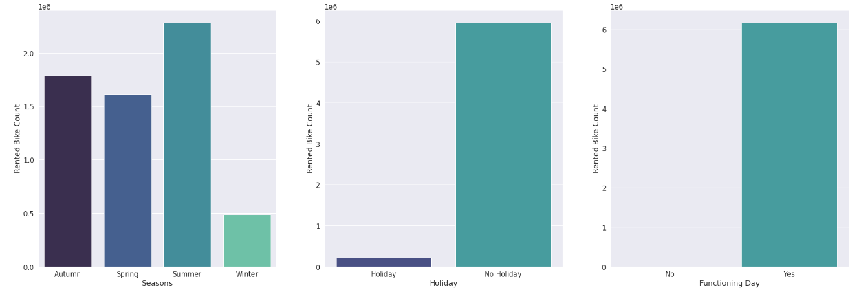
Exploratory Data Analysis (continued)
Sum plot for dependent variable.

Slide 19
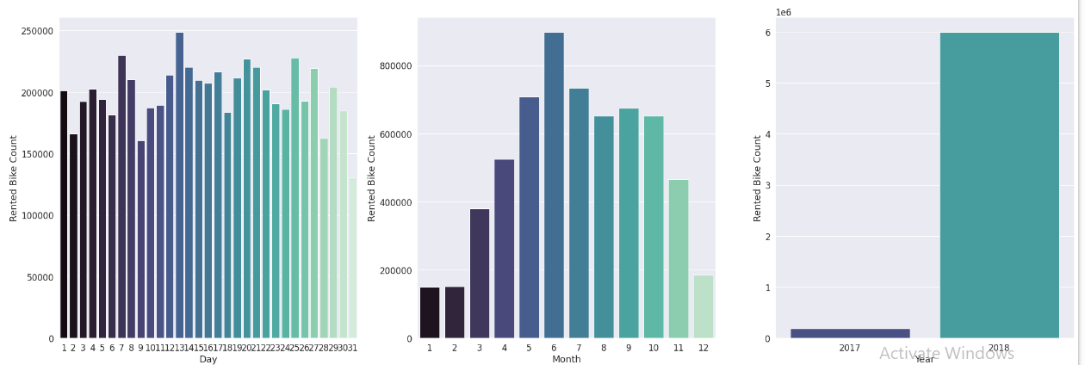
Exploratory Data Analysis (continued)
Sum plot for dependent variable.

Slide 20
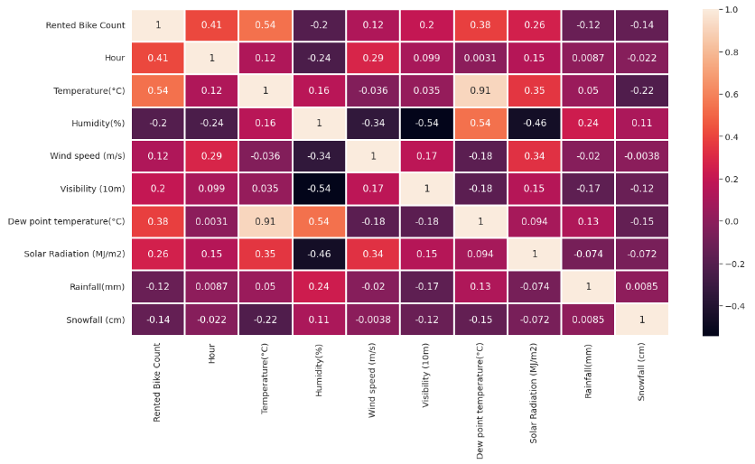
Exploratory Data Analysis (continued)
Multicollinearity

Slide 21
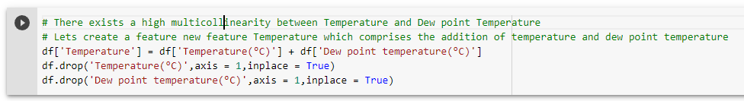
Feature Engineering
There exists a high multicollinearity between ’Temperature(^C)’ and ’Dew point Temperature(^C)’.
Lets create a new feature ’Temperature’ which comprises the addition of temperature and dew point temperature
Then remove the features ’Temperature(^C)’ and ’Dew point Temperature(^C)’ from the dataset.

Slide 22
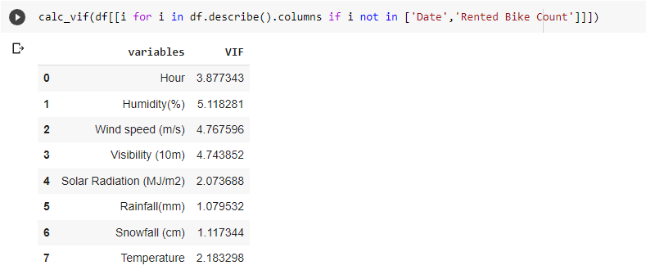
Feature Engineering (continued)
Variance Inflation Factor(VIF)
VIF measures the correlation and strength of correlation between the explanatory variables in a regression model

Slide 23
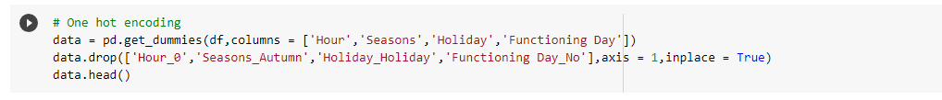
Feature Engineering (continued)
OneHotEncoder
The input to this transformer should be an array-like of integers or strings, denoting the values taken on by categorical (discrete) features.
This creates a binary column for each category and returns a sparse matrix or dense array (depending on the sparse parameter)

Slide 24
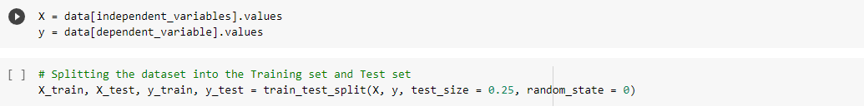
Preparing dataset for modelling
Train Test Split
Train test split is a model validation procedure that allows you to simulate how a model would perform on new/unseen data.
Train dataset: (6570, 35)
Test dataset: (2190, 35)

Slide 25
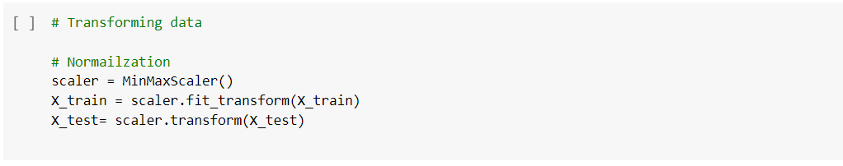
Preparing dataset for modelling
Normalization
Normalization in machine learning is the process of translating data into the range [0, 1] or simply transforming data onto the unit sphere.

Slide 26
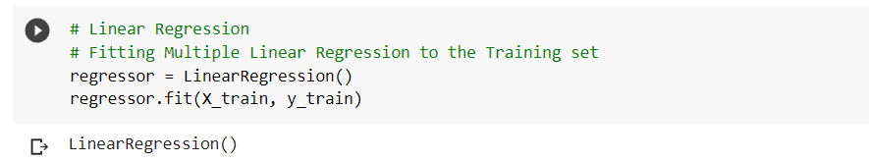
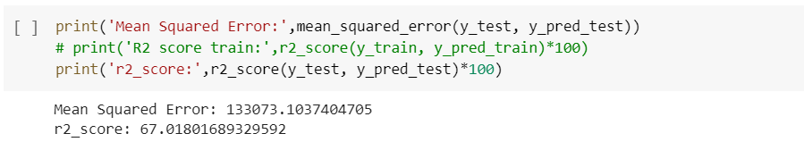
Applying Model
Linear Regression
Model Validation

Slide 27
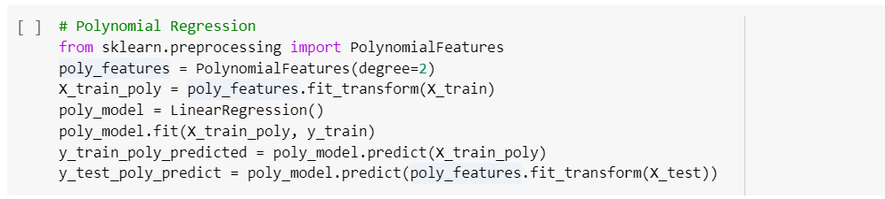
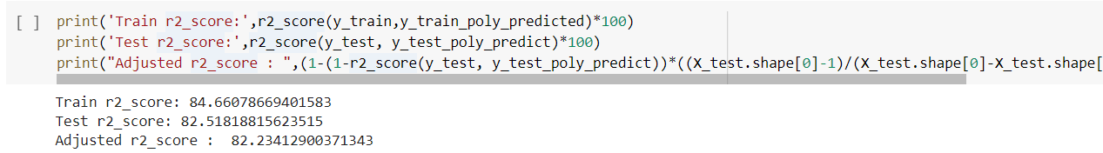
Applying Model (continued)
Polynomial Regression
Model Validation

Slide 28
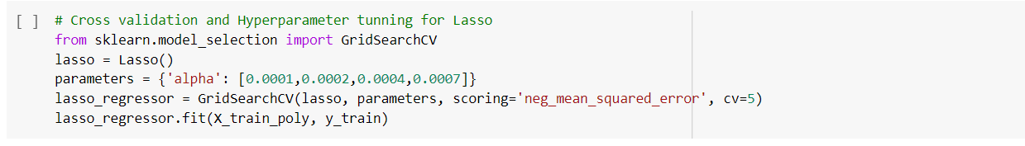
Applying Model (continued)
Lasso Regression
Model Validation

Slide 29
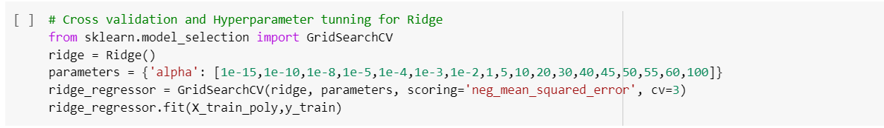
Applying Model (continued)
Ridge Regression
Model Validation

Slide 30
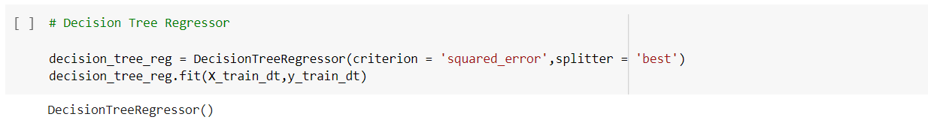
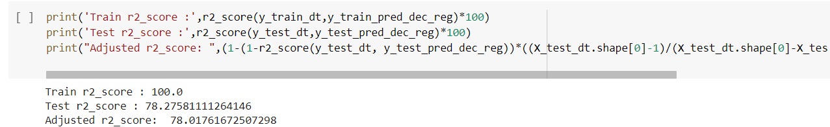
Applying Model (continued)
Decision Tree
Model Validation

Slide 31
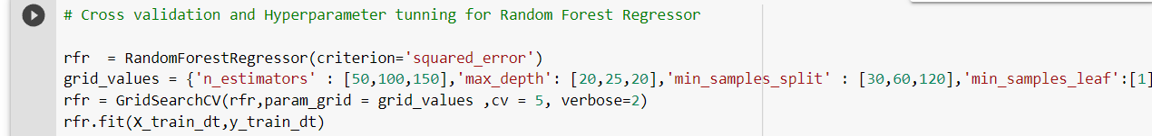
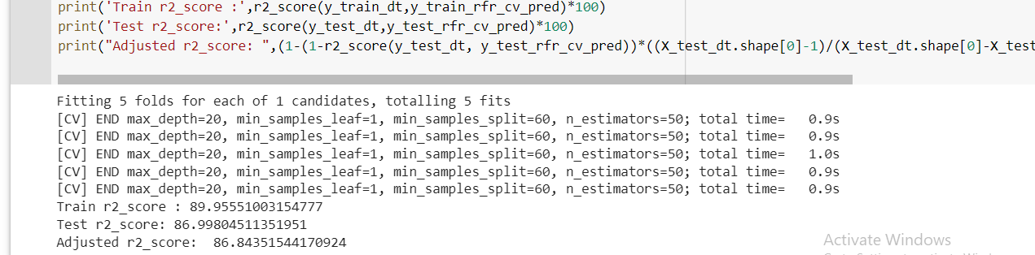
Applying Model (continued)
Random Forest Regressor
Model Validation

Slide 32
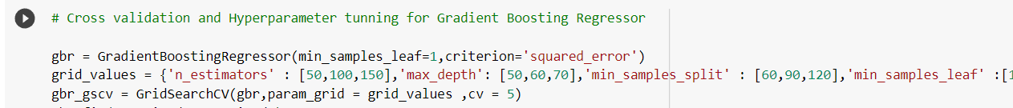
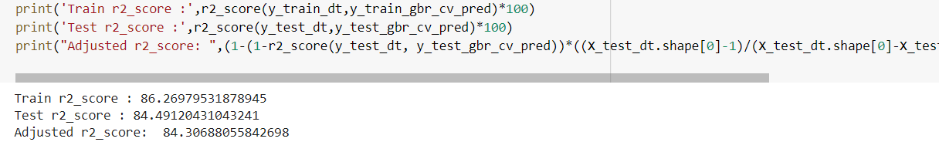
Applying Model (continued)
Gradient Boost Regressor
Model Validation

Slide 33
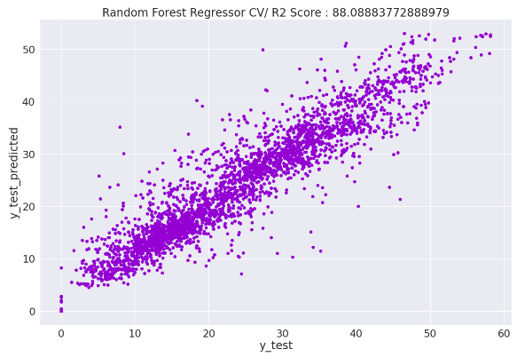
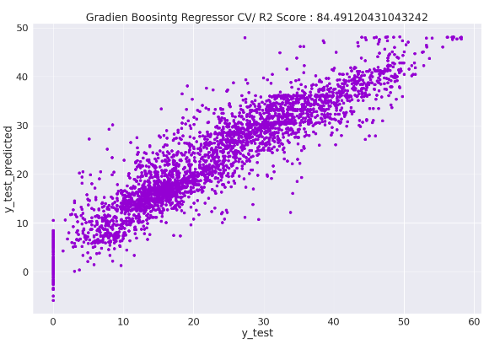
Applying Model (continued)
Visual representation of Decision Tree model's prediction
Random Forest Regressor Gradient Boost Regressor

Slide 34
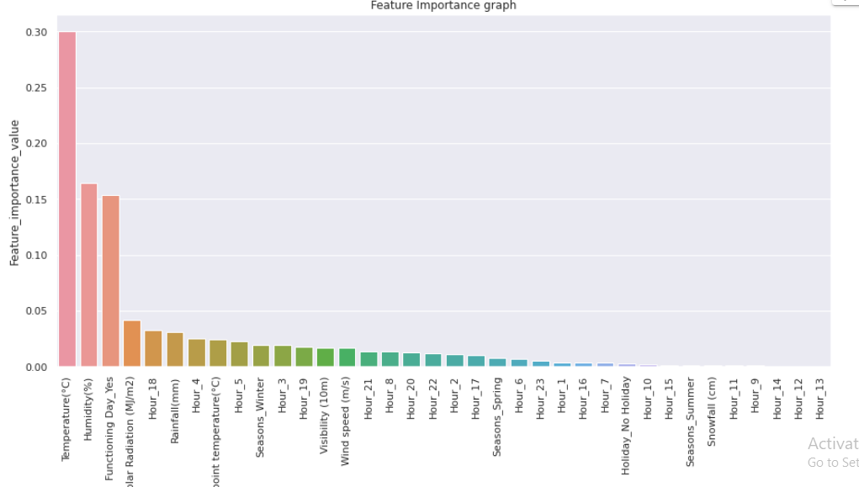
Feature Importance

Slide 35
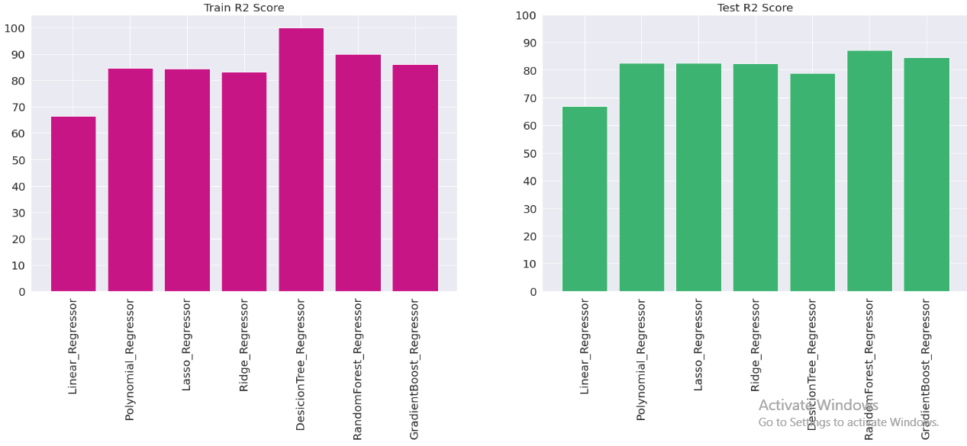
Model Performance
Visualization of model score

Slide 36
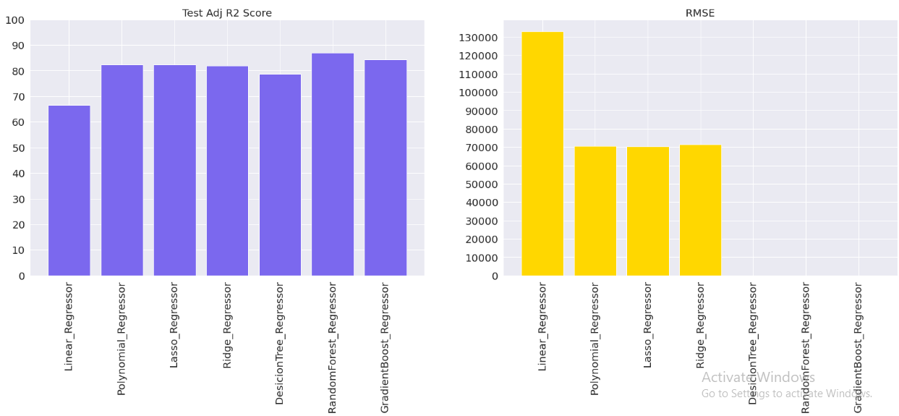
Model Performance (continued)
Visualization of model score

Slide 37
Conclusion
It’s quite obvious that most Bikes are rented during Summer season.
And the least number of bikes are rented during Winter season.
By using simple Polynomial Regressor algorithms we were able to get the R2 score of 82.5 percent.
Very little improvement in R2 score after using Lasso and Ridge with cross validation and hyper parameter tunning.
By using simple Decision Tree algorithm, we couldn’t get the desired results as over fitting occurred.
We got the best R2 score of 87 percent using Random Forest Regressor with cross validation and hyper parameter tunning.
Top five most important features are Temperature, Humidity, Functioning day, Solar Radiation, Hour_18.

Slide 38
Conclusion
For the given dataset, Random Forest Regressor has proven to be the best fit model with,
Train r2 score : 90 %
Test r2 score : 87%
Test Adj r2 score : 86.9%
Test RMSE : 19.88

Slide 39
Thank you

