Slide 1
Capstone Project - 3
Supervised – ML – Cardiovascular Risk Prediction Sri Harish A Sethupathy M

Slide 2
Contents
1) Addressing the problem statement
2) EDA
3) Feature Engineering
4) Feature Selection
5) Preparing dataset for modelling
6) Applying Model
7) Model Validation
8) Model Performance
9) Conclusion

Slide 3
Addressing the problem
The purpose of this project is to try a machine learning approach for Cardiovascular Risk Prediction by given the id, sex, and information about the health condition of the person. This project contains: Exploratory data analysis, feature engineering, choosing appropriate features, cross algorithms, cross validation, tuning the algorithms, analysis of feature importance, analysis of model performance. The predictions of future could help for saving a person’s life and could help them to get rid off unhealthy habits. Another point of view is to test the machine learning algorithms how good are at solving this problem.

Slide 4

Addressing the problem
How Cardiovascular Heart Disease Risk Prediction helps?
Cardiovascular disease is the leading cause of death worldwide and a major public health concern. Therefore, its risk assessment is crucial to many existing treatment guidelines.
Risk estimates are also being used to predict the magnitude of future cardiovascular disease mortality and morbidity at the population level and in specific subgroups to inform policymakers and health authorities about these risks. Additionally, risk prediction inspires individuals to change their lifestyle and behavior and to adhere to medications.

Slide 5
Why CHD Risk prediction is important?
The disease is caused when the heart's blood vessels, the coronary arteries, become narrowed or blocked and can't supply enough blood to the heart. This can cause a heart attack or angina. The good news is that if we tackle these risk factors, we can reduce our numbers of people developing heart disease.
By CHD risk prediction, we can analyze the risk factors which are contributing more to develop a heart disease.
The ability to predict risk for and from cardiovascular disease is increasingly important for several reasons. Perhaps foremost among these is the need to determine individual risk to better plan investigation and management with the greatest accuracy and safety for patients and lowest costs for the health care system. This will be even more important as personalized medicine becomes more widespread.

Slide 6
Features Summary
Independent variables:
Id – Unique identification number for each patient.
Age – Age of the patient(Continuous).
Education – Educational qualification of the patients(ordinal).
Sex – Male or Female(‘M’ or ’F’).
Is_smoking – Whether or not the patient is a current smoker(Binary).
CigsPerDay – The number of cigarettes that the patient smoked on average in one day(Continuous).
BPMeds – Whether or not the patient was on blood pressure medication(Nominal).
prevalentStroke – Whether or not the patient previously had a stroke(Nominal).

Slide 7
Features Summary (continued)
Independent variables:
prevalentHyp – Whether or not the patient was hypertensive(Nominal).
Diabetes – Whether or not the patient had diabetes(Nominal).
Tot_Chol – Total Cholesterol level(Continuous).
Sys_BP – Systolic blood pressure(Continuous).
Dia_BP – Diastolic blood pressure(Continuous).
BMI – Body Mass Index(Continuous).
Heart rate – The speed at which the heart beats(Continuous).
Glucose – Glucose level in blood(Continuous).
Dependent variable:
TenYearCHD – Whether the patient will develop a risk of Cardiovascular Disease in a 10 years(Binary).
.

Slide 8
Outliers
An outlier is an extremely high or extremely low data point relative to the nearest data point and the rest of the neighboring co-existing values in a data graph or dataset you're working with.
Ways to detect outliers:
Interquartile range
Box plot
Scatter plot
Z – score
In the given dataset we have used Box plot to detect outliers.

Slide 9
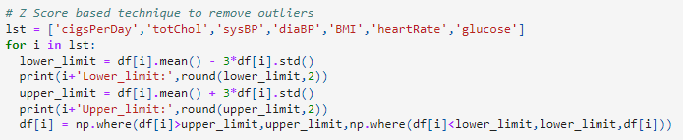
Outliers (continued)
Z–Score – To handle outliers.

Slide 10
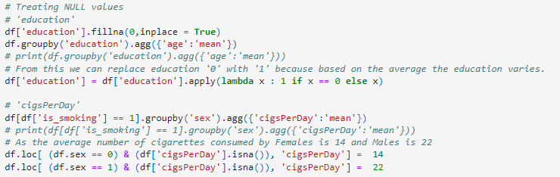
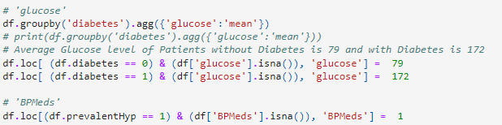
NULL value treatment
Null values are imputed with most closest value as possible by grouping features

Slide 11
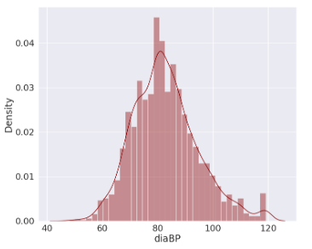
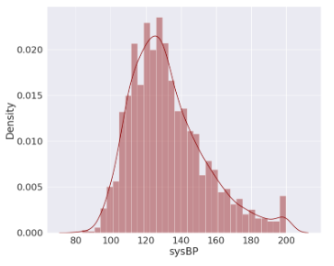
Exploratory Data Analysis
Distribution plot for Numeric independent variable.

Slide 12
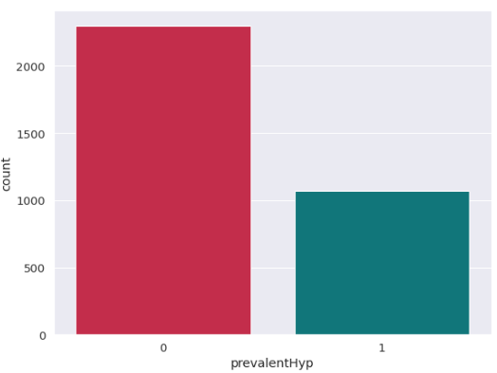
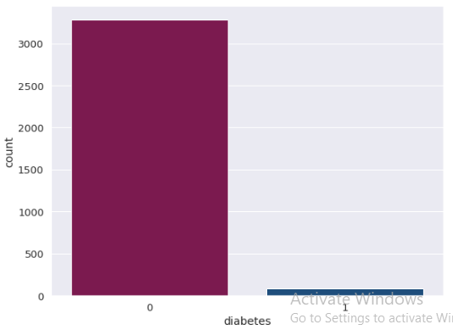
Exploratory Data Analysis (continued)
Count plot for Categorical independent variables.

Slide 13
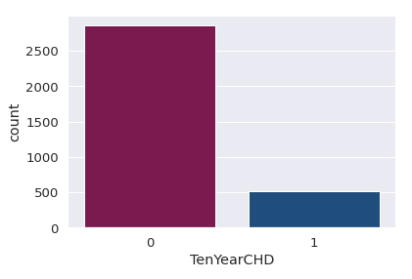
Exploratory Data Analysis (continued)
Count plot for dependent variable.
Data Imbalance:
From this we could clearly see
the data imbalance.

Slide 14
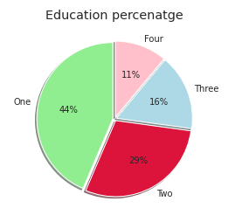
Exploratory Data Analysis (continued)
Pie chart for Categorical independent variable

Slide 15
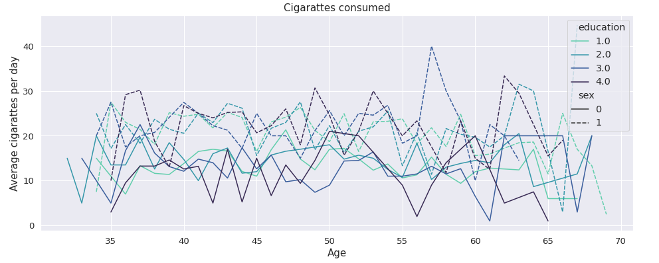
Exploratory Data Analysis (continued)
Line plot for Cigarettes consumption

Slide 16
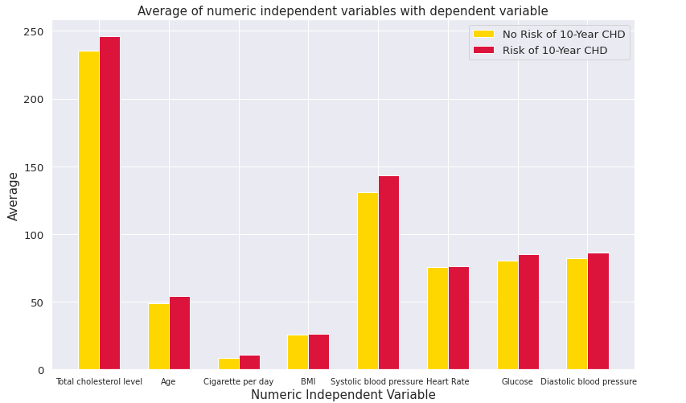
Exploratory Data Analysis (continued)
Bar plot for comparison between patients with and without risk of CHD.

Slide 17
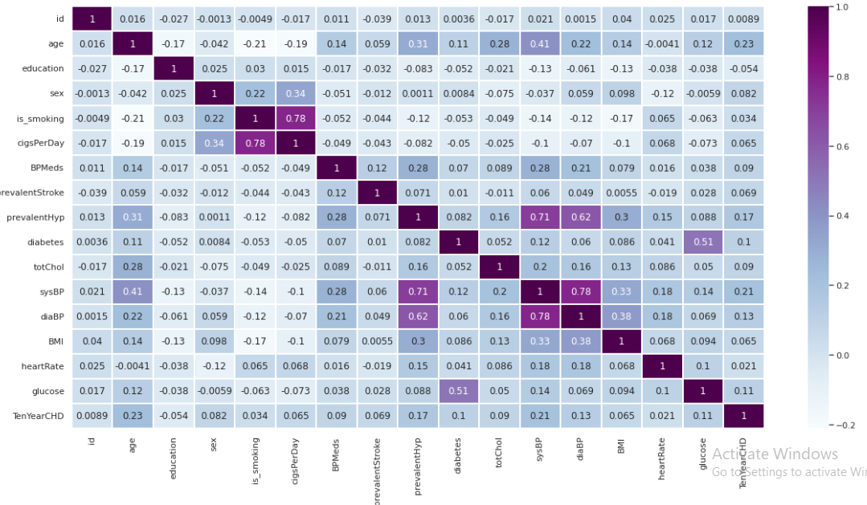
Exploratory Data Analysis (continued)
Multicollinearity

Slide 18

Feature Engineering
The Metric Trap
One of the major issues when dealing with unbalanced datasets relates to the metrics used to evaluate their model. Using simpler metrics like accuracy score can be misleading. In a dataset with highly unbalanced classes, the classifier will always “predict” the most common class without performing any analysis of the features and it will have a high accuracy rate, obviously not the correct one.
Imbalance in our dataset

Slide 19
Feature Engineering (continued)
To encounter imbalance dataset following sampling techniques are used:
Random Over Sampling
Randomly duplicate examples in the minority class.
Random Under Sampling
Randomly delete examples in the majority class.
Synthetic Minority Oversampling Technique (SMOTE)
New examples are synthesized from the existing examples. This is a type of data augmentation for the minority class.
SMOTETomek
A hybrid method which is a mixture of under-sampling method (Tomek) with an oversampling method (SMOTE).

Slide 20
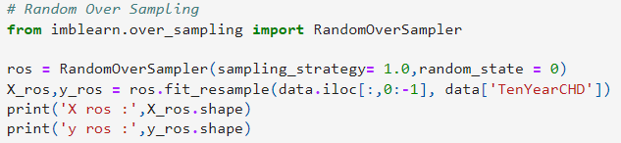
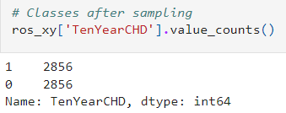
Feature Engineering (continued)
For our dataset Random Over Sampling is found to be effective.

Slide 21
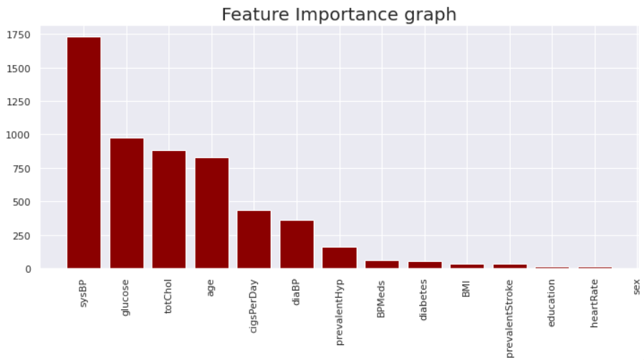
Feature Engineering (continued)
Feature Selection

Slide 22
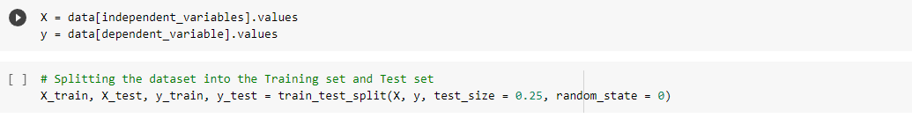
Preparing dataset for modelling
Train Test Split
Train test split is a model validation procedure that allows you to simulate how a model would perform on new/unseen data.
X_train: (2523, 15)
X_test : (842, 15)
y_train : (2523, 1)
y_test : (842, 1)

Slide 23
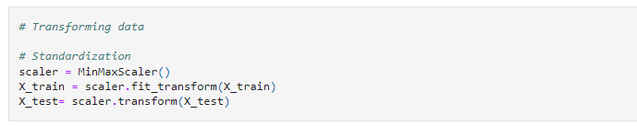
Preparing dataset for modelling
Standardization
Standardizing a dataset involves rescaling the distribution of values so that the mean of observed values is 0 and the standard deviation is 1.

Slide 24
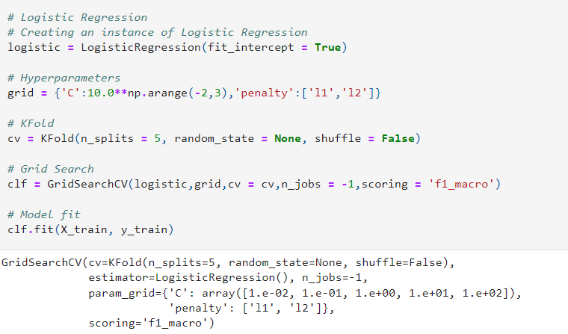
Applying Model
Logistic Regression

Slide 25
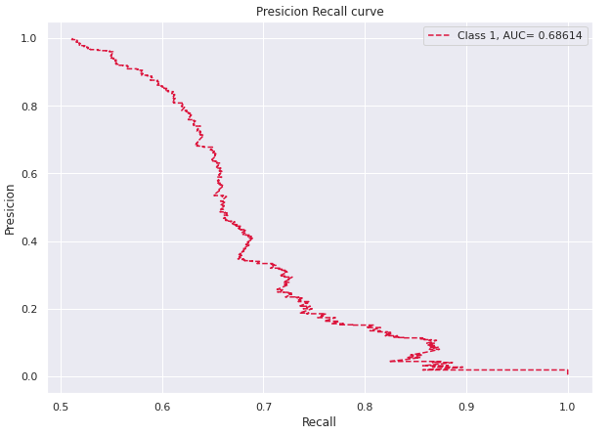
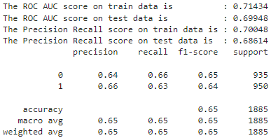
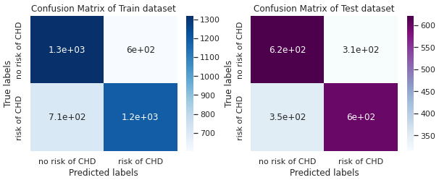
Applying Model
Model Validation(Logistic regression)

Slide 26
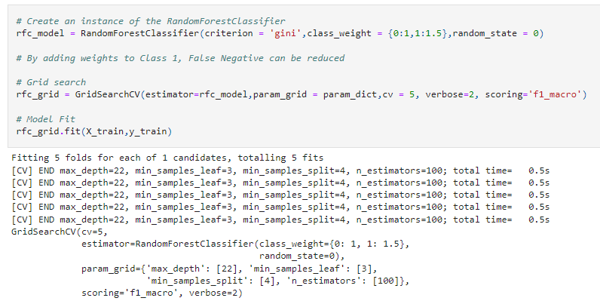
Applying Model (continued)
Random Forest Classifier

Slide 27
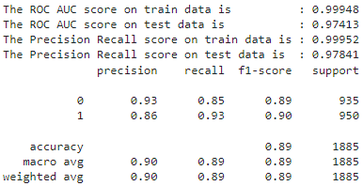
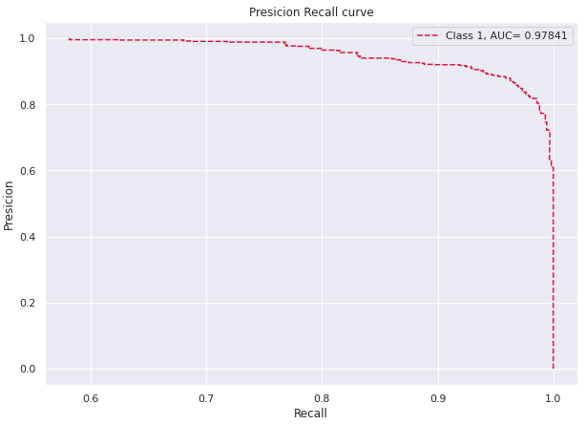
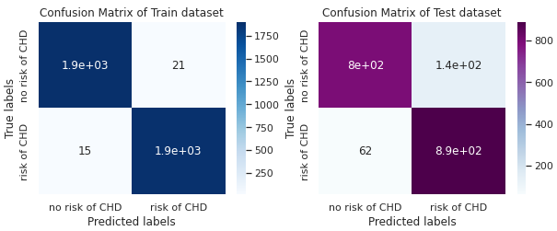
Applying Model (continued)
Model Validation(Random forest classifier)

Slide 28
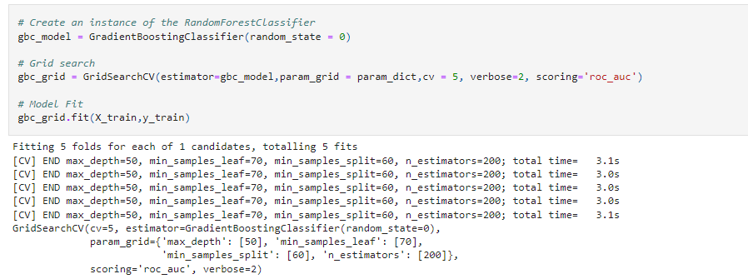
Applying Model (continued)
Gradient Boost Classifier

Slide 29
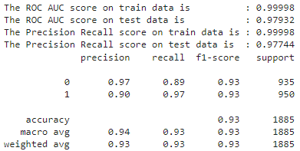
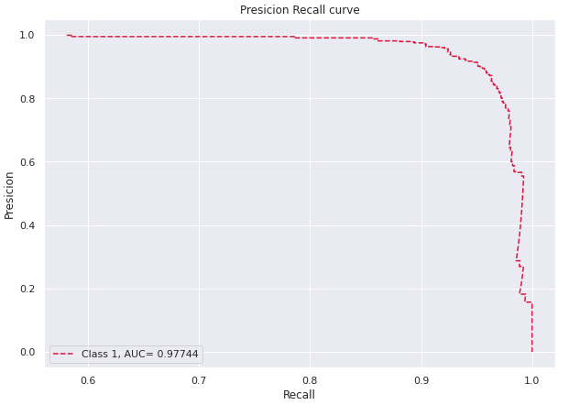

Applying Model (continued)
Model Validation(Gradient Boost classifier)

Slide 30
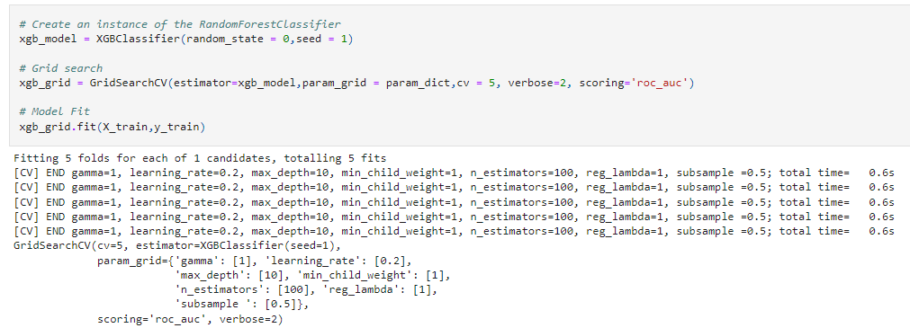
Applying Model (continued)
XGB Classifier

Slide 31
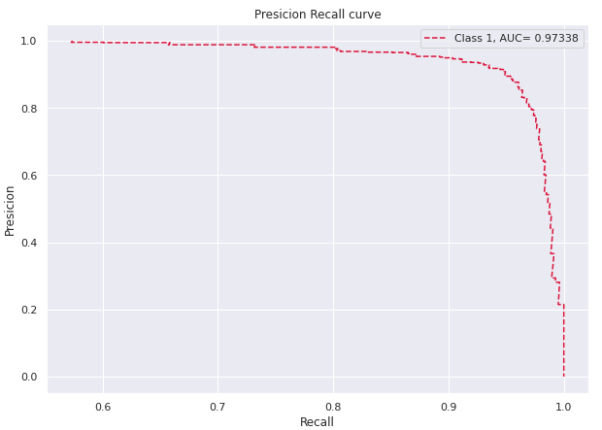
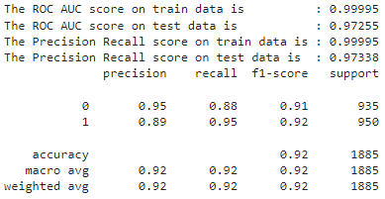
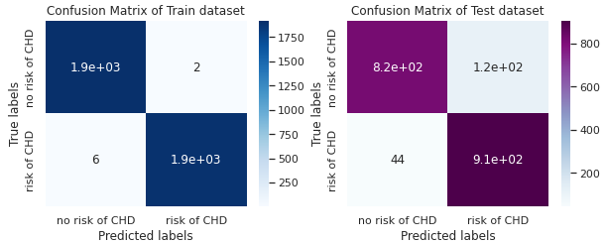
Applying Model (continued)
Model Validation(XGB Classifier)

Slide 32
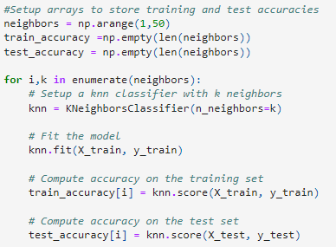
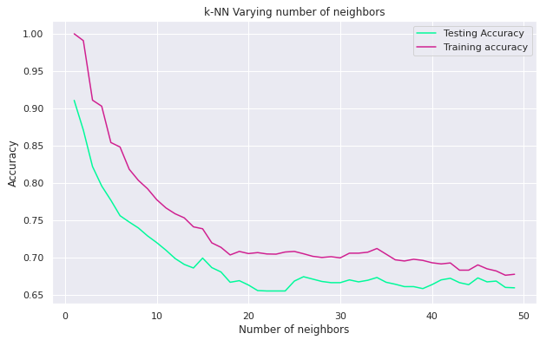
Applying Model (continued)
KNNeighbors Classifier

Slide 33
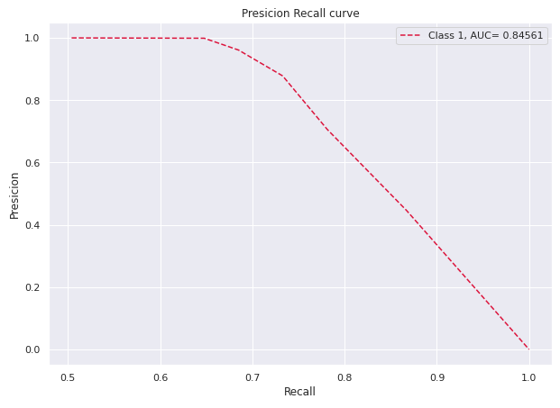
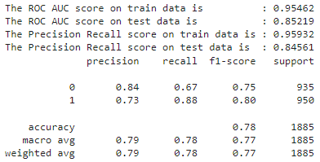
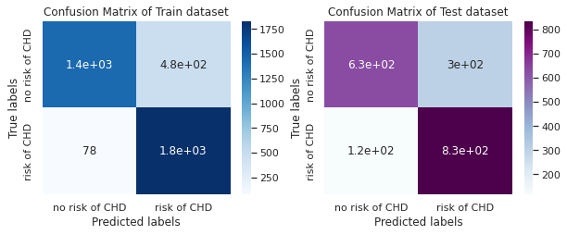
Applying Model (continued)
Model Validation(KNNeighbors Classifier)

Slide 34
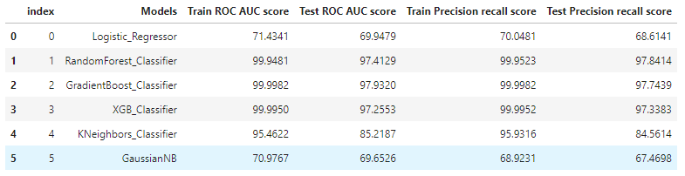
Model Performance
Used model’s scores

Slide 35
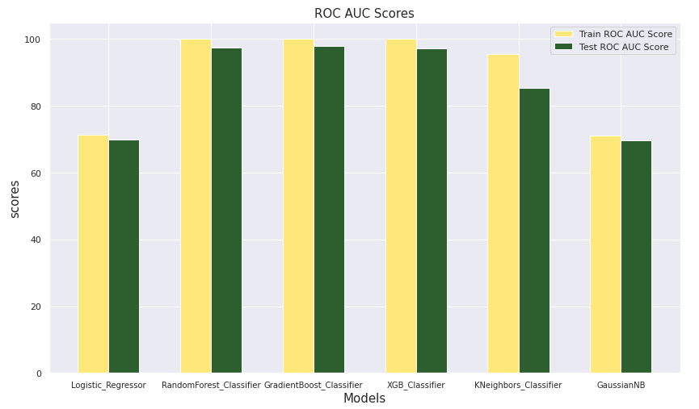
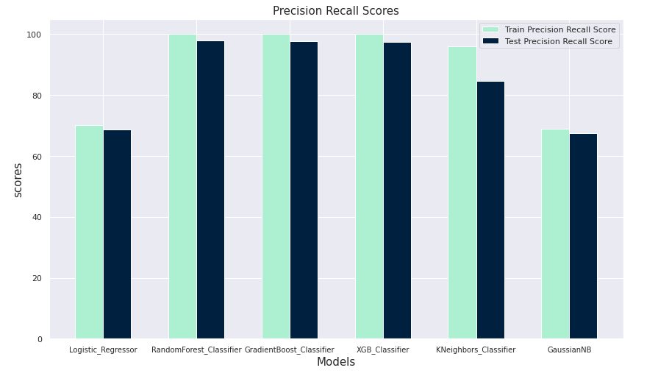
Model Performance (continued)
Visualization of model scores

Slide 36
Conclusion
It’s quite obvious that smokers have a high risk of 10 year CHD.
Patients with no history of hypertensive, stroke, diabetes have less risk of 10 year CHD.
By using simple Logistic Regressor algorithm we were able to get the Precision Recall AUC score of 68 %
Very little improvement in Precision Recall AUC score after using Random Forest classifier because of data imbalance.
Data Imbalance is addressed by Random Over sampling technique..
We got the best Precision Recall AUC score of 97.8 percent using Random Forest Classifier with cross validation and hyper parameter tunning.
Top five most important features are SysBP,Glucose ,Totchol,age,Cigsperday

Slide 37
Conclusion
For the given dataset, Random Forest Classifier has proven to be the best fit model with,
Train Precision Recall AUC score : 99.9 %
Test Precision Recall AUC score : 97.8%
Train ROC AUC score : 99.9 %
Test ROC AUC score : 97.4%

Slide 38
Thank you

