Slide 1
Capstone Project - 4
Unsupervised – ML – Zomato Restaurant Clustering and Sentiment Analysis Sri Harish A Sethupathy M

Slide 2
Contents
1) What is Zomato?
2) How Zomato works?
3) Zomato funds and stats
4) Zomato business model
5) Addressing the problem
6) Feature summary
7) EDA
8) Text Pre-processing
9) Clustering
10) KMeans Clustering
11) DBSCAN Clustering
12) Sentiment Analysis
13) Conclusion

Slide 3

What is ?
Zomato is one of the most comprehensive and user-friendly apps where people can search for nearby restaurants and cafe's, order food online, and get it delivered at their doorstep in no time. Moreover, you can also get accurate information about restaurants as it provides menus, reviews, and ratings. Based on that, users can place orders and enjoy lip-smacking food at their homes.
Zomato was founded by Deepinder Goyal and Pankaj Chaddah, two Delhi IIT graduates, in 2008. Till November 2010, Zomato was known as “Foodiebay.” Once they saw their colleagues who were seeking menus of different restaurants to order food. That’s when the idea took birth, and they thought of converting these manual menus into a digital format. In the year 2012, Zomato had spread its wings across the globe and started to list out the number of restaurants in the market.

Slide 4

How works ?
The main work of Zomato is to suggest local and nearby restaurants to users and receive orders from them. Users can place orders from their favorite restaurant based on ratings and reviews shared by previous customers.
Step 1:From the desiccated app solution or website, users can explore various restaurants and order meals. Step 2: Particular restaurant owners receive
an order request and start preparing a meal. Step 3: Once the food is ready to dispatch,
it will be handed over to delivery providers. Step 4: Delivery providers deliver the meal
to the customer’s preferred location. Step 5: From the given payment options, customers can make payments and share reviews based on their experience.

Slide 5
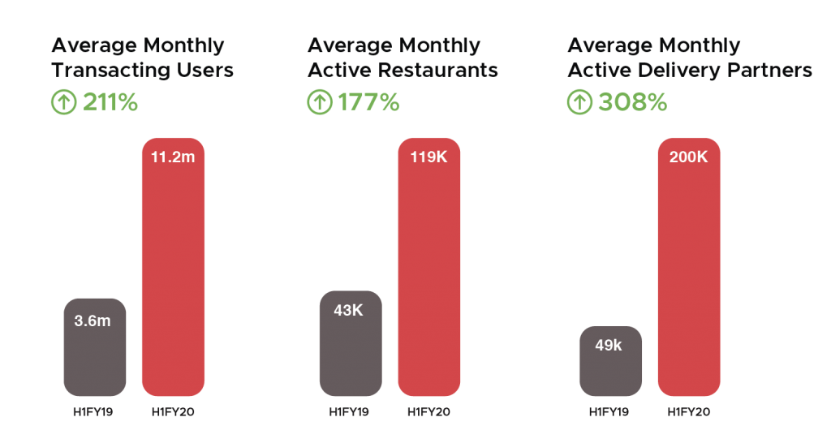
Funds and Stats
Zomato received a total number of 909.6 million from different investors. Their funding was from Private Equity in 2020. Info Edge is a leading investor of Zomato. Other than that, Ant Financial, Delivery Hero, Shunwei Capital, Vy Capital, and many others are the investors of Zomato who have contributed their major stack to make Zomato popular worldwide. Now let’s have a look at some interesting figures about Zomato’s growth.

Slide 6
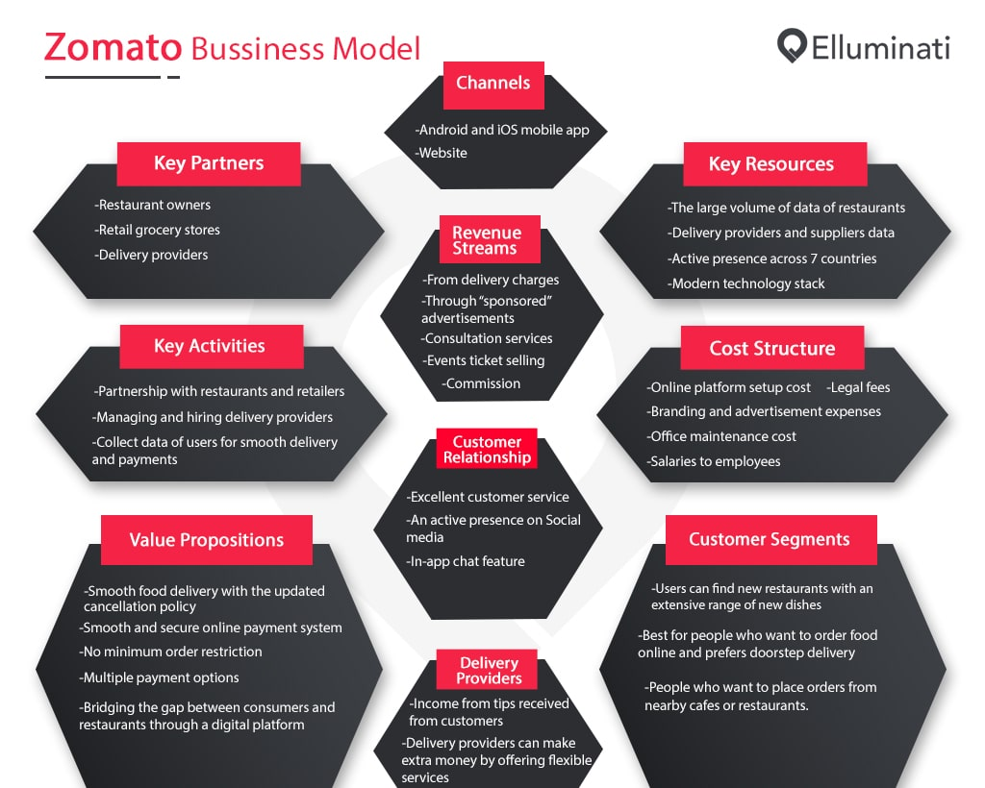
Business Model
Zomato’s Business Model is aimed at
providing quality food services,
information related to restaurants,
their menus and user reviews. The
Business Model of Zomato consists of
providing food delivery services,
information, user reviews and menu’s
of partner restaurants. It has created a
revolution in industries doing food
business by including different
restaurants and facilitating people to
look for restaurants more conveniently.

Slide 7
Addressing the Problem
The Project focuses on Customers and Company, and to analyze the sentiments of the reviews given by the customer in the data and made some useful conclusion in the form of Visualizations. Also, clustering the zomato restaurants into different segments. The data is visualized as it becomes easy to analyze data at instant. The Analysis also solve some of the business cases that can directly help the customers finding the Best restaurant in their locality and for the company to grow up and work on the fields they are currently lagging in.
The Project contains : Exploratory data analysis, Clustering, Sentiment Analysis which could help the customers to choose best restaurants and the restaurant owners to improve the restaurants in various aspects.

Slide 8
Features Summary
Zomato Restaurant Names and Metadata
Name – Name of the Restaurants.
Links – Links of the Restaurants.
Cost – Average cost of the meal in Restaurants.
Collections - The Collections in Zomato features popular restaurants across specific themes and trends at a particular location.
Cuisine – A cuisine is specific set of cooking traditions and practices, often associated with a specific culture or region.
Timings – Opening and closing time of the Restaurants.

Slide 9
Features Summary (continued)
Zomato Restaurant Reviews
Restaurants – Name of the Restaurants.
Reviewer – Name of the Reviewer.
Review – Experience of the reviewer in the restaurant expressed in words.
Rating - Experience of the reviewer in the restaurant expressed in numbers.
Metadata – A set of data that describes and gives information about reviewers.
Time – Time at which the reviews and ratings are given.
Pictures – Number of pictures taken by the reviewer.

Slide 10
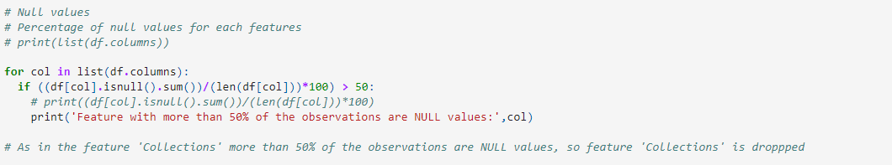
NULL value treatment
In the ‘Zomato Restaurant Names and Metadata’ dataset ‘Collections’ feature contains more than 50 % of its values as NULL. So ‘Collections’ feature is dropped.

Slide 11
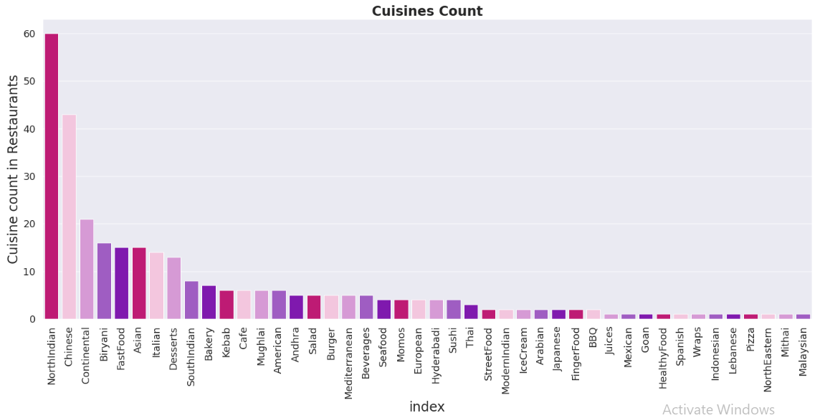
Exploratory Data Analysis
On Zomato Restaurant Names and Metadata dataset.

Slide 12
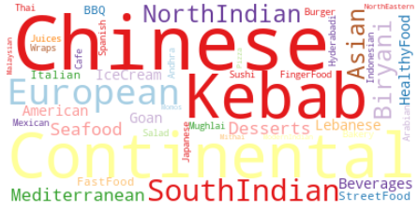
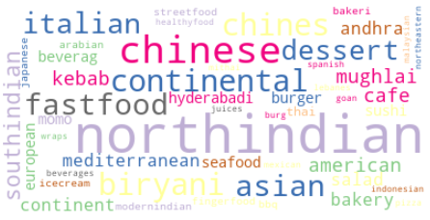
Exploratory Data Analysis (continued)
On Zomato Restaurant Names and Metadata dataset.

Slide 13
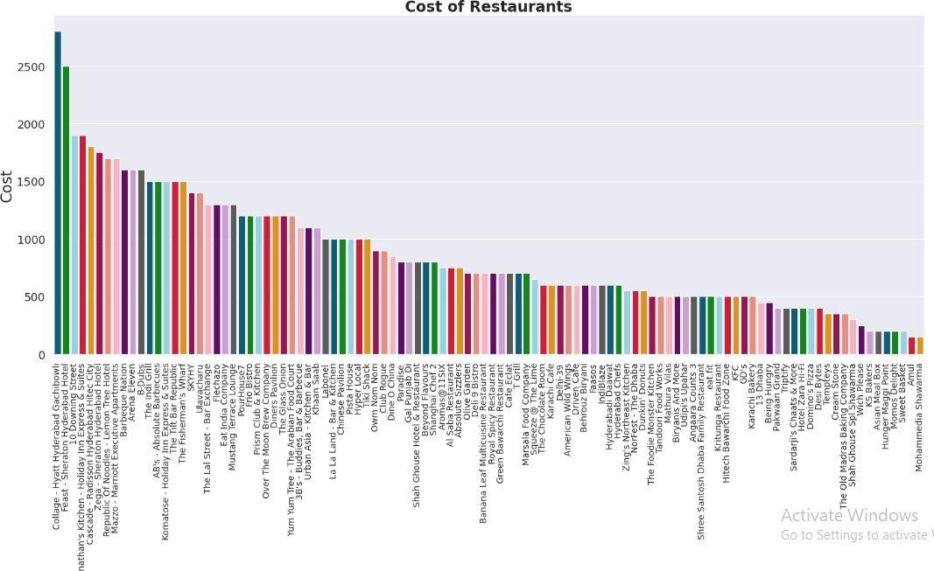
Exploratory Data Analysis (continued)
On Zomato Restaurant Names and Metadata dataset.

Slide 14
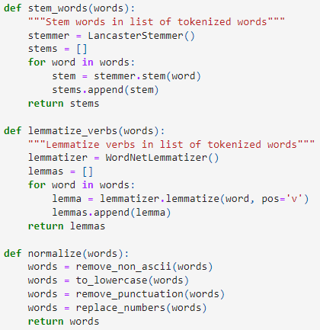
Text Preprocessing
On Zomato Restaurant Names and Metadata dataset.
Stemming
It is a technique used to extract
the base form of the words by removing
affixes from them. It is just like cutting
down the branches of a tree to its stems.
Lemmatization
Lemmatization is a method responsible
for grouping different inflected forms of
words into the root form, having the
same meaning.

Slide 15
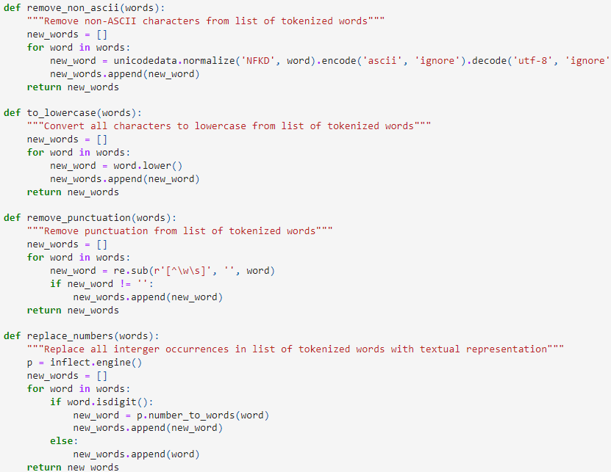
Text Preprocessing (continued)
On Zomato Restaurant Names and Metadata dataset.
Non-ASCII characters are those that
are not encoded in ASCII, such as
Unicode,EBCDIC..
Converting Uppercase letters to
Lowercase.
Removing punctuations.

Slide 16
Text Preprocessing (continued)
On Zomato Restaurant Names and Metadata dataset.
TFIDF vectorizer
Term frequency-inverse document frequency is a text vectorizer that transforms the text into a usable vector. It combines 2 concepts, Term Frequency (TF) and Document Frequency (DF). The term frequency is the number of occurrences of a specific term in a document.

Slide 17
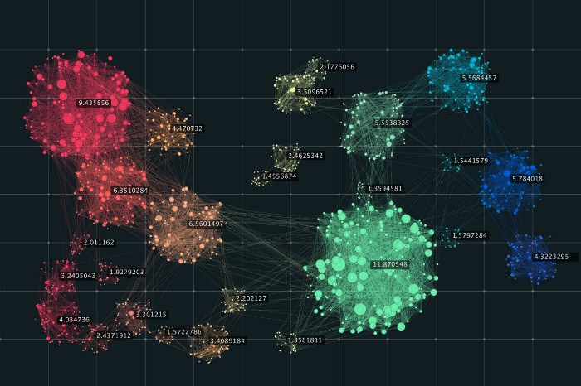
Clustering
On Zomato Restaurant Names and Metadata dataset.
Clustering – It is the task of dividing
the population or data points into a
number of groups such that data
points in the same groups are more
similar to other data points in the
same group than those in other
groups.

Slide 18
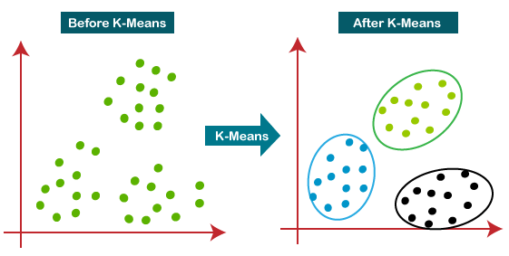
Clustering (continued)
On Zomato Restaurant Names and Metadata dataset. K Means Clustering
The K-means clustering algorithm computes centroids and repeats until the optimal centroid is found. It is presumptively known how many clusters there are. It is also known as the flat clustering algorithm. The number of clusters found from data by the method is denoted by the letter ‘K’ in K-means.

Slide 19
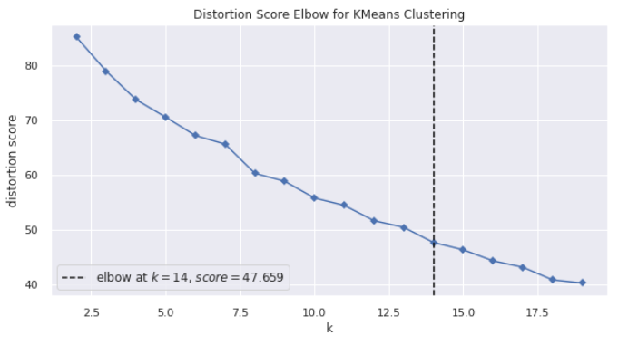
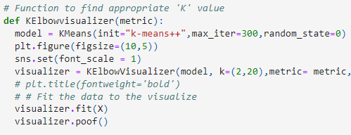
Clustering (continued)
On Zomato Restaurant Names and Metadata dataset. Finding appropriate ‘K’ value

Slide 20
Clustering (continued)
On Zomato Restaurant Names and Metadata dataset.
Working of K-Means Algorithm
The following stages will help us understand how the K-Means clustering technique works-
Step 1: First, we need to provide the number of clusters, K, that need to be generated by this algorithm.
Step 2: Next, choose K data points at random and assign each to a cluster. Briefly, categorize the data based on the number of data points.
Step 3: The cluster centroids will now be computed.
Step 4: Iterate the steps below until we find the ideal centroid, which is the assigning of data points to clusters that do not vary.

Slide 21
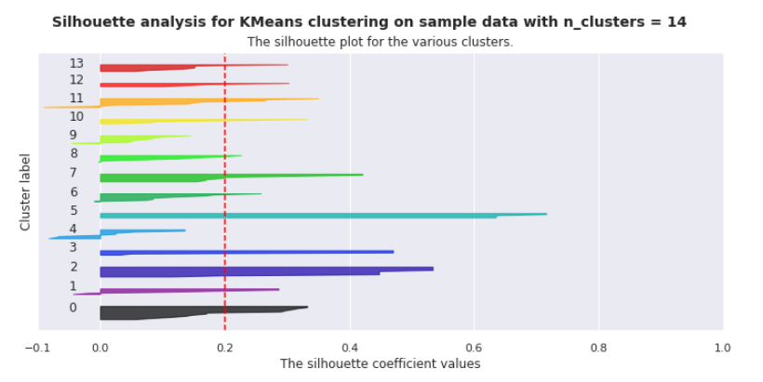
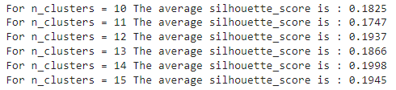
Clustering (continued)
On Zomato Restaurant Names and Metadata dataset.
K Means Clustering Model Validation

Slide 22
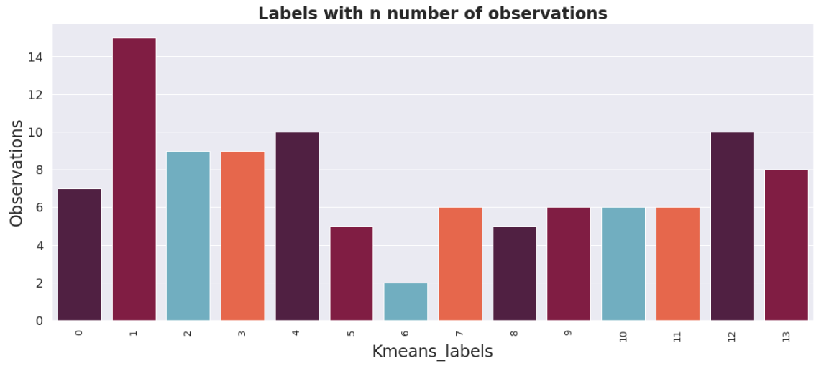
Clustering (continued)
On Zomato Restaurant Names and Metadata dataset.
K Means Clustering

Slide 23
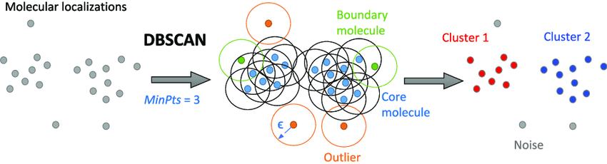
Clustering (continued)
On Zomato Restaurant Names and Metadata dataset.
DBSCAN Clustering
DBSCAN is a density-based clustering algorithm that works on the assumption that clusters are dense regions in space separated by regions of lower density. It groups ‘densely grouped’ data points into a single cluster. It can identify clusters in large spatial datasets by looking at the local density of the data points. The most exciting feature of DBSCAN clustering is that it is robust to outliers.

Slide 24
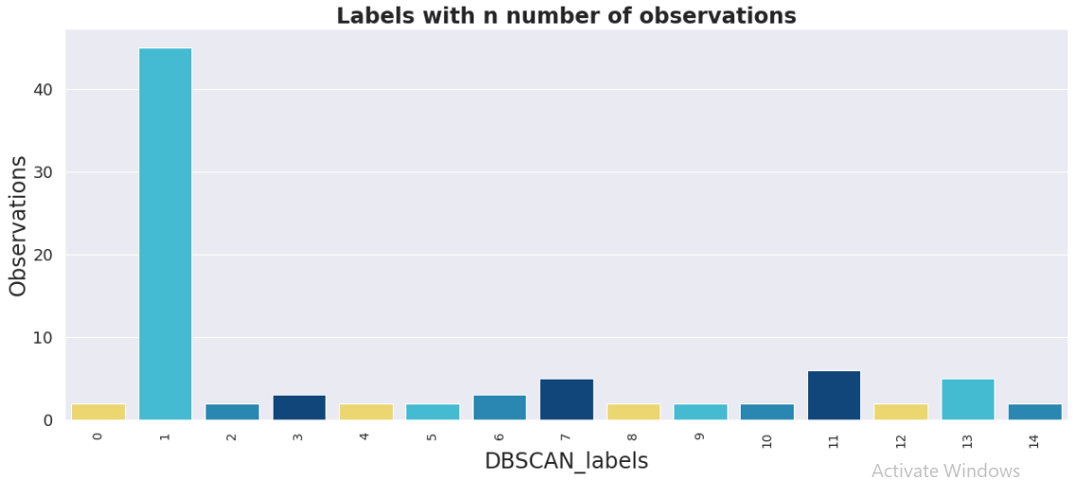
Clustering (continued)
On Zomato Restaurant Names and Metadata dataset.
DBSCAN Clustering

Slide 25
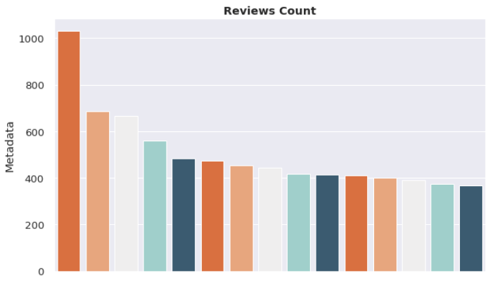
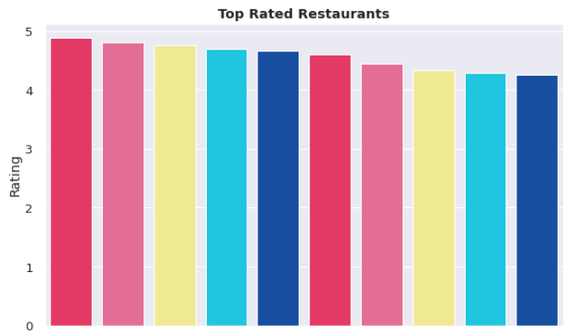
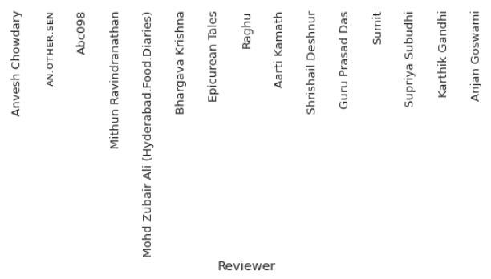
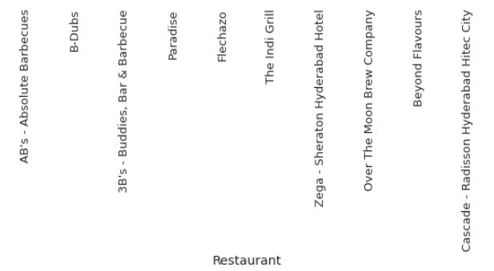
Exploratory Data Analysis
On Zomato Restaurant Reviews dataset.

Slide 26
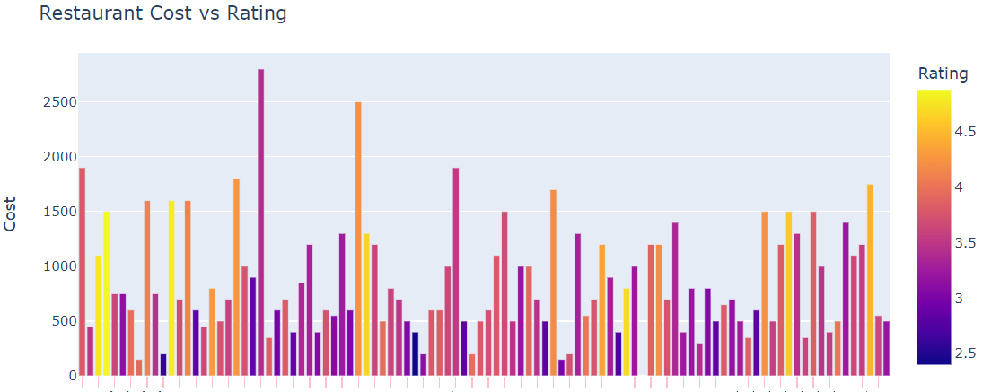
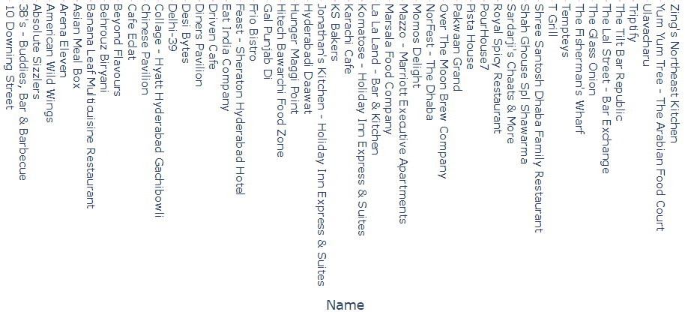
Exploratory Data Analysis (continued)
On Merged dataset.

Slide 27
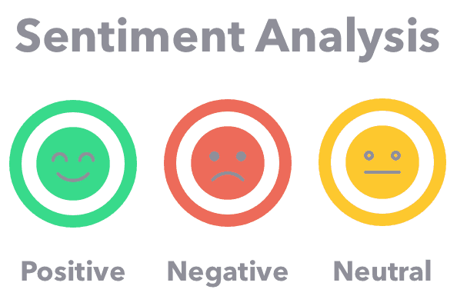
Sentiment Analysis
Vader Model
Sentiment analysis is a text analysis method that detects polarity (e.g. a positive or negative opinion) within the text, whether a whole document, paragraph, sentence, or clause. Sentiment analysis aims to measure the attitude, sentiments, evaluations, attitudes, and emotions of a speaker/writer based on the computational treatment of subjectivity in a text.

Slide 28
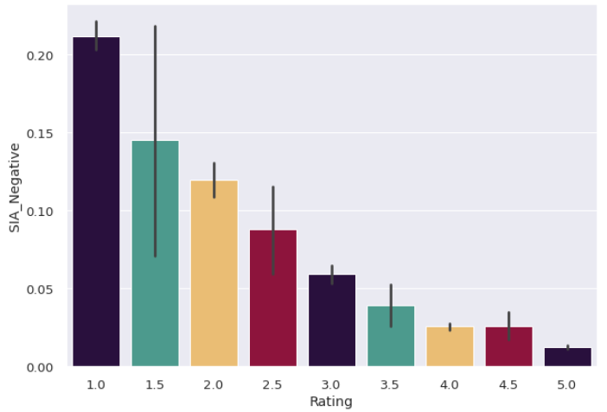
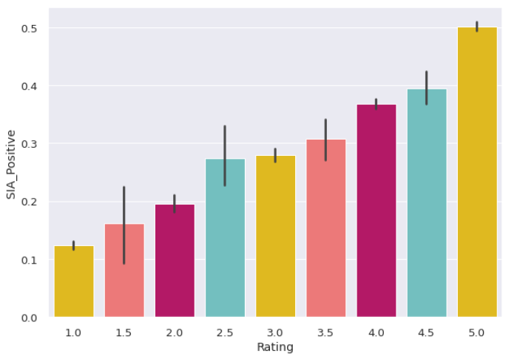
Sentiment Analysis (continued)
Vader Model

Slide 29
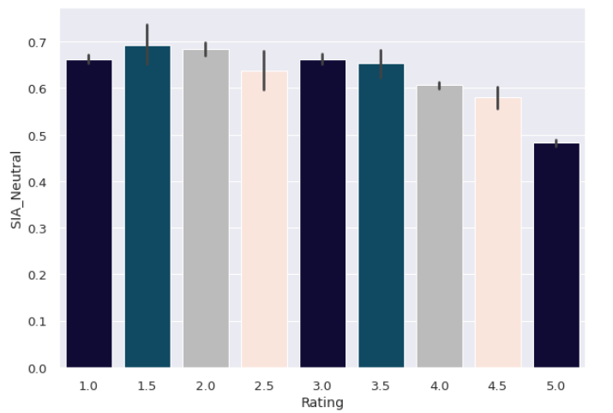
Sentiment Analysis (continued)
Vader Model

Slide 30
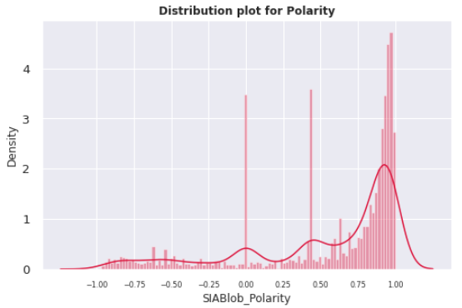
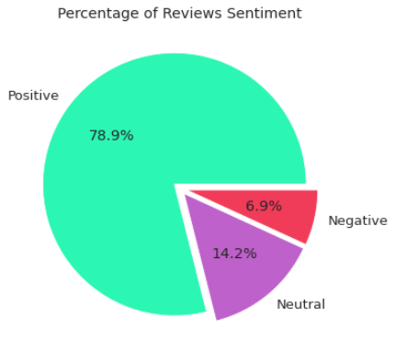
Sentiment Analysis (continued)
Vader Model

Slide 31
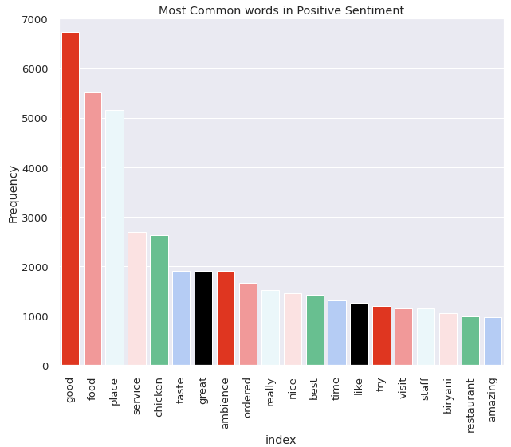
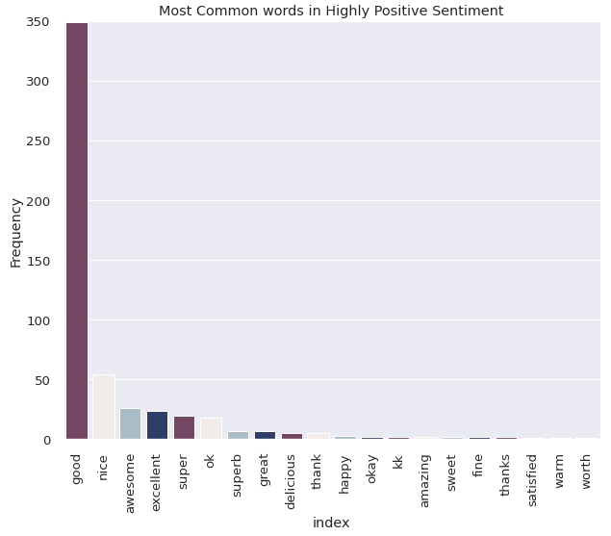
Sentiment Analysis (continued)
Vader Model

Slide 32
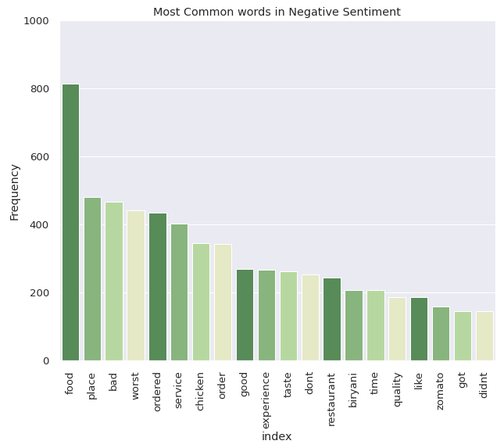
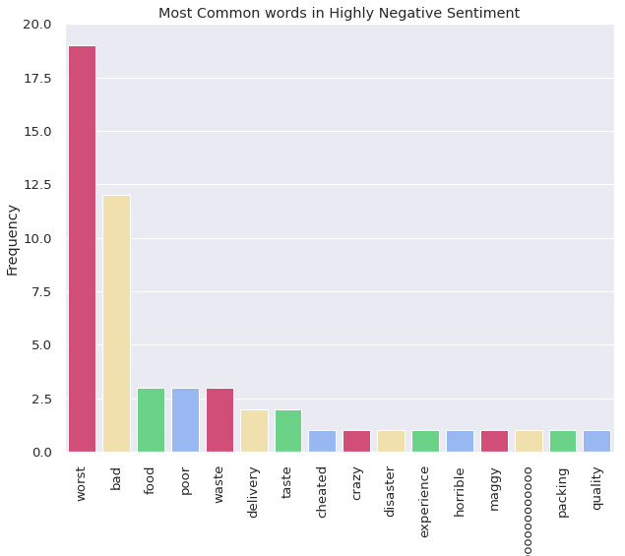
Sentiment Analysis (continued)
Vader Model

Slide 33
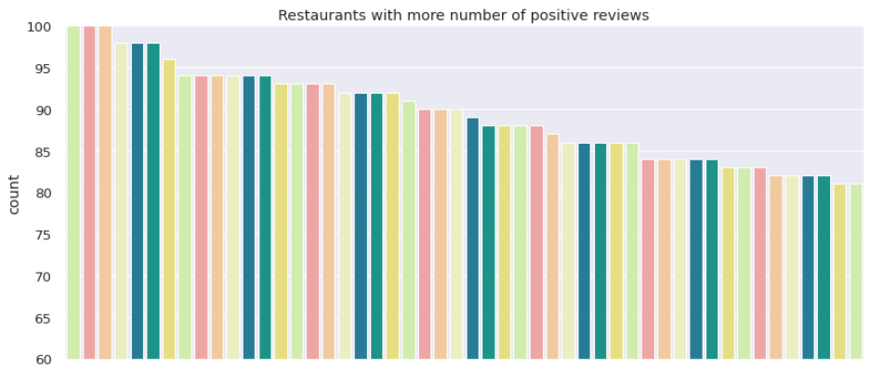
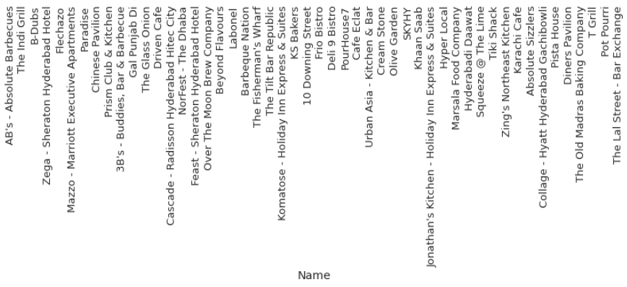
Sentiment Analysis (continued)
Vader Model

Slide 34
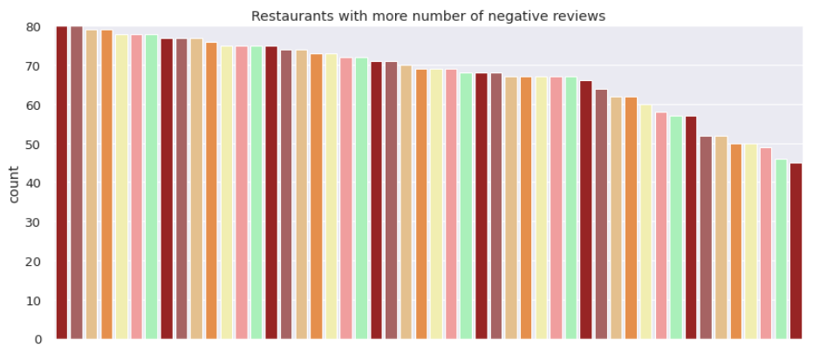
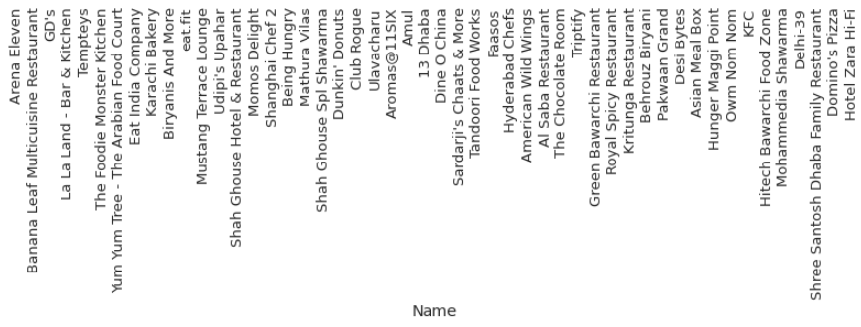
Sentiment Analysis (continued)
Vader Model

Slide 35
Conclusion
North Indian cuisine is most common cuisine found in the restaurants.
Collage - Hyatt Hyderabad Gachibowli is most expensive restaurant.
Amul and Mohammedia Shawarma are the most affordable restaurants.
The Restaurants are clustered on cuisines into 15 clusters by using KMeans clustering algorithm with the Silhouette score of 0.195.
DBSCAN algorithm is also used to cluster the restaurants into 15 clusters and also helps us to detect the outliers with the Silhouette score of 0.107.
Anvesh Chowdary has given the most number of reviews.
AB’s – Absolute Barbecues is the top rated restaurant.
Almost 79 percent of the observations have Positive sentiment and 14 and 7 percent of the observations have Neutral and Negative sentiments respectively

Slide 36
Conclusion
Good is the most common word in the Highly positive sentiment.
Worst is the most common word in the Highly negative sentiment.
AB’s – Absolute Barbecues, The Indi grill and B-Dubs are the restaurants with the most number of positive reviews.
Arena Eleven and Banana leaf Multicuisine restaurant are the restaurants with the most number of negative reviews.
Udipi's Upahar is the most affordable restaurant with the best rating.
Feast - Sheraton Hyderabad Hotel is the most expensive restaurant with the best rating.
Asian Meal Box is the most affordable restaurant with the worst rating.
Club Rogue is the expensive restaurant with worst rating.

Slide 37
Thank you

