Slide 1

AVIVA CASE STUDY
Wildfire Risk Analytics
Wildfire Insured-Loss Modelling
Frequency-Severity Loss Model for an Alberta Property Portfolio,
Projected Under a Future Climate Scenario (EC-Earth3, SSP1-2.6)
Seti Rahmani
2026

Slide 2
PROJECT OVERVIEW
Objective & Approach
Goal
Quantify wildfire insurance risk by FSA and portfolio-wide, and project losses under a future climate scenario.
Project Workflow
Raw claims + climate + fuel data
Framework
Frequency-severity structure — Negative Binomial GLM for claim frequency, Gamma GLM for claim severity.
Feature engineering
Poisson baseline
Features
Climate (Fire Weather Index) + geospatial (fuel type) + exposure, combined into one claims feature table.
Overdispersion → Negative Binomial
Multiple FWI features → Multicollinearity
Discipline
Every non-obvious result was independently verified against source data, not assumed — model complexity was deliberately scoped to what 2 historical events can support.
Feature reduction (2 climate + 1 fuel)
Validation & diagnostics (LOEO + spatial dependence)
Scope
A transparent, defensible baseline — not a production catastrophe model.
Future climate scenario (SSP1-2.6)
Figures • Maps • Results • Report
Wildfire Insured-Loss Modelling — Alberta Portfolio
2

Slide 3
DATA
Data Sources & Pipeline
Data Sources
Data Pipeline
Validation
Key assumptions regarding climate, spatial data, and joins have been verified and corrected.
Portfolio 159 FSAs (Alberta region)
Climate
Claims 305 rows; 2 wildfire events
Fire Weather Index
Fuel Data
Portfolio
Testing
High-risk transformations are covered by pytest, which also successfully identified a minor data artifact.
CMIP6 Climate Global climate projections
Canadian Fuel Raster National fuel type mapping
FSA Features
StatCan FSA Boundaries Official spatial polygons
Historical Claims
Boundary Gaps
Five FSAs are missing polygons, including two valid FSAs (T3T and T4K) that require resolution.
Claims Feature Table
Wildfire Insured-Loss Modelling — Alberta Portfolio
3

Slide 4
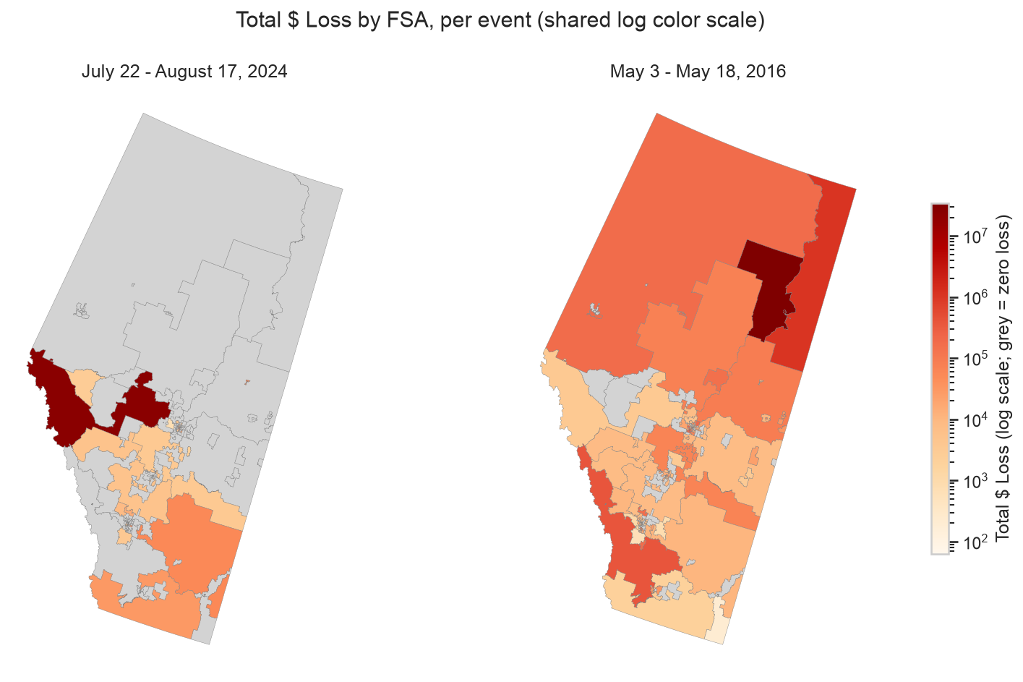
EDA
Exploratory Insights
Losses are concentrated
Most FSA/event rows record zero loss; nonzero losses span ~6 orders of magnitude ($62 to $33.9M).
Severity ≠ exposure scaling
No clear linear relationship between exposure value and loss — whether an FSA was affected matters more than its size.
24% of claim rows lack FWI signal
Investigated, not discarded — mostly a genuine pre-fire-season timing issue in the May 2016 event.
Spatial signatures differ by event
May 2016 losses are geographically clustered (one spreading fire); Jul/Aug 2024 losses are scattered (multiple disconnected fires).
FWI distributions are multi-modal
Consistent with the two events drawing from different fire-weather regimes, not one smooth distribution.
Wildfire Insured-Loss Modelling — Alberta Portfolio
4

Slide 5
MODELLING APPROACH
Feature Engineering & Model Evolution
Feature Selection Logic
▪ Climate:fwi_max (headline fire-weather hazard), dc_max (drought/fuel-dryness proxy, r≈0.35 with fwi_max).
▪ Geospatial:dominant_fuel_pct — low collinearity with both climate features (r<0.1).
▪ Constraint:Why only 3 predictors? FWI-family features are almost collinear (r>0.9) — EDA ruled out using several together.
Model Evolution Pipeline
Poisson baseline GLM
Overdispersion identified
Negative Binomial GLM
Multicollinearity identified
Model Evolution Narrative
1.Poisson baseline → badly overdispersed.
2.Negative Binomial → substantially better fit.
3.Multiple FWI features together → unacceptable multicollinearity.
4.Final specification → 2 climate predictors + 1 geospatial predictor, followed by validation, spatial-dependence testing, and future-scenario application.
Feature Selection (2 Climate + 1 Fuel)
Model Validation (LOEO + Spatial)
Future Climate (SSP1-2.6 Illustrative)
Final Model
Wildfire Insured-Loss Modelling — Alberta Portfolio
5

Slide 6
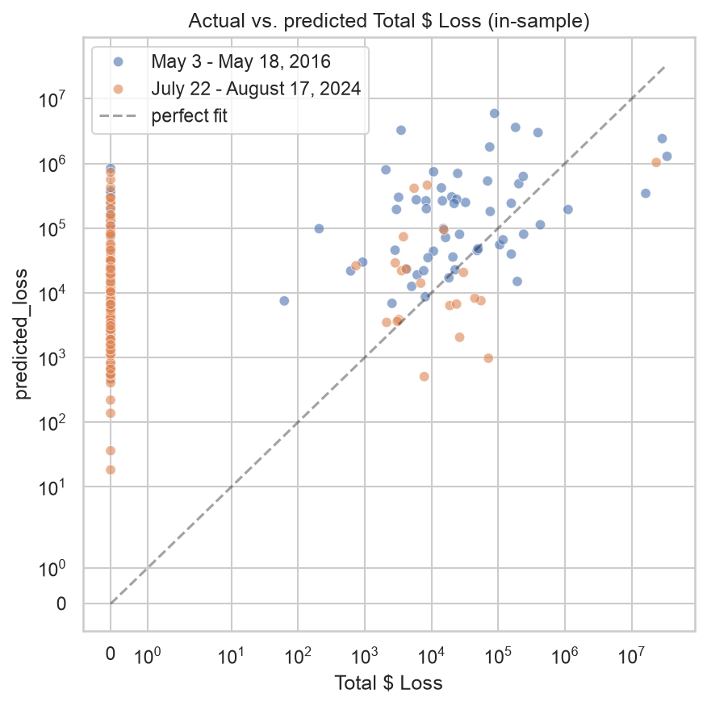
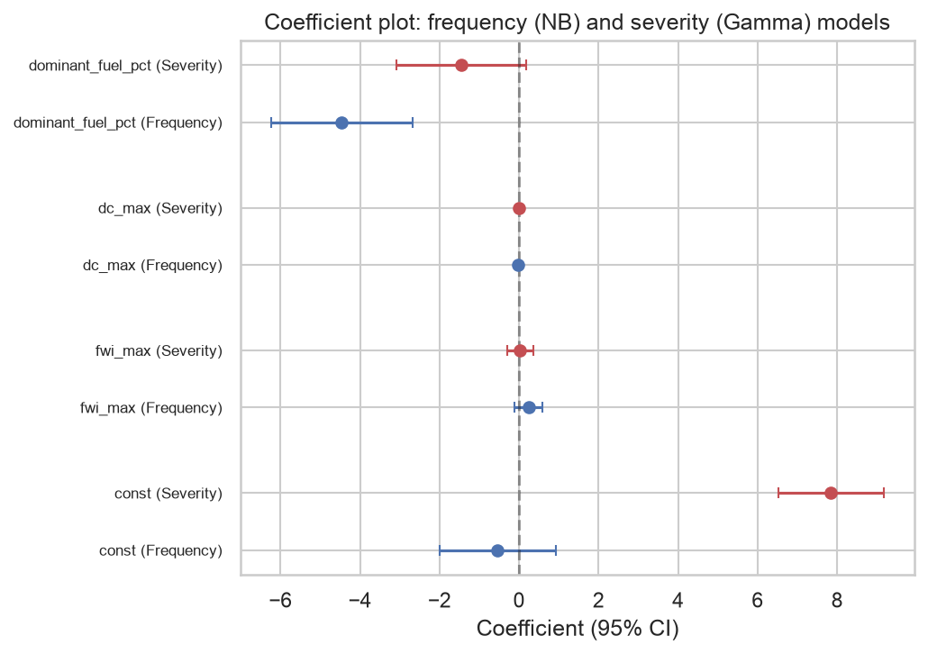
MODEL FITTING
Model Results — Frequency & Severity
Frequency model | AIC
Poisson | 135,998.1
Negative Binomial | 1,196.8
Model Coefficients & Prediction Alignment
Performance
Predicted loss: 39% of actual
MAE: $573K
RMSE: $3.34M
Frequency Model (Negative Binomial)
Geospatial feature earns its place:
Adding dominant_fuel_pct improves AIC by 21.0 and a likelihood-ratio test rejects the reduced (climate-only) model strongly (p=1.65×10⁻⁶).
Metric | Value
Predicted / actual total loss | $41.4M / $106.9M (39%)
MAE | $572,725
RMSE | $3,336,833
Severity Model (Gamma)
Limited statistical power:
No predictor is significant on 76 usable rows — indicating limited power to detect relationships rather than confirming that none exist.
Wildfire Insured-Loss Modelling — Alberta Portfolio
6

Slide 7
VALIDATION
Validation — Out-of-Sample & Spatial Dependence
Leave-One-Event-Out (LOEO)
Unreliable
Insufficient sample size
▪ Two wildfire events are entirely insufficient for a trustworthy, robust out-of-sample validation of the model.
Spatial Dependence (GEE)
≈ 0
(-0.008) estimated within-event correlation
▪ Not a precise estimate. With only 2 clusters, this metric cannot reliably demonstrate whether spatial dependence exists.
Train → Test | Predicted | Actual | Rank corr.
May 2016 → Jul/Aug 2024 | $186K | $23.7M | ≈0 (0.068)
Jul/Aug 2024 → May 2016 | $189.9M | $83.2M | 0.297
Bottom Line:
With only two wildfire events, neither out-of-sample performance nor spatial dependence can be estimated reliably. This is not evidence that either is absent, but rather that the currently available data cannot yet answer the question.
Wildfire Insured-Loss Modelling — Alberta Portfolio
7

Slide 8
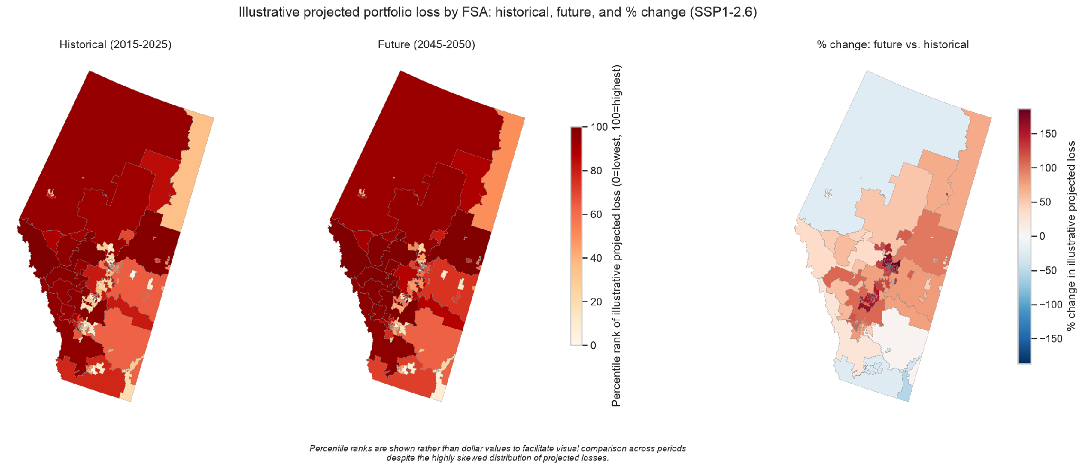
SSP1-2.6, 2045–2050 VS. 2015–2025
Future Climate Projection (Illustrative)
Labelled “illustrative,” not “predicted”
Model trained on event-window extremes; future comparison uses period-average inputs — a feature-scale mismatch that pushes it outside training distribution.
Illustrative Projected Portfolio Loss by FSA
Historical, future, and % change (SSP1-2.6)
No prediction interval reported
Parameter uncertainty from only 2 historical wildfire events would make any prediction interval itself highly unstable and unreliable.
Single model, scenario, & ensemble member
A narrow projection pathway, whereas other CMIP6 climate models often project overall increasing fire-weather risk for similar geographic regions.
Frequency/loss rise despite FWI falling
Driven by a negative dc_max coefficient learned from only 2 events — which is plausibly a statistical artifact rather than a stable physical relationship.
Percentile ranks are shown rather than dollar values to facilitate visual comparison across periods despite the highly skewed distribution of projected losses.
Metric | Historical (2015–2025) | Future SSP1-2.6 (2045–2050) | Rel. diff.
Mean FWI | 3.47 | 1.36 | −61%
Mean DC | 203.6 | 148.7 | −27%
Illustrative claim frequency | 1,870 | 3,862 | +107%
Illustrative projected loss | $4.5M | $7.65M | +70%
Wildfire Insured-Loss Modelling — Alberta Portfolio
8

Slide 9
DISCUSSION
Limitations, Next Steps
Key limitations:
▪ Only 2 historical events. Thin basis for frequency/severity or tail-risk estimation.
▪ Poor out-of-sample generalization. LOEO failed to converge in both directions.
▪ Spatial dependence imprecisely estimated. Only 2 clusters.
▪ Open data gaps. 24% of claims lack FWI signal; T3T/T4K boundary gap; fuel codes unlabelled.
▪ Single climate pathway. One model, one scenario, one ensemble member.
Next steps (by business value):
1. More historical events. The single highest-value addition.
2. Monte Carlo simulation. Real prediction intervals once enough events exist.
3. Multi-model climate ensemble. Beyond one model/scenario/member.
4. Resolve remaining data gaps. FWI coverage, boundary gap, fuel legend.
5. Alternative severity predictors. An exposure-oriented set, not climate-only.
Conclusion: the modelling framework is technically sound and reproducible, but additional historical wildfire events are the critical requirement before operational deployment.
Wildfire Insured-Loss Modelling — Alberta Portfolio
9

