Slide 1




Settleed Section 8 landlords will list on Settleed because they need a faster way to find qualified voucher holders, and tenants with vouchers will use Settleed because no other platform is built specifically for the Section 8 search experience. How many interviews so far? 8 How many interviews conducted since last time? 8 How many since the latest pivot? 8
Demetrius
Wilburn

Slide 2
Customer Discovery Report — Landlords
What did we think?
We believed landlords who accept Section 8 struggle primarily because they cannot find tenants fast enough, and that most of the pain was around advertising costs and vacancy time. We assumed landlords were comfortable with the AHA process but just lacked a good channel to find tenants.
What did we do?
We conducted 5 in-depth interviews with active Section 8 landlords in the Atlanta metro area, ranging from single-unit owners to landlords managing 10 or more units. We spoke with both AHA participants and DCA landlords.
What did we learn?
The biggest pain is not advertising cost but the complexity of the HAP contract process and unexpected HQS inspection failures. Landlords described being caught off guard by inspection dates and losing payment while units sit vacant. Every landlord we spoke with wanted a curated pipeline of pre-screened, voucher-approved tenants who are ready to move quickly. Several mentioned they stopped accepting new Section 8 tenants specifically because finding them felt too unreliable.
What to do next?
Validate willingness to pay $49/month for a verified tenant pipeline with built-in HQS inspection tracking. Test whether landlords will self-serve listings or need hands-on onboarding. Conduct 5 more interviews targeting landlords who recently stopped accepting Section 8 to understand the dropout rate.

Slide 3
Customer Discovery Report — Tenants
What did we think?
We believed the main barrier for voucher holders was affordability and neighborhood availability. We assumed tenants knew which landlords accepted vouchers and that the primary problem was finding units in good school zones or near transit.
What did we do?
We conducted 3 interviews with active voucher holders in Atlanta who were currently in search or had recently found housing. Participants held AHA and DCA vouchers and had been searching anywhere from 3 weeks to 4 months.
What did we learn?
The real pain is information scarcity and time pressure, not affordability. Every tenant we interviewed spent weeks calling landlords from generic sites like Zillow and Craigslist only to be told the unit does not accept vouchers. The voucher expiration clock (typically 60 to 120 days) creates extreme anxiety. One tenant described calling over 40 landlords before finding one who accepted her voucher. None of them knew a centralized, verified directory existed. All three said they would have paid for a list they could actually trust.
What to do next?
Test whether tenants will pay $4.99/month for premium access including unlimited applications and SMS alerts. Identify the highest-motivation moment (right after receiving voucher) as the acquisition trigger. Conduct 5 more interviews with tenants who let their vouchers expire to understand what caused them to give up.

Slide 4
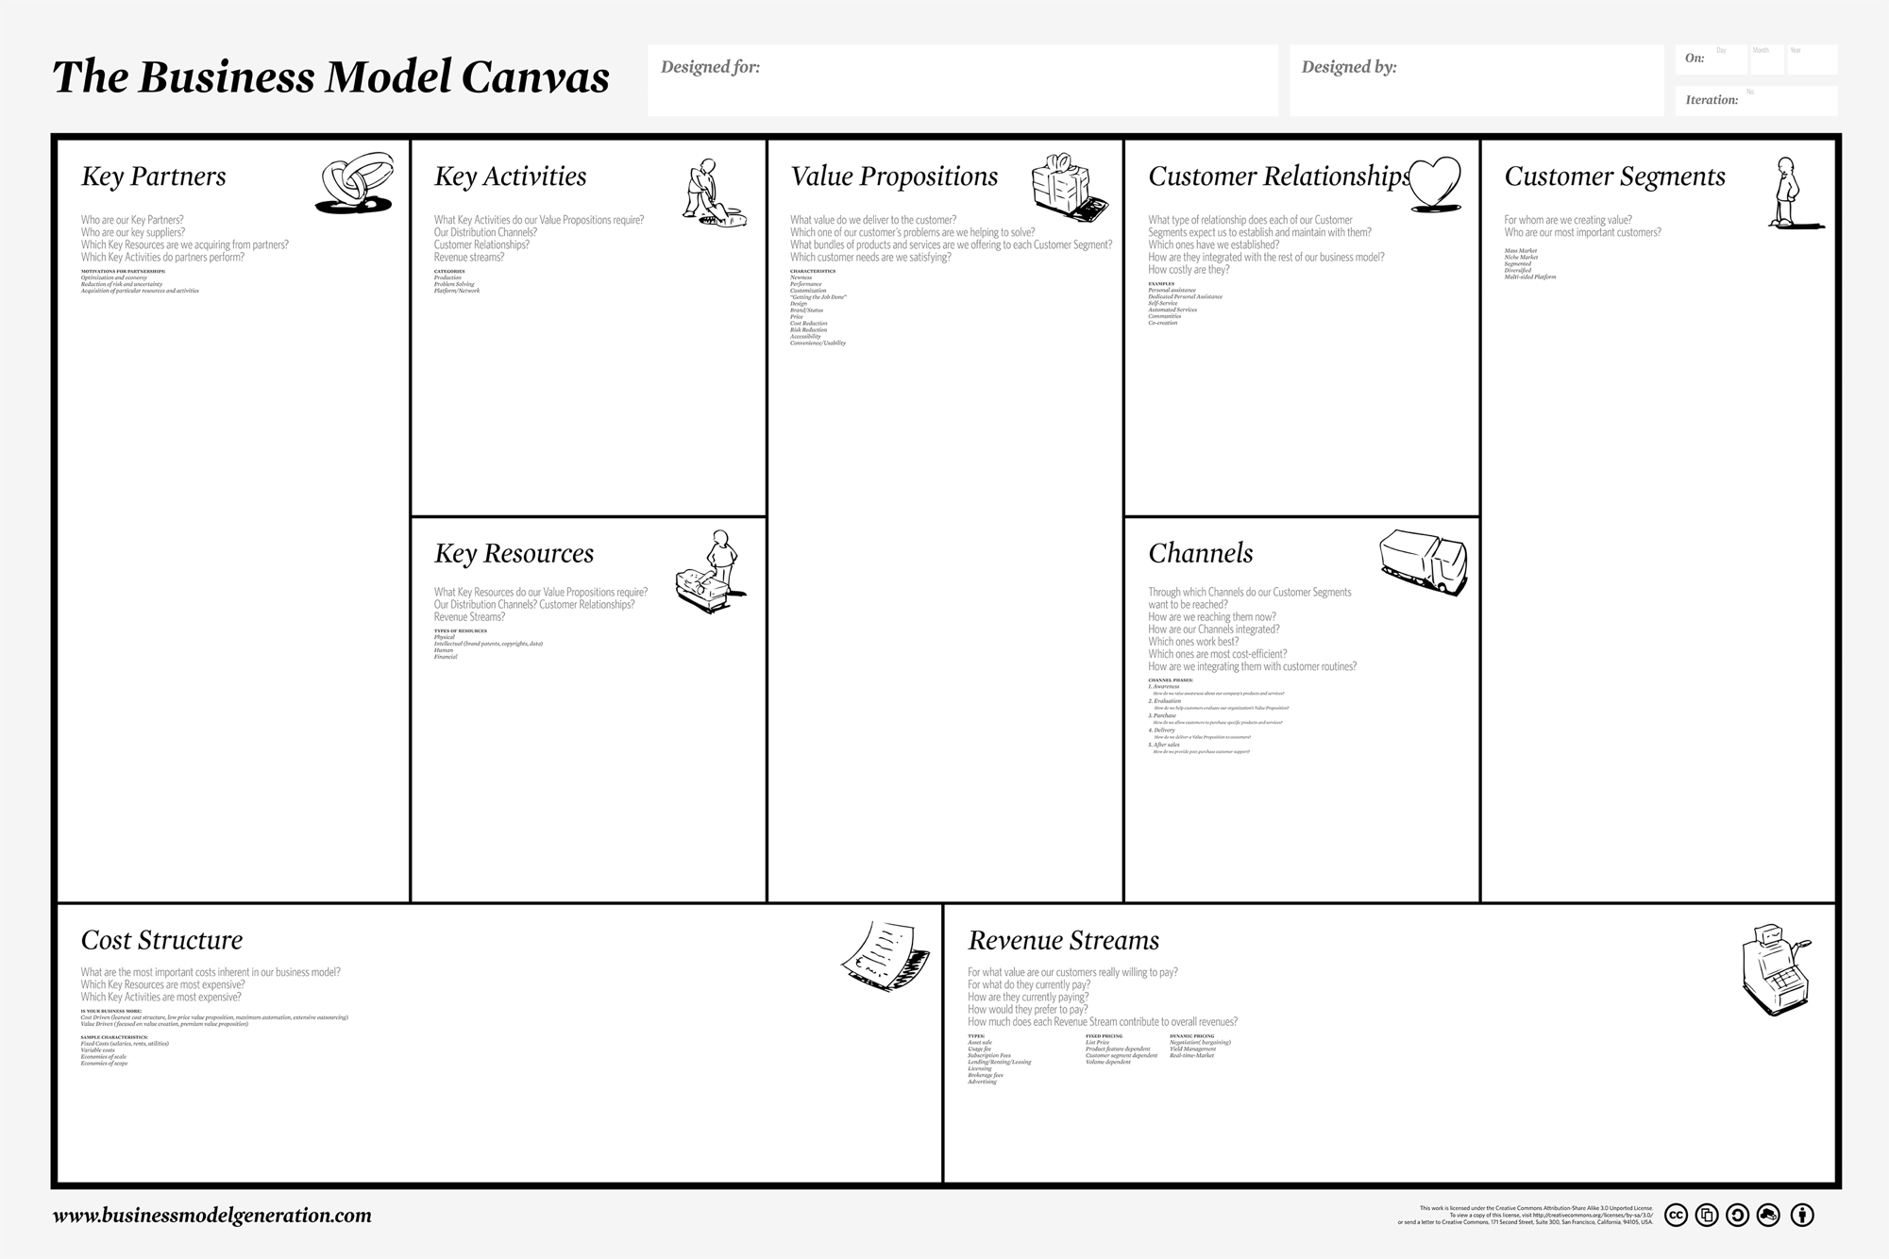
Your Current Canvas Goes Here

Slide 5
VP1
CS1
VP2
CS2
VP3
CS3
VP4
VP5
At least one unique VP for each CS
Color code to indicate which CSes go with each VP
Map your VPs to your CSes

Slide 6
What’s Next
We intend to conduct 10 more customer interviews (5 landlords, 5 tenants), launch a beta waitlist at settleed.com to validate demand, and onboard our first 3 paying landlords in the Atlanta market. We will use those early relationships to test pricing, refine the listing flow, and build out HQS inspection tracking based on what landlords tell us they actually need.

