Slide 1
CVSHealth Active Directory Overview AD Engineering Workspace & Core Services, ETS
September 2021

Slide 2
Active Directory
What is Active Directory?
Active Directory Domain Services provides centralized authentication and authorization services. It provides a directory service to centrally store and manage security principals, such as users, groups, and computers, and it offers centralized and secure access to network resources.
What is Azure Active Directory?
Azure Active Directory Domain Services provides centralized authentication and authorization services in the Azure cloud environment. It provides an extension of on-prem directory service to centrally store and manage security principals, such as users, groups, and computers, and it offers centralized and secure access to network resources.
What is SSO in Azure / Active Directory?
With single sign-on, users sign in once with one account to access domain-joined devices, company resources, software as a service (SaaS) applications, and web applications. After signing in, the user can launch applications from Office 365 portal without being prompted for credentials.

Slide 3
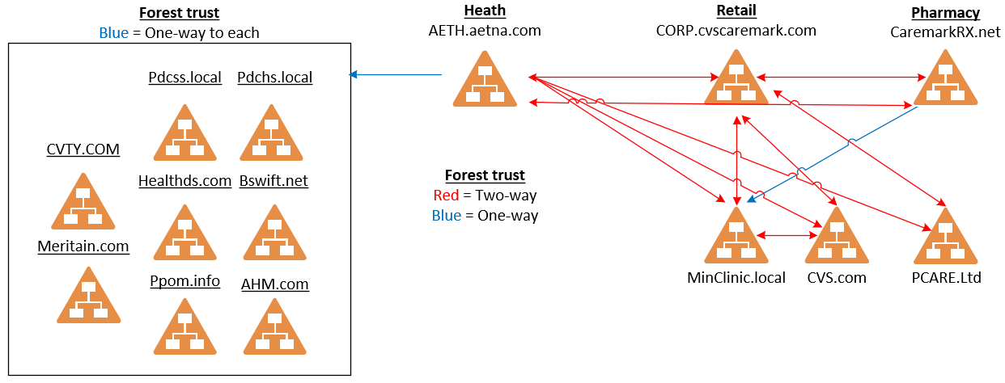
Active Directory Enterprise Domain Structure
Additional Supported AD Forests
AETDMZ.com
HealthEHost.com
Omnicare.com

Slide 4
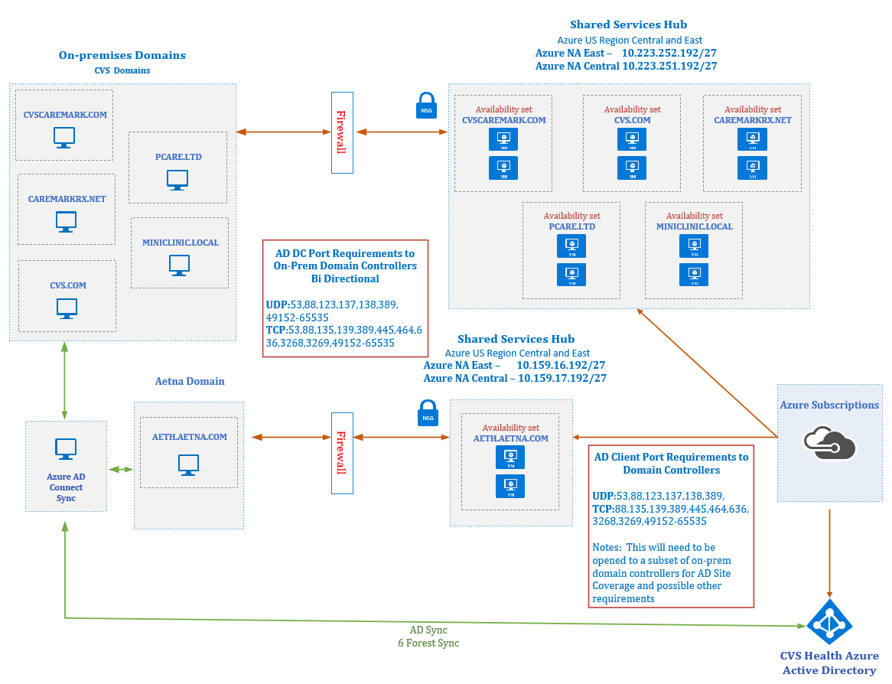
Active Directory / Azure AD Integration

Slide 5
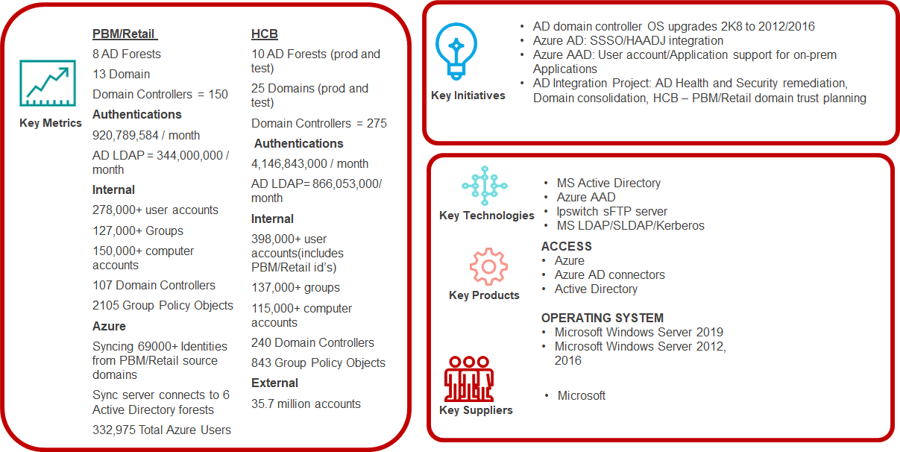

Slide 6
Active Directory Infrastructure
Group Policy Objects - Group Policy is a feature of Active Directory that controls the working environment of user accounts and computer accounts. Group Policy provides centralized management and configuration of operating systems, applications, and users' settings in the Active Directory environment. Thorough review of environments completed with remediation and restructuring of GPO across the enterprise to standardize. Continuing through 2022.
Health and Security Assessments – Engaged Microsoft on a complete assessment of the environment which includes configuration, security, and best practices. Remediation project started on 2020 and will continue to completion which should be end of 2022. Futer annual assessments will be ongoing and deficinecies will be remediated.
Microsoft Security Baseline – Internal assessment to review and configure the Enterprise Active Directory domains to best practice, standardization, and consistency. Continuing through 2nd quarter 2022.
Monitoring and Logging – Implemented Enterprise monitoring utilizing Microsoft System Center Operations Manager (SCOM). Implemented Splunk logging which captures system and security events which are used for troubleshooting, configuration dashboards, and custom alerting.

Slide 7
EIS / IAM / PAM Roles in Active Directory
Provisioning
Governance
PAM
Audit Response

