Slide 1
Hall Effect Sensor -Speedometer
Seung Min Song
Automotive UI

Slide 2
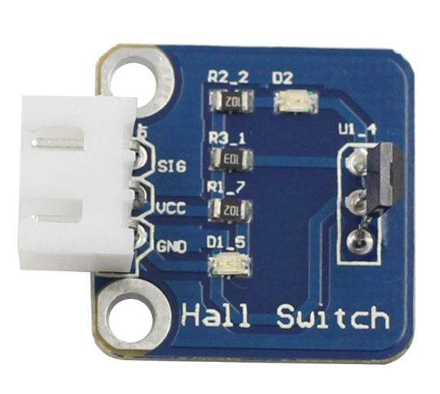
Proposal
Project Name: Automotive UI
Project Goal(For hardware): Develop dashboard for paramedic
Hall Effect Sensor: for speedometer
- Hall effect sensors - change the output voltage in response to a magnetic field.
- can test using magnet
- can get rpm, speed, distance

Slide 3
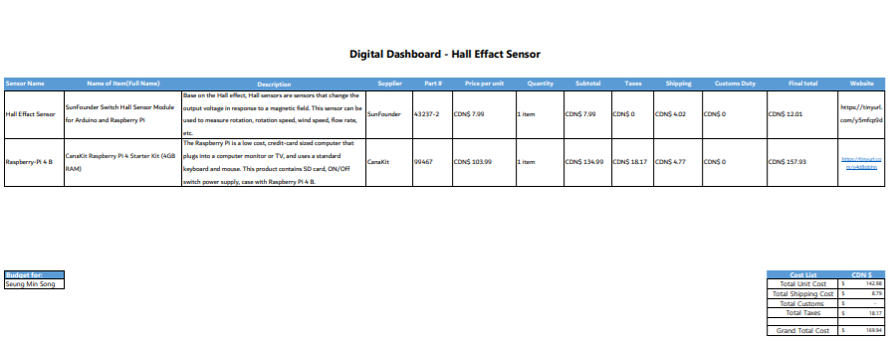
Budget
Hall Effect Sensor (SunFounder Switch Hall Sensor Module)
-SunFounder
-CDN $7.99
- Amazon
Raspberry-Pi 4 B
-CanaKit
-CDN $157.93
- Amazon
Not in budget:
magnet
Around $2 (Dollarama)

Slide 4
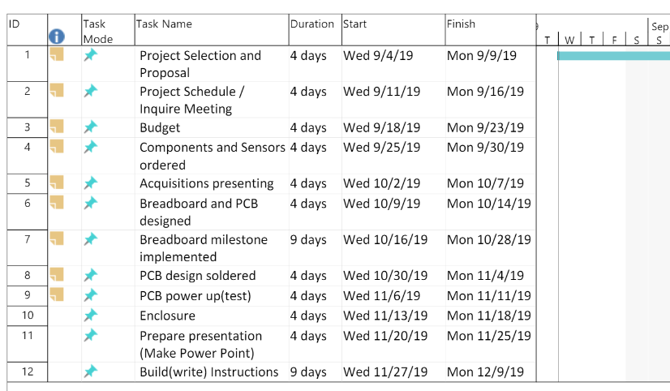
Schedule
Most parts are fine
Except
Breadboard milestone
-issue with raspberry pi
And PCB power up
-issue with PCB

Slide 5
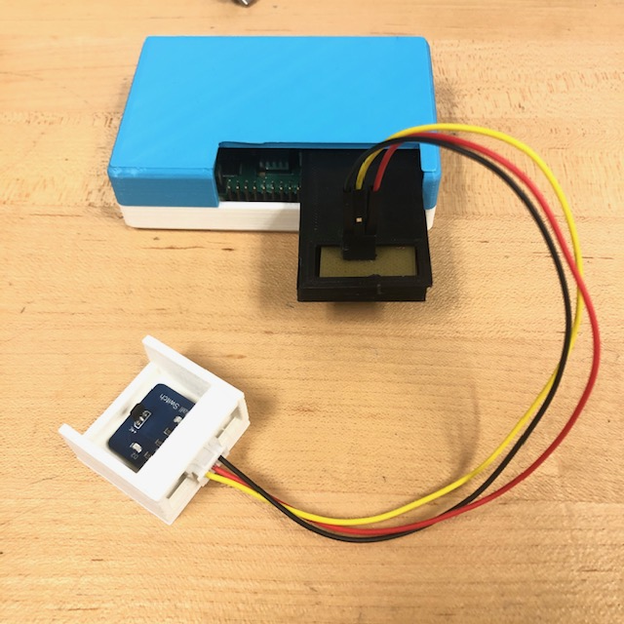
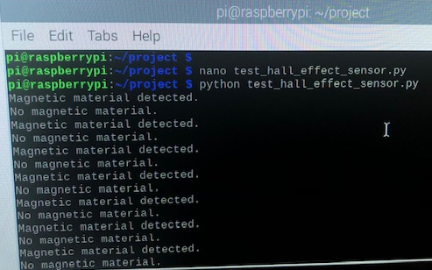
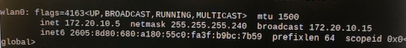
Image

Slide 6
Course knowledge utilized from previous courses
CENG252-Embedded Systems
How to use Raspberry Pi
TECH150-Electronic Devices & Circuits
How to do soldering
TECH101-Electric Circuits
How to design circuits

