Slide 1
Speedometer – Hall Effect Sensor
Seung Min Song
TEAM: EmergensUI

Slide 2
Proposal
Project Name: Automotive UI
Project Goal(For hardware): Develop dashboard for paramedic
Hall Effect Sensor: for speedometer
- Hall effect sensors - change the output voltage in response to a magnetic field.
- magnet is detected or not.
- can get RPM, SPEED, DISTANCE

Slide 3
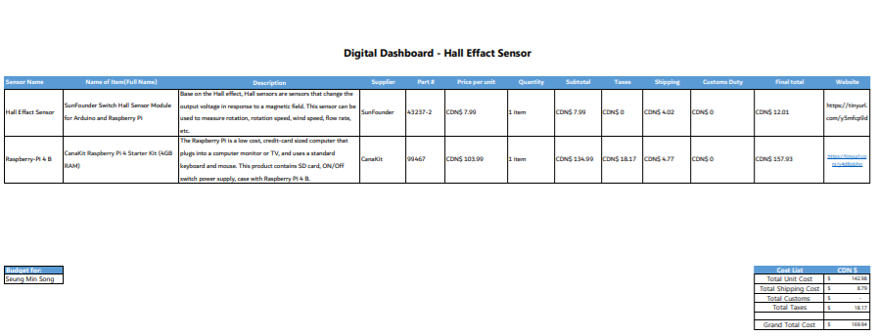
Budget
Hall Effect Sensor(SunFounder)
-CDN $7.99
- Amazon
Raspberri-Pi 4 B(CanaKit)
-CDN $157.93
- Amazon
1 over
- magnet
Around $2 (Dollarama)

Slide 4
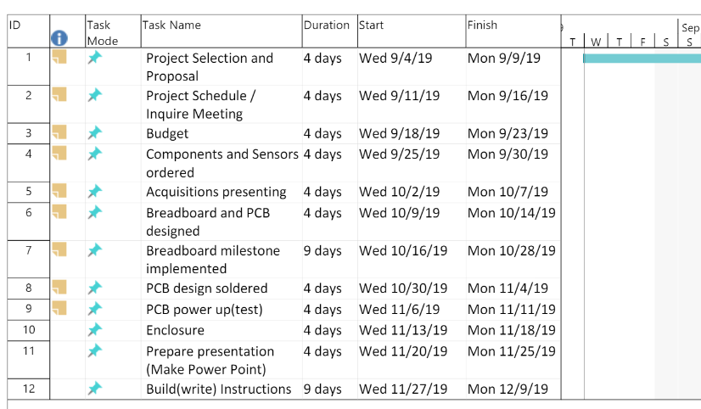
Schedule
Everything - fine.
Just spend more time at
Breadboard milestone

Slide 5
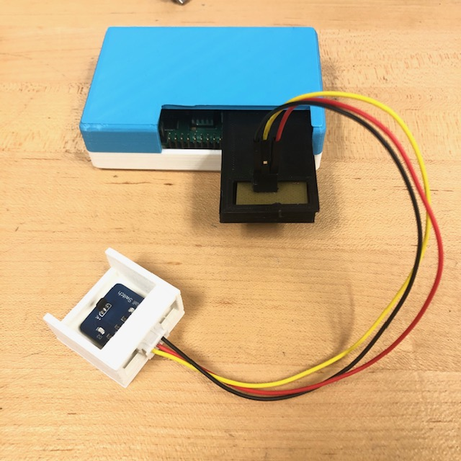
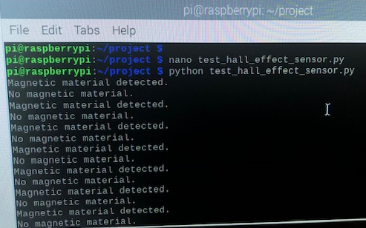
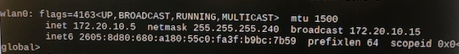
Image

Slide 6
Course knowledge utilized from previous courses
CENG254
- How to use Raspberry Pi

