Slide 1
11/7 Meeting
2022313382 백승렬

Slide 2
AiXplain Pipeline Service Test & Bug_Report

Slide 3
Decision Tree

Slide 4
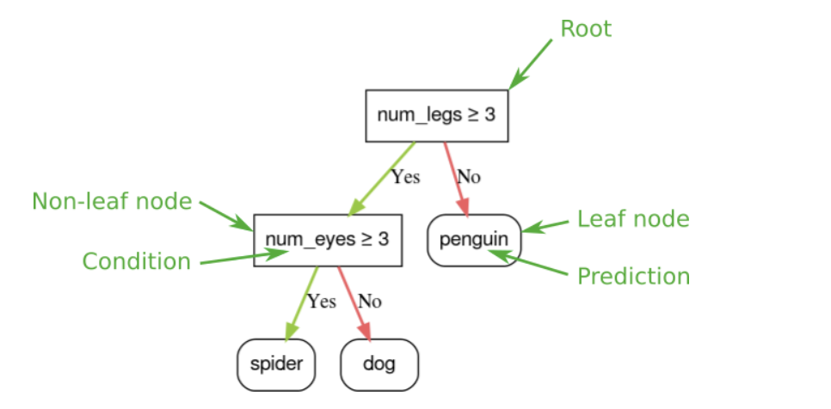

Slide 5
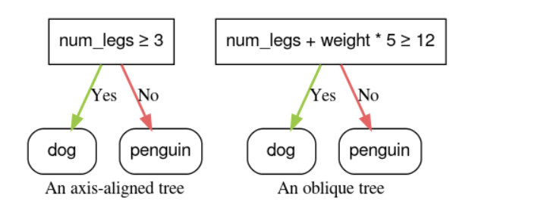

Slide 6
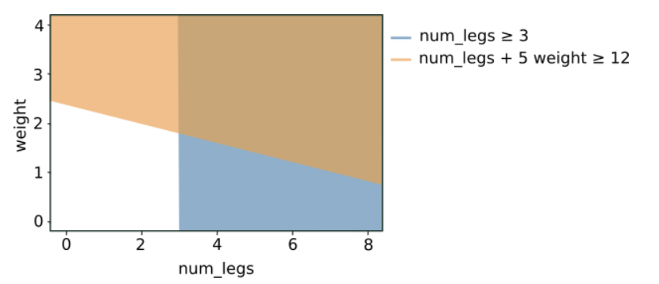

Slide 7
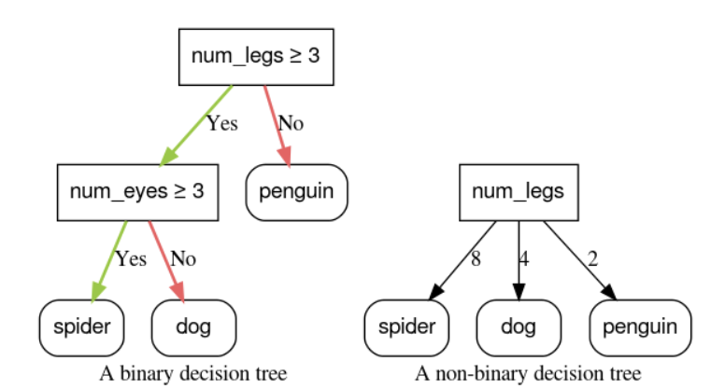

Slide 8
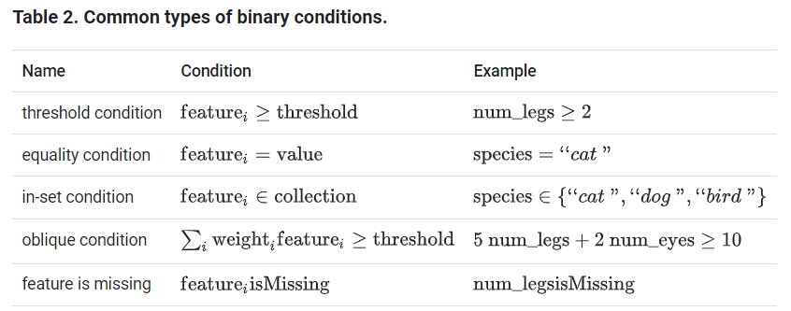

Slide 9
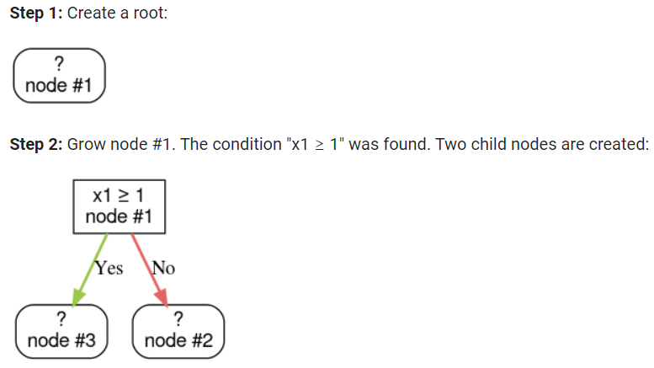

Slide 10
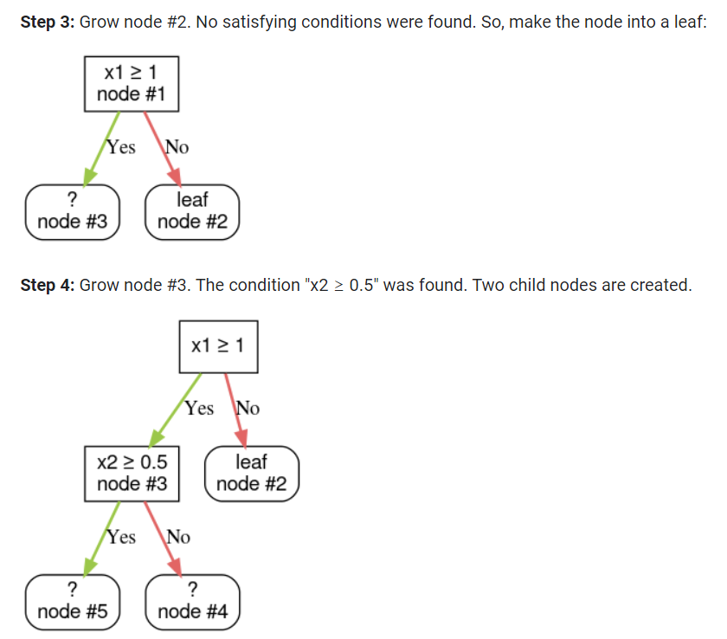

Slide 11
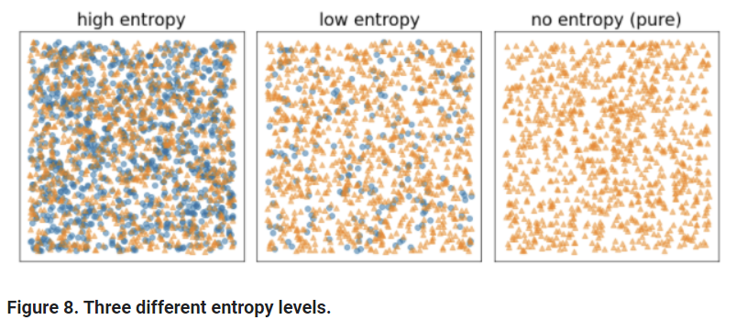

Slide 12
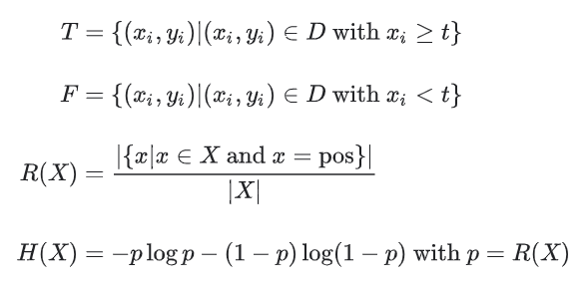

Slide 13


Slide 14
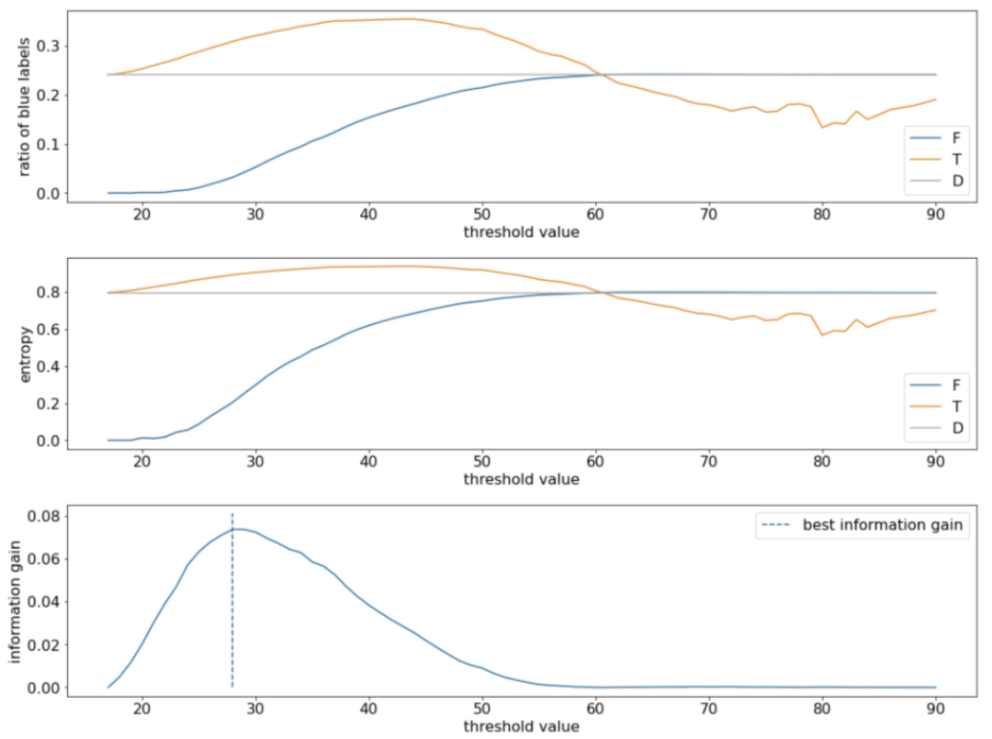

Slide 15
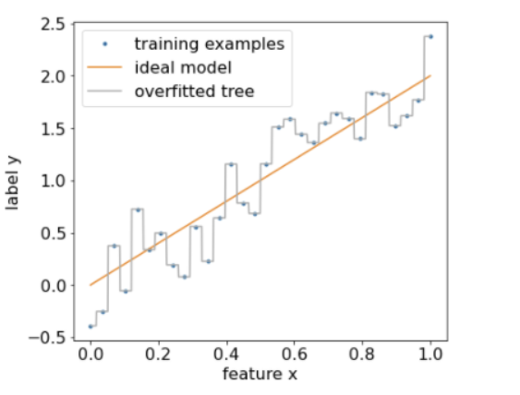

Slide 16
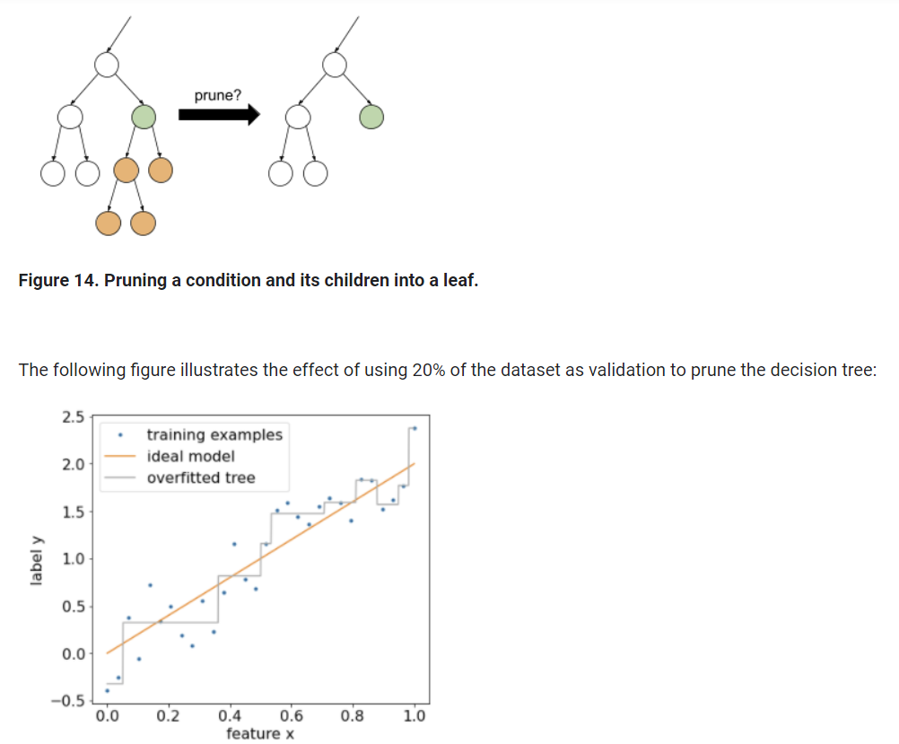

Slide 17
Decision Forests
A decision forest is a generic term to describe models made of multiple decision trees. The prediction of a decision forest is the aggregation of the predictions of its decision trees.
The implementation of this aggregation depends on the algorithm used to train the decision forest.

Slide 18
Random Forest
A random forest (RF) is an ensemble of decision trees in which each decision tree is trained with a specific random noise.
Bagging (bootstrap aggregating) means training each decision tree on a random subset of the examples in the training set.
Attribute sampling means that instead of looking for the best condition over all available features, only a random subset of features are tested at each node.

Slide 19
