Slide 1
Segment Anything Model
2022313382 백승렬

Slide 2

Goal: Make a Foundation Model for Image Segmentation

Slide 3



Need to Answer…
1. What task will enable zero-shot generalization?
2. What is the corresponding model architecture?
3. What data can power this task and model?

Slide 4

Task

Slide 5
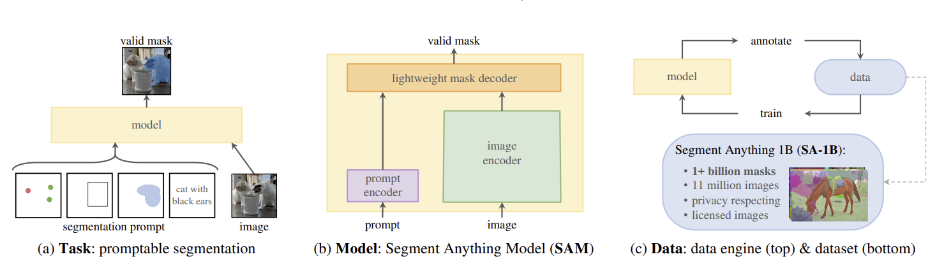

Slide 6



Task We start by translating the idea of a prompt from NLP to segmentation
Zero-shot transfer In general, a wide array of practical segmentation tasks can be cast as prompting.
Pre-training suggests a pre-training algorithm that simulates prompts and compares the mask predictions against the ground truth. We adapt this method from interactive segmentation

Slide 7

Model

Slide 9
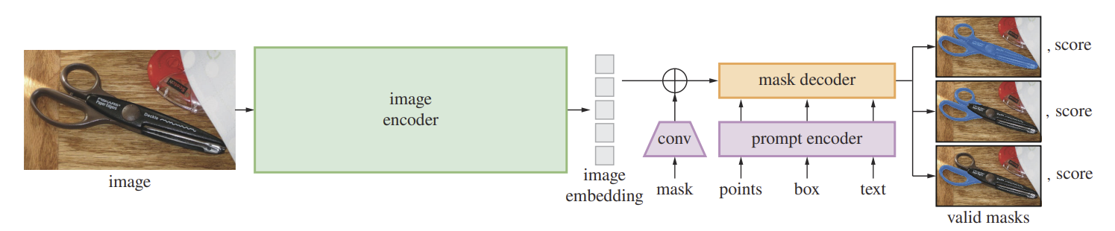
Architecture – Input&Output

Slide 10
Architecture – Using Prompt

Slide 11
Image Encoder
Motivated by scalability and powerful pretraining methods, we use an pre-trained Vision Transformer (ViT)

Slide 12
Prompt Encoder
We consider two sets of prompts: sparse (points, boxes, text) and dense (masks).
We represent points and boxes by positional encodings summed with learned embeddings for each prompt type and free-form text with an off-the-shelf text encoder from CLIP.
Dense prompts (i.e., masks) are embedded using convolutions and summed element-wise with the image embedding.

Slide 13
Mask Decoder
The mask decoder efficiently maps the image embedding, prompt embeddings, and an output token to a mask.
Employs a modification of a Transformer decoder block followed by a dynamic mask prediction head.
Uses prompt self-attention and cross-attention (prompt-to-image embedding and vice-versa) to update all embeddings.

Slide 14
Resolving ambiguity
With one output, the model will average multiple valid masks if given an ambiguous prompt.

Slide 15


Training
focal loss – focus the high score mask
dice loss – to catch small objects, not to focus on background

Slide 16

Data

Slide 17
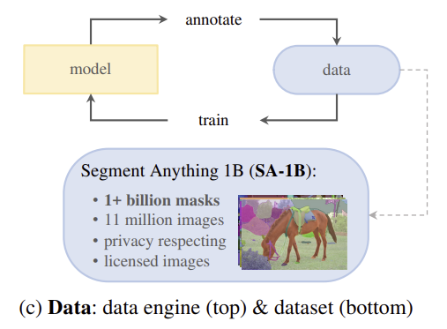

Slide 18
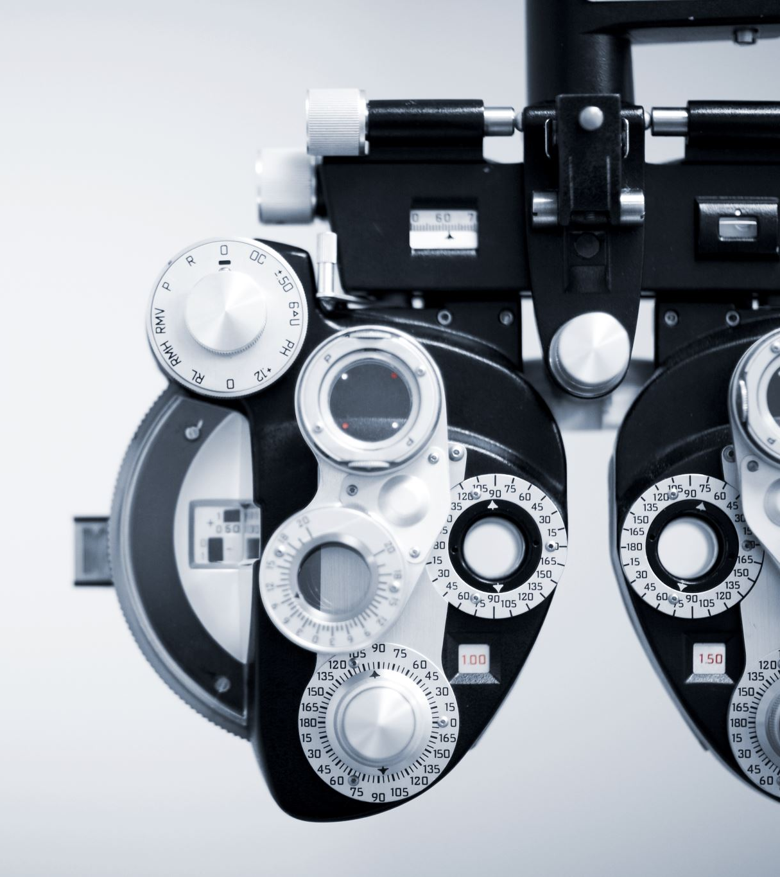
The data engine
A model-assisted manual annotation stage
A semi-automatic stage with a mix of automatically predicted masks and model-assisted annotation
A fully automatic stage in which our model generates masks without annotator input.

Slide 19

Assisted-manual stage
resembling classic interactive segmentation, a team of professional annotators labeled masks by clicking foreground / background object points using a browser-based interactive segmentation tool powered by SAM

Slide 20

Semi-automatic stage
first automatically detected confident masks. Then we presented annotators with images prefilled with these masks and asked them to annotate any additional unannotated objects. To detect confident masks, we trained a bounding box detector on all first stage masks using a generic “object” category.

Slide 21

Fully automatic stage
At the start of this stage, we had collected enough masks to greatly improve the model
Second, by this stage we had developed the ambiguity-aware model
after selecting the confident and stable masks, we applied non-maximal suppression (NMS) to filter duplicates.

Slide 22

Application - FastSAM

Slide 23

Problem-Hard to use SAM
Reason - ViT is too big and require a lot of computing resources

Slide 24

Solution-Use CNN for Image Encoder
Solve - Divide SAM Encoding into 2 steps:
Image Encoding: Possible with CNN
2. Prompt Encoding: Already light enough
Used Model – Yolov8_seg

Slide 25
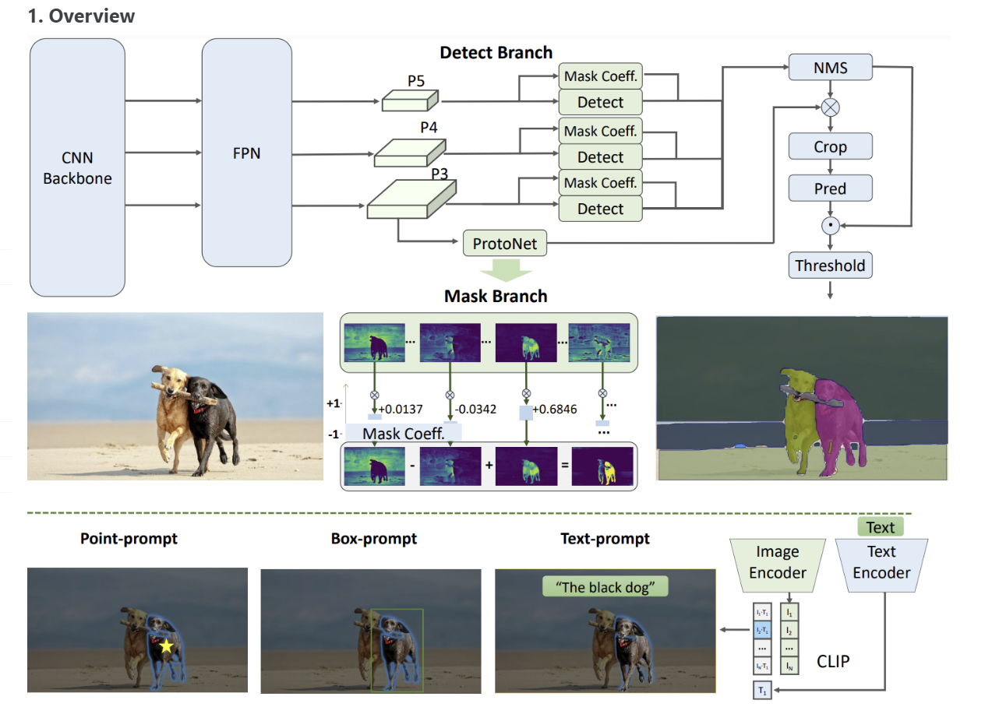

Slide 26
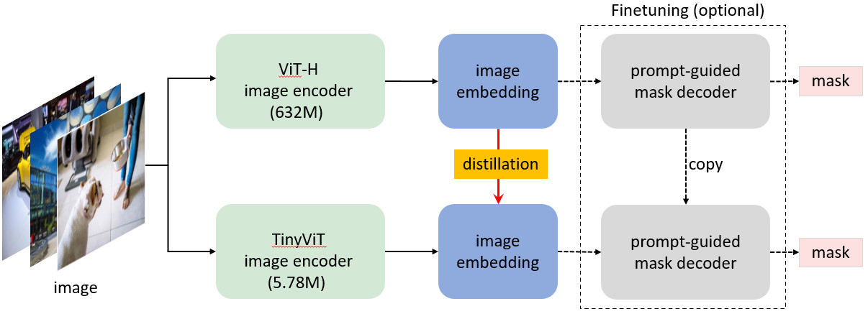
mobileSAM- Lighter Model

