Slide 1
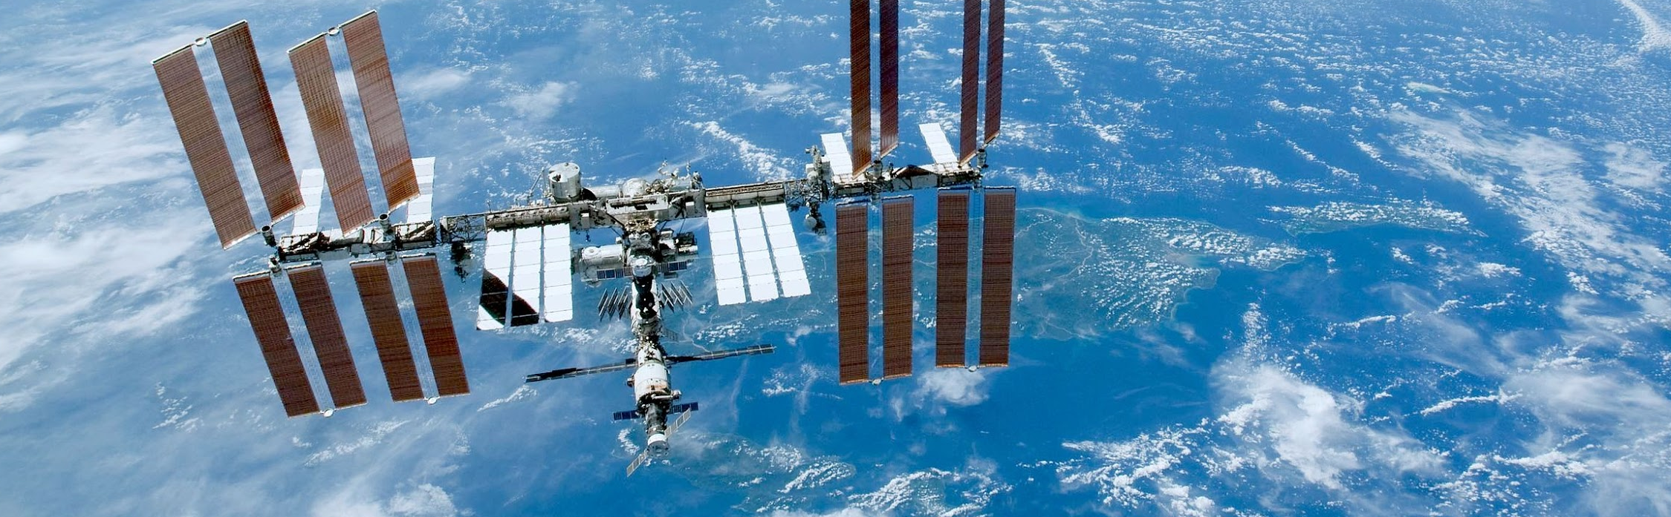
IoT project
IoT: Bernardo Sata, Gonçalo Fontes Neves
Data Manage: Alberto Gonzalez, Seungah Lee
AI: Brian Franklin, Mohamed Eltablawy, Adrien Mencik
GUI: Gabriella Catalan, Aizar Berlanga

Slide 2
Introduction
Project name : Factory of the future
Project goals : Deploy a system to monitor and control a finite set of factories remotely.
Description: This project will consider two different factories. Factory ‘Le Monde’ and ‘Chocolatine’. Both factories will be monitored thanks to a redundant system of three environmental sensors. After merging the data of the sensors using a clustering algorithm, it is sent to a server which is in charge of storing the information and send it back to a remote display and to a prediction block. The server also sends data back to the factories regarding the state of two actuators: a fan and a LED.

Slide 3




Introduction
IoT
Bernardo Sata
Gonçalo Fontes Neves
Data Management
Alberto Gonzalez
Seungah Lee
AI
Brian Franklin
Mohamed Eltablawy
Adrien Mencik
GUI
Gabriella Catalan
Aizar Berlanga

Slide 4
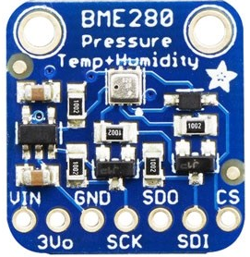
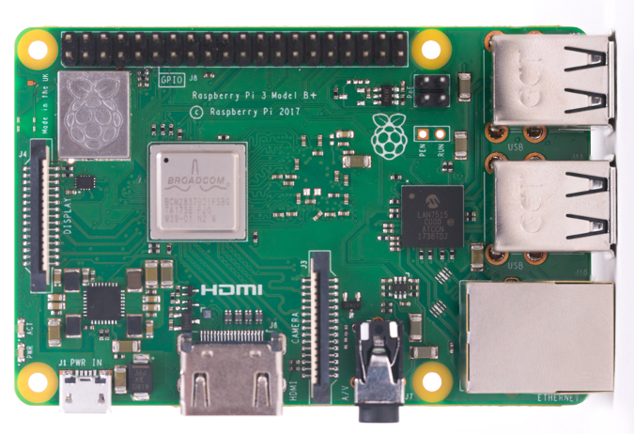
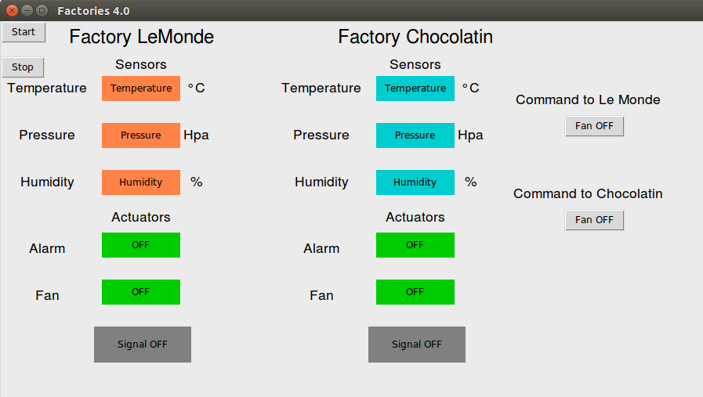
System Configuration
Server
Factory Le Monde
Factory Chocolatine

Slide 5
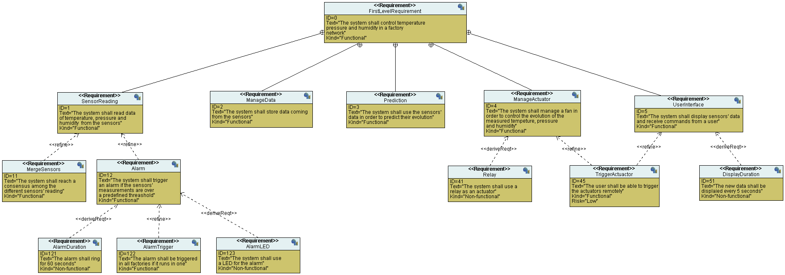
Conceptual Analysis: Requirement Diagram

Slide 6
Conceptual Analysis: Requirement Diagram

Slide 7
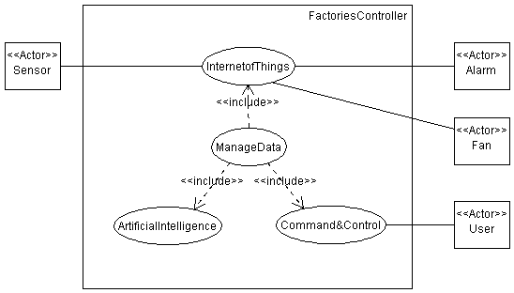
Functional Analysis: Use Case Diagram

Slide 8
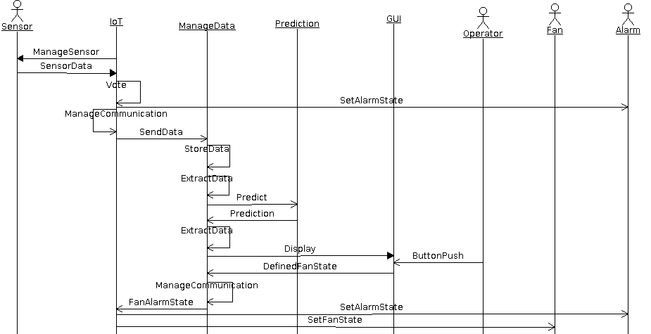
Functional Analysis: Sequence Diagram

Slide 9
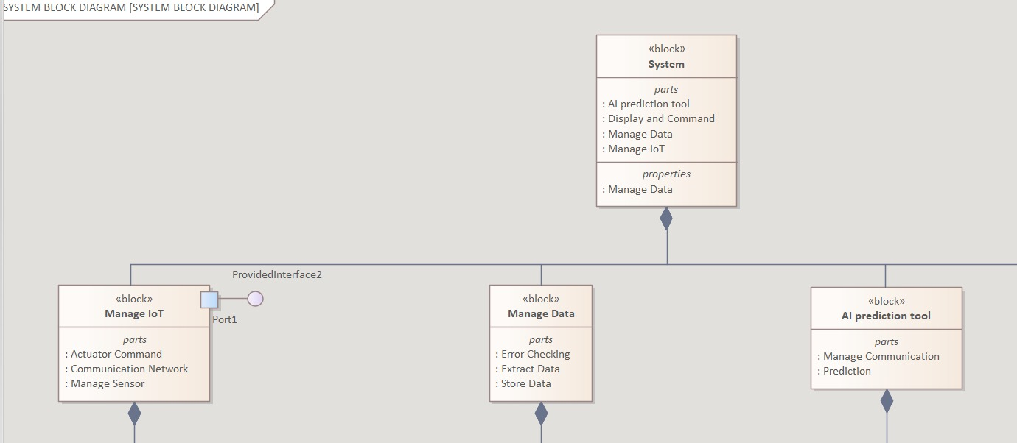
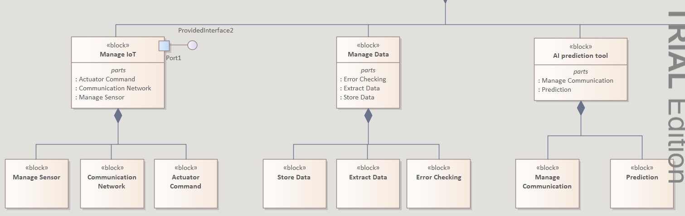
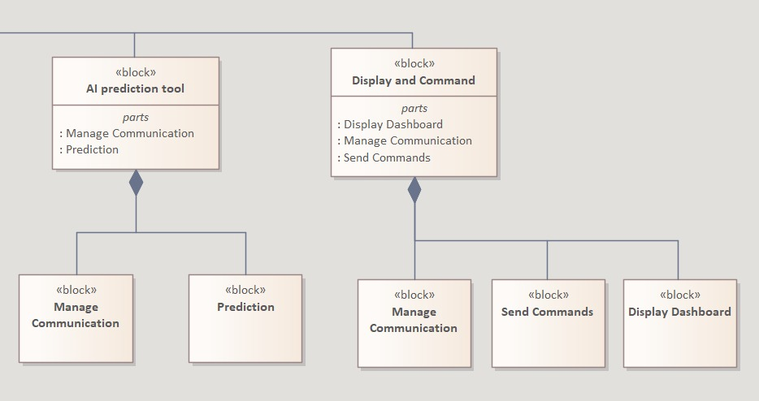
Functional Analysis: Block Diagram

Slide 10
Functional Analysis: Block Diagram

Slide 11
Functional Analysis: Block Diagram

Slide 12
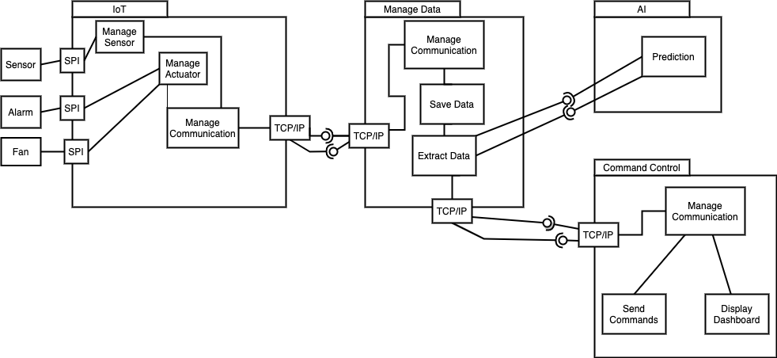
Functional Analysis: Internal Block Diagram
2
1
3
2
4
Sensor and Actuator data: IoT → Manage Data → GUI & AI
Prediction result: AI → Manage Data → Command Control
Command: GUI → Manage Data → IoT
Blue box : sensor, actuator, prediction
Yellow box: commands
1
Notes:
1 minute\\ square identification spi proxy

Slide 13
IoT Factories
Sensor reading
Periodic Task
Receive Commands
Sporadic Task
Merge & Send
Sporadic Task
LED blink
Sporadic Task

Slide 14
Data Manage
Factories
Data Manage & AI
GUI
For factories
Port: 8080
For GUI
Port: 9090
factory 1
factory 2
Notes:
1 minute

Slide 15
Data Manage
Factories
Data Manage & AI
GUI
Launch Thread
factory
Communication
GUI
Communication
GUI Communication
handler
factory 1
factory 2
factorycommunication handler
factorycommunication handler
Notes:
1 minute

Slide 16
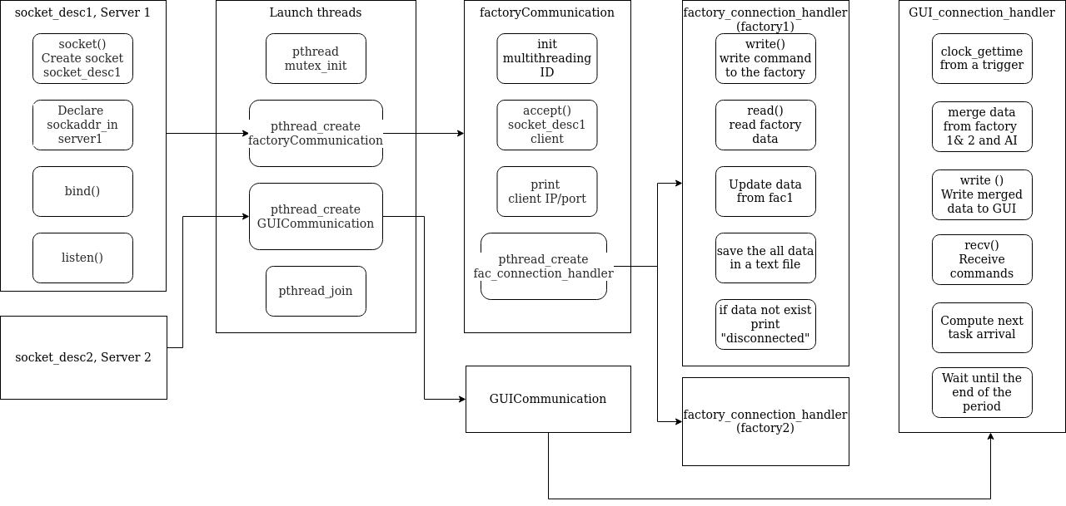
Data Manage
Flow chart
Notes:
1 minute

Slide 17
Data Manage
Use of TCP socket
create a socket
for data transmission
read/write
data and command
create, bind socket
wait for a client
Notes:
1 minute

Slide 18
Data Manage
Use of mutex
initalize mutex
lock & unlock mutex
Notes:
1 minute

Slide 19
Graphical Interface
Data Manage
Open a client connection to read the
information
Launch Thread
to Read info and Send commands
Display Thread
Update display
Thread
Send Commands
Plot
Thread

Slide 20
GUI

Slide 21
AI
AI’s purpose: To predict values based on received data:​
-Time, pressure/humidity/temperature. ​
-Data received as a structure. ​
-Prediction made using a linear regression model. This model is computed using the GSL library. ​
-Data received every 5 seconds. ​
-Prediction done at every reception of data.

Slide 22
AI : The code
Link with the data processing:
-the function Pred() is called after reception of data. The data comes as a structure.
-The structure is divided in values of time pressure, humidity and temperature. These values are swiped in the existing array and used in the function argument.
-Pred() takes into argument arrays of the time and the received value of data to be predicted.

Slide 23
AI : The function Pred
The function Pred():
-uses the gsl function gsl_fit_linear to calculate the linear regression.
-returns the values of temperature, pressure or humidity predicted as double, later sent to GUI.

Slide 24
THANK YOU

