Slide 1
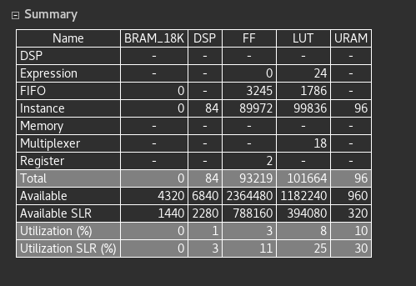
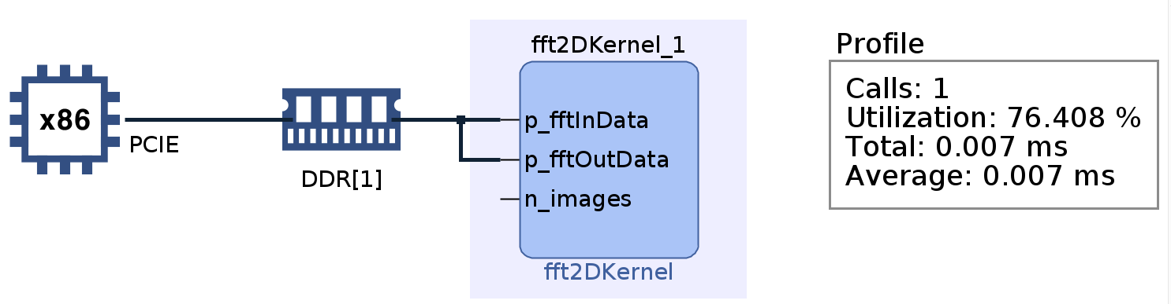
2-Dimensional FFT, Sami Ben Ali & Seungah Lee, Université de Rennes 1, https://github.com/SeungahLEE0820/xacc_2022/tree/master
Summary
Plan – Use 2D FFT (2-dimensional Fast Fourier Transform), a filter for image processing and use a Inverse 2D FFT
Final project – Apply 2D FFT with impulse as input
Block diagram
Use L2 library - DSP
Optimize library to run on Vitis (library path, xclbin path, memory bank)
Reduce repeating time (4096 ->1)
Results

