Slide 1

25.4.24 세미나
Statistical Learning and Computational Finance Lab.
Department of Industrial Engineering
http://slcf.snu.ac.kr

Slide 2
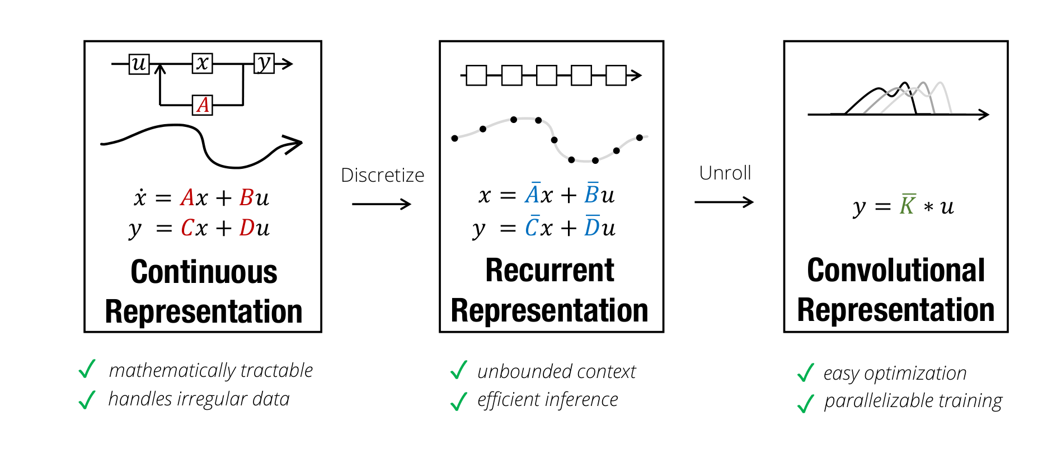
State space model
State space model with DL
Hippo (NeurIPS 20)
State space model with hippo (NeurIPS 21)
S4 (ICLR 22 outstanding)

