Slide 1













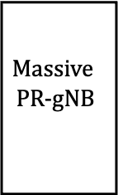


1
$$P_{gNB}$$
$$Massive$$
PR-gNB
2
$$H_{eff}^{ }∈ℂ^{2×2N_{t}}$$
$$Y_{gNB}$$
$d$ownlink
Neural Network
$$Y_{UE}$$
$$W$$
$$P_{UE}$$
Neural Network
$N_{t}$-1
uplink
$$H_{eff}^{T}∈ℂ^{2N_{t}×2}$$
UE
$$N_{t}$$
$Y_{gNB}:$ uplink pilots
$Y_{UE}:d$ownlink pilots

Slide 2









1
$$P_{gNB}$$
$$Massive$$
PR-gNB
2
$$H_{up}^{ }∈ℂ^{2×2N_{t}}$$
$$Y_{gNB}$$
$d$ownlink
Neural Network
$$Y_{UE}$$
$$w$$
$$p_{UE}$$
Neural Network
$N_{t}$-1
uplink
$$H_{up}^{T}∈ℂ^{2N_{t}×2}$$
UE
$$N_{t}$$
$Y_{gNB}:$ uplink pilots
$Y_{UE}:d$ownlink pilots

Slide 3

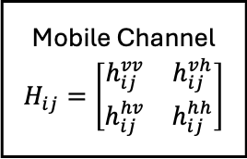






Beamformer
Reconfigurable Antenna
Maximal-Ratio Combining
$$w_{1}$$
1
1
Massive PR-gNB
2
Mobile Channel
$$H_{ij}=\left[\begin{matrix}h_{ij}^{vv} & h_{ij}^{vh} \\ h_{ij}^{hv} & h_{ij}^{hh}\end{matrix}\right]$$
Data source
2
$$w_{2}$$
$$N_{t}$$
$N_{t}$-1
$$N_{t}$$
$$w_{N_{t}}$$
Polarization precoding
Polarization postcoding
Channel state information (CSI)

