Slide 1








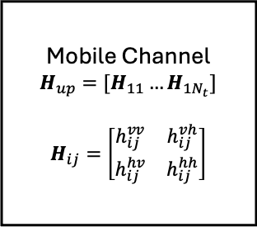



gNB
$$w$$
Reconfigurable Antenna
$$w_{1}$$
$${\tilde{x}}_{1 }$$
Mobile Channel
$$H_{up}=[H_{11}…H_{1N_{t}}]$$
$$H_{ij}=\left[\begin{matrix}h_{ij}^{vv} & h_{ij}^{vh} \\ h_{ij}^{hv} & h_{ij}^{hh}\end{matrix}\right]$$
$$x_{ }$$
$$x_{ }$$
$${\tilde{x}}_{2 }$$
UE
$$w_{2}$$
$$r$$
$$x_{ }$$
$${\tilde{x}}_{N_{t} }$$
$$w_{N_{t}}$$
gNB
Polarization
UE
Polarization
Channel state information (CSI)

