Slide 1
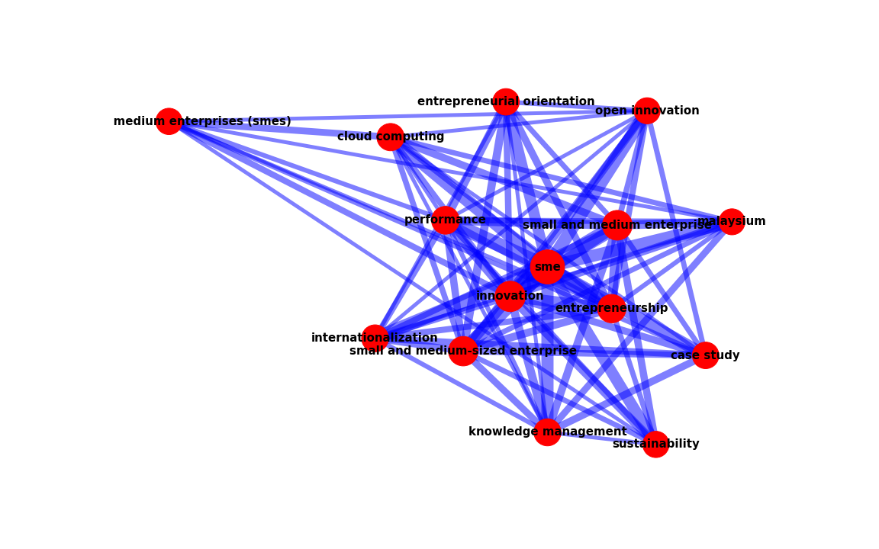
entire network for SME

Slide 2
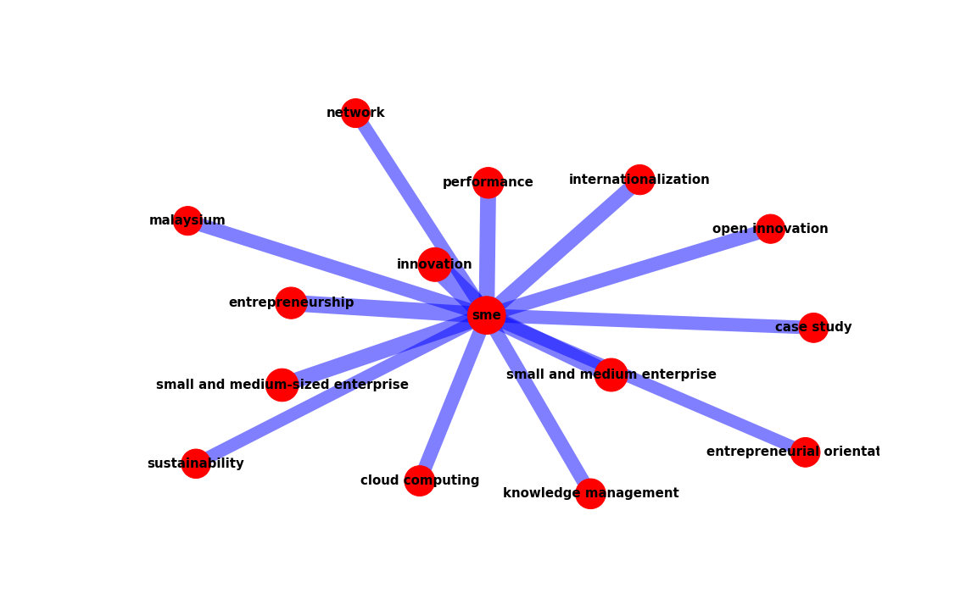
ego network of 'sme'

Slide 3
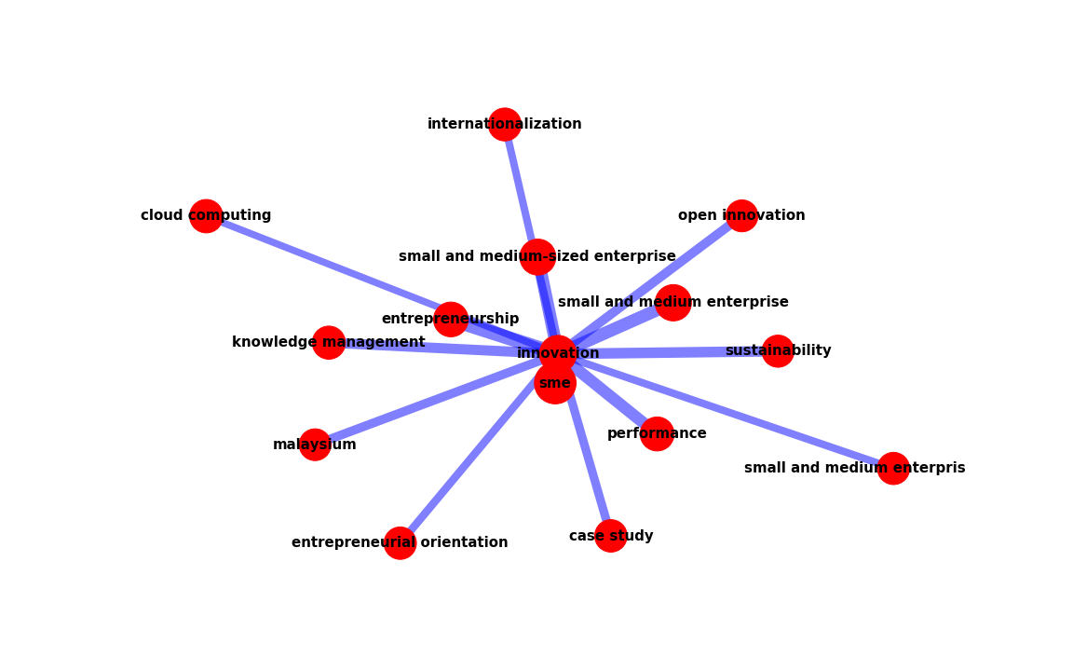
ego network of 'innovation'

Slide 4
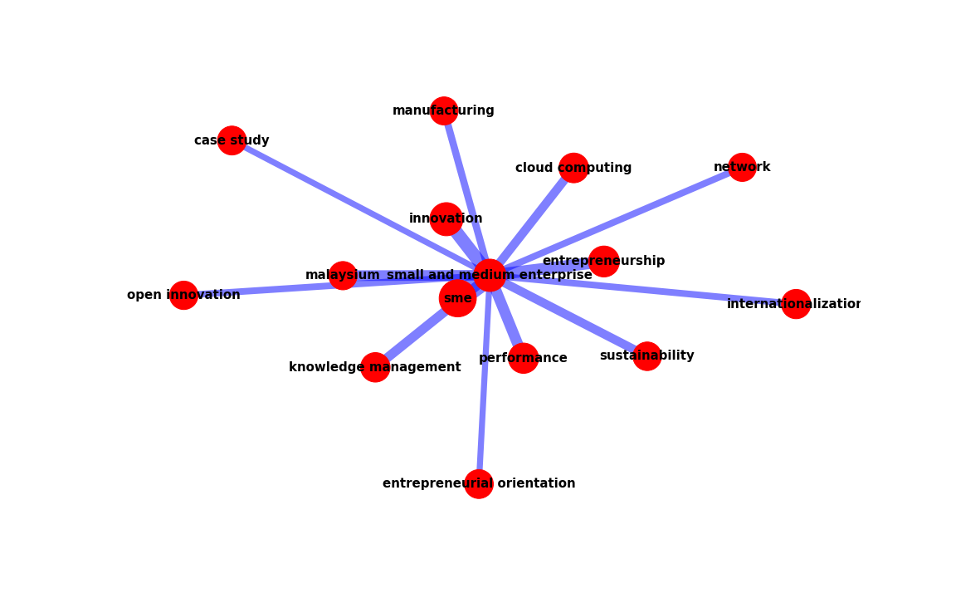
ego network of 'small and medium enterprise'

Slide 5
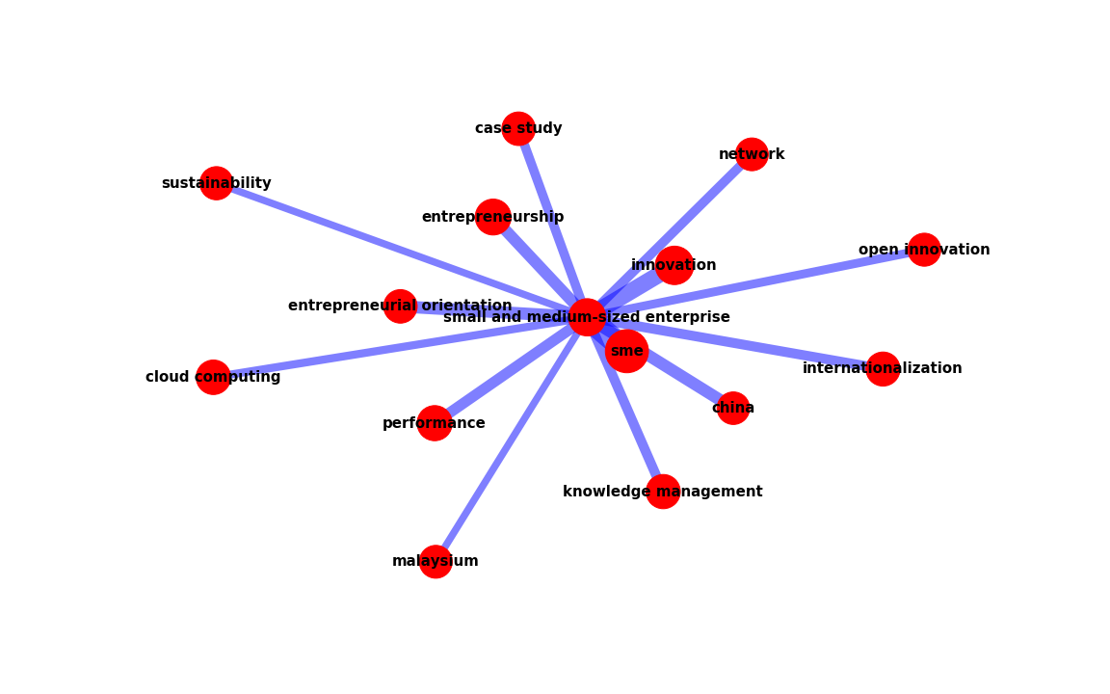
ego network of 'small and medium-sized enterprise'

Slide 6
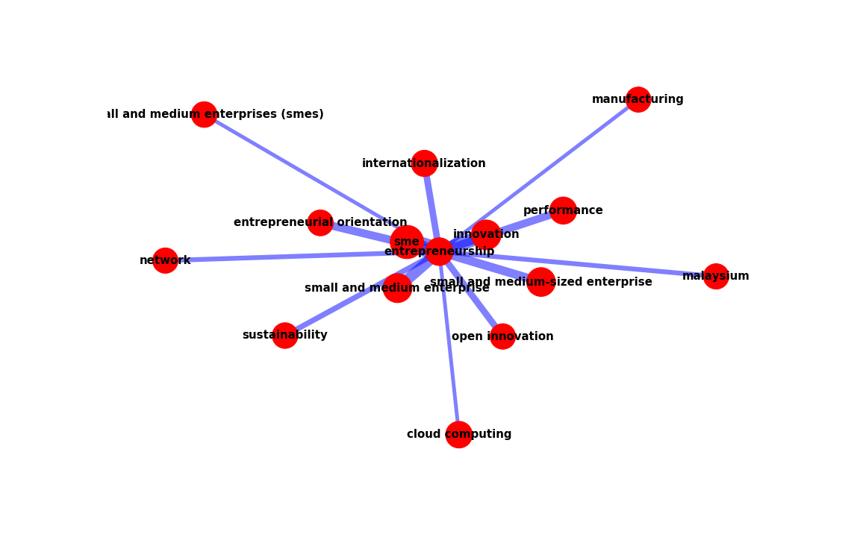
ego network of 'entrepreneurship'

Slide 7
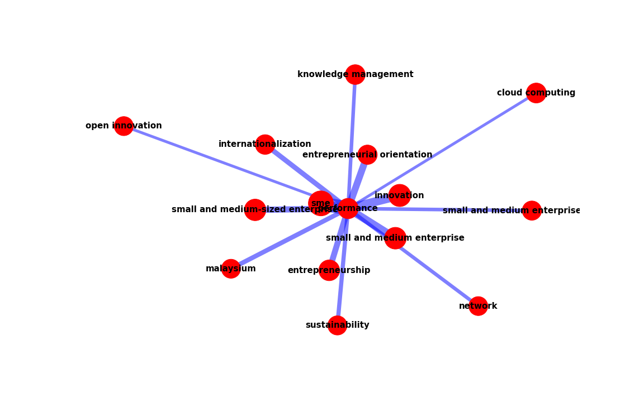
ego network of 'performance'

Slide 8
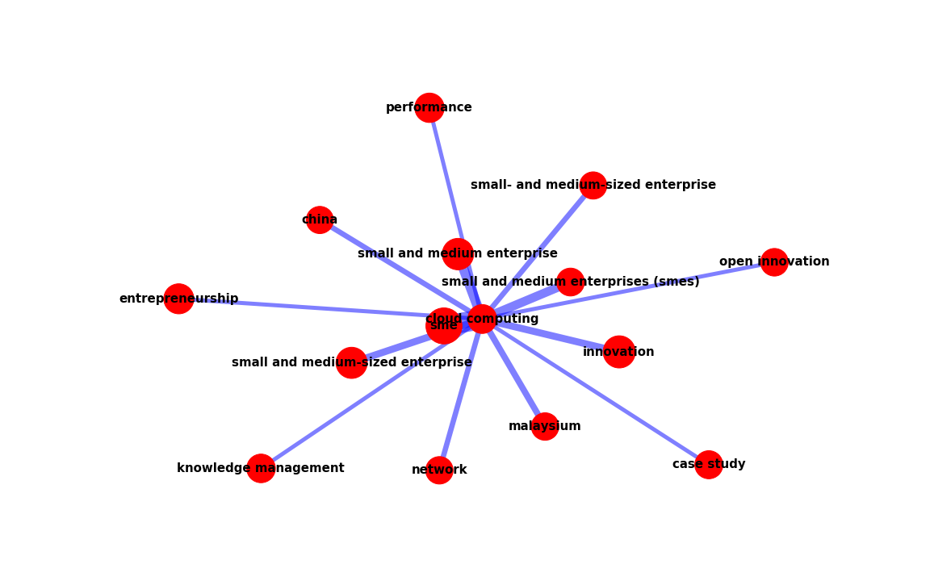
ego network of 'cloud computing'

Slide 9
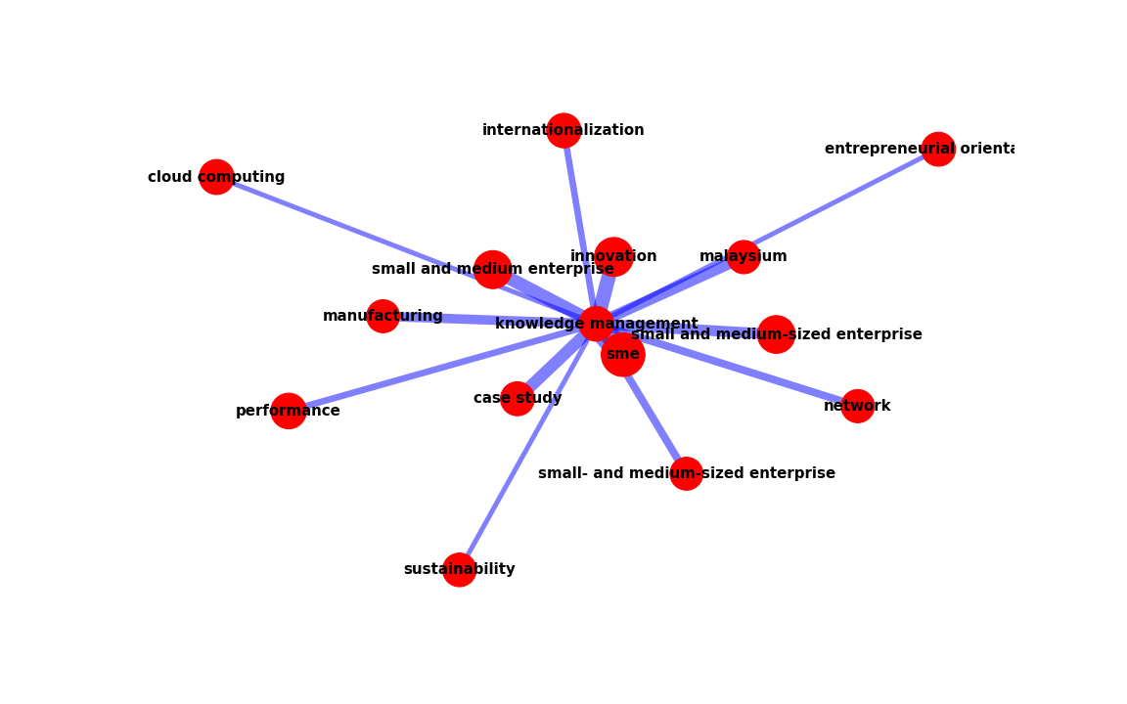
ego network of 'knowledge management'

Slide 10
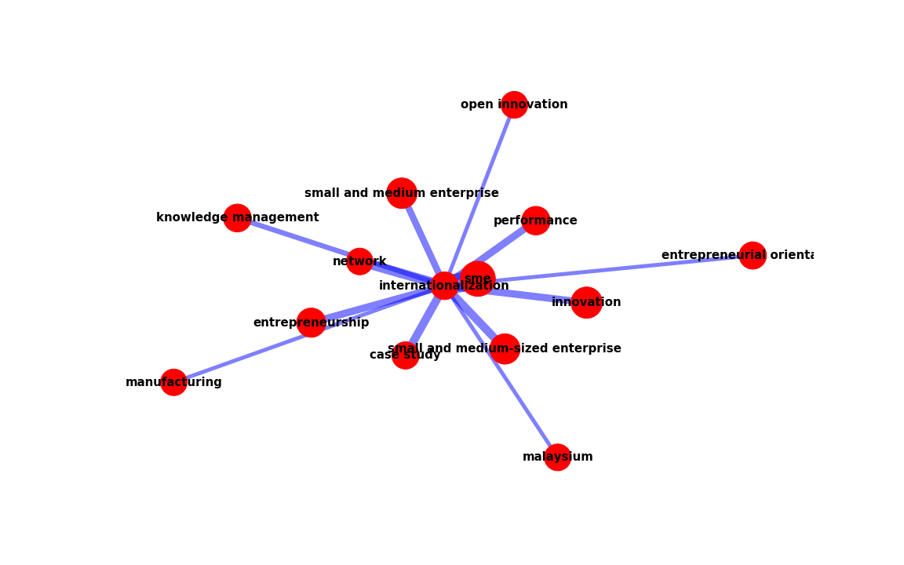
ego network of 'internationalization'

Slide 11
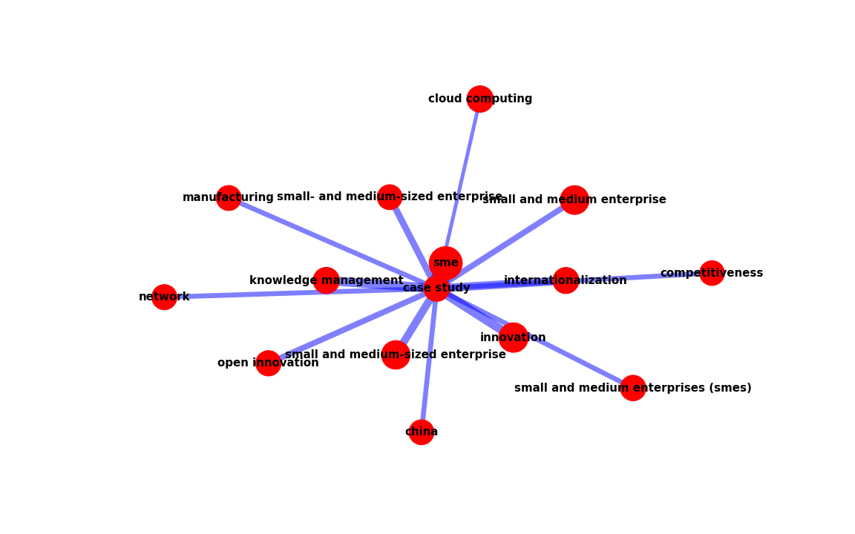
ego network of 'case study'

