Slide 1
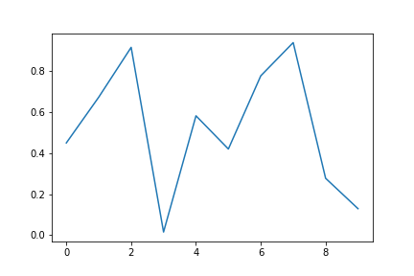
title: 0
content: 0

Slide 2
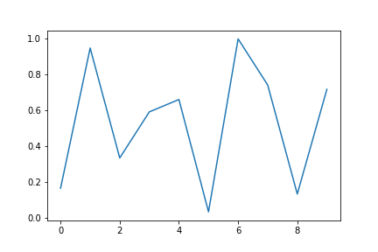
title: 1
content: 1

Slide 3
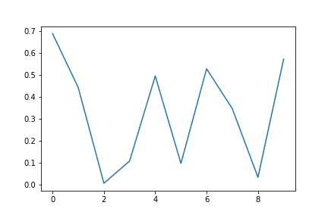
title: 2
content: 2

Slide 4
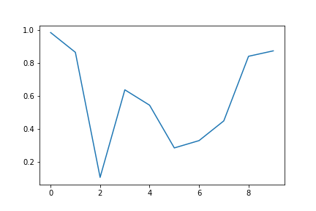
title: 3
content: 3

Slide 5
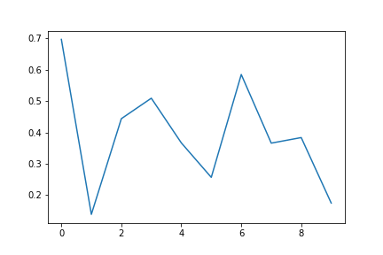
title: 4
content: 4

