Slide 1
One Quantitative Variable: Measures of Spread
Section 2.3

Slide 2
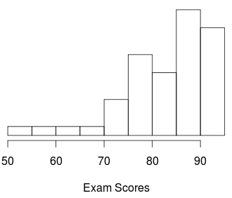
Review
The exam scores shown in the histogram are
Symmetric
Left-skewed
Right-skewed

Slide 3
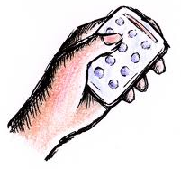
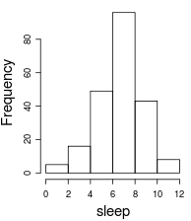
The 95% Rule
The standard deviation for hours of sleep per night is closest to
½
1
2
4
I have no idea

Slide 4
z-score
Which is better, an ACT score of 28 or a combined SAT score of 2100?
ACT: μ = 21, σ = 5
SAT: μ = 1500, σ = 325
Assume ACT and SAT scores have approximately bell-shaped distributions
ACT score of 28
SAT score of 2100
I don’t know

Slide 5
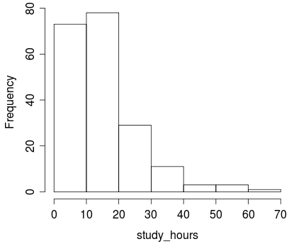
Five Number Summary
> summary(study_hours)
Min. 1st Qu. Median 3rd Qu. Max.
2.00 10.00 15.00 20.00 69.00
The distribution of number of hours spent studying each week is
Symmetric
Right-skewed
Left-skewed
Impossible to tell

Slide 6
Measures of Spread
Range = Max – Min
Interquartile Range (IQR) = Q₃ – Q₁
Is the range resistant to outliers?
Yes
No
Is the IQR resistant to outliers?
Yes
No
The range depends entirely on the most extreme values.
The IQR is based off the middle 50% of the data, which will not contain outliers.

