Slide 1
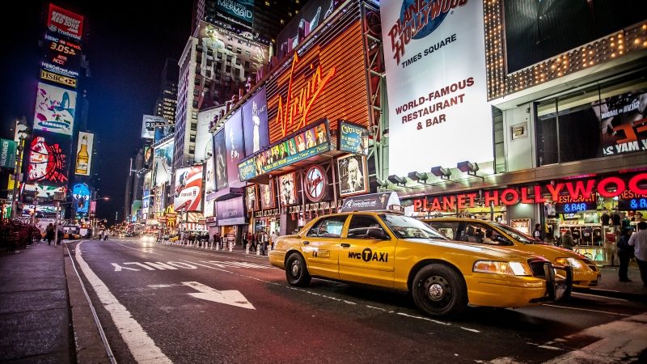
Take Home Assessment
New York City Taxi Data
Samir Yelne

Slide 2
Data Details
Lets first look into the data details before doing any analysis.
I have two csv files named : trip_fare.csv trip_data.csv
The data periodicity is from 2013-03-31 to 2013-04-29 So it is almost one month NYC taxi data from March 31 - April 29 2013.
The number of rows for both these csv files is 15100468 which is approximately 15 million rows.
The size of these two files is : trip_fare.csv -> 1.72 GB trip_data.csv -> 2.52 GB
I have used the entire data for answering most of the questions. Only for few questions where I needed to plot a map I have used sample data as the data size is big.

Slide 3
Basic Questions

Slide 4
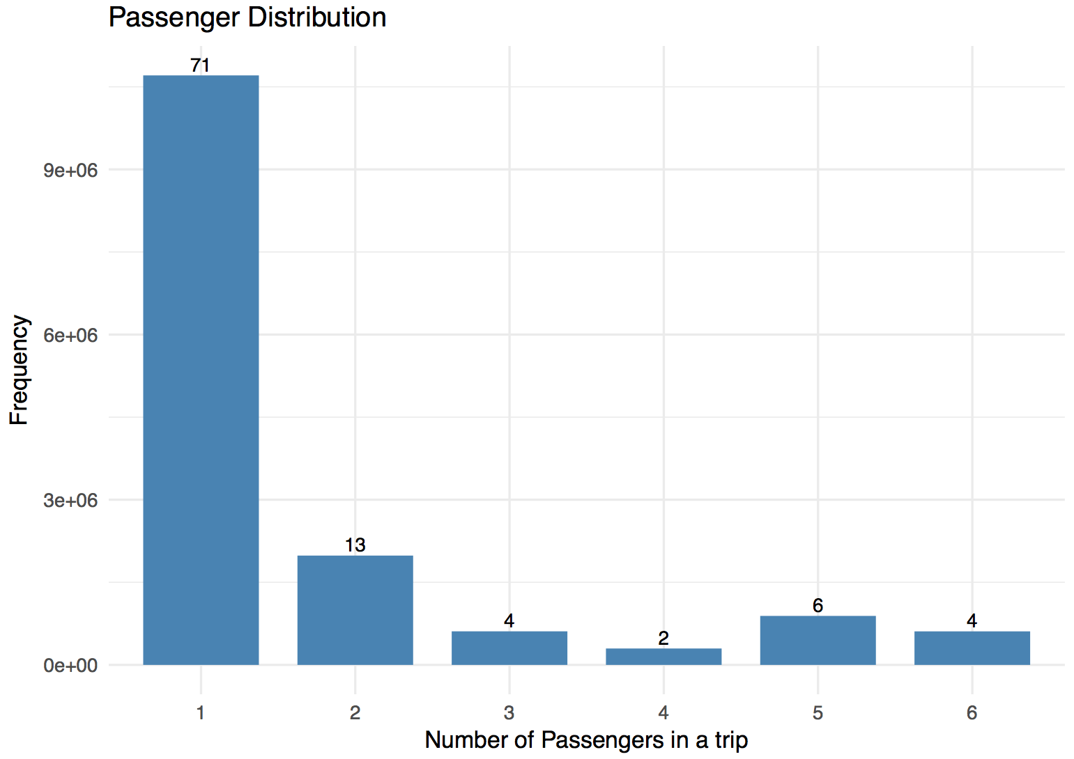
Basic Questions
a. What is the distribution of number of passengers per trip ?
The bar-plot on the left shows the distribution of number of passengers per trip.
The figure on the top of bars is the approximate percentage. Y axis is the number of trips / frequency.
From the plot you can see almost 71% of all the trips had one passenger, 13% had 2 passengers and like wise.
There was one trip which had 8 passengers and one trip which had 9 passengers. I removed those data points from this plot as it is an outlier.
Also 229 trips in the data had zero passengers which could have been some data error so I removed those data points too.

Slide 5
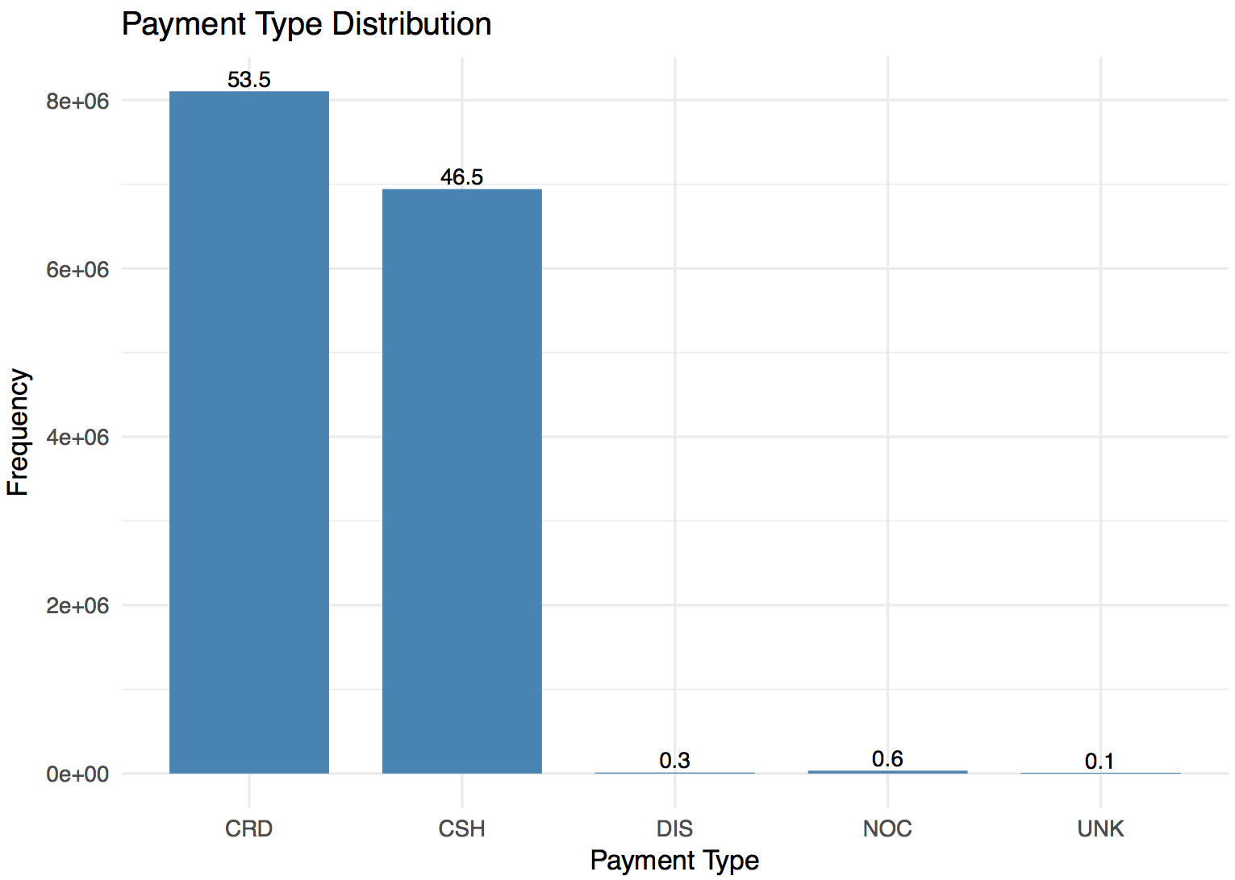
Basic Questions
b. What is the distribution of payment type ?
The bar-plot on the left shows the distribution of payment type.
The figure on the top of bars is the approximate percentage. Y axis is the number of trips / frequency.
From the plot you can see almost 53.5% of all the payments were made through CRD, 46.5% of the payments through CSH and likewise.

Slide 6
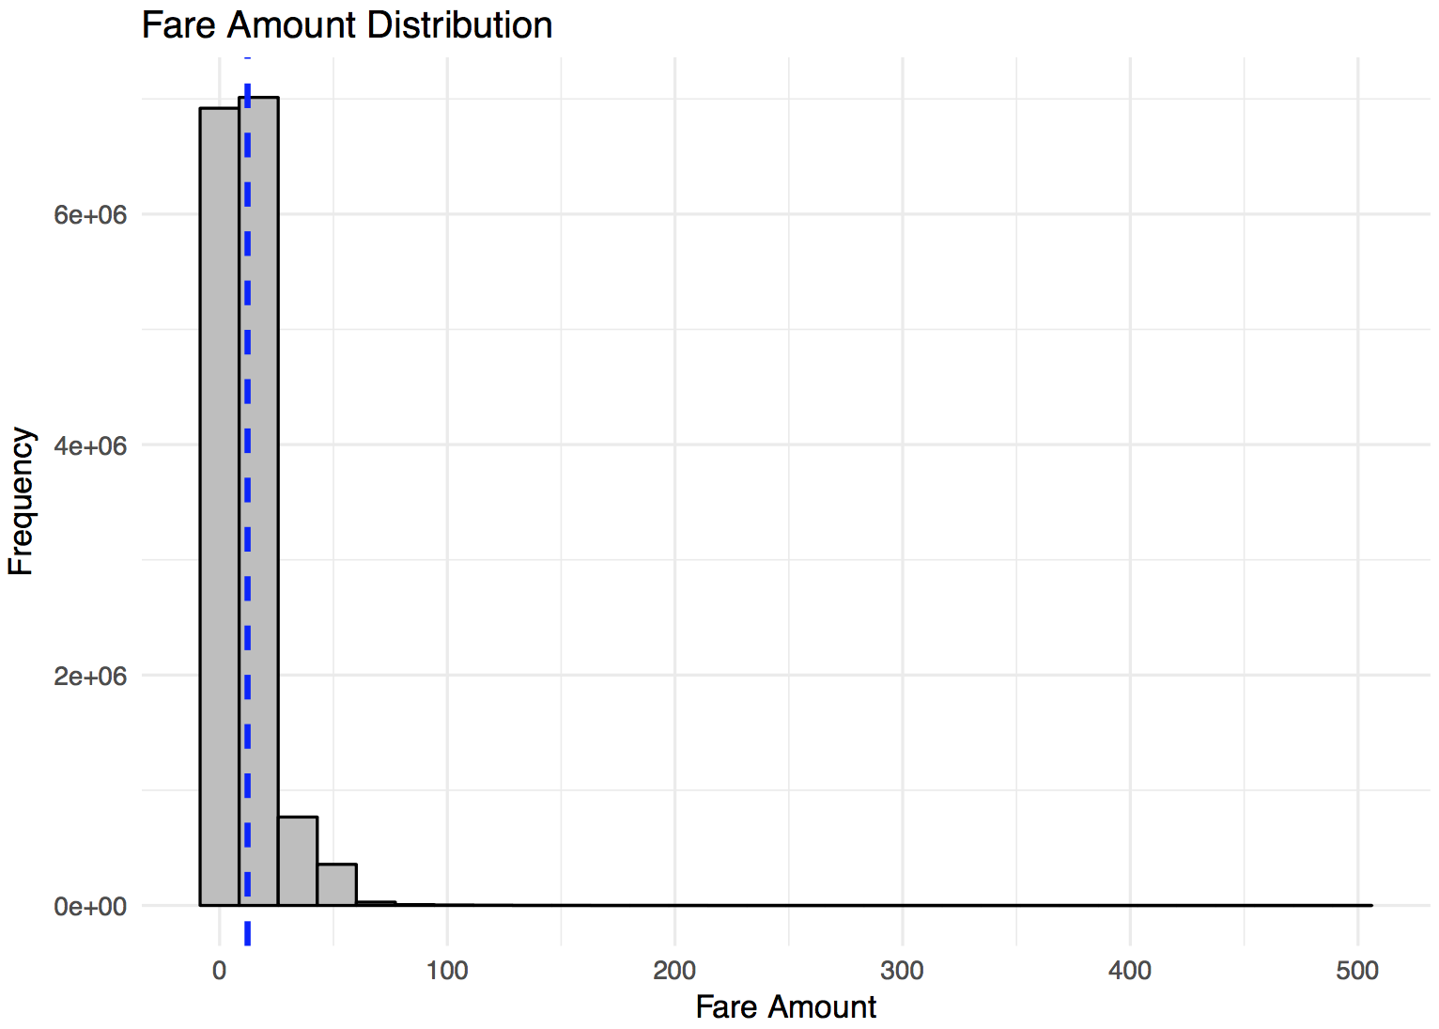

Basic Questions
c. What is the distribution of fare amount ?
Summary Statistics
The summary statistics of Fare amount is shown at the top. The median < mean so the distribution is right skewed.
The histogram shows the distribution of fare amount which is a right skewed distribution. The blue line shows the mean fare amount value.
The mean fare amount is 12.27$ and the median is 9.50$.
There are few outliers with very high fare amount and the maximum fare amount is 500$.

Slide 7
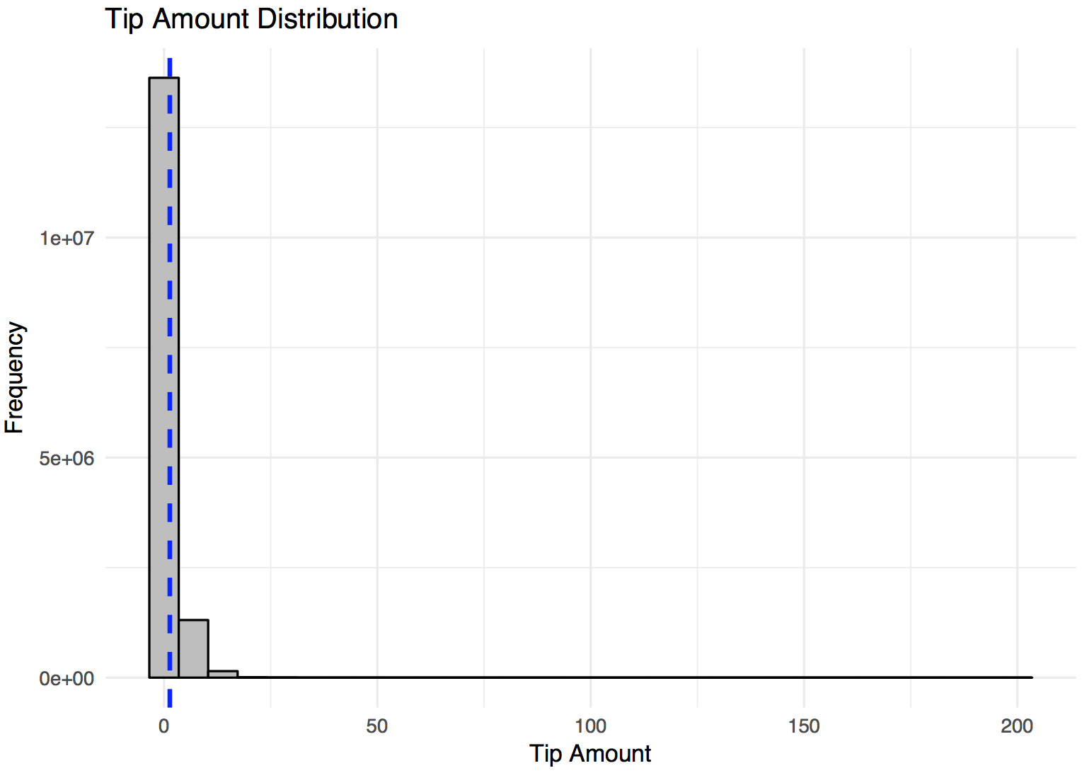
Basic Questions
d. What is the distribution of tip amount ?
Summary Statistics
The summary statistics of tip amount is shown at the top. The median < mean so the distribution is right skewed.
The histogram shows the distribution of tip amount which is a right skewed distribution. The blue line shows the mean tip amount value.
The mean tip amount is 1.346$ and the median is 1.00$.
There are few outliers with very high tip amount and the maximum tip amount is 200$.

Slide 8
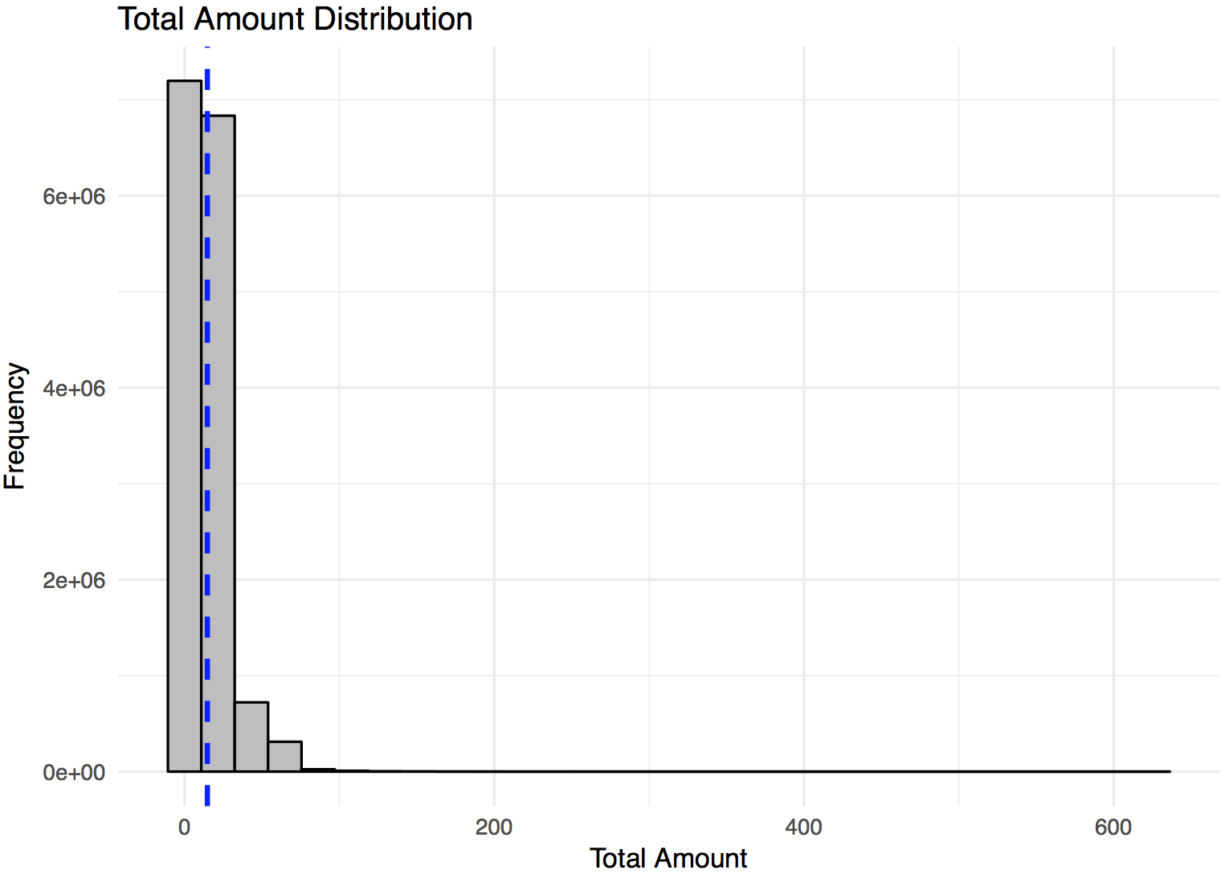

Basic Questions
e. What is the distribution of total amount ?
Summary Statistics
The summary statistics of total amount is shown at the top. The median < mean so the distribution is right skewed.
The histogram shows the distribution of total amount which is a right skewed distribution. The blue line shows the mean tip amount value.
The mean total amount is 14.69$ and the median is 11.00$.
There are few outliers with very high total amount and the maximum total amount is 628.10$.
All the histogram plots for fare amount, tip amount and total amount are right skewed distribution with few outliers having very large values.

Slide 9
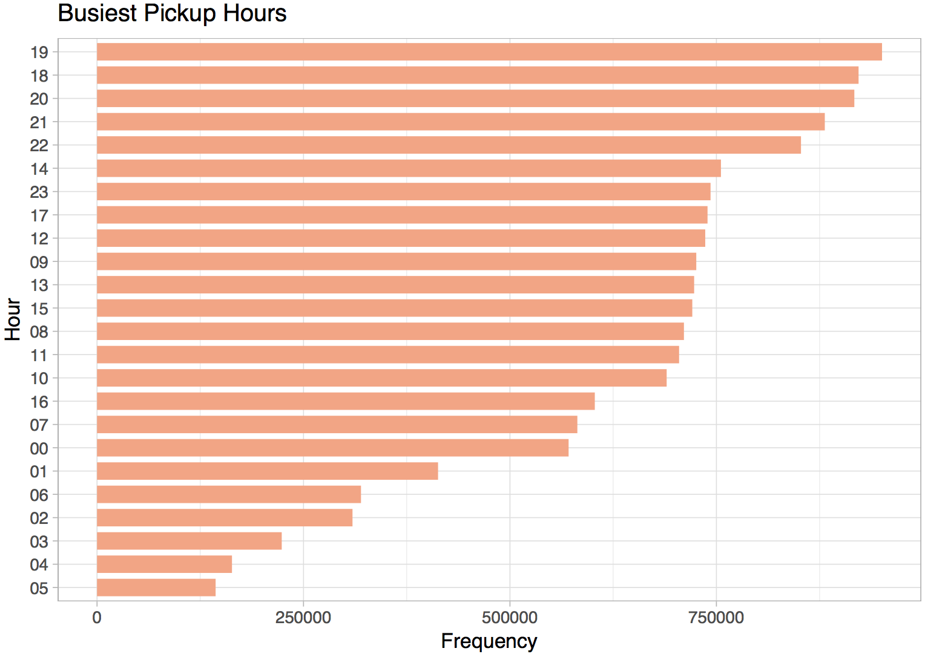
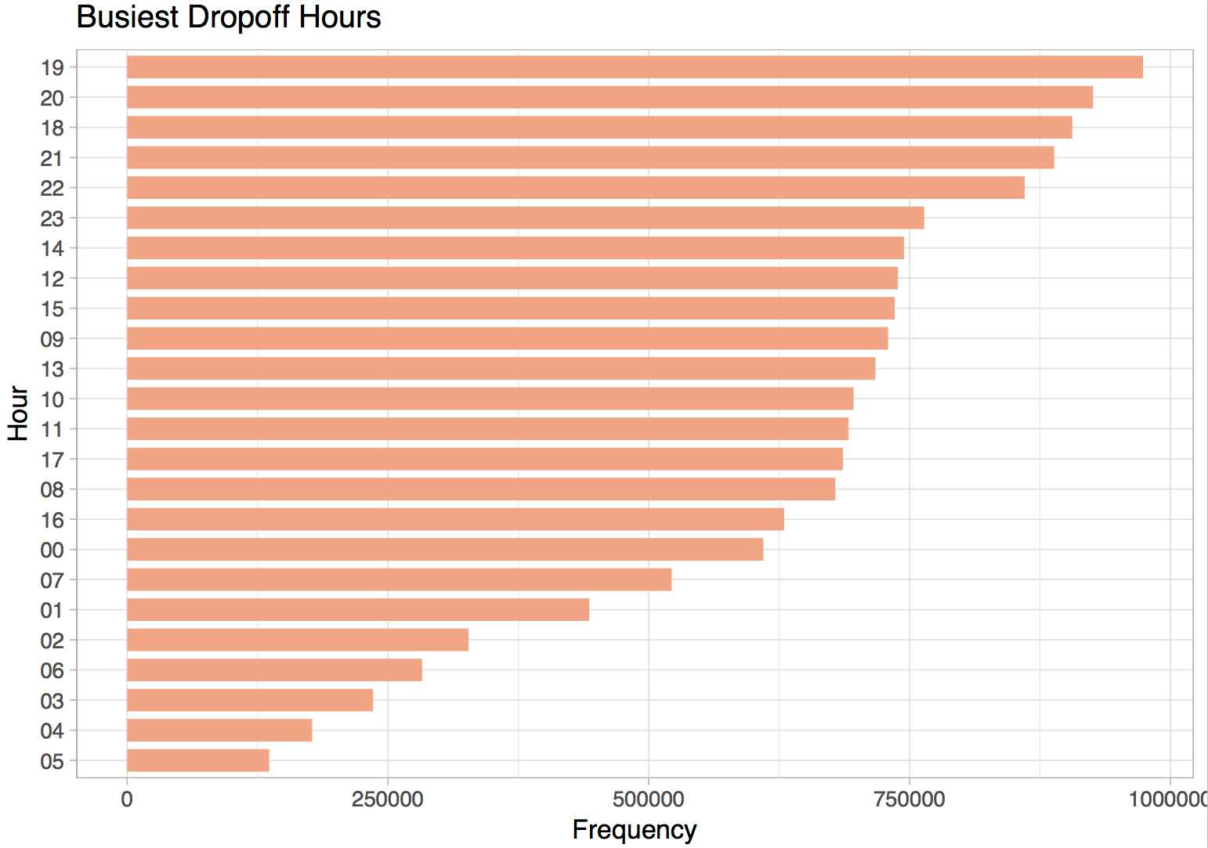
Basic Questions
f. What are the top 5 busiest hours of the day ?
The top 5 busiest pickup and drop-off hours are 18,19,20,21,22.
So the top 5 busiest hours are from 6pm - 10pm.

Slide 10
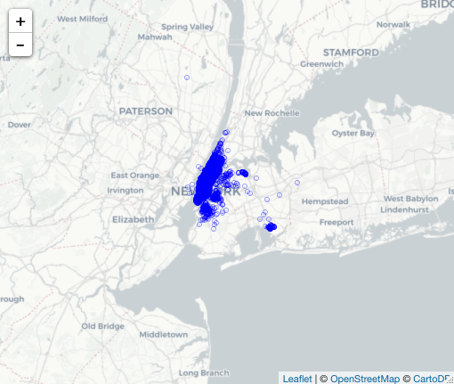
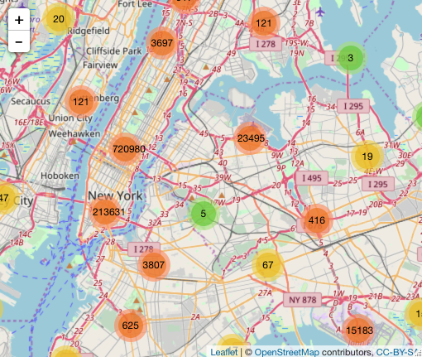
Basic Questions
g. What are the top 10 busiest locations of the city ?
The left map show a high level view of which areas are the busiest and the map on the right show the clusters of highest number of pickup locations in New York City. I have used sample data to create these plots.
It is evident from the right map plot that the most busiest locations are the various regions of the Manhattan such as Chelsea, Greenwich village, East village, Lower Manhattan etc. and adjacent areas of Manhattan such as Queens and Brooklyn.
There is also a cluster around John F. Kennedy international airport.

Slide 11

Basic Questions
h. Which trip has the highest standard deviation of the travel time ?
Summary Statistics
The summary statistics of travel time is shown above.
The standard deviation of travel time is 550.4414 seconds.
There are two trips in the data where the travel time is the highest with 10,800 seconds which is 3 hours.
So these two trips which has 10,800 seconds of travel time has the highest standard deviation of the travel time.

Slide 12
Basic Questions
i. Which trip has the most consistent fares ?
Summary Statistics
To answer this question you may consider either fare amount or total amount, I am considering fare amount.
The summary statistics of fare amount is shown above. From it we can calculate the inter quartile range which is given by Q3 - Q1. So, the IQR is 14 - 6.5 = 7.5
Now we can calculate the outliers such that anything less than (Q1 - 1.5*IQR) will be considered as an outlier. Similarly anything greater than (Q3 + 1.5*IQR) will also be considered as an outlier.
All the fare values that fall within this range will be considered as consistent fares.
We get the range values as -4.5$ and 25.25$. So, any fare value that is less than -4.5$ and greater than 25.25$ will be considered as an outlier and therefore will not be consistent. Now since there cant be negative fare we will consider the lower range value as 2.5 since it is the minimum fare.
Now the trips with most consistent fare will be the ones whose fare amount is exactly equal to the median value of 9.5$.
There are total 566,348 trips with fare amount equal to median value. So these trips could be considered as the trips with most consistent fares.

Slide 13
Open Questions

Slide 14
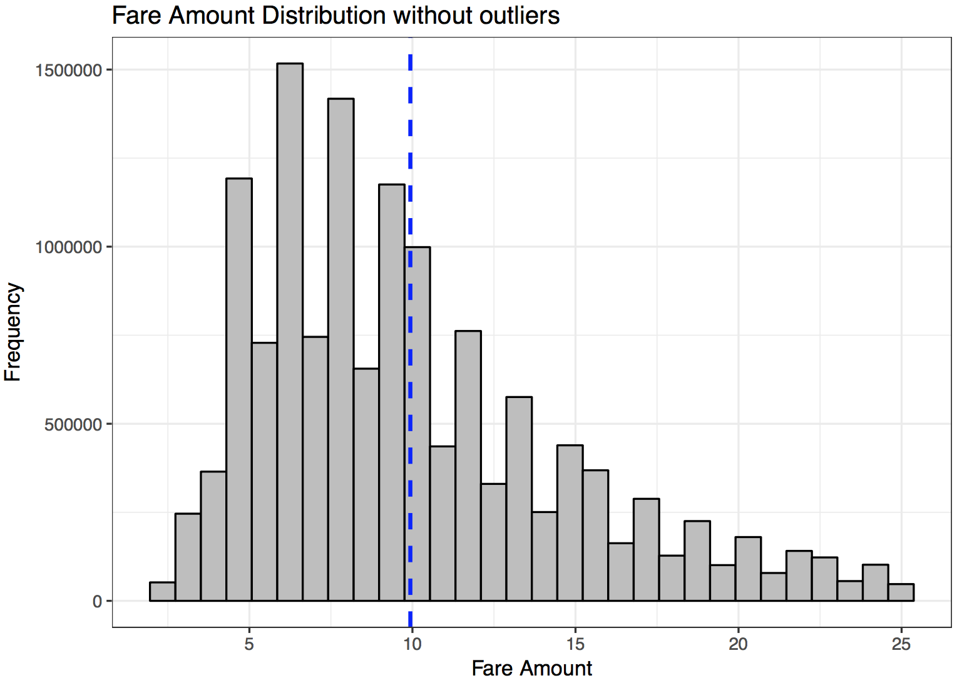
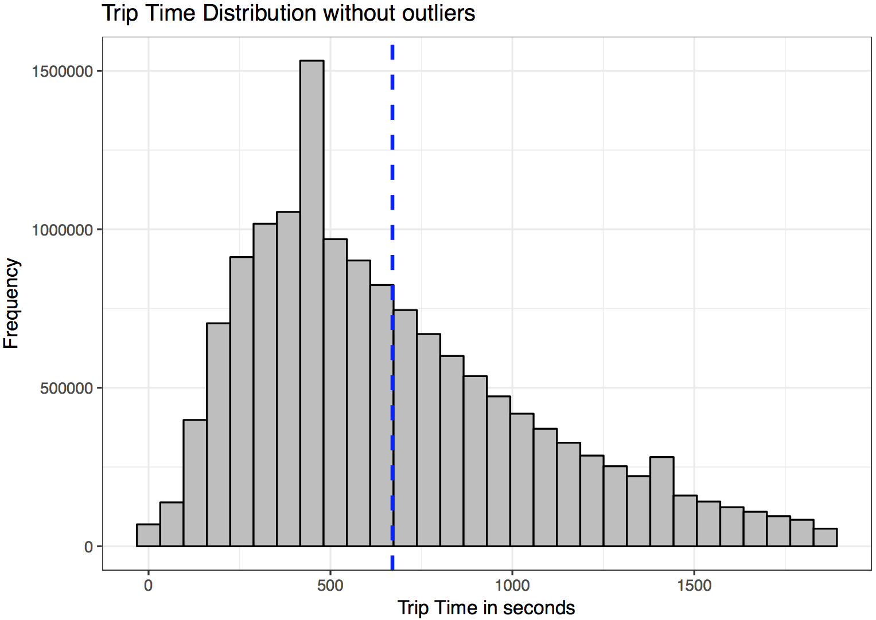
Open Questions
a. In what trips can you confidently use respective means as a measures of central tendency to estimate fare, time taken ?
General rule of thumb is if the distribution is skewed median is a better measure of central tendency and if the distribution is normal then mean is a better measure of central tendency.
Now since we have skewed distributions, we will have to remove the outliers and try to make skewed distribution approximately normal.
Once you have approx. normal distribution then mean can be a better measure of central tendency.
The histogram plots show the trips where mean is better measure of central tendency after removing the outliers. The histogram plots look approximately normal.
There are 13887894 (~92%) trips where mean can be used to estimate fare after removing outliers.
There are 14468180 (~96%) trips where mean can be used to estimate time taken after removing outliers.

Slide 15
Open Questions
b. Can we build a model to predict fare and tip amount given pick up and drop-off coordinate, time of the day and week ?
Yes we can create a machine learning model to predict the tip amount and fare amount, given pick up and drop off coordinates, time of the day and week.
We may also use other features in the model such as trip distance, trip time etc.
The way I will create a model will be first do some exploratory data analysis to find any patterns within data.
Next, if we have many features, perform Principal component analysis on the numerical features so as to tackle the problem of multicollinearity.
Next, try with a simple model first (e.g. Multiple Regression, Simple Decision Tree etc.) and evaluate the performance. If the performance is not too good then go for advanced models (e.g. Random forests, Deep Learning etc.)

Slide 16
Open Questions
c. If you were a taxi owner how would you maximize your earnings in a day ?
Based on the previous analysis and plots I created, I already know that the busiest hours of the day are in the evening from 6pm to 10 pm.
I also know the top locations for getting pickups are various regions of Manhattan area and regions surrounding it like Queens and Brooklyn. The other most prominent pickup location is the John F. Kennedy international airport.
So, to maximize my earnings I will drive in the evening from 6pm till 10 pm in the night on those specific locations so as to get maximum possible earnings.
I can also check for any correlation between busiest time of the day and tip amount a customer gives. (For e.g. if a customer is likely to give more tip between 7 - 9 p.m. then I will target those specific times)
I can also check for correlation between tip amount a customer gives and more specific locations within the top locations to see whether there is any pattern there. I could target more specific areas within the top areas of the city so as to maximize my earnings.

Slide 17
Open Questions
d. If you were a taxi owner, how would you minimize your work time while retaining the average wages earned by a typical taxi in the dataset ?
I will look into the data / slice the data to find the trips with minimum possible trip time and average fare amount or total amount.
I will target those areas that satisfy both these conditions.
I also know the top locations and the busiest hours of the days, so within that data I will look into the pickup locations with minimum trip time. I will target those specific locations.
Thus I will try to maximize my earnings or retain at least average wages from the fares and at the same time minimize my work time.

Slide 18
Open Questions
e. If you run a taxi company with 10 taxis, how would you maximize your earnings ?
I already know the top locations for pickup and the busiest hours of the day.
Within these top locations (Manhattan, Brooklyn etc.) at the busiest hours of the day (6pm-10pm), I will select my top 10 specific locations based on the tip amount the customer gives. So, I will target the 10 top areas where the customer tends to give more tip amount.
I will ask each of my drivers to drive on one of those 10 locations which I just identified and thus would maximize my earnings.

