Slide 1
Sliding-window Top-k Queries on Uncertain Streams
Cheqing Jin, Ke Yi, Lei Chen, Jeffrey Xu Yu, Xuemin Lin
ECUST HKUST HKUST CUHK UNSW
Sliding-window Top-k Queries on Uncertain Streams, VLDB 2008

Slide 2
Outline
Introduction
  Top-k queries
  contribution
Our solution
Experiments
Conclusion
Sliding-window Top-k Queries on Uncertain Streams, VLDB 2008

Slide 3
Possible World Model
ID | Speed(*10) | Prob.
1 | 5 | 0.8
2 | 6 | 0.5
3 | 8 | 0.4
4 | 2 | 0.4
A small record set
of reading logs
Tuples | Pr. | Tuples | Pr. | Tuples | Pr.
8, 6, 5, 2 | .064 | 8, 6, 5 | .096 | 8, 5, 2 | .064
8, 5 | .096 | 8, 6, 2 | .016 | 8, 6 | .024
8, 2 | .016 | 8 | .024 | 6, 5, 2 | .096
6, 5 | .144 | 6, 2 | .024 | 6 | .036
5, 2 | .096 | 5 | .144 | 2 | .024
Empty | .036
16 possible world
instances
Sliding-window Top-k Queries on Uncertain Streams, VLDB 2008

Slide 4
Uncertain Top-k queries
U-Topk [4]
  returns the top-k tuples in all possible worlds with maximum probability.
U-kRanks [4]
  returns the winner for the i-th rank for all 1 ≤ i ≤ k.
PT-k [2]
  returns all the tuples with maximum aggregate probability greater than a user-given threshold p
    aggregate probability: the prob. of being the top-k among all.
Pk-Topk
  returns the k most probable tuples of being the top-k among all.
  A slight modification of PT-k, while without threshold p.
Sliding-window Top-k Queries on Uncertain Streams, VLDB 2008

Slide 5
Example (k=2)
Tuples | Pr. | Tuples | Pr. | Tuples | Pr.
8, 6, 5, 2 | .064 | 8, 6, 5 | .096 | 8, 5, 2 | .064
8, 5 | .096 | 8, 6, 2 | .016 | 8, 6 | .024
8, 2 | .016 | 8 | .024 | 6, 5, 2 | .096
6, 5 | .144 | 6, 2 | .024 | 6 | .036
5, 2 | .096 | 5 | .144 | 2 | .024
Empty | .036
16 possible world
instances
Query results
Query | U-Topk | U-kRanks | PT-k | Pk-Topk (p=0.3)
Result | {6, 5} | {8, 5} | {5, 6, 8} | {5, 6}
Sliding-window Top-k Queries on Uncertain Streams, VLDB 2008

Slide 6
Contributions
However, Sliding-window solutions on uncertain streams
[Still None]
Contribution:
Ours is the first work
In this area, especially for
Top-k queries!
Sliding window
[A lot]
Uncertain Data processing
[Lots of work]
Uncertain stream processing
[quite A few recently]
Stream processing
[Lots of work]
Sliding-window Top-k Queries on Uncertain Streams, VLDB 2008

Slide 7
Working model
In the ultimate situation, all tuples in the window must be saved in memory!
  Example
    t_{i}: the i-th tuple in stream, (value:1/i, probability:1/i).
    The window size is W, at time n, for any k, tuple t_{n-W+1} is at the query result of Pk-Topk query.
  So, worst-case bounds are trivial and meaningless.
So, we consider a more general scenario: random order stream model.
  The value and probability of a tuple are both randomly and independently drawn from some (arbitrary) distribution.
Sliding-window Top-k Queries on Uncertain Streams, VLDB 2008

Slide 8
Naïve solution
Basic Synopsis (BS)
  Reserve all recent W tuples in memory
  Use traditional method to answer top-k queries
Analysis
  Time-efficient, but space-inefficient.
  The space complexity is O(W).
Sliding-window Top-k Queries on Uncertain Streams, VLDB 2008

Slide 9
Framework
GOAL: designing a general framework for all kinds of top-k queries,
not only for a special kind of query.
Design Compact Set
List all Useful Compact Sets
Compress Compact Sets
A small subset of
the original dataset
Self-maintenance
C(D∪{t})⊆C(D)∪{t}
Capable of answering
a top-k query
W different windows.
i.e., [t-j, t], for j=0..W-1
One compact set for
each window
CSQ, CCSQ, SCSQ,
SCSQ-buffer
Space-efficient
Time-efficient
Sliding-window Top-k Queries on Uncertain Streams, VLDB 2008

Slide 10
Example: Compact Set for Pk-Topk
Symbols
  D_{i}: the subset of D containing the first i tuples in D.
  r_{i,j}: the probability that a randomly generated world from D_{i} has exactly j tuples.
    r_{i,j} can be maintained through dynamic program.
  p(t_{i}): the probability of tuple t_{i}.
  p(t_{i})r_{i-1,j-1}: the probability that t_{i} ranks the j-th in a randomly generated world from D.
  p(t_{i})Σ_{i=1..k}r_{i-1,j-1}: the probability that t_{i} ranks top-k in all possible worlds generated from D.
  Σ_{i=1..k}r_{i-1,d-1}: The up-bound probability of any other tuple outside of D_{d} that ranks top-k in all possible worlds generated from D.
Compact set for Pk-Topk
  Smallest D_{d} with k tuples (t_{a}) satisfying: p(t_{a})Σ_{i=1..k}r_{i-1,a-1} > Σ_{i=1..k}r_{i-1,d-1}
Sliding-window Top-k Queries on Uncertain Streams, VLDB 2008

Slide 11
Possible sub-windows
Assume window size W=8, k=3
time
1
2
3
4
5
6
7
8
9
10
11
12
13
8
7
2
9
3
5
6
1
Possible sub-windows
[6,8]
5
6
1
[5,8]
3
5
6
1
[4,8]
9
3
5
6
1
[3,8]
2
9
3
5
6
1
Create a compact
set for each
sub-window!
[2,8]
7
2
9
3
5
6
1
[1,8]
8
7
2
9
3
5
6
1
Sliding-window Top-k Queries on Uncertain Streams, VLDB 2008

Slide 12
Create compact sets
time
1
2
3
4
5
6
7
8
8
7
2
9
3
5
6
1
[6,8]
5
6
1
[5,8]
3
5
6
[4,8]
9
5
6
Duplicate!
[3,8]
9
5
6
[2,8]
7
9
6
[1,8]
8
7
9
Goal: Compress the
remaining compact sets.
Sliding-window Top-k Queries on Uncertain Streams, VLDB 2008

Slide 13
Synopsis (1):
Compact Set Queue
1. A new tuple
arrives
time
1
2
3
4
5
6
7
8
9
2. Generate a new compact set
8
7
2
9
3
5
6
1
4
[7,9]
6
1
4
3. Update compact sets
[6,9]
5
6
1
4
[6,8]
[5,9]
3
5
6
4
6. Duplicate pruning
[5,8]
[4,9]
9
5
6
[4,8]
4. Compact sets are unchanged
[3,8]
[3,9]
[2,8]
7
9
6
[2,9]
5. Remove Compact set if expired
[1,8]
8
7
9
Sliding-window Top-k Queries on Uncertain Streams, VLDB 2008

Slide 14
Compact Set Queue: Analysis
Advantages
  Easy to understand
  The space consumption and the per-tuple processing cost are small.
Disadvantages
  Redundancy exists between neighbor compact sets.
Solution
  compress neighbor compact sets!
Sliding-window Top-k Queries on Uncertain Streams, VLDB 2008

Slide 15
Synopsis (2):
Compressed Compact Set Queue
1. A new tuple
arrives, reserve it in CCSQ
time
1
2
3
4
5
6
7
8
9
8
7
2
9
3
5
6
1
4
[6,8]
5
6
1
4
3
5
6
[5,8]
3
3. Process tuple 5
[4,8]
9
5
6
4. Process tuple 3
[3,8]
2. Maintain a compact set.
[2,8]
7
9
6
8
7
9
5. State after processing tuple 7
[1,8]
8
7
9
3
5
6
1
4
6. Remove expired tuple 8
Sliding-window Top-k Queries on Uncertain Streams, VLDB 2008

Slide 16
Compressed Compact Set Queue: Analysis
Advantages
  The space consumption is reduced.
Disadvantages
  Lots of compact sets must be generated and checked for each incoming tuple, which results in high per-tuple processing cost.
Solution
  Group neighbor compact sets!
  In fact, it’s the combination of CSQ and CCSQ.
Sliding-window Top-k Queries on Uncertain Streams, VLDB 2008

Slide 17
Synopsis (3):
Segmental Compact Set Queue
1. A new tuple
arrives
time
1
2
3
4
5
6
7
8
9
8
7
2
9
3
5
6
1
4
5. Generate a new SCS
2. update compact sets
6
1
4
RULE: Sum of the affiliated tuples in two neighbor compact sets is smaller than k
6
4
[6,8]
5
6
1
4
[5,8]
3
5
6
4
3. Duplicate pruning
4. Remove expired tuple
[4,8]
9
5
6
6. merge
[3,8]
[2,8]
7
9
6
[1,8]
8
7
9
Sliding-window Top-k Queries on Uncertain Streams, VLDB 2008

Slide 18
Segmental Compact Set Queue: Analysis
Advantages
  Low space consumption.
  Low per-tuple processing cost.
Disadvantages
  Some medial compact sets are unnecessary to be maintained per tuple.
Solution
  Use a buffer!
Sliding-window Top-k Queries on Uncertain Streams, VLDB 2008

Slide 19
Synopsis (4): SCSQ-buffer
Basic structure contains:
  A buffer with size kH to reserve new tuples
  A SCSQ for all tuples except the buffer
  A compact set C(S_{W}) for query result
When a tuple t arrives
  Insert t into B
  remove out-of-date tuples in SCSQ if possible
  If B is full, update SCSQ with B;
  Else, update C(S_{W});
Sliding-window Top-k Queries on Uncertain Streams, VLDB 2008

Slide 20
SCSQ-buffer
SCSQ
buffer
The state at time t
During [t+1, t+12],
1. Fill buffer till full,
2. Remover expired
tuples in SCSQ
Then,
Update SCSQ,
Clear buffer
Sliding-window Top-k Queries on Uncertain Streams, VLDB 2008

Slide 21
Performance summary
 | Space consumption | Processing time
Basic Synopsis | O(W + kH) | O(kH²/W+logW)
Compact Set Queue | O(H²logW) | O(kH²)
Compressed Compact Set Queue | O(H(k+log W)) | O(kH²)
Segmental Compact Set Queue | O(H(k+log W)) | O(kH logW)
SCSQ-buffer | O(H(k+log W)) | O(kH²/W+logW)
Sliding-window Top-k Queries on Uncertain Streams, VLDB 2008

Slide 22
Experiments
Dataset: International Ice Patrol (IIP) Iceberg Sightings Database
  information on iceberg activity in North Atlantic to monitor iceberg danger near the Grand Banks
  Sighting signals
    R/V (radar and visual) – 0.8
    VIS (visual only) – 0.7
    RAD(radar only) – 0.6
    SAT-LOW(low earth orbit satellite) – 0.5
    SAT-MED (medium earth orbit satellite) – 0.4
    SAT-HIGH (high earth orbit satellite) – 0.3
    EST (estimated, used before 2005) – 0.4
  we created a 1,000,000-record data stream by repeatedly selecting records randomly.
Sliding-window Top-k Queries on Uncertain Streams, VLDB 2008

Slide 23
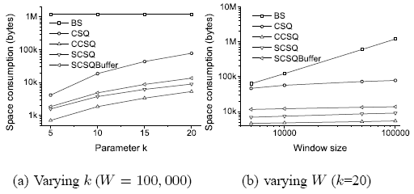
Space consumption
Sliding-window Top-k Queries on Uncertain Streams, VLDB 2008

Slide 24
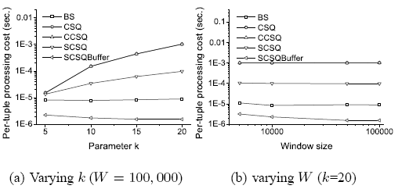
Per-tuple processing cost
Sliding-window Top-k Queries on Uncertain Streams, VLDB 2008

Slide 25
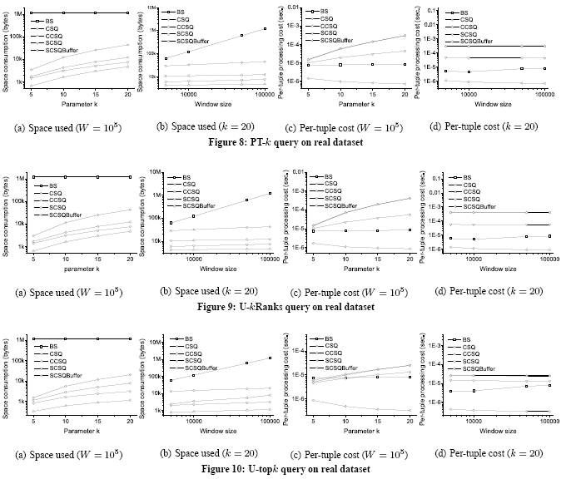
Sliding-window Top-k Queries on Uncertain Streams, VLDB 2008

Slide 26
Conclusion & Future work
Conclusion
  We propose a general framework to process Sliding-window Top-k queries on uncertain streams.
  Support U-Topk, U-kRanks, PT-k, Pk-Topk.
  Our work is the first work in processing sliding-window queries on uncertain streams.
Future work
  Handle other kinds of queries with this framework
  Handle more complex uncertain models
  Calculate approximate query results
Sliding-window Top-k Queries on Uncertain Streams, VLDB 2008

Slide 27
Reference (uncertain top-k queries)
[1] J. Chen and K. Yi. Dynamic structures for top-k queries on uncertain data. In Proc. of ISAAC, 2007.
[2] M. Hua, J. Pei, W. Zhang, and X. Lin. Efficiently answering probabilistic threshold top-k queries on uncertain data. In Proc. of ICDE, 2008.
[3] M. Hua, J. Pei, W. Zhang, and X. Lin. Ranking queries on uncertain data: A probabilistic threshold approach. In Proc. of SIGMOD, 2008.
[4] M. A. Soliman, I. F. Ilyas, and K. C.-C. Chang. Top-k query processing in uncertain databases. In Proc. of ICDE, 2007.
[5] K. Yi, F. Li, G. Kollios, and D. Srivastava. Efficient processing of top-k queries in uncertain databases. In Proc. of ICDE, 2008.
Sliding-window Top-k Queries on Uncertain Streams, VLDB 2008

Slide 28
Reference (uncertain stream processing)
[6] C. C. Aggarwal and P. S. Yu. A framework for clustering uncertain data streams. In Proc. of ICDE, 2008.
[7] G. Cormode and M. Garofalakis. Sketching probabilistic data streams. In Proc. of ACM SIGMOD, 2007.
[8] T. Jayram, S. Kale, and E. Vee. Efficient aggregation algorithms for probabilistic data. In Proc. of SODA, 2007.
[9] T. Jayram, A. McGregor, S. Muthukrishnan, and E. Vee. Estimating statistical aggregates on probabilistic data streams. In Proc. of PODS, 2007.
[10] Q. Zhang, F. Li, and K. Yi. Finding frequent items in probabilistic data. In Proc. of SIGMOD, 2008.
Sliding-window Top-k Queries on Uncertain Streams, VLDB 2008

Slide 29
Questions?
Thanks.
Sliding-window Top-k Queries on Uncertain Streams, VLDB 2008

