Slide 1
繼續花 JCConf 2022 式 Spring Data JPA
Rhys Chang (Softleader)

Slide 2

README
Rhys Chang
godjdc@gmail.com
DEMO

Slide 3
Agenda
JPQL : 我就是不想寫SQL
Projection : 我就是不想查出整個Entity
JPQL + Projection : 但還是得完成手上的需求

Slide 4
JPQL

Slide 5
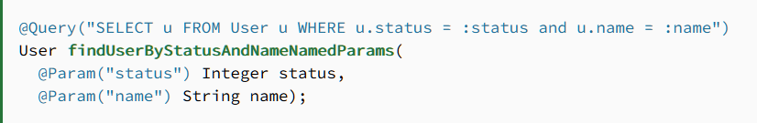
JPQL
Java Persistence Query Language

Slide 6
JPQL? HQL?
Ｑ．有啥差？
Ａ．HQL的Function多一點
Ｑ．該寫哪種？
Ａ．都可以寫！

Slide 7
JPQL簡單實例
Entity Class Name
Parameter
https://www.baeldung.com/spring-data-jpa-query#1-jpql-3

Slide 8
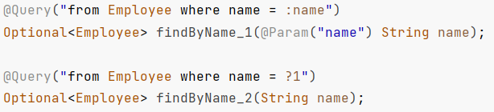
Parameter
使用名稱關聯 (:param1, :param2)
使用Index關聯 (?1, ?2, ?3)
from employee employee0_
where employee0_.name=?
from employee employee0_
where employee0_.name=?
這兩種皆以 PreparedStatement 的方式執行參數注入, 不會有SQL Injection風險

Slide 9
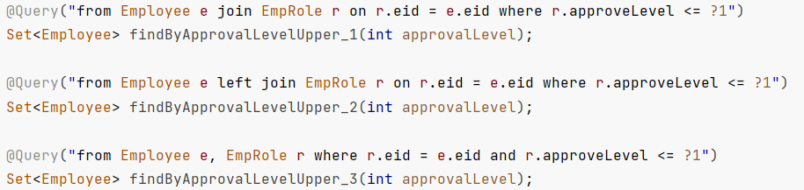
JOIN
Inner Join
Left Outer Join
Cross Join
from employee employee0_
inner join emp_role emprole1_ on (emprole1_.eid=employee0_.eid)
where emprole1_.approve_level<=?
from employee employee0_
left outer join emp_role emprole1_ on (emprole1_.eid=employee0_.eid)
where emprole1_.approve_level<=?
from employee employee0_
cross join emp_role emprole1_
where emprole1_.eid=employee0_.eid and emprole1_.approve_level<=?

Slide 10
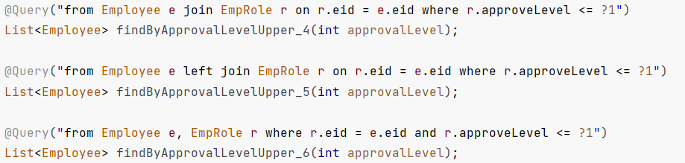
JOIN (過度展開)
輸出為List
不指定select欄位
Select
Employee0_.id as id1_1_0_, emprole1_.id as id1_2_1_, employee0_.duty_date as duty_dat2_1_0_,
Employee0_.eid as eid3_1_0_, employee0_.name as name4_1_0_, employee0_.salary as salary5_1_0_,
Emprole1_.approve_level as approve_2_2_1_, emprole1_.code as code3_2_1_, emprole1_.eid as eid4_2_1_, emprole1_.name as name5_2_1_
from employee employee0_ inner join emp_role emprole1_ on (emprole1_.eid=employee0_.eid) where emprole1_.approve_level<=?
多了EmpRole的結果

Slide 11
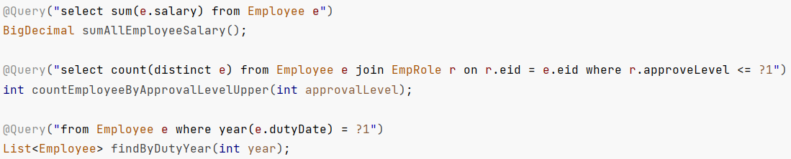
Aggregation Function
JPQL |  | HQL
CONCAT | ABS | BIT_LENGTH | MINUTE
SUBSTRING | MOD | CAST | SECOND
UPPER | SQRT | EXTRACT | STR
LOWER | CURRENT_DATE | YEAR
TRIM | CURRENT_TIME | MONTH
LENGTH | CURRENT_TIMESTAMP | DAY
LOCATE |  | HOUR

Slide 12
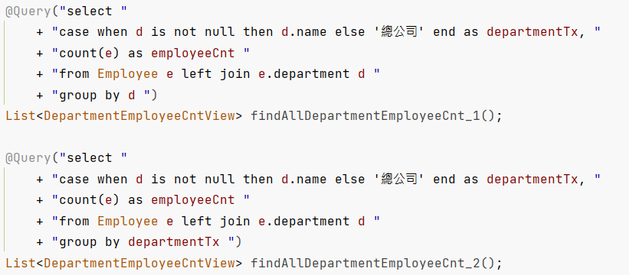
Case/When with Group
標準Group
Select
case when department1_.id is not null then department1_.name else '總公司' end as col_0_0_,
count(employee0_.id) as col_1_0_
from employee employee0_
left outer join department department1_ on employee0_.department_id=department1_.id
group by department1_.id

Slide 13
Case/When with Group
以Case/When結果Group
Select
case when department1_.id is not null then department1_.name else '總公司' end as col_0_0_,
count(employee0_.id) as col_1_0_
from employee employee0_
left outer join department department1_ on employee0_.department_id=department1_.id
group by col_0_0_

Slide 14
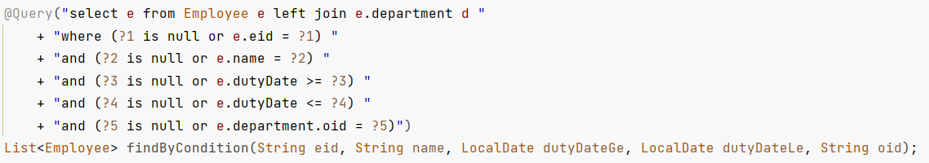
動態Query
利用 (? is null or field = ?) 語句達成

Slide 15
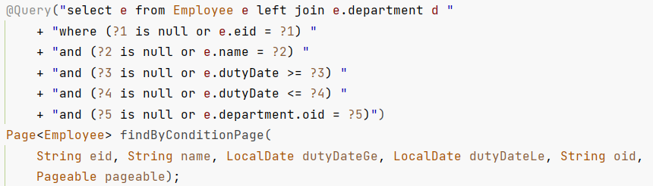
Pageable
用JPQL寫分頁就是如此無腦
Output 改成 Page<?>
Parameter 增加 Pageable pageable 即可

Slide 16
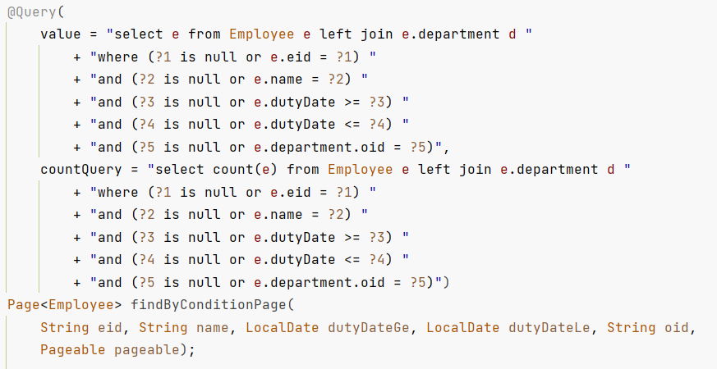
Pageable+
Sorry 其實也沒有那麼無腦
因為Spring不會幫你產CountQuey, 要自己寫

Slide 17
Projection

Slide 18
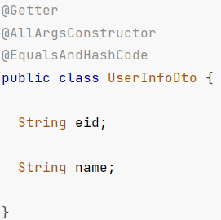
Class-based
DTO必須具有唯一個建構子
其參數名稱是Entity的子集
無法使用@Query

Slide 19
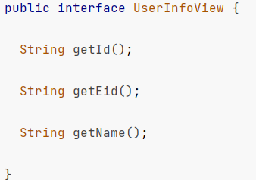
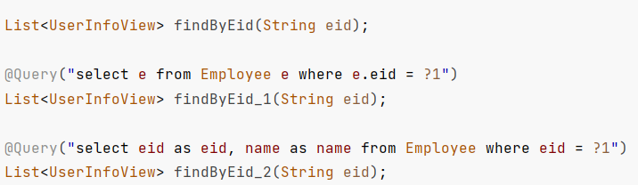
Interface-Based
於View中描述Getter
可使用@Query
可以吃相同欄位物件①
或下Alias②(即使原始欄位名稱相同也要下)
①
②

Slide 20
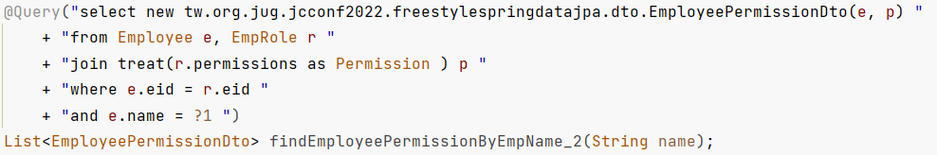
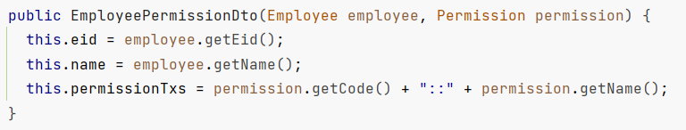
DTO constructor
DTO欄位隨意
只要參數對了, 就塞得進建構子

Slide 21
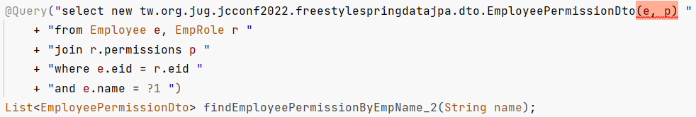
DTO constructor+
其實可以不用寫轉型(treat)
只是寫了可以阻止IDE報錯XD

Slide 22
JPQL + Projection

Slide 23
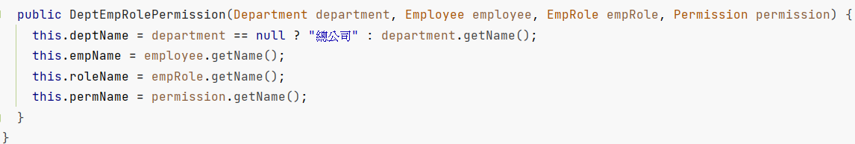
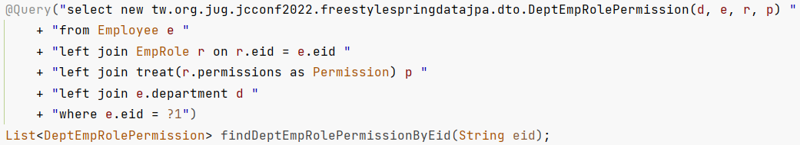
善用Constructor
輕鬆製作縫合怪, 高速完成列表畫面需求
(須注意傳遞整個物件意味select整個物件所有欄位, 若I/O過大時需改成只傳遞特定欄位)

Slide 24
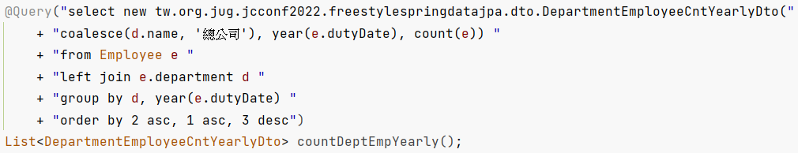
Function + Projection
只要DB開得夠好, 寫完JPQL就等於寫完一個需求
夢回用SQL出年報的時代XD

Slide 25
結語
為什麼要花式?
花式有什麼後果?
我如何看待花式?

Slide 26

Q&A
DEMO

