Slide 1
06 Stacks and Queues

Slide 2
Outline
Stack
Stack ADT
Array implementation and linked list implementation
Queue
Queue ADT
Array implementation and circular array implementation
Linked list implementation

Slide 3
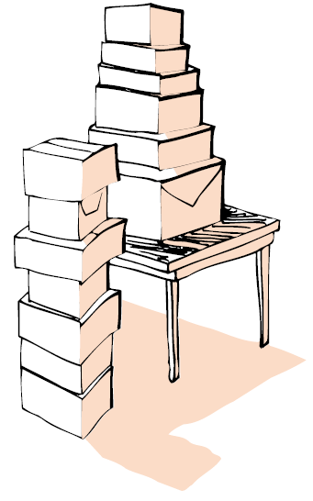
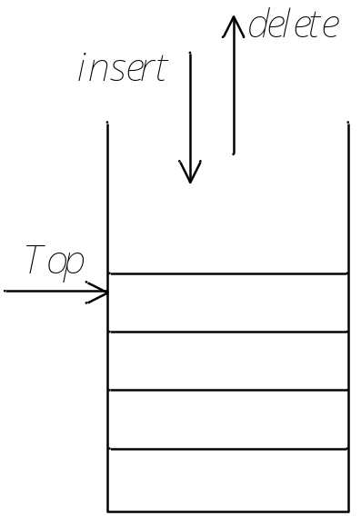

Stacks (1)
A stack is a collection of items into which new items are inserted and from which items are deleted at one end ( call the top of the stack).
Therefore, the only accessible item is the top of the stack. Top is the only place where you can put new items.
Objects are stacked

Slide 4
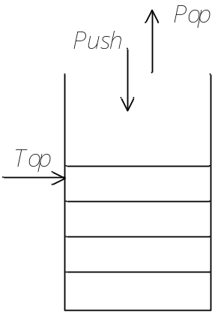
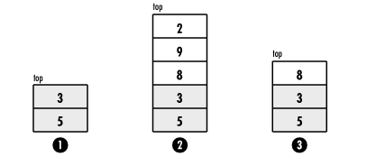
Stacks (2)
The two fundamental operations of stacks
  Push: to place an element on the top of a stack. We push it. It is equivalent to an insert.
  Pop: to delete an element from the top. We pop it.
  Example:

Slide 5
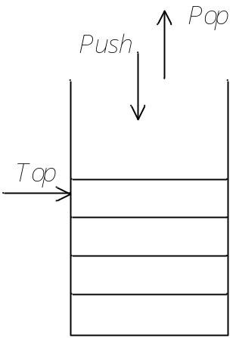
Stacks (3)
Properties of stacks
To operate data in a Last-In, First-Out, or LIFO, manner
Therefore, stacks are known as LIFO list.
Implementation of stacks
Because a stack is a list, any list implementation will do.
  Using pointers – linked list (dynamic: never become full)
  Using an array (static: the size of stack is given initially)

Slide 6
Stack ADT
The Stack ADT (Abstract Data Type): define the stack interface whatever the method is being used
  The attributes of Stack
    the information of the data in Stack
  The operations of Stack
    CreateStack: create stack and return the new created stack
    DisposeStack: destroy stack and free all the data
    IsEmpty: return true if stack is empty, return false otherwise
    Push: add an element to the top of stack
    Pop: delete the element at the top of stack
    Top: return the top element of stack
    MakeEmpty: empty stack

Slide 7
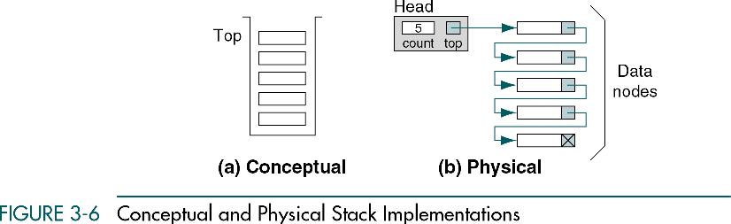
Linked List Implementation of Stack ADT(1)
Illustration of the stack implemented by linked list

Slide 8
Linked List Implementation of Stack ADT (2)
Type declaration of a linked list implementation with a header node of the stack ADT
  //Type declaration of linked list implementation of the stack ADT
  struct Node;
  typedef struct Node *PtrToNode;
  typedef PtrToNode Stack;
  struct Node
  {
  ElementType Element;
  PtrToNode Next;
  };
  //test whether a stack is empty
  //S is a pointer (the type of struct Node) points to a stack
  //1-NULL; 0-NOT NULL
  int IsEmpty( Stack S )
  {
  return S->Next == NULL;
  }

Slide 9
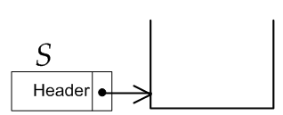
Linked List Implementation of Stack ADT (3)
Initializing and destroying of a stack
  //Initialization – create an empty stack with a header node
  Stack CreateStack( void )
  {
  Stack S;
  S = malloc( sizeof( struct Node ) );
  if( S == NULL )
  FatalError( "Out of space!!!" );
  S->Next = NULL;
  MakeEmpty( S );
  return S;
  }
  //Make Stack S empty.
  void MakeEmpty( Stack S )
  {
  if( S == NULL )
  Error( "Must use CreateStack first" );
  else
  while( !IsEmpty( S )
  Pop( S );
  }

Slide 10
Linked List Implementation of Stack ADT (4)
Initializing and destroying of a stack
  //Destroy a stack – free the stack and release the memory back to //the system
  void DisposeStack( Stack S )
  {
  MakeEmpty( S );
  free( S );
  }
  //Make Stack S empty.
  void MakeEmpty( Stack S )
  {
  if( S == NULL )
  Error( "Must use CreateStack first" );
  else
  while( !IsEmpty( S )
  Pop( S );
  }
Notes:
-

Slide 11
Linked List Implementation of Stack ADT (5)
Top is to return the element at the top of the stack ( in the first position of the list )
  ElementType Top( Stack S )
  {
  if( !IsEmpty( S ) )
  return S->Next->Element;
  Error( "Empty stack" );
  return 0;
  }

Slide 12
Linked List Implementation of Stack ADT (6)
Push operation – push an element into a stack
  we use a linked list to implement a stack;
  the front of the linked list serves as the top of the stack;
  So, push is implemented as an insertion into the front of a linked list.
  void Push( ElementType X, Stack S )
  {
  PtrToNode TmpCell;
  TmpCell = malloc( sizeof( struct Node ) );//allocate the space
  if( TmpCell == NULL )
  FatalError( "Out of space!!!" );
  else
  {
  TmpCell->Element = X;
  TmpCell->Next = S->Next;
  S->Next = TmpCell;
  }
  }

Slide 13
Linked List Implementation of Stack ADT (7)
Pop operation – delete an element from the top of the stack
  we use a linked list to implement a stack;
  the front of the linked list serves as the top of the stack;
  So, pop is implemented as a deletion from the front of a linked list.
  void Pop( Stack S )
  {
  PtrToNode FirstCell;
  if( IsEmpty( S ) )
  Error( "Empty stack" );
  else
  {
  FirstCell = S->Next;
  S->Next = S->Next->Next;
  free( FirstCell );
  }
  }

Slide 14
Array Implementation of Stack ADT (1)
Recall: to add an item to the end of an array - constant time
  In the same way, we can remove an item from the end in constant time (without shifting any elements.)
We may use this property to implement a stack using an array efficiently.
We need to declare the max stack size (Capacity) firstly. This is a drawback, but usually it’s not critical. Average applications don’t require very large stacks.
Besides an array to supply the space, we need a marker to mark the top of stack element in the array: TopOfStack, it is an index into the array.
  For an empty stack, it is -1.
  To push some element X into the stack, we increment TopOfStack and then set Stack[TopOfStack] = X, where Stack is the array representing the actual stack.

Slide 15
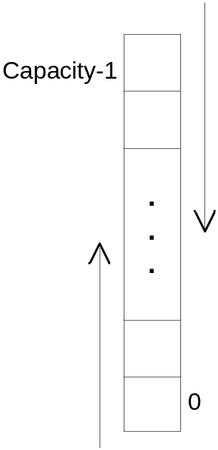
Up or Down?
An array has 2 fixed ends.
  With index 0;
  With index Capacity−1.
We may start a stack from either ends.
  From index 0 and grow upwards;
  From index Capacity−1 and grow downwards.
Here, we implement the stack upwards. The empty stack is represented by
“TopOfStack = -1”.

Slide 16
Array Implementation of Stack ADT (2)
The Stack ADT: define the stack interface whatever the method is being used
  The elements of a stack
  The operations on a stack
  typedef int ElementType;
  struct StackRecord;
  typedef struct StackRecord *Stack;
  int IsEmpty( Stack S );
  int IsFull( Stack S );
  Stack CreateStack( int MaxElements );
  void DisposeStack( Stack S );
  void MakeEmpty( Stack S );
  void Push( ElementType X, Stack S );
  ElementType Top( Stack S );
  void Pop( Stack S );
  ElementType TopAndPop( Stack S );
  you should pay attention to do the error testing for avoiding the overflow situation:
  Pop on an empty stack?
  Push on a full stack?

Slide 17
Array Implementation of Stack ADT (3)
Type declaration of array implementation of the stack ADT – a dynamically allocated array
  #define EmptyTOS ( -1 )
  #define MinStackSize ( 5 ) //the minimum size of the stack
  typedef int ElementType;
  struct StackRecord
  {
  int Capacity;
  int TopOfStack;
  ElementType *Array;
  };

Slide 18
Array Implementation of Stack ADT (4)
Assistant routines
  //create an empty stack
  void MakeEmpty( Stack S )
  {
  //an empty stack: TopOfStack = -1
  S->TopOfStack = EmptyTOS;
  }
  //test whether a stack is empty
  int IsEmpty( Stack S )
  {
  //if an empty stack, TopOfStack = -1
  return S->TopOfStack == EmptyTOS;
  }
  //test whether a stack is full
  Int IsFull( Stack S )
  {
  return S->TopOfStack == S->Capacity - 1;
  }

Slide 19
Array Implementation of Stack ADT (5)
Initializing and destroying of a stack
  //create a stack of a given maximum size
  Stack CreateStack( int MaxElements )
  {
  Stack S;
  if( MaxElements < MinStackSize )
  Error( "Stack size is too small" );
  S = malloc( sizeof( struct StackRecord ) );
  if( S == NULL )
  FatalError( "Out of space!!!" );
  S->Array = malloc( sizeof( ElementType )* MaxElements );
  if( S->Array == NULL )
  FatalError( "Out of space!!!" );
  S->Capacity = MaxElements;
  MakeEmpty( S ); //that is: S->TopOfStack=-1
  return S;
  }

Slide 20
Array Implementation of Stack ADT (6)
Initializing and destroying of a stack
  //destroying an array implemented stack
  void DisposeStack( Stack S )
  {
  if( S != NULL )
  {
  free( S->Array );
  free( S );
  }
  }

Slide 21

Array Implementation of Stack ADT (7)
Push operation – insert an element
  Index increase in array implementation
  void Push( ElementType X, Stack S )
  {
  if( IsFull( S ) )
  Error( "Full stack" );
  else
  S->Array[ ++S->TopOfStack ] = X;
  }
must-fit-lp002/C/08
Notes:
-

Slide 22
Array Implementation of Stack ADT (8)
Pop operation – delete an element
  Index decrease in array implementation
  void Pop( Stack S )
  {
  if( IsEmpty( S ) )
  Error( "Empty stack" );
  else
  S->TopOfStack--;
  }

Slide 23
Array Implementation of Stack ADT (9)
Top is to return the element at the top of the stack ( the last element of the array (for upwards manner) )
  ElementType Top( Stack S )
  {
  if( !IsEmpty( S ) )
  return S->Array[ S->TopOfStack ];
  Error( "Empty stack" );
  /* Return value used to avoid warning */
  return 0;
  }

Slide 24
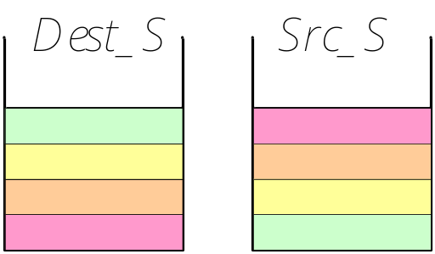
Moving Items to Another Stack
We may use the Stack ADT to accomplish the task.
  Pop from the source stack and push to the destination stack.
  The result of the moving is reversed.
  void Rev_move(Stack Dest_S, Stack Src_S)
  {
  while ( !IsEmpty(Src_S) )
  Push( Pop(Src_S), Dest_S);
  }

Slide 25
Stack Applications (1)
Reversing data
  To convert a decimal number to its binary equivalent
Parsing data
  To test the parentheses matching: “(),[]”
Function calls
When a routine calls a new function, all the local variables of the routine need to saved by the system. Otherwise, the new function will overwrite the calling routine’s variables.
The current location in the routine must be saved so that the new function knows where to go back after it is done.

Slide 26
Stack Applications (2)
Examples for reversing data
  Reverse a list: {1 2 3 4} becomes {4 3 2 1}
  Convert decimal to binary

Slide 27
Stack Applications – Reverse Data(1)
Reverse a number series
  To read a list of integers from the keyboard, push them into a stack and print them in reverse.
  #include <stdio.h>
  #include "stackli.h“
  int main( void )
  {
  int boolvalue = 0;
  int* dataPtr;
  Stack S;
  dataPtr = (int*) malloc ( sizeof(int) );
  if ( dataPtr == NULL )
  printf ( “Out of space!!!” );
  //create a stack
  S = CreateStack();
  (continue…)

Slide 28
Stack Applications – Reverse Data(2)
Reverse a number series
  (…continue)
  //fill the stack
  while ( !boolvalue )
  {
  printf ( "Enter a number: <EOF> (Ctrl+Z for Win) to stop the enter:" );
  if ( scanf ("%d", dataPtr) == EOF )
  boolvalue = 1;
  else
  Push ( *dataPtr, S );
  }
  printf( "\n\nThe list of numbers reversed:\n" );
  while ( !IsEmpty(S) )
  {
  *dataPtr = Top(S);
  Pop(S);
  printf( "%3d\n", *dataPtr );
  }
  free( dataPtr );
  DisposeStack(S);
  return 0;
  }
Notes:
-

Slide 29
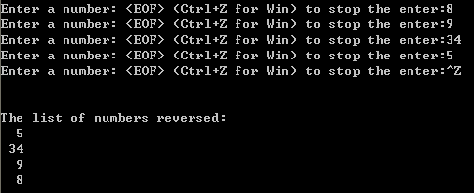
Stack Applications – Reverse Data(3)
Running result:

Slide 30
Queue Overview
Queue ADT
Basic operations of queue
  Enqueuing, dequeuing etc.
Implementation of queue
  Array

Slide 31
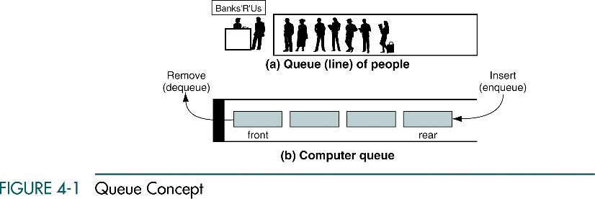
Queue
Like a stack, a queue is also a list. However, with a queue, insertion is done at one end, while deletion is performed at the other end.
Accessing the elements of queues follows a First-In, First-Out (FIFO) order.
  Like customers standing in a check-out line in a store, the first customer in is the first customer served.

Slide 32
Enqueue and Dequeue
Primary queue operations: Enqueue and Dequeue
Like check-out lines in a store, a queue has a front and a rear .
Enqueue – insert an element at the rear of the queue
Dequeue – remove an element from the front of the queue
Remove
(Dequeue)
Insert
(Enqueue)
front
rear

Slide 33
Implementation of Queue
Just as stacks can be implemented as arrays or linked lists, so with queues.
Dynamic queues have the same advantages over static queues as dynamic stacks have over static stacks
  dynamic: never become full
  static: the size of stack is given initially

Slide 34
Array Implementation of Queue
There are several different algorithms to implement Enqueue and Dequeue
Intuitive way
  When enqueuing, the front index is always fixed and the rear index moves forward in the array.
rear
rear
rear
3
3
6
3
6
9
front
front
front
Enqueue(3)
Enqueue(6)
Enqueue(9)

Slide 35
Array Implementation of Queue
Intuitive way (cont’d)
  When dequeuing, the front index is fixed, and the element at the front of the queue is removed. Move all the remain elements after it by one position. (Inefficient!!!)
rear
rear
rear = -1
6
9
9
front
front
front
Dequeue(3)
Dequeue(6)
Dequeue(9)

Slide 36
Array Implementation of Queue
A better way
  When an item is enqueued, the rear index moves forward.
  When an item is dequeued, the front index also moves forward by one element
Linear array
front
rear
X = occupied, and O = empty
(front)
XXXXOOOOO (rear)
OXXXXOOOO (after 1 dequeue, and 1 enqueue)
OOXXXXXOO (after another dequeue, and 2 enqueues)
OOOOXXXXX (after 2 more dequeues, and 2 enqueues)
The problem here is that the rear index cannot move beyond the last element in the array.

Slide 37
Implementation using Circular Array
Using a circular array
When an element moves past the end of a circular array, it wraps around to the beginning, e.g.
  OOOOO7963 → 4OOOO7963 (after Enqueue(4))
  After Enqueue(4), the rear index moves from 3 to 4.
How to detect an empty or full queue, using a circular array algorithm?
  Use a counter of the number of elements in the queue.

Slide 38
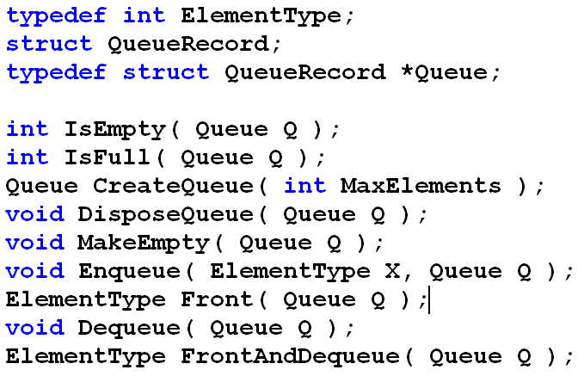
Queue Implementation Using Circular Array
Type declarations for queue

Slide 39
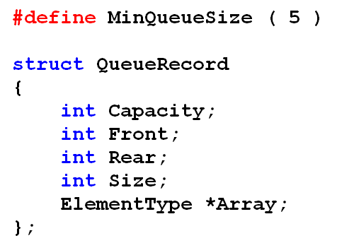
Queue Implementation Using Circular Array
Circular array
Rear
Front

Slide 40
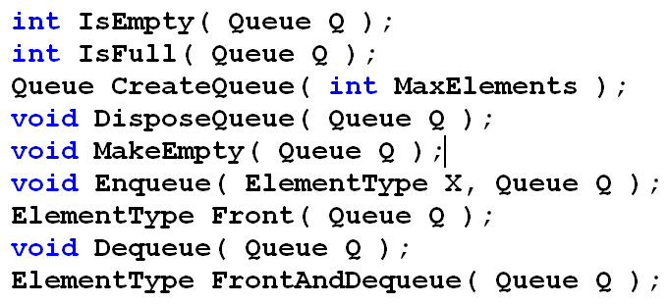
Queue Implementation Using Circular Array
Operations of queue
  IsEmpty: return true if queue is empty, return false otherwise
  IsFull: return true if queue is full, return false otherwise
  CreateQueue: create queue with “MaxElements” capacity
  DisposeQueue: destroy queue and free the memory
  Enqueue: add an element to the rear of queue
  Dequeue: delete the element at the front of queue
  Front: return the data at the front of queue

Slide 41
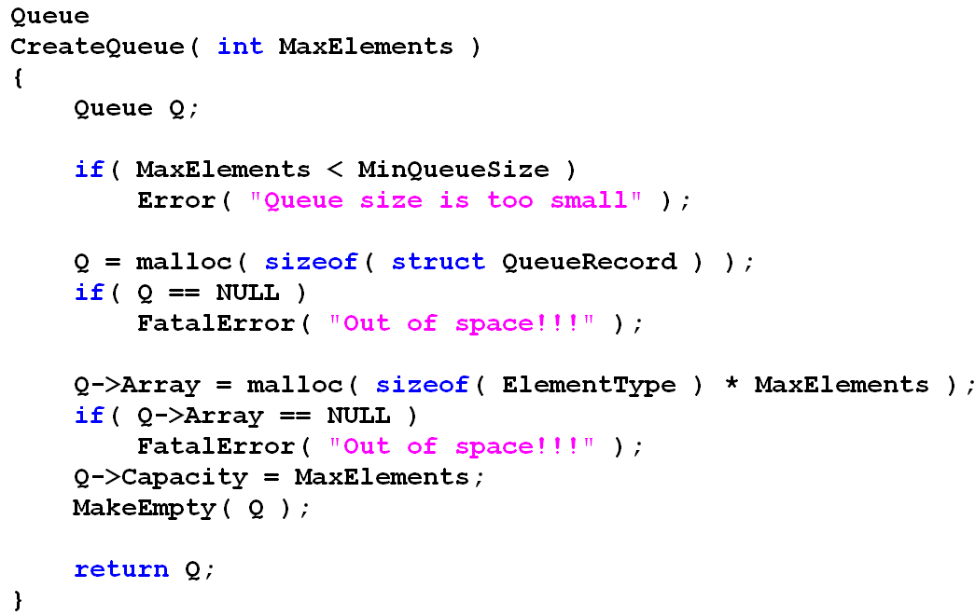
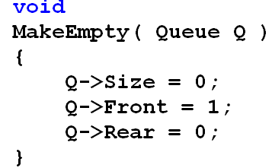
Create Queue

Slide 42
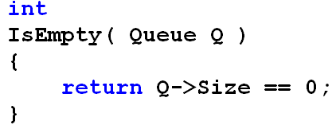

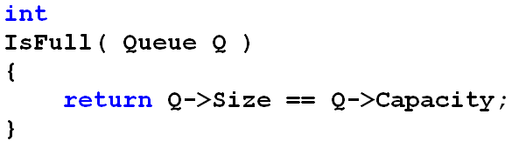
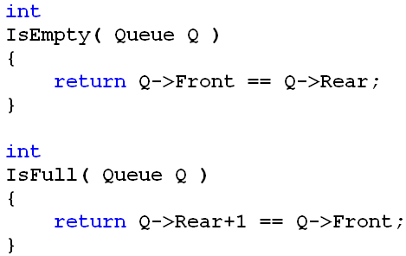
IsEmpty & IsFull
Since we use Size to keep track of the number of elements that are actually in the queue, it is easy to check if the queue is empty or full.
Another way: counter is no needed
When creating the queue,
replaced by
full
Circular Array
Rear
Front

Slide 43
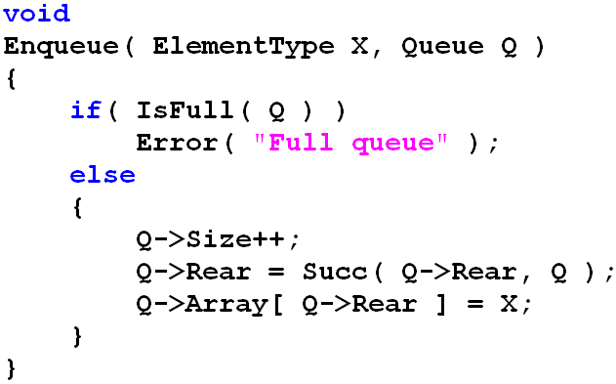
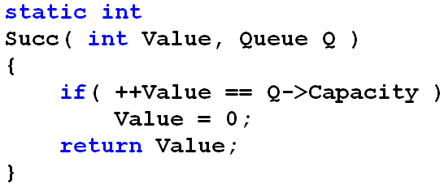
Enqueue
Circular Array
Front
Rear
Rear
Front

Slide 44
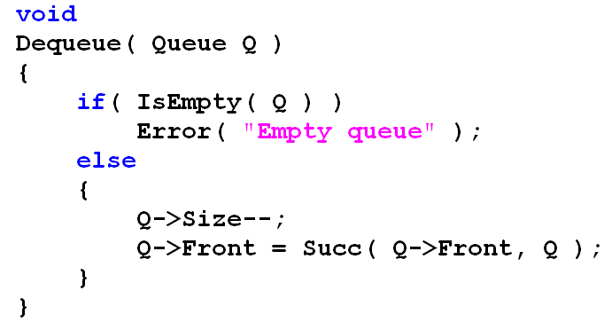
Dequeue
Circular Array
Rear
Front
Front
Rear

Slide 45
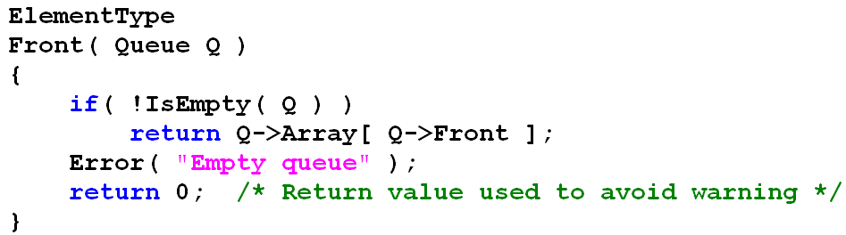
Front
Return the element at the Front position of queue

Slide 46
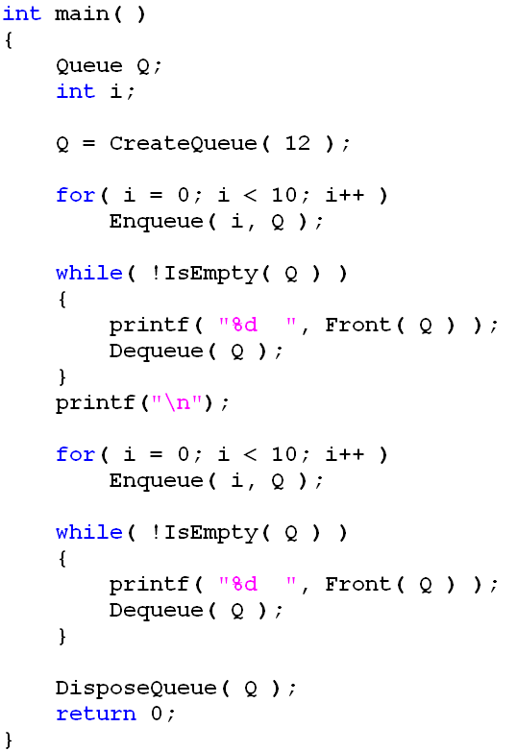

Using Queue
Result:

Slide 47
Queue Implementation Using Linked List
A linked list can represent a queue by adding Rear pointer that points to the last element (if available).
typedef int ElementType;
struct Node {
ElementType data;
struct Node *next;
};
typedef struct Node *PtrToNode;
struct QueueRecord{
PtrToNode Front;
PtrToNode Rear;
};
typedef struct QueueRecord *Queue;

Slide 48
Queue Implementation Using Linked List
Operations of queue
  IsEmpty: return true if queue is empty, return false otherwise
  IsFull: return true if queue is full, return false otherwise
  CreateQueue: create queue
  DisposeQueue: destroy queue and free the memory
  MakeEmpty: make queue empty if it isn’t empty
  Enqueue: add an element to the rear of queue
  Dequeue: delete the element at the front of queue
  Front: return the data at the front of queue

Slide 49
Queue Implementation Using Linked List
Hints
  IsEmpty: return true if queue is empty, return false otherwise
  Queue->Front =?= NULL;
  CreateQueue: create queue
  allocate space for “Queue” and initialize Front and Rear;
  DisposeQueue: destroy queue and free the memory
  deallocate space;
  MakeEmpty: make queue empty if it isn’t empty
  Queue->Front == NULL;
  Enqueue: add an element to the rear of queue
  insert a node at the end of queue
  consider queue is empty and not empty
  Dequeue: delete the element at the front of queue
  delete a node at the front of queue
  consider queue is empty and not empty
  Front: return the data at the front of queue

Slide 50
Assignment 05
Implement the header file of Queue queueli.h
Implement the code queueli.c using linked list
Write a test program test-queueli.c to test your implementation.
  Create a queue: 0, 3, 99, 100, 106, 58, 9, 365 and print it
  Dequeue three elements of this queue and print the result
Submit it to Moddle
Attachment: queueli.h
  queueli.c
        test-queuli.c

