Slide 1
y’’
x’’
P
y
y’
O’’
x’
O’
O
x

Slide 2






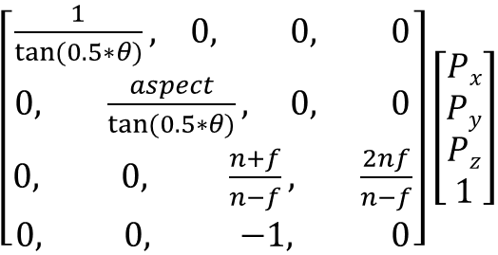




($\frac{1}{\tan\left(0.5∗θ\right)},\frac{aspect}{\tan{(0.5∗θ)}}$, $−z\frac{f+n}{f−n}+\frac{2nf}{n−f},−z)$
P’_{y}$=\frac{\frac{1}{\tan{(0.5∗θ)}}}{−Pz}$P_{y}
$$z^{′}=\frac{A}{z}+B$$
P’_{x}$=\frac{\frac{1}{\tan{(0.5∗θ)}}}{−Pz}$P_{x}
-1$=\frac{A}{−n}+B$
P
P’_{x}$=\frac{\frac{1}{\tan{(0.5∗θ)}}}{−Pzaspect}$P_{x}
P’
θ
Q’
Q
O
1$=\frac{A}{−f}+B$
$$A=\frac{2nf}{f−n}$$
$z^{′}=\frac{1}{−z}\frac{2nf}{n−f}$+$\frac{f+n}{f−n}$
$\left[\begin{aligned}\frac{1}{\tan{(0.5∗θ)}}, 0, 0, 0 \\ 0, \frac{aspect}{\tan{(0.5∗θ)}}, 0, 0 \\ 0, 0, \frac{n+f}{n−f}, \frac{2nf}{n−f} \\ 0, 0, −1, 0\end{aligned}\right]\left[\begin{aligned}Px \\ Py \\ Pz \\ 1\end{aligned}\right]$
B$=\frac{f+n}{f−n}$

Slide 3






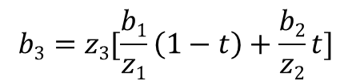

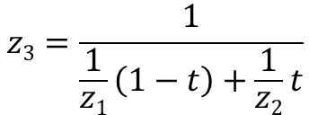
$ax$+bz = c
(x1,z1)
$\frac{b3−b1}{b2−b1}$=$\frac{z3−z1}{z2−z1}$
$$\frac{p}{x}=\frac{−e}{z}$$
$$z3=\frac{1}{\frac{1}{z1}\left(1−t\right)+\frac{1}{z2}t}$$
$$(−\frac{ap}{x}+b)z=c$$
(x2,z2)
(p1,-e)
(p2,-e)
$$\frac{1}{z}=\frac{−ap}{ce}+\frac{b}{c}$$
e
$$b3=z3[\frac{b1}{z1}\left(1−t\right)+\frac{b2}{z2}t]$$
$$p3=\left(1−t\right)p1+tp2)$$
x
$$\frac{1}{z3}=\frac{−ap3}{ce}+\frac{b}{c}=\frac{1}{z1}\left(1−t\right)+\frac{1}{z2}t$$
z

Slide 4

$$x^{′}=\left(x+1\right)∗0.5∗ScreenWidth$$
$$y^{′}=\left(1−y\right)∗0.5∗ScreenHeight$$

