Slide 1
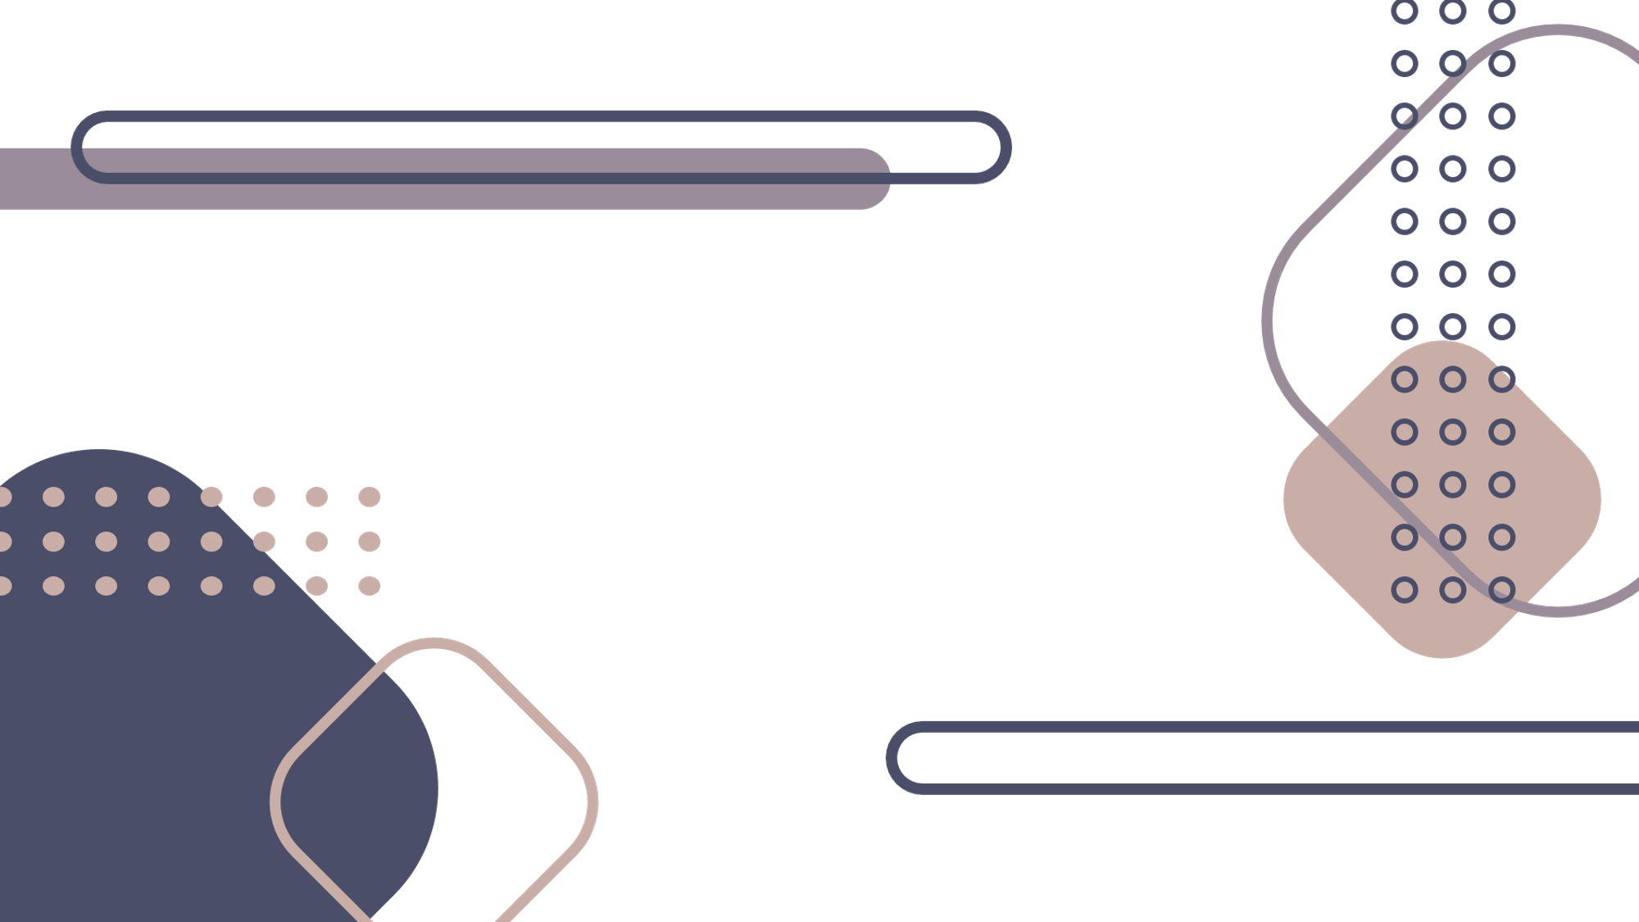
PrezPal Dynamic Slideshows
George Lyu & Ivana Hsyung

Slide 2

Benefits of Using PrezPal
Ease and Convenience: No more manually creating slides Dynamic Presentations: Adapt and address audience queries on the fly Efficiency: Save time on slide preparation Engagement: Capture audience attention with real-time content generation

