Slide 1
23CSE461
Healing Bridges: Digital Mental Health Access for Women & Youth
“Aurova”
GitHub URL: sanhithaac/Healing-Bridges-Digital-Mental-Health-Access-for-Women-and-Youth · GitHub

Slide 2



Case study Review 1
Professor – T Senthil Kumar ( CSE)
ROLL NUMBER | NAME | EMAIL | MOBILE NUMBER | PHOTO | GITHUB URL
CB.SC.U4CSE23206 | A.C Sanhitha Reddy | cb.sc.u4cse23206@cb.students.amrita.edu | 9949804994 |  | https://github.com/sanhithaac
CB.SC.U4CSE23245 | Shaik Abdus Sattar | cb.sc.u4cse23245@cb.students.amrita.edu | 7032698579 |  | https://github.com/Seventie
CB.SC.U4CSE23165 | Thota Neha | cb.sc.u4cse23165@cb.students.amrita.edu | 6281073629 |  | https://github.com/Thotaneha007

Slide 3
Collaborator Details
Current Status: To be onboarded
Target Collaborators:
→ Mental health professionals (psychologists, psychiatrists, counselors)
→ Women wellness organizations
→ Youth mental health organizations
→ NGOs working in mental health support
→ Healthcare institutions & clinics (for women and youth)

Slide 4
Abstract & Inspiration
Aurova is a digital mental health support platform for women and youth, designed to provide safe, anonymous, and stigma-free emotional care. The product enables users to express feelings through private journaling, receive empathetic support via a chatbot, and schedule therapy sessions when required. Users may remain anonymous or voluntarily share personal details based on their comfort.
Inspired by existing mental health apps and chatbot-based wellness platforms, Aurova integrates journaling, emotional analysis, therapy coordination, and progress tracking into a single system with strong emphasis on privacy and consent.
Key Features: Anonymous onboarding, emotional journaling, supportive chatbot, therapy scheduling, pre- and post-therapy journaling, emotional trend analysis, doctor dashboard, progress reports, and safety alerts.
Reports: Emotional trend reports, therapy progress comparison, weekly summaries, and doctor feedback (with consent).
Requirements:
Functional – Journaling, chatbot interaction, emotion analysis, therapy scheduling, report generation, doctor access.
Non-Functional – Privacy, anonymity, security, reliability, scalability, and user-friendly design.

Slide 5
Introduction
Mental health challenges among women and youth are often left unaddressed due to social stigma, fear of judgment, lack of privacy, and limited access to professional care. Many users need a safe, non-intrusive space to express their emotions before seeking formal therapy.
From a usage and need perspective, users increasingly rely on digital platforms for emotional expression, self-reflection, and mental well-being support. However, existing solutions often lack anonymity, continuous progress tracking, or integrated doctor collaboration.
From a social perspective, concerns about identity disclosure and societal judgment prevent many individuals from openly discussing mental health issues. An anonymous, consent-based system encourages early emotional expression and reduces stigma.
From a workflow perspective, users need structured journaling, emotional tracking, and organized reports that help both users and doctors understand emotional progress over time.
Aurova addresses these needs using an AI-assisted solution that combines journaling, emotionally supportive chatbot interactions, progress analysis, and consent-based doctor access, creating a holistic and user-centered mental health support system.

Slide 6
What is AI Role in this product ?
Artificial Intelligence plays a supportive and assistive role in Aurova, enhancing emotional care while ensuring ethical and human-centered interaction.
Emotion & Sentiment Analysis:
AI analyzes journal entries and chatbot conversations to identify emotional patterns such as stress, anxiety, or emotional improvement over time.
Emotionally Supportive Chatbot:
AI powers a conversational chatbot that conducts gentle check-ins, asks reflective questions, and provides empathetic responses without replacing human professionals.
Personalized Coping Suggestions:
Based on emotional analysis, AI suggests simple, non-clinical self-care actions such as breathing exercises, short breaks, or reflection prompts.
Progress Tracking & Reports:
AI helps generate emotional trend reports and pre- vs post-therapy comparisons that assist doctors in monitoring user progress.
Risk Detection & Safety Alerts:
AI detects high-risk keywords (e.g., self-harm or suicidal ideation) and triggers supportive alerts and guidance while maintaining user privacy.
Consent-Based Data Handling:
AI processes data only with user consent and ensures anonymized insights are shared with doctors when permitted.

Slide 7
Algorithms used and their purpose
1. Natural Language Processing (NLP) – Sentiment & Emotion Analysis
Algorithm/Models:
  TF-IDF / Word Embeddings + ML classifiers (early stage)
  Transformer-based models (LLM-based) for advanced analysis
Purpose:
  Analyze journal entries and chatbot conversations
  Detect emotions such as stress, anxiety, sadness, or
  improvement
Scenario:
  Understanding user emotional state from written text
3. Rule-Based + NLP Keyword Detection (Safety Layer)
Algorithm Type:
  Keyword matching + NLP-based risk classification
Purpose:
  Identify high-risk content such as self-harm or suicidal ideation
Scenario:
  Trigger safety alerts and encourage professional support
2. Large Language Models (LLMs) – Chatbot Interaction
Algorithm Type:
  LLM-based conversational models
Purpose:
  Enable empathetic, human-like chatbot conversations
  Ask guided questions and provide emotional support
Scenario:
  Daily emotional check-ins and motivational conversations
  Encouraging journaling and self-reflection
4. Machine Learning – Progress Tracking & Reports
Algorithm Type:
  Supervised / Unsupervised ML (trend analysis, clustering)
Purpose:
  Track emotional changes over time
  Generate progress summaries for doctors
Scenario:
  Pre- and post-therapy comparison and weekly reports
Advanced Aspects Considered
Deep Learning (DL):
  Used for emotion detection and text
  understanding
Large Language Models (LLMs):
  Used for chatbot interaction and contextual
  understanding

Slide 8
Data Building
Dataset Name | Purpose | Usage in Aurova | Dataset Link
Mental Health Sentiment Dataset (Depression & Anxiety) | Detect depression, anxiety, and emotional polarity | Emotion analysis from journals and chatbot conversations | https://www.kaggle.com/datasets/suchintikasarkar/sentiment-analysis-for-mental-health/data
Suicide Sentiment Analysis Dataset | Identify suicidal ideation and self-harm indicators | Safety and alert mechanism for high-risk content | https://www.kaggle.com/datasets/umar1103/suicide-sentiment-analysis-dataset
Mental Health Counseling Conversations Dataset | Real counseling conversation data | Fine-tuning LLM-based chatbot for empathetic responses | https://huggingface.co/datasets/Amod/mental_health_counseling_conversations

Slide 9
Hackathon Pitching on this product
Current Status:
Used as an inspiration and validation source for problem understanding and solution direction.
Hackathon Readiness:
Aurova can be taken to a hackathon as a problem-driven solution idea.
Nature of Submission:
Proposed as a conceptual solution with a working prototype, not a fully deployed product.
Why Hackathon-Suitable:
Addresses a real-world social problem (mental health access)
Strong scope for AI-based innovation
Clear user workflow and modular architecture
Ethical and privacy-focused approach
Expected Outcome:
Validate the idea through expert and peer feedback
Improve design, AI models, and user experience
Identify potential collaborators and mentors

Slide 10
Companies working on similar problem
Company Name | Location | URL
Emy (Emotional Support App) | Europe | https://emy.chat
MindDoc | Germany | https://minddoc.com/
Amaha | India | https://www.amahahealth.com/
Woebot Health | USA | https://woebothealth.com/
Headspace | USA | https://www.headspace.com/
Calm | USA | https://www.calm.com/
BetterHelp | USA | https://www.betterhelp.com/
Talkspace | USA | https://www.talkspace.com/
Wysa | India / USA | https://www.wysa.io/

Slide 11
Research labs working on similar problem
Research Lab Name | URL
MIT Media Lab – Affective Computing group | https://www.media.mit.edu/groups/affective-computing
Stanford Center for digital Health | https://digitalhealth.stanford.edu
Harvard T.H Chan – Mental Health & Technology Lab | https://www.hsph.harvard.edu/
Oxford Internet Institute – Digital Mental Health Research | https://www.oii.ox.ac.uk/
UCLA Center for Mental Health & Technology | https://www.semel.ucla.edu/mental-health-technology

Slide 12
Media specific inputs on this product
Media reports increasingly highlight the rising mental health concerns among women and youth, especially related to stress, anxiety, trauma, and social pressure.
News articles and social media discussions emphasize that stigma and fear of judgment remain major barriers to seeking mental health support.
Digital media trends show a growing demand for anonymous, app-based mental health solutions, particularly among young users who prefer private and non-confrontational support.
Several media stories point out gaps in existing systems, such as:
Limited access to mental health professionals
High cost of therapy
Lack of continuous emotional monitoring
The rise of AI-based wellness apps in media discussions reflects the need for scalable, technology-driven mental health support, especially for early intervention.
These media insights reinforce the relevance of Aurova as a platform that combines anonymity, emotional support, and guided access to care.

Slide 13
1.Project Overview
Product Name: Aurova
Slogan: Restoring hope, one voice at a time.
Logo:
Client / Industry Targeted:
  Digital Mental Health & Wellness
  Healthcare Technology
  Women & Youth Mental Well-being
Problem Statement
Women and youth experiencing emotional distress often avoid seeking mental health support due to stigma, fear of identity exposure, and limited access to affordable and continuous care. Existing solutions lack anonymity, emotional continuity, and integrated progress tracking with professionals.
Target Users: Women, Youth(age between 11-19 yrs), Medical Counsellors or Doctors

Slide 14
Hackathon Ref & Inspiration
Reference Platform:
MIT Solve Hackathon – https://solve.mit.edu/solutions/99200
Purpose of Reference:
This hackathon serves as a conceptual reference and inspiration for identifying real-world mental health challenges and solution approaches.
Problem Alignment:
The challenges highlighted in the MIT Solve problem statement align with the need for accessible, stigma-free mental health support for women and youth.
Idea Adaptation:
Aurova adapts and extends the referenced idea into a women and youth-focused digital platform with AI-assisted emotional support, journaling, and doctor-guided progress tracking.
Current Status:
Used as an inspiration and validation source for problem understanding and solution direction.

Slide 15
Types of Questions & Queries
USER SPECIFIC What is Aurova and how does it help me? Who can use this platform? Can I use the app without sharing my identity? Is my personal data safe and private? Is this app free to use? | ANALYTICAL How does the system understand my emotions? How are my journals analyzed? What kind of reports are generated? How is my progress tracked over time?
PREDICTIVE Can the system suggest when I may need therapy? Will it alert me if my emotional state worsens? Can it predict emotional patterns from my entries? Will it recommend next steps based on my activity? | PRODUCT & FEATURE RELATED Does Aurova replace a doctor or therapist? How does the chatbot work? Can I schedule therapy sessions through the app? Can doctors see my data without my permission?

Slide 16
Requirements
Functional Non Functional
User Registration & Consent Management: Allows users to sign up anonymously or share personal details voluntarily. Emotional Journaling: Enables users to record thoughts and emotions privately. Chatbot Interaction: Provides empathetic conversations, emotional check-ins, and guidance. Therapy Session Scheduling: Supports booking and reminders for therapy sessions. Doctor Dashboard: Allows professionals to view consent-based reports and track progress. Report Generation: Creates emotional trend and pre-/post-therapy comparison reports. Safety Alert System: Detects high-risk content and triggers supportive alerts. | Privacy & Security: Ensures anonymized, encrypted, and consent-based data handling. Usability: Simple, accessible, and user-friendly interface. Reliability: System availability and consistent performance. Scalability: Ability to support increasing users and data. Performance: Quick response time for chatbot and analysis. Ethical Compliance: Responsible handling of sensitive mental health data.

Slide 17
What type of study does the product require?
1. Descriptive Study
To understand mental health challenges faced by women and youth
To study user needs, concerns, and expectations from a digital mental health platform
2. Observational Study
To observe user interaction patterns with journaling and chatbot features
To analyze emotional trends without direct intervention
3. Exploratory Study
To explore how AI-based journaling and emotional support can reduce stigma
To identify gaps in existing digital mental health solutions
4. Analytical Study
To analyze emotional data from journals and feedback forms
To evaluate changes in emotional states before and after therapy sessions
5. User-Centered (Qualitative) Study
To collect user feedback on usability, emotional comfort, and trust
To understand user experience and acceptance of anonymity and AI support
6. Pilot Study (Future Scope)
To test the effectiveness of Aurova on a small group before large-scale deployment

Slide 18
2.Technology Stack - MEAN
MongoDB:
Used for storing user journals, emotional data, reports, and consent-based records in a flexible and scalable database.
Express.js:
Handles backend logic, APIs, authentication, and communication between frontend, database, and AI services.
React.js
Used for building a fast, interactive, and user-friendly frontend interface for users and doctors
with reusable components and efficient state management.
Node.js:
Provides a fast and scalable server environment for handling multiple user requests efficiently.
Additional Tools:
Git: Version control and collaboration
Docker: Containerization for consistent deployment
AWS: Cloud hosting, storage, and scalability

Slide 19
2.1 Technology Stack - MEAN
MongoDB
Flexible, document-based storage for journals and reports
Supports large volumes of unstructured emotional data
Enables easy scalability and fast data retrieval
Additional Tools
Git: Version control and team collaboration
Docker: Consistent deployment across environments
AWS: Cloud hosting, scalability, and secure storage
Express.js
Lightweight backend framework for API development
Manages user authentication and data flow
Handles secure communication between frontend and database
Node.js
Asynchronous, non-blocking request handling
Supports real-time chatbot and scheduling features
Ensures high performance for concurrent users

Slide 20
3.System Architecture
High-Level Architecture
User Interface for women/youth and doctors
Backend Server (Node.js + Express.js) for business logic
AI Services for emotion analysis and chatbot support
Database (MongoDB) for storing journals, reports, and user data
Cloud Infrastructure (AWS) for hosting and scalability
API Flow
User actions (journaling, chatbot interaction, scheduling) are sent as API requests
Express.js APIs handle authentication, consent checks, and routing
AI services process text for emotion analysis and chatbot responses
Processed data is stored or retrieved from MongoDB
Final response is sent back to the frontend interface
Database Structure (MongoDB)
Users Collection: Anonymous/consent-based user profiles
Journals Collection: User journal entries with timestamps
Reports Collection: Emotional trend and progress reports
Therapy Sessions Collection: Scheduled session details
Doctor Feedback Collection: Notes and observations (with consent)
Flow:
User/Doctor → Frontend → Backend APIs → AI Services / Database → Response to Frontend

Slide 21
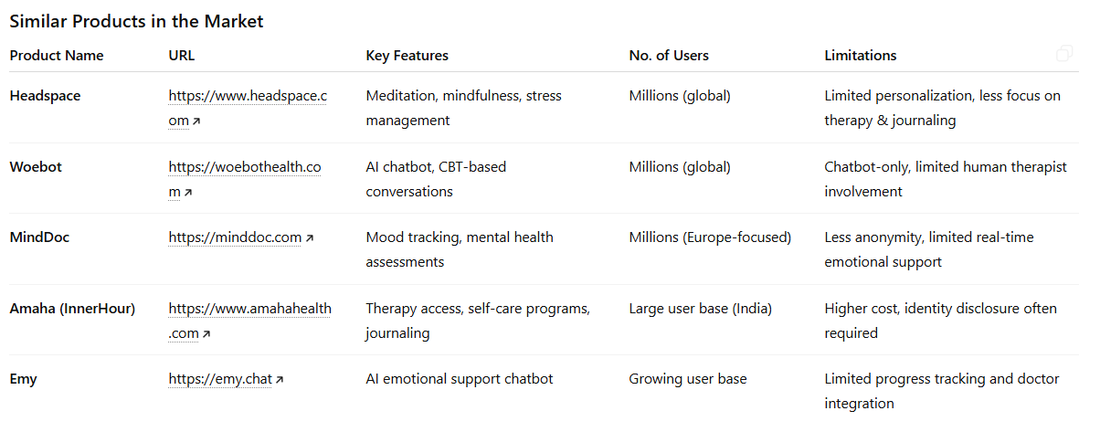
Comparison with similar products

Slide 22
Aurova - Features
Why this project is suitable for Hackathon / Industry
Addresses a real-world, socially relevant problem: mental health access for women and youth
Combines technology + healthcare + social impact, which aligns well with hackathon and industry innovation goals
Scalable digital solution that can be adapted for different communities and regions
Focuses on privacy, ethics, and user consent, which are critical industry concerns in mental health tech
Novelty in the Project
Anonymous-first mental health support with optional identity disclosure
Integration of journaling + AI emotional analysis + doctor progress tracking in one platform
Emotionally supportive chatbot that does not over-medicalize user concerns
Consent-based data sharing between users and doctors
Pre- and post-therapy emotional comparison for better treatment insights
Planned Features (UI/UX, DL, LLM, Other Aspects)
UI / UX - Simple, calming, and user-friendly interface, Separate dashboards for users and doctors, Easy journaling and therapy scheduling workflows
Deep Learning (DL)- Emotion and sentiment detection from journal text, Emotional trend analysis over time
Large Language Models (LLM)- Empathetic chatbot for emotional check-ins and guidance, Context-aware responses based on user input

Slide 23
Step by Step Workflow
1.User Onboarding & Consent
User signs up anonymously or chooses to share personal details; consent preferences are set.
2.Daily Emotional Check-in
User interacts with the chatbot or writes a journal entry describing current feelings.
3.AI-Based Emotion Analysis
Journal entries and chatbot inputs are analyzed to detect emotional state and patterns.
4.Supportive Feedback & Suggestions
The chatbot provides empathetic responses and suggests simple coping actions.
5.Therapy Scheduling (Optional)
User schedules a therapy session based on availability and need.
6.Pre-Therapy Journaling
User records emotional state before the scheduled session.
7.Doctor Review & Session Discussion
Doctor reviews consent-based reports and discusses them during therapy.
8.Post-Therapy Journaling
User journals feelings after the session for comparison.
9.Progress Tracking & Reports
System generates emotional trend and progress reports.
10.Safety Monitoring
High-risk content triggers supportive alerts and guidance

Slide 24
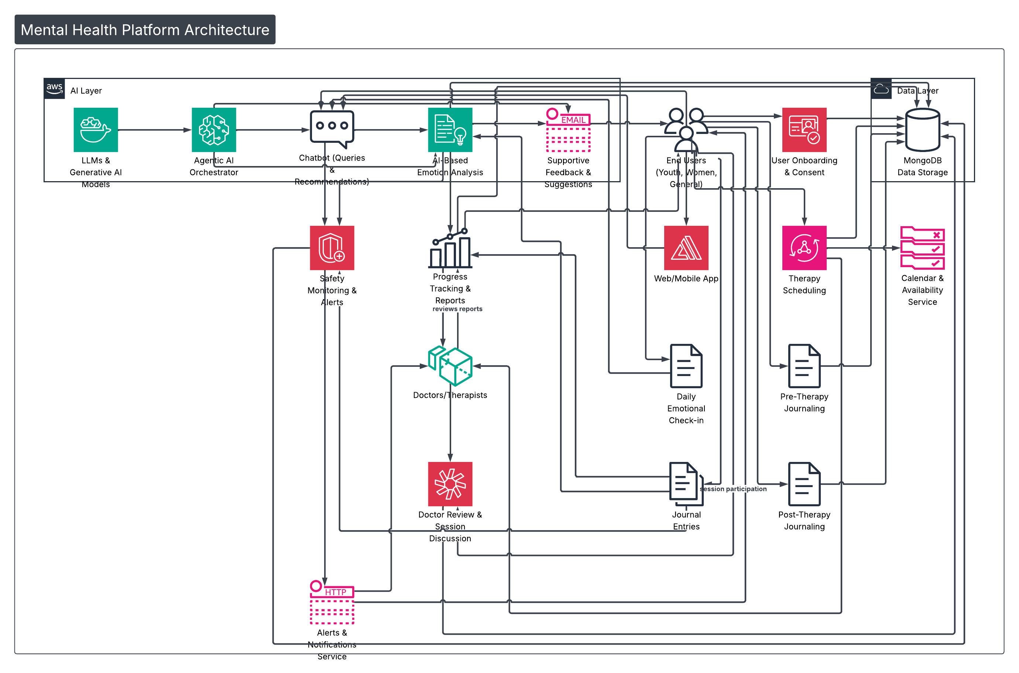

Architecture Diagram

Slide 25
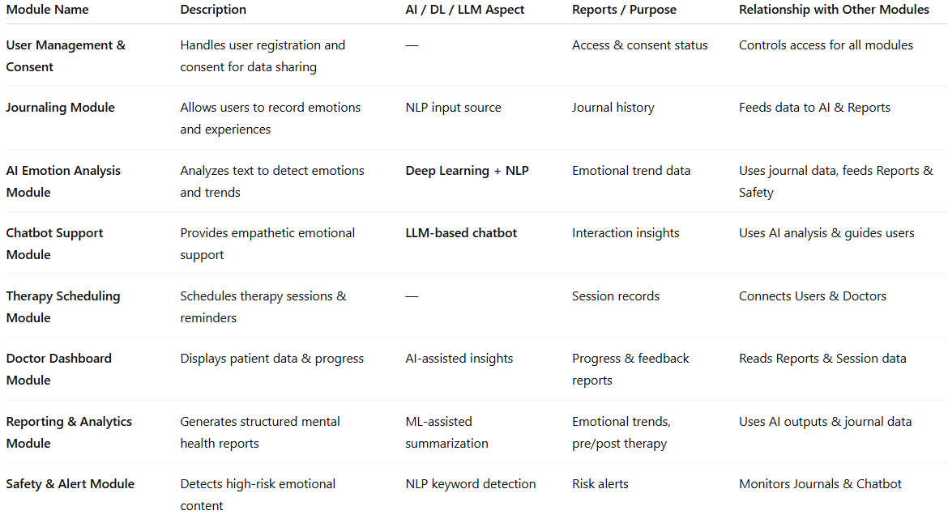
List of Modules

Slide 26
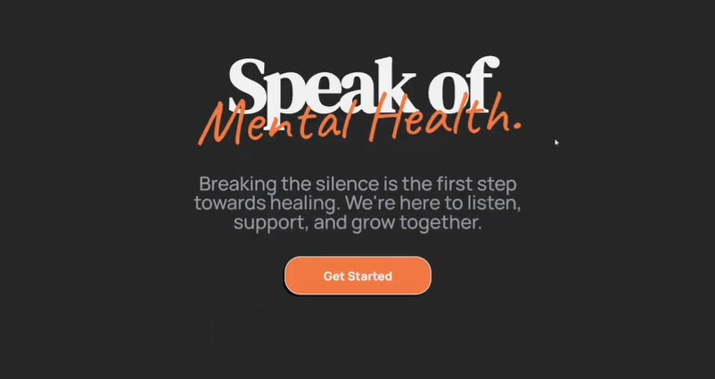
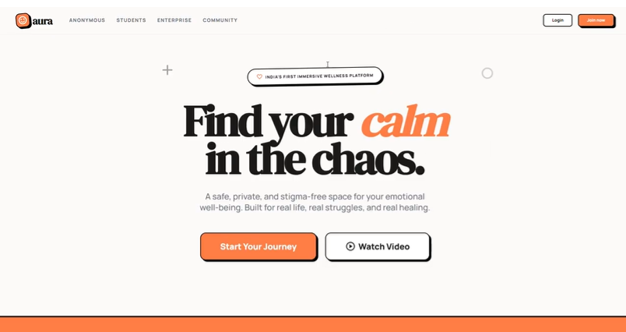
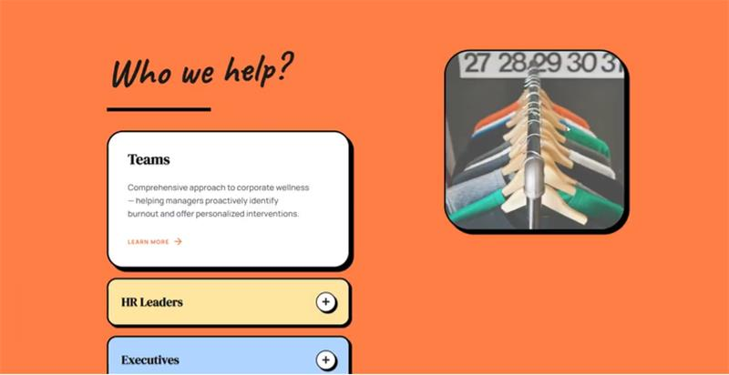
Sample Expected Output

Slide 27
Changes for mobile stack compatibility
Frontend Change:
Replace Angular web UI with a mobile framework such as Flutter or React Native for Android and iOS support.
UI/UX Adaptation:
Redesign interfaces for smaller screens, touch interactions, accessibility, and offline-friendly journaling.
Backend (Minimal Changes):
Existing Node.js + Express APIs can be reused with minor optimizations for mobile performance.
Database (No Major Change):
MongoDB remains unchanged; additional indexing may be added for faster mobile queries.
Authentication Updates:
Implement mobile-friendly authentication (OTP, biometric login, secure tokens).
AI Service Integration:
AI/DL/LLM services remain server-side; mobile app consumes AI results via APIs.
Push Notifications:
Add mobile push notifications for check-ins, reminders, and therapy schedules.
Offline & Sync Support:
Enable local storage and background sync for journaling when internet is unavailable.

Slide 28
DevOps Solutions
Version Control & Collaboration:
Use Git/GitHub for source control, branching, and team collaboration.
CI/CD Pipeline:
Implement CI/CD using GitHub Actions / Jenkins to automate build, test, and deployment of frontend, backend, and AI services.
Containerization:
Package application components using Docker for consistent deployment across environments.
Cloud Deployment:
Deploy services on AWS (EC2, ECS, or EKS) for scalability and availability.
Infrastructure as Code (IaC):
Use Terraform / AWS CloudFormation to automate infrastructure setup and management.
Monitoring & Logging:
Integrate Prometheus, Grafana, or CloudWatch for system health monitoring and log management.
Security & Compliance:
Implement secrets management, secure API gateways, role-based access control, and regular vulnerability scans.
Auto-Scaling & Reliability:
Enable auto-scaling and load balancing to handle variable user traffic.

Slide 29
Integration to Cloud
Cloud Platform:
Deploy the application on AWS for scalability, security, and reliability.
Application Hosting:
Host frontend and backend services using EC2 / ECS (Docker containers) for flexible deployment.
Database Layer:
Use MongoDB Atlas (Cloud) for secure, scalable, and managed data storage.
AI Services Deployment:
Host AI/DL/LLM services as microservices on cloud instances, accessed via secure APIs.
API Management:
Use AWS API Gateway to manage, secure, and monitor API requests.
Storage & Backup:
Store logs and backups using Amazon S3, with automated backup policies.
Security & Access Control:
Implement IAM roles, encryption, and secure authentication to protect sensitive mental health data.
Scalability & Reliability:
Enable auto-scaling, load balancing, and high availability to support growing user traffic.

Slide 30
List of Research papers published on similar products
Journal & Conference Papers (IEEE / ACM / Others)
“Artificial Intelligence in Mental Health Care”
IEEE Computer Society
Focus: Role of AI, NLP, and ML in mental health systems
“The Use of Chatbots in Mental Health”
ACM Digital Health / CHI Proceedings
Focus: Conversational agents for emotional support
“Digital Phenotyping and Mental Health”
Nature Digital Medicine
Focus: Behavioral data analysis for mental health monitoring
“Effectiveness of Mobile Mental Health Applications”
Journal of Medical Internet Research (JMIR)
Focus: Evaluation of digital mental health platforms
“Ethical Considerations in AI-Based Mental Health Systems”
IEEE Access
Focus: Privacy, consent, and responsible AI
Research Lab–Based Papers
Affective Computing for Mental Health
MIT Media Lab – Affective Computing Group
Focus: Emotion recognition, human–AI emotional interaction
Digital Mental Health Interventions
Stanford Center for Digital Health
Focus: Technology-assisted mental health care
AI and Mental Health
UCLA Center for Mental Health & Technology
Focus: AI tools for psychological assessment and support

Slide 31
Cost of the Product (approx.)
Feature Development:
Moderate (Frontend, Backend, AI, Reports)
Database (MongoDB Atlas):
₹0 (development) → ₹1,500–₹3,000 / month
Cloud & Processing (AWS):
₹2,000–₹5,000 / month (CPU-based AI)
Storage & Visualization:
₹500–₹1,000 / month (Cloud storage, dashboards)
Hardware & Devices:
No additional cost (cloud-based, user-owned devices)
Total Estimated Monthly Cost:
₹4,000 – ₹10,000 (academic / early-stage deployment )

Slide 32
My product is unique because..
Anonymity-first design: Users can express emotions freely without mandatory identity disclosure, which directly addresses stigma and fear in mental health support.
Hybrid care model: Combines self-help (journaling & chatbot support) with optional professional care, allowing users to seek help at their own pace.
Emotion-aware AI: Uses Deep Learning and NLP to analyze journal entries and track emotional trends rather than offering generic responses.
Empathetic LLM chatbot: Designed to be emotionally supportive and human-like, avoiding over-medicalization of user concerns.
Consent-based doctor dashboard: Doctors access only approved, anonymized data, enabling ethical and transparent collaboration.
Pre- and post-therapy reflection: Structured journaling before and after therapy improves emotional insight and therapy effectiveness.
Safety-focused architecture: Built-in risk detection and alert mechanisms ensure responsible handling of critical emotional states.
Scalable and inclusive: Cloud-based, low-cost architecture suitable for diverse communities, academic research, and industry adoption.

Slide 33
List of hackathons that can pitch in this project
MIT Solve – Digital Health & Social Impact
Smart India Hackathon – Telemedicine & e-Healthcare
Google Solution Challenge – SDG 3 (Good Health & Well-being)
Microsoft Imagine Cup – HealthTech Category
AWS Health Innovation Hackathons – Cloud Healthcare Solutions

Slide 34
List of Modules Used
MODULES | USAGE
User Management & Consent Module | Handles user registration, anonymous access, and consent preferences for sharing data with doctor
Journaling Module | Allows users to record daily emotions and thoughts, including pre- and post-therapy journaling.
AI Emotion Analysis Module | Uses NLP and Deep Learning to analyze journal text and identify emotional states and trends.
Chatbot Support Module | LLM-based chatbot that provides empathetic responses, emotional check-ins, and coping suggestions.
Therapy Scheduling Module | Enables users to schedule therapy sessions and receive reminders (no therapy conducted).
Doctor Dashboard Module | Allows doctors to view consent-based reports, emotional trends, and patient feedback.
Reporting & Analytics Module | Generates structured emotional trend reports and therapy progress summaries.
Safety & Alert Module | Detects high-risk content (self-harm, suicide indicators) and triggers supportive alerts.
Doctor Availability & Slot Viewing Module | Allows patients to view real-time doctor availability, browse open time slots, and select preferred consultation timings
Appointment Management Module (Doctor Side) | Enables doctors to view booked appointments, manage schedules, approve/reschedule sessions, and track patient session history.
Community Support Module | Provides a moderated peer-support space where users with similar mental health concerns can share experiences, coping strategies, and encouragement (with anonymity options).
Personalized Recommendation Module | Uses AI-driven analysis of emotional trends and user preferences to suggest wellness activities such as yoga, meditation, journaling prompts, reading materials, breathing exercises, or lifestyle improvements.

Slide 35
List of Reports
Emotional Trend Report
Analyzes journal entries over time to identify recurring emotions, mood fluctuations, and long-term emotional patterns.
Pre-Therapy vs Post-Therapy Report
Compares emotional states before and after therapy sessions to assess therapy effectiveness and emotional improvement.
Weekly Progress Summary Report
Provides a consolidated weekly overview of emotional well-being, highlighting improvements, concerns, and consistency.
Doctor Feedback Report
Contains structured notes, observations, and recommendations shared by doctors based on user consent.
Risk Alert Report
Automatically generated when high-risk keywords or emotional indicators are detected, supporting timely intervention and safety.

Slide 36
List of Forms for each module
User Registration & Consent preference form
Collects basic user information while allowing anonymous or identified access based on user preference which
allows users to explicitly choose what data can be shared with doctors and what remains private.
Daily Journal Entry Form
Enables users to record their emotions, thoughts, and experiences on a regular basis.
Pre & Post Therapy Journal Form
Captures the user’s emotional state and concerns before & after attending a therapy session.
Emotional Check-in Form (Chatbot-guided)
Uses guided questions through the chatbot to assess current emotional well-being.
Therapy Session Booking Form
Allows users to select available time slots and schedule therapy sessions.
Doctor Observation & Feedback Form
Enables doctors to record notes, observations, and guidance after reviewing reports

Slide 37
List of Database Tables for each module
Table Name | Description
Users | Stores anonymous or consent-based user profile details.
User_Consent | Maintains user privacy and data-sharing permissions.
Journals | Contains user journal entries with timestamps.
Emotion_Analysis | Stores AI-generated emotion and sentiment scores.
Chatbot_Logs | Records chatbot interactions and responses.
Therapy_Sessions | Stores therapy scheduling and session status details.
Doctor_Feedback | Contains observations and guidance from doctors.
Reports | Stores generated emotional trend and progress reports.
Risk_Alerts | Logs detected high-risk emotional events and actions taken.

Slide 38
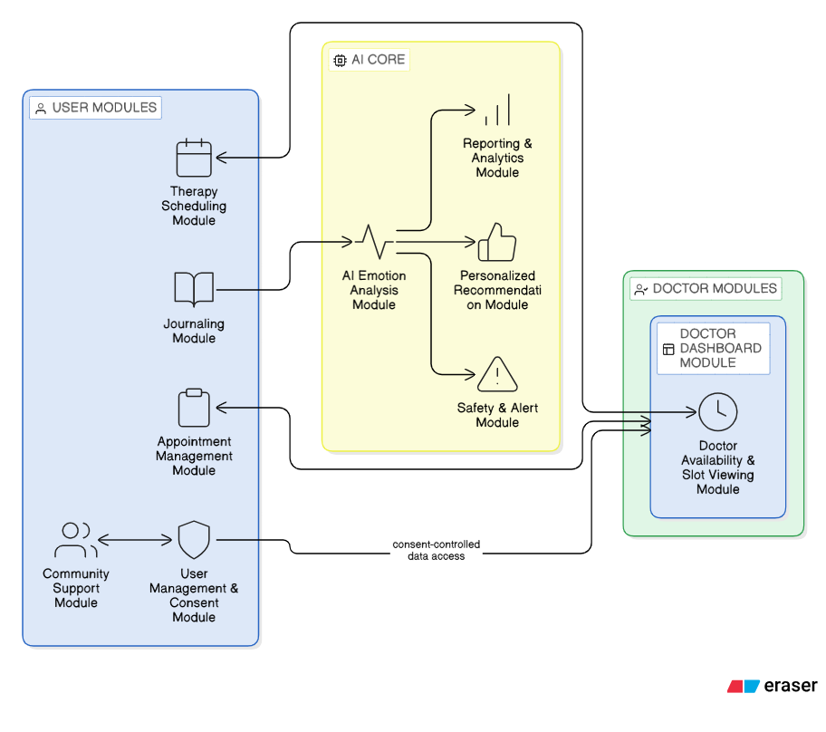
Module Diagram

Slide 39
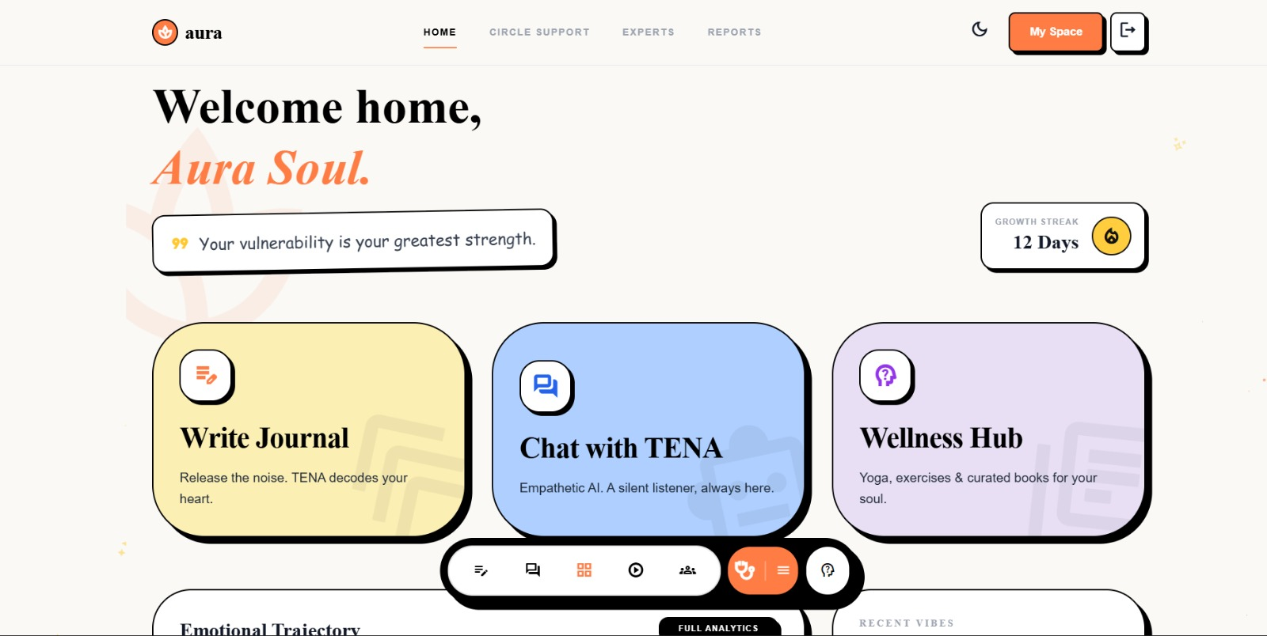
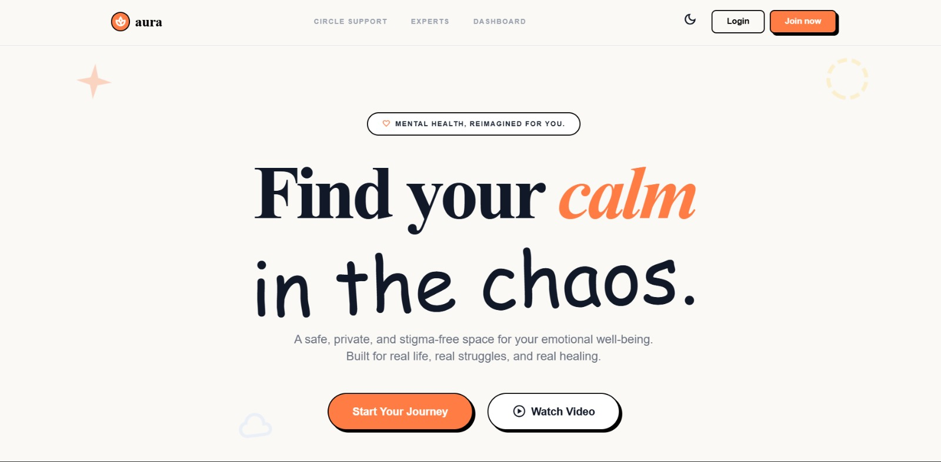
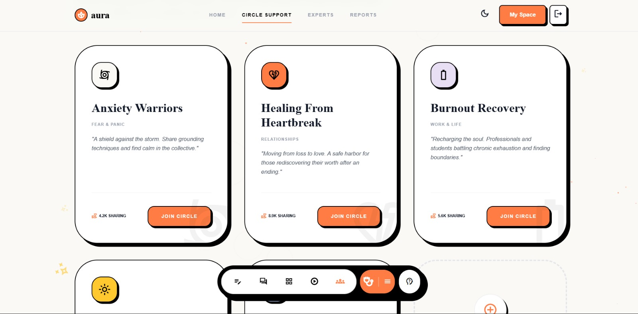
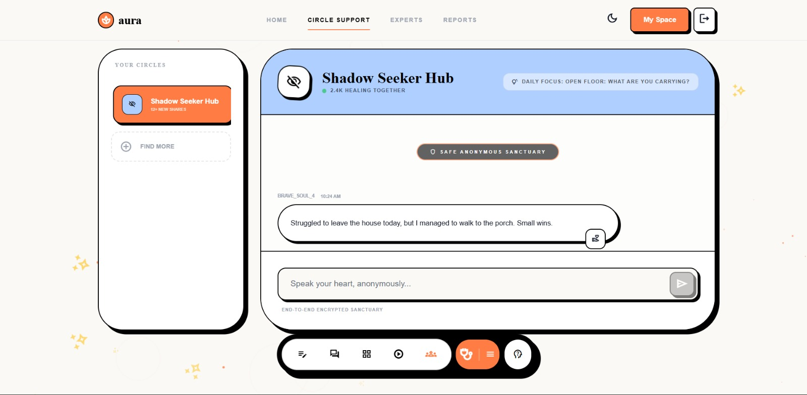
Progress so far

Slide 40
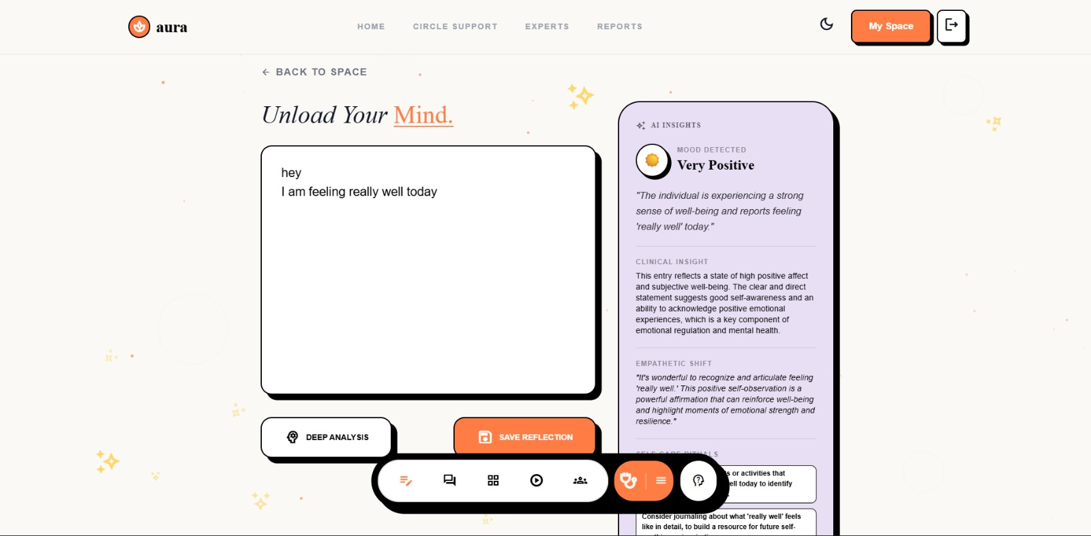
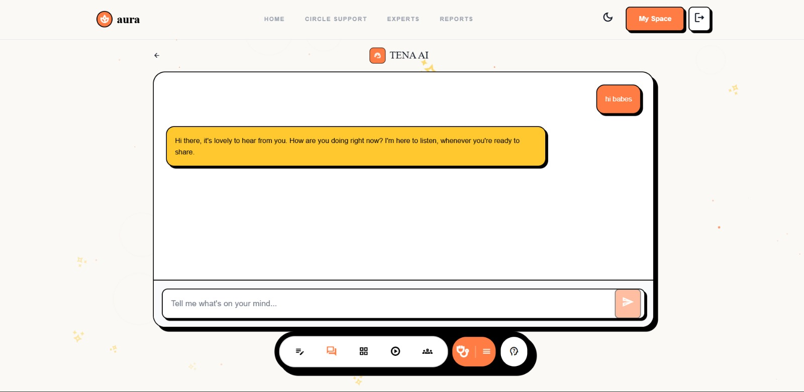
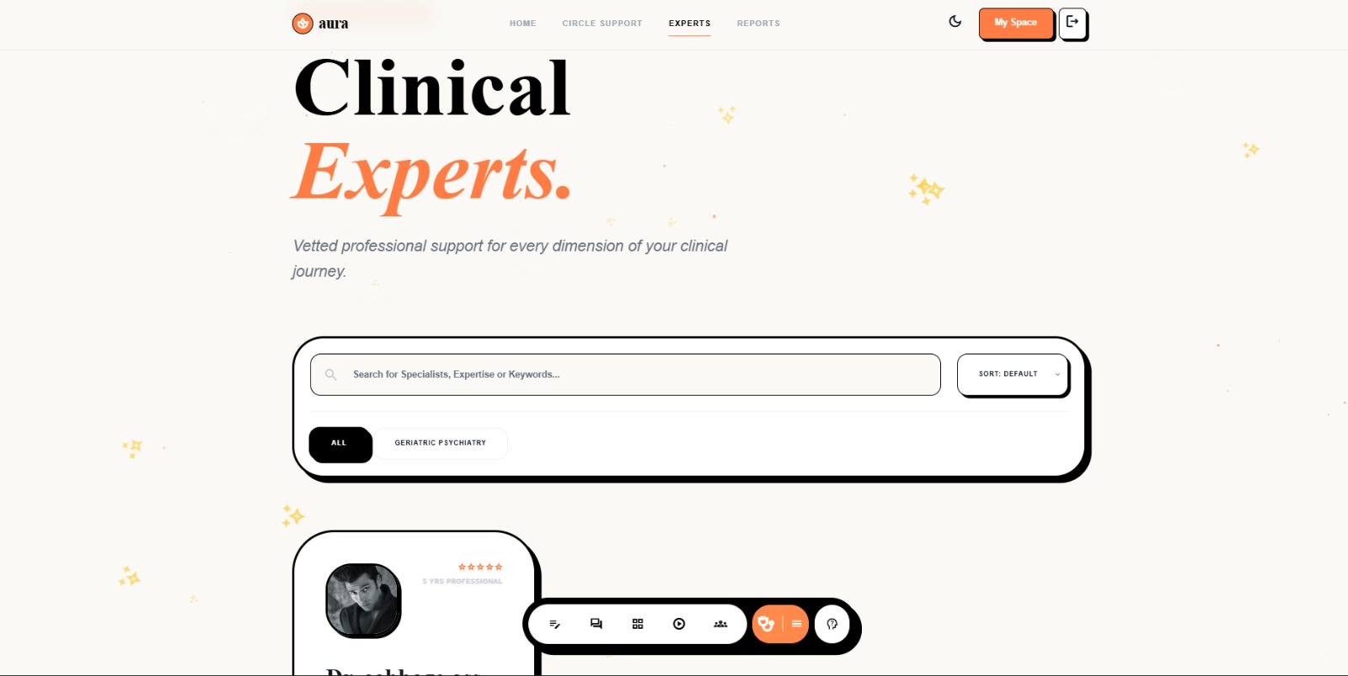
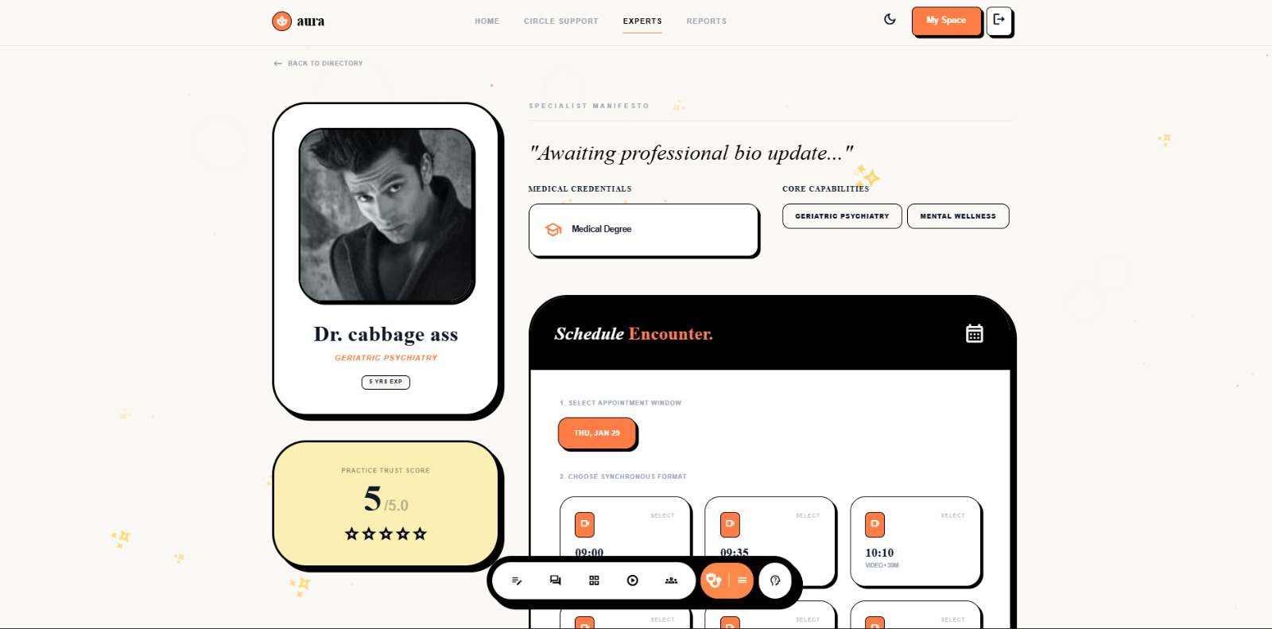
Progress so far

Slide 41
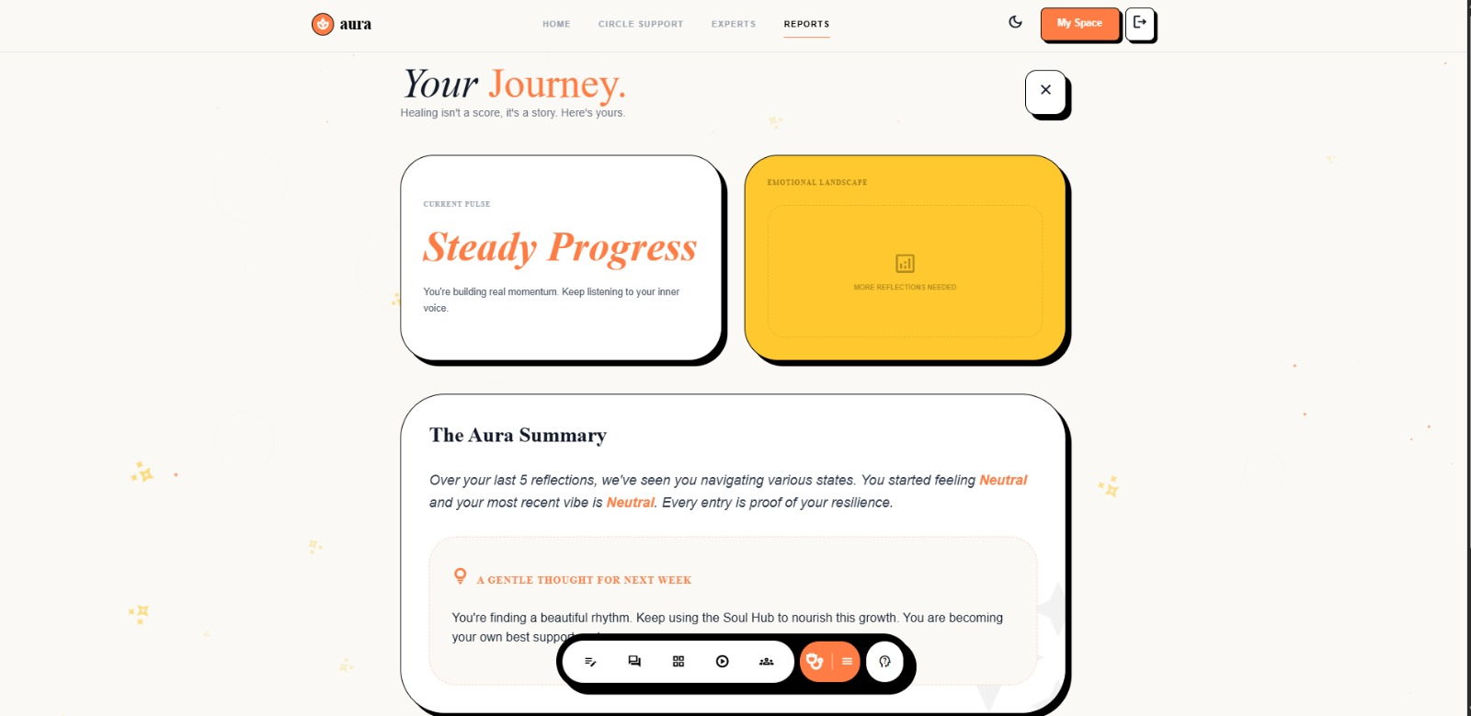
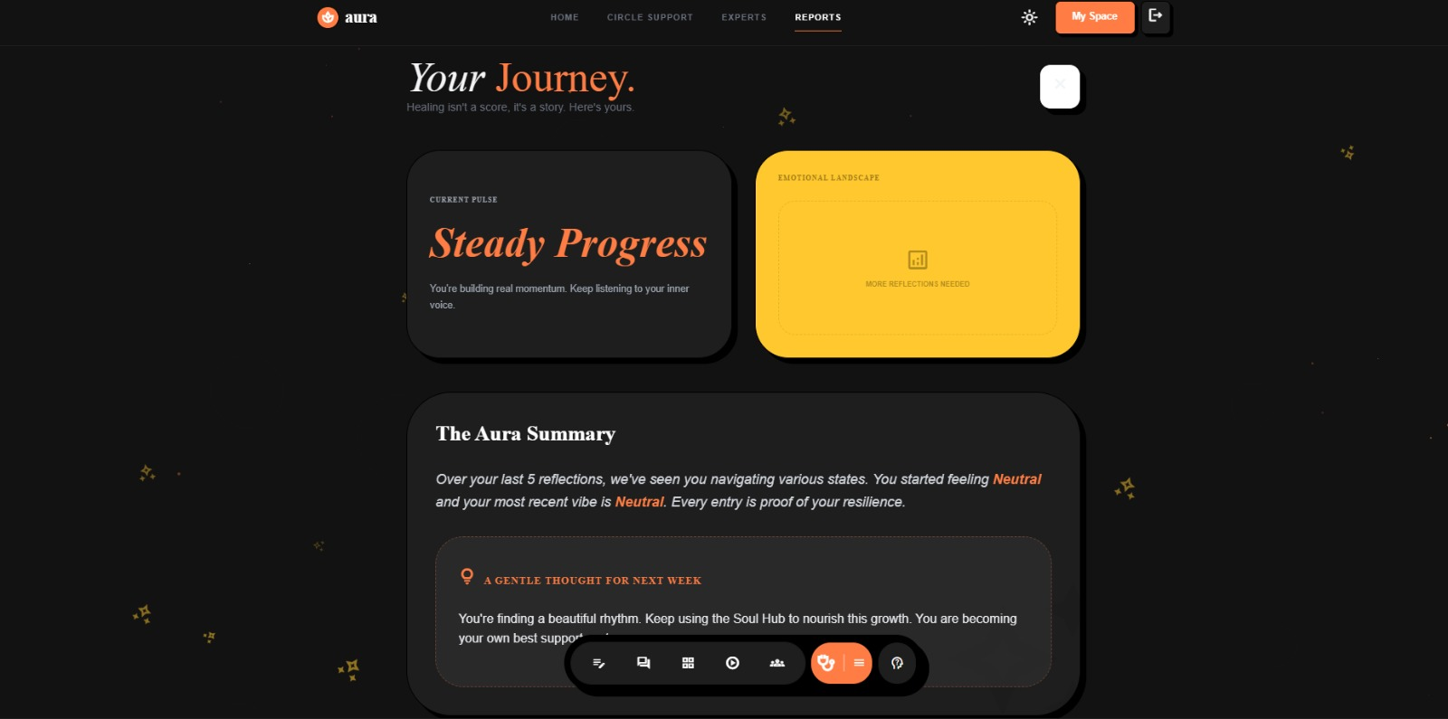
Progress so far

Slide 42
To be done
Introduce a Community Module where users can connect with others facing similar issues and share experiences in a safe space.
Add a Yoga and Book Recommendation feature to suggest wellness activities and helpful reading materials for mental well-being.
Develop a Women-Specific, Youth-Specific Support Section providing focused resources and discussions on challenges unique to women.
Implement NLP-based threat detection to analyze user text and identify harmful or high-risk content for timely intervention.

