Slide 1
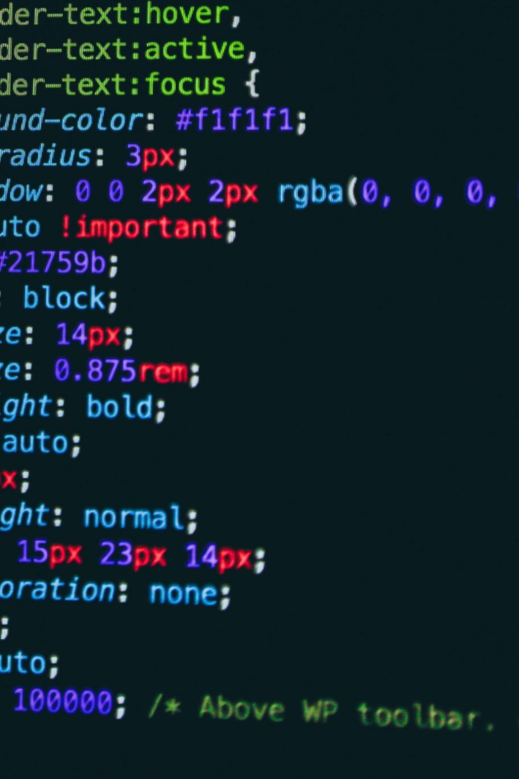

CSS BASIC FOR BEGINNERS
Welcome to the world of CSS! Now , we will cover the fundamentals of CSS, including syntax, selectors, properties, and layout techniques.

Slide 2

CSS Introduction and Syntax
1
What is CSS?
2
CSS Syntax
CSS stands for Cascading Style Sheets and is used to style the appearance of web pages.
Learn the basic structure of CSS rules, selectors, and declaration blocks.
3
Inheritance and Cascading
Discover how styles are inherited and how the cascade determines the final style of an element.

Slide 3
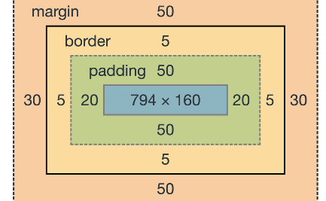
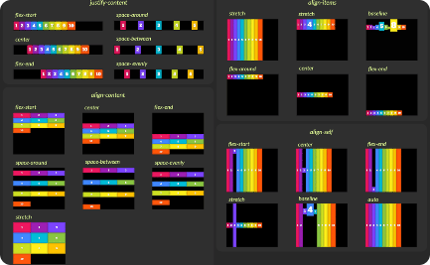
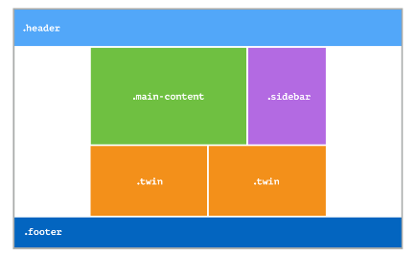
Box Model and Layout
Box Model
Flexbox
Grid
Understand the box model and how it affects the layout of elements on a web page.
Learn how to use flexbox to create responsive and flexible layouts.
Discover the power of CSS grid for creating complex layouts with ease.

Slide 4
Styling Text and Fonts
Font Properties
Text Styling
Web Fonts
Explore the different font properties like family, size, weight, style, and decoration.
Learn how to style text with properties such as color, alignment, spacing, and text effects.
Discover how to use web fonts to enhance your website's typography.

Slide 5

Working with Colors and Backgrounds
1
Color Properties
2
Background Images
Learn about different ways to specify colors in CSS, including named colors, RGB, and hexadecimal values.
Explore how to add background images to elements and control their positioning and repetition.
3
Gradient Effects
Discover how to create stunning gradient effects using CSS.

Slide 6
Conclusion and Next Steps
1
Review and Recap
2
Further Learning
3
Apply Your Knowledge
Recap the key concepts covered in this presentation.
Explore additional resources and tutorials to further enhance your CSS skills.
Start practicing and implementing CSS to create stunning and responsive web pages.

Slide 7
Resources For CSS
CSS: Cascading Style Sheets | MDN
CSS Tutorial
CSS Resources - CSS Portal

