Slide 1
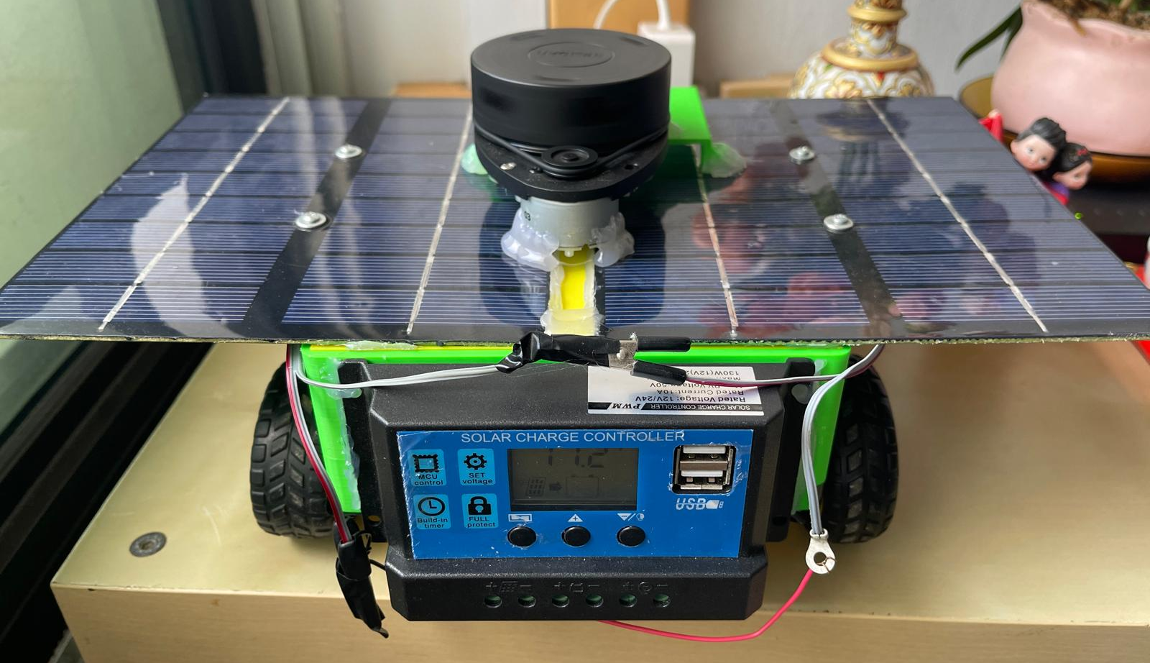
AI AND SOLAR POWERED
GRASS CUTTING ROBOT
BEng Robotics & AI · Individual Major Project · Project No. 7-13
Student: Tan Qi Yuan
Student ID: 031DDDDD (PSB) | qt24aae (UH) Supervisor: Wong Kim Siong Date: 09 April 2026
30 wks
project duration
5 / 8
objectives done
ROS2 Kilted
+ SLAM + Nav2
Raspberry Pi 4B
Ubuntu 24.04 LTS

Slide 2
Introduction & Aims
Why build a solar-powered autonomous grass cutting robot?
⚠ The Problem
🎯 Project Aim
Traditional petrol mowers:
• Produce CO₂ and greenhouse gases
• Require manual effort every week
• Cause noise pollution
• Carry operator safety risks
Commercial robot mowers exist but minimum cost $1000+
To design and develop a low-cost AI solar-powered grass cutting robot for residential lawn maintenance. Integrate AI for navigation and obstacle detection, enabling it to map and plan efficient cutting paths, avoid object in real time, and renewable solar energy to reduce manual effort and promote eco-friendly smart home automation.
✔
Solar charging power system
✔
2WD teleoperation via ROS2
✔
LIDAR scanning + SLAM mapping + Saved map
✔
Printed Chassis & Assembled
✔
Cutting mechanism
✗
Camera (object detection + recognition)
✗
Localization --> Autonomous Navigation
✗
Real Time Object Avoidance + Plan cutting paths
AI & Solar Grass Cutting Robot | Tan Qi Yuan | 9 April 2026 | BEng Robotics & AI

Slide 3
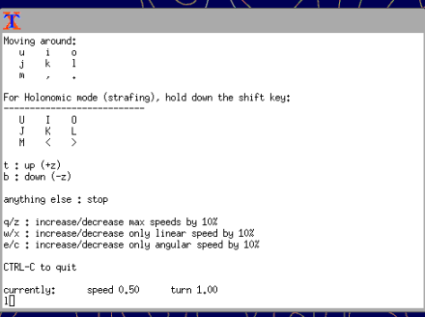
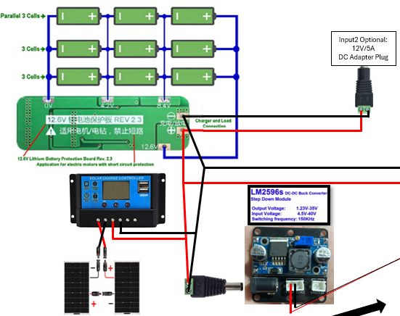
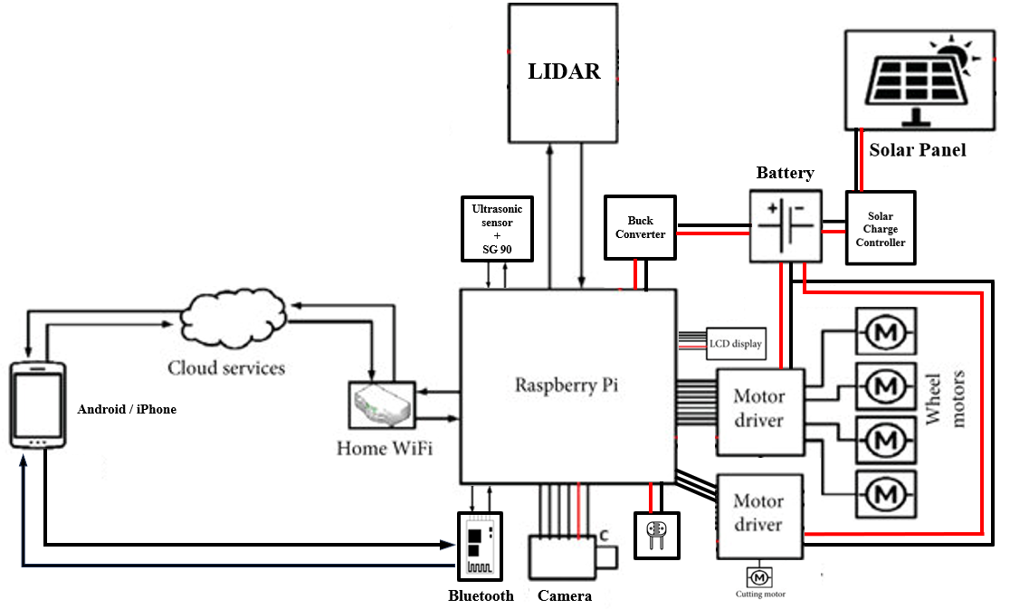
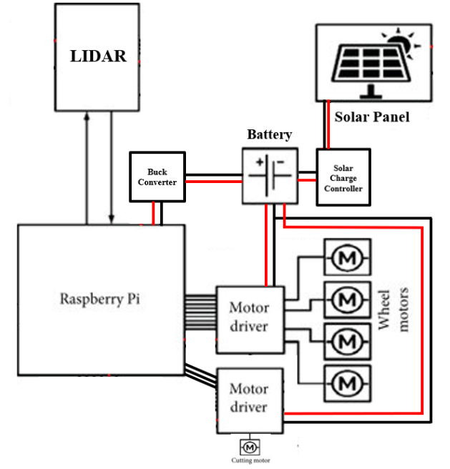
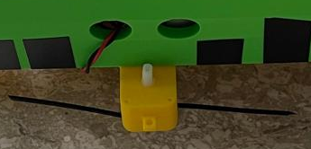
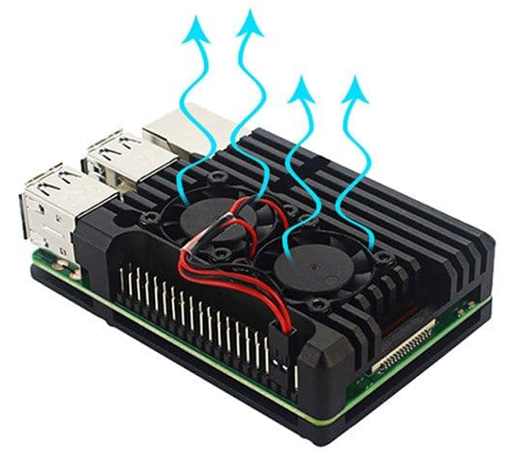
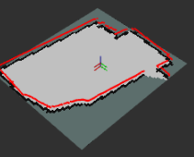
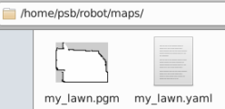
Methodology — System Architecture
Four subsystems connected through Raspberry Pi 4B running ROS2 Kilted
☀️ Power System
⚙️ Locomotion & Cutting
2× 4W Dexter Solar Panels (series) [21V / 0.5A]
└─> PWM Solar Charge Controller
└─> 12.6V BMS + 3S3P 18650 Battery [11.1V / 12.6V]
├ LM2596 5V → RPi → LIDAR via USB
├ L298N #1 → 4× DC Drive Motors
└ L298N #2 → 1× DC Cutter Motor
4× 5V DC Motors — 2WD config
L298N #1 GPIO BCM:
L = 13(IN1) / 19(IN2) / 26(ENA)
R = 5(IN3) / 6(IN4) / 12(ENB)
PWM 1000Hz — teleop via ROS2 (Xterm)
1× 5V DC Motor (Cutter)
L298N #2 GPIO BCM: 16(IN3) / 20(IN4) / 21(ENB)
cutter_controller.py to control the cutter ON/OFF
📡 Sensing
💻 Computation & Software
RPLidar A1M8 — USB to RSPi
Scan (/scan) — RVIZ2 ✔
Teleop (/cmd_vel) — ROS2 ✔
SLAM Toolbox — map saved ✔ (.pgm | .yaml)
Camera (Pi Cam) — not working (OS issue)
Ultrasonic + SG90 / LDR — not integrated
Raspberry Pi 4B (4GB RAM)
Ubuntu Server 24.04 LTS + XFCE (Headless Setup)
Putty SSH + TigerVNC remote access
ROS2 Kilted
Aluminium case + Dual fan cooling
AI & Solar Grass Cutting Robot | Tan Qi Yuan | 9 April 2026 | BEng Robotics & AI

Slide 4
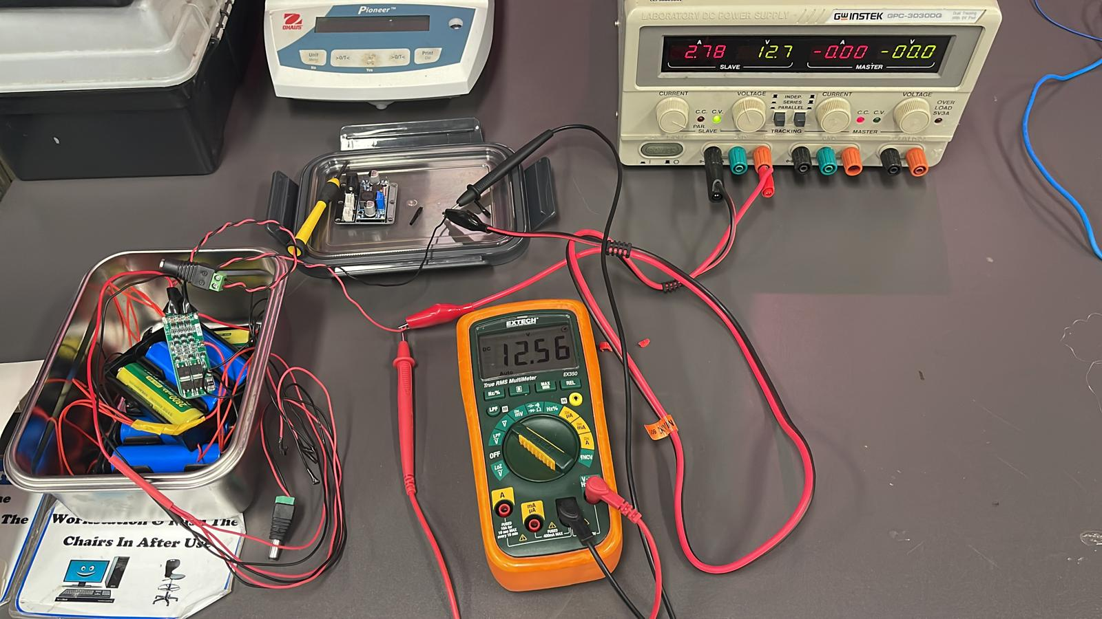
Results
Summary of what was achieved against each objective
Objective
Status
Notes
Solar charging system
✔ Done
Verified with multimeter. Solar panels insufficient current for whole system operation
2WD Teleoperation
✔ Done
keyboard_teleop → /cmd_vel → GPIO → motors via VNC.
Note: linear speed too fast; turning too slow — PWM tuning needed
LIDAR scanning (RVIZ2) + SLAM mapping + map saved
✔ Done
RPLidar A1M8 → /scan topic verified live in RVIZ2
Occupancy grid maps built and saved via map_saver_cli to ~/robot/maps/ (.pgm | .yaml)
3D chassis assembly
✔ Done
Cults3D design printed and assembled at school
Cutting mechanism
✔ Done
L298N #2 wiring complete (BCM 16/20/21)
Camera integration
✗ No
libcamera incompatible with Ubuntu Server 24.04
Autonomous navigation (Nav2)
✗ No
Nav2 configured and loads saved map. Needs real odometry (no wheel encoders / IMU)
Object Avoidance + Path Planning
✗ No
RVIZ show object detection. Boustrophedon cutting path plan planned but tested yet
AI & Solar Grass Cutting Robot | Tan Qi Yuan | 9 April 2026 | BEng Robotics & AI

Slide 5
Discussion — Key Challenges
What went wrong and how to fix it
💥 SD Card Failure (Biggest Impact)
🌞 Solar Power — Not Enough
SD card failed Feb 2026 — lost ALL data
~ 2 weeks wasted rebuilding from scratch
No backups were kept (lesson learned)
Pushed autonomous navigation past deadline
Sol 1: Git version control
Sol 2: full setup.sh automation script
Sol 3: Buy an extra MicroSD card
2 panels = max 0.5A output
5 motors + LIDAR + RPi need more current under load
Panels only practical for idle battery charging
Sol: Use higher wattage solar panel
📷 Camera — OS Incompatibility
🗺️ Nav2 — No Odometry
Sol 1: Use a standard USB webcam instead
Sol 2: Use a second RPi with RPi OS and let both boards communicate
Sol 1: Add wheel encoders — Accurate distance + speed per wheel & Add IMU (Inertial Measurement Unit) — Rotation drift, straight-line
Sol 2: Create fake odometry node
Pi Camera needs libcamera stack
libcamera only works on Raspberry Pi OS
Ubuntu Server 24.04 LTS does not support it
Nav2 launches + loads saved map ✔
AMCL needs real odometry to localise
No wheel encoders or IMU = position drift
⚡ Speed Tuning — No Stable
🏗️ 3D Chassis — Not Customize
Sol 1: Reduce PWM duty cycle in motor_control node
Increase angular gain / angular velocity cap in motor_control node
Sol 1: Design in Fusion 360, make a weatherproof enclosure, implement more cooling fans to reduce high temperature
Moves too fast in forward/reverse
Turns too slowly
Wheel keep touching robot body
No space for more components
No wiring management
Not ready for outdoor use
Temperature high
AI & Solar Grass Cutting Robot | Tan Qi Yuan | 9 April 2026 | BEng Robotics & AI

Slide 6
Conclusions
✔
Solar charging circuit — BMS + LM2596 stable 5V supply confirmed
✔
2WD teleoperation working — full ROS2 → GPIO → motor pipeline verified
✔
RPLidar A1M8 fully integrated with ROS2 — live scan in RVIZ2 | SLAM mapping complete — maps saved with map_saver_cli (.pgm | .yaml)
✔
Cutting mechanism — safe prototype zip-tie blade
✔
Physical prototype assembled — 3D chassis, all hardware mounted
✗
Autonomous navigation not achieved — unforeseen SD card failure + no wheel encoders + IMU for odometry
✗
Object avoidance & path planning not achieved — planned and still working on it
→
Pi Camera, HC-SR04, LDR integration not achieved — Ubuntu Server does not support libcamera libraries & insufficient time
✗
AI & Solar Grass Cutting Robot | Tan Qi Yuan | 9 April 2026 | BEng Robotics & AI

Slide 7
Further Development
What comes next — in priority order
🗺️ #1 — Immediate
⚡ #2 — Immediate
☀️ #3 — Short term
✂️ #5 — Short term
Odometry → Autonomous Navigation
Motor Speed Tuning
Solar Power Upgrade
Cutting Motor
No wheel encoders & IMU
→ Create fake odometry node
→ Nav2 autonomous navigation
→ Boustrophedon cutting path plan
Reduce linear PWM duty cycle
Increase angular speed/gain
Use higher wattage solar panel for sustainable charging
Replace with better motor cutter to cut the grass efficiently
📷 #4 — Short term
💾 #6 — Ongoing
🏗️ #7 — Future
📱 #8 — Future
Camera → YOLOv8
Backup & Version Control
Custom Chassis
Mobile App Control
Switch to USB webcam
→ Camera feed in ROS2
→ YOLOv8 object detection
Git version control for all code
Automated weekly SD card
Image backup to network share
Design in Fusion 360
Better component fit
Weatherproof enclosure
Cooling system
Use Wi-Fi or Bluetooth to replace keyboard teleop with customize mobile app interface for convenience
AI & Solar Grass Cutting Robot | Tan Qi Yuan | 9 April 2026 | BEng Robotics & AI

Slide 8
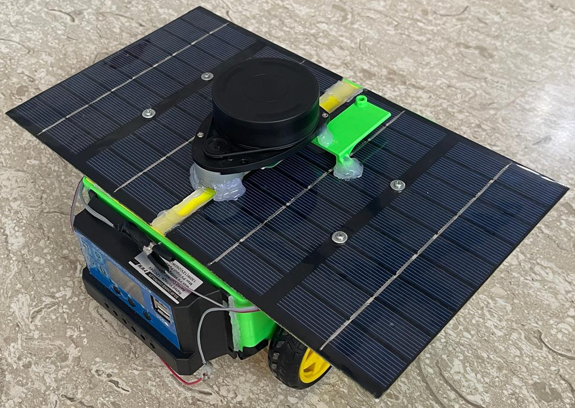
Prototype Demo & Q&A
Project at a Glance
~30 wks
Demo will show:
project duration
15 phases
✔ Raspberry Pi 4B running ROS2 Kilted accessed via VNC
in Gantt chart
✔ RPLidar A1M8 — live 360° scan in RVIZ2
5 ✔ done
main objectives
✔ 2WD teleoperation — motors responding to keyboard commands
ROS2 Kilted
✔ Saved SLAM map in ~/robot/maps/ (.pgm | .yaml)
on Ubuntu Server 24.04
SLAM ✔
✗ Autonomous navigation — not available (needs more time to create fake odometry)
map saved
Thank you for listening — Welcome
Thank you for listening — Questions Welcome
GITHUB Link: Stored: Flowchart, Gantt Chart (Old/New), Risk Assessment, Codes
[URL] – https://github.com/Seventy969/IMP
YouTube Link: Stored: Testing & Demo Video
[SolarChargeBatteryTestingURL] – https://youtu.be/AOLYDHLWg1Y
[SolarChargeaControllerTestingURL] – https://youtu.be/r81rF58QbzE
[FullRunDemoURL] – https://youtu.be/DD2j_6H0hDs
AI & Solar Grass Cutting Robot | Tan Qi Yuan | 9 April 2026 | BEng Robotics & AI

