Slide 1
MLOps Project for Object detection with YOLO
Group 1:
Grundl Andrin, Werren Arjan, Freytag Lukas, Heitzer Severin
Machine Learning and Data in Operation

Slide 2

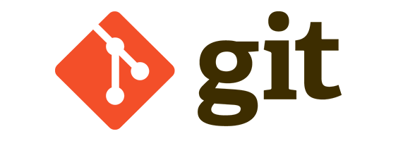



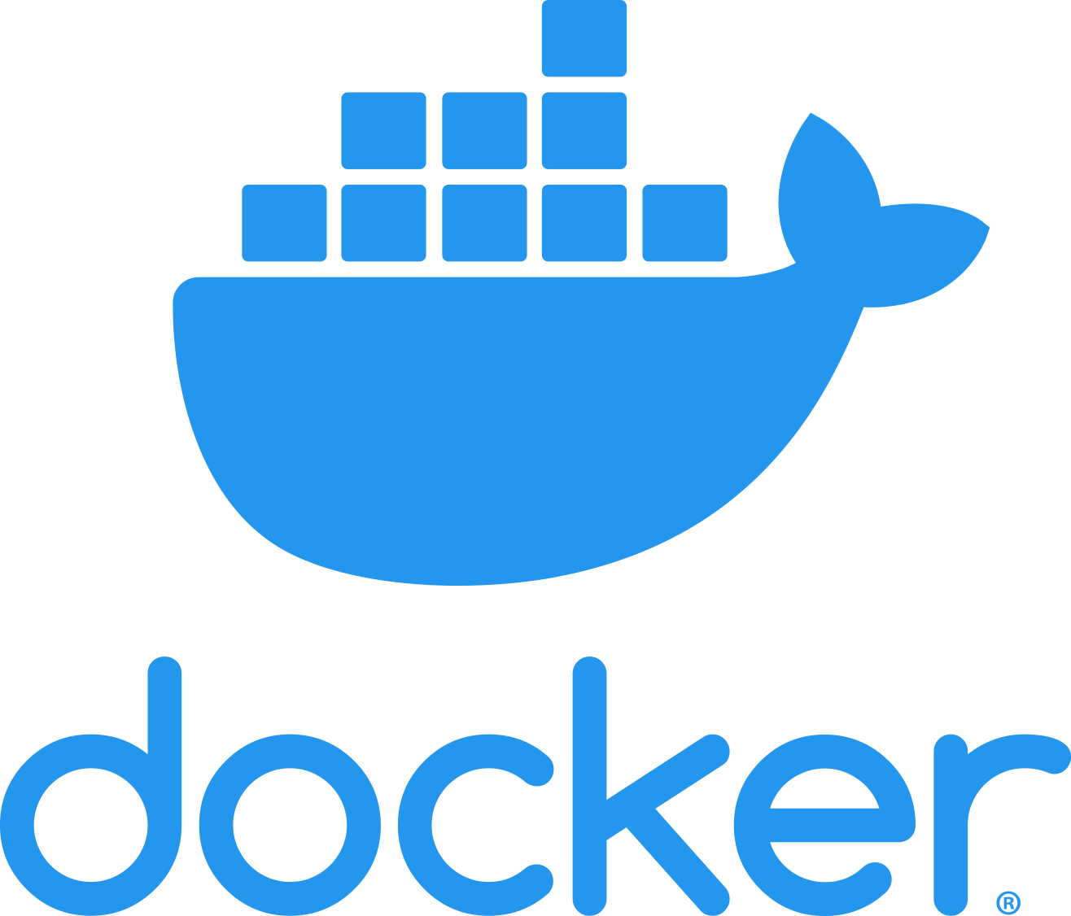
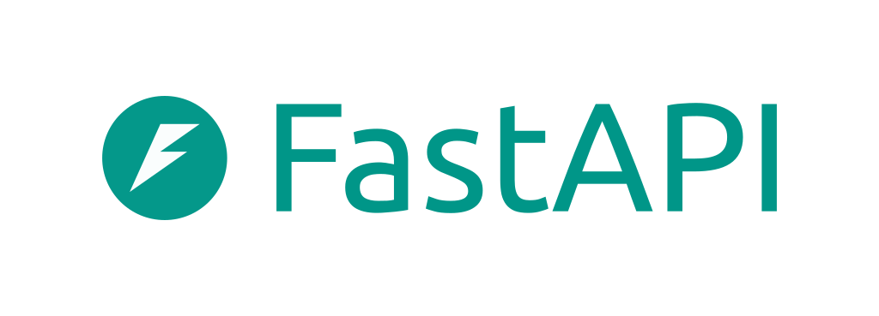


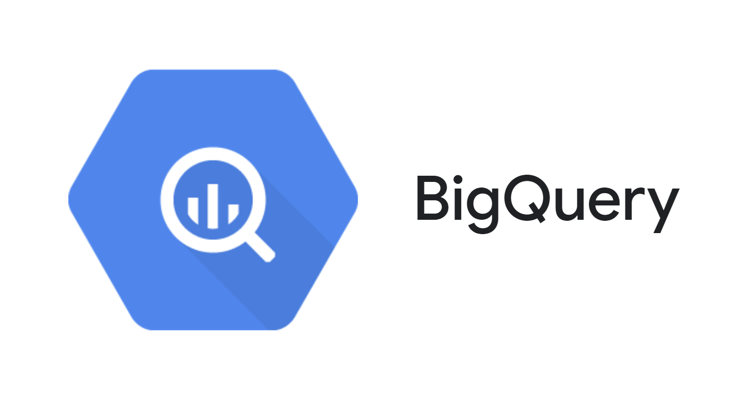
Components and Tools
Tool | Usecase
 | Versioning & CI/CD
 | Modelling
 | Pipeline automation/Workflows
 | Deployment
 | Hosting
 | Performance monitoring and tracking
 | Data Source

Slide 3
Versioning & CI/CD
Git-Driven Lifecycle: Version control for all source code and configuration files, ensuring a "single source of truth" for the entire development team.
CI/CD Integration: Automated testing and integration pipelines to validate code changes and ensure stable model deployments.
Collaborative Tracking: Managed history of changes allowing for easy rollbacks and transparent collaboration across all group members.

Slide 4
Modelling
State-of-the-Art Detection: Utilizing YOLO (You Only Look Once) architectures for real-time, high-accuracy object detection performance.
Hugging Face Ecosystem: Leveraging pre-trained models and the Transformers library to accelerate development and fine-tuning.
Optimized Training: Efficient model selection and hyperparameter tuning to balance detection speed with mean Average Precision (mAP).

Slide 5
Pipeline & workflow automation
DAG-Based Orchestration: Programmatic management of complex ML workflows using Directed Acyclic Graphs (DAGs) for clear task dependency.
Scalable Scheduling: Automated execution of data ingestion, preprocessing, and training tasks at scale.
Failure Handling: Built-in retry logic and monitoring to ensure pipeline robustness and minimize manual intervention during errors.

Slide 6
Deployment
Containerized Portability: Packaging the model and dependencies into Docker containers for consistent execution across any infrastructure.
High-Performance Serving: FastAPI provides lightweight, asynchronous endpoints for low-latency inference requests.
Scalable Architecture: Simplified scaling of inference services through container orchestration and efficient REST API design.

Slide 7
Hosting
Enterprise Infrastructure: Leveraging Google Cloud Platform (GCP) for reliable, high-availability hosting of the project services.
On-Demand Compute: Flexible access to GPU and CPU resources to handle varying training and inference workloads.
Integrated Ecosystem: Seamless connectivity between hosting services and other cloud-native data tools.

Slide 8
Performance monitoring and tracking
Interactive Dashboards: Rapidly deployed Streamlit applications to visualize model performance and real-time detection results.
User-Centric Feedback: Simple interface for stakeholders to interact with the model and review detection accuracy.
Live Metrics: Dynamic tracking of key performance indicators (KPIs) to monitor the health and drift of the deployed model.

Slide 9
Data Source
Serverless Data Warehousing: Scalable storage and management of large-scale datasets without infrastructure overhead.
High-Speed SQL Queries: Rapid analysis and extraction of training data using BigQuery’s distributed processing engine.
Seamless ML Integration: Easy data delivery to the training pipeline, ensuring high-quality data is ready for the next improvement cycle.

