Slide 1
Semaine 2

Slide 2
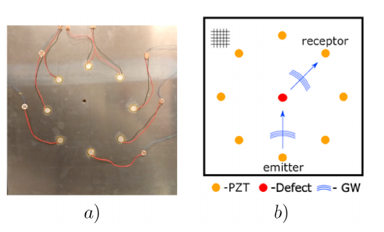
Lecture
Defect sizing in guided wave imaging structural health monitoring using convolutional neural networks (Roberto Miorelli, Clément Fisher, Andrii Kulakovskyi, Bastien Chapuis, Olivier Mesnil, Oscar D’Almeida, May 2021)
  Trained a CNN on synthetic data
  Location + size of defect
  Delay and Sum algorithm
  1 emitter n-1 receivers

Slide 3
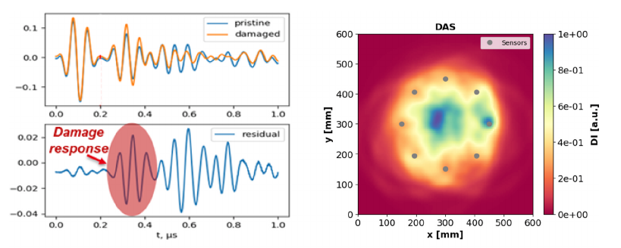
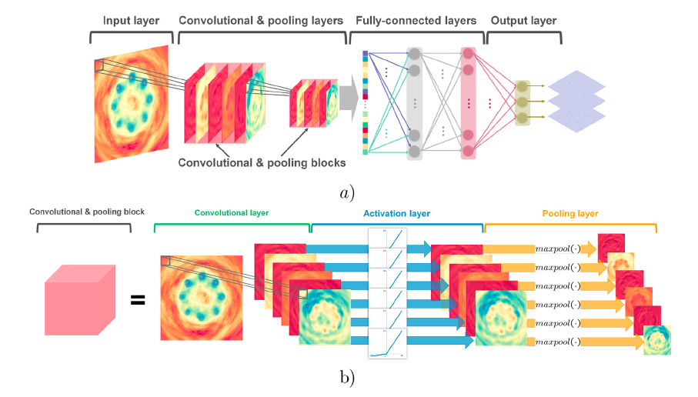

Slide 4
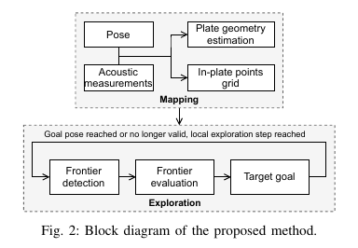
Lecture
On-plate autonomous exploration for an inspection robot using ultrasonic guided waves (Ayoub Ridani , Othmane-Latif Ouabi , Nico F. Declercq and Cédric Pradalier, Aug 2021)
  At each exploration step:
    Frontier points are extracted from the grid map.
    A utility function is used to evaluate the potential destinations.
    The candidate pose with the highest utility is selected as the next goal.
    The robot navigates to the target position.
  Occupancy grid

Slide 5
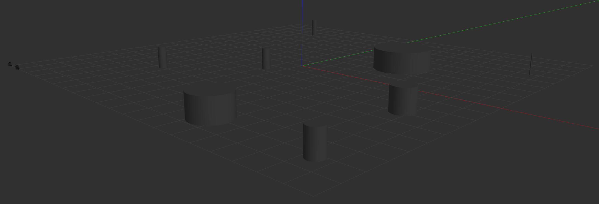
Simulation

