Slide 1
Multi-robot navigation and control for acoustic inspection of metal plate structures
Semaine 1

Slide 2
Lectures
Learning the propagation properties of rectangular metal plates for Lamb wave-based mapping:
  recover the geometry of a metal plate using UGWs acquired by a mobile unit without using a predetermined propagation model.
  Uses beamforming for localisation of boundaries;
A FastSLAM Approach Integrating Beamforming Maps for Ultrasound-based Robotic Inspection of Metal Structures
  localization and mapping on metal plates using UGWs.
  Uses a wave propagation models and beamforming
Combined Grid and Feature-based Mapping of Metal Structures with Ultrasonic Guided Waves
  mapping using UGWs and beamforming

Slide 3
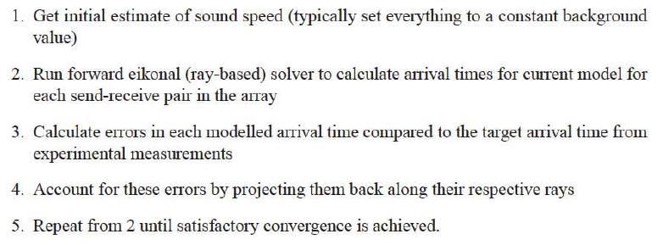
Lectures
Experimental Investigation of Impact Localization in Composite Plate using newly Developed Imaging Method
  compression molding process to create a composite plate
  piezoelectric sensors used
  wavelet transform based method to get TOF of waves of each cluster of sensors
  specific algorithm to determine localisation thanks to TOF
High Resolution Guided Wave Tomography
  HARBUT, the Hybrid Algorithm for Robust Breast Ultrasound Tomography
  Beamforming algorithm
  velocities of waves vary with the product of frequency and thickness
A Magnetic Crawler System for Autonomous Long-Range Inspection and Maintenance on Large Structures
  Uses particle filter for position estimation
  Ultrasonic mapping with beamforming, only when robot stops, not simulated on large structure

Slide 4
Lectures
MinPos : a Novel Frontier Allocation Algorithm for Multi-robot Exploration
  Approches classiques: nearest frontier, greedy assignment (he robot-frontier pair with lowest cost is selected, the robot is assigned to the frontier, and both are removed from their respective list), utility-based
  Centralized / decentralized
  synchronous: The centralizer wait for all robots to arrive at their frontier to assign the new set of frontiers / asynchronous: whenever a robot reaches its frontier
  Each robot performs repeatedly the following steps: 1. Frontiers identification and clustering 2. Computation of the distances to frontiers 3. Assignment to a frontier 4. Navigation towards the assigned frontiers for a fixed time period
  The map representation used is an Occupancy Grid
  Minimum Position: approach that consists in assigning to a robot a frontier for which it is in best position, i.e. the frontier having the less robots closer than itself.
  Wavefront propagation stopping and Parallel computation of wavefronts are used to reduce computation complexity

Slide 5
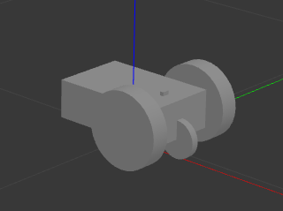
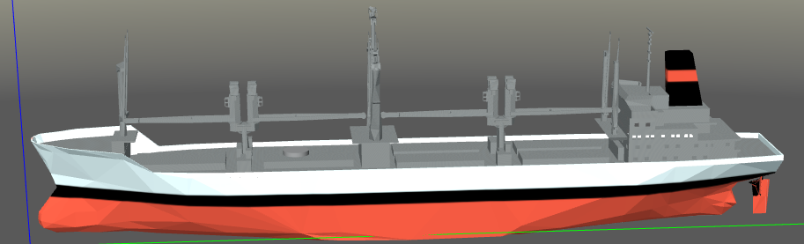
Simulation
Blender to create corroded metal plate
Gazebo
drone_simulator:

