Slide 1
PFE / Master’s Thesis
Semaine

Slide 2
Simulation
Line following, AlignWithTarget - OK
Wait for Completion
Collision avoidance
TSP

Slide 3
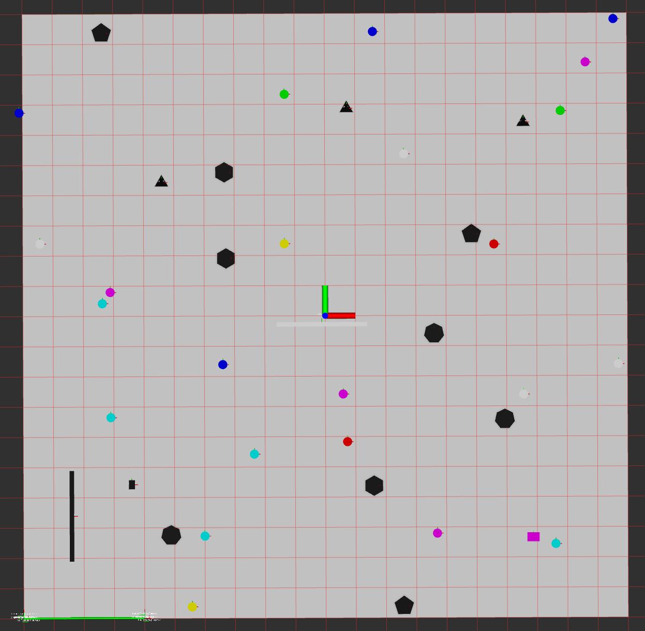
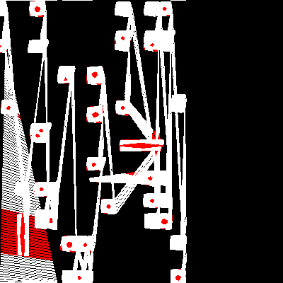
Mission Investigate

Slide 4
