Slide 1
PFE / MT

Slide 2
Simulation
Arrêter investigation si zone EMPTY
  OK
Environnements plus petits
  OK
Velocity avoidance
  Pas bloquant

Slide 3
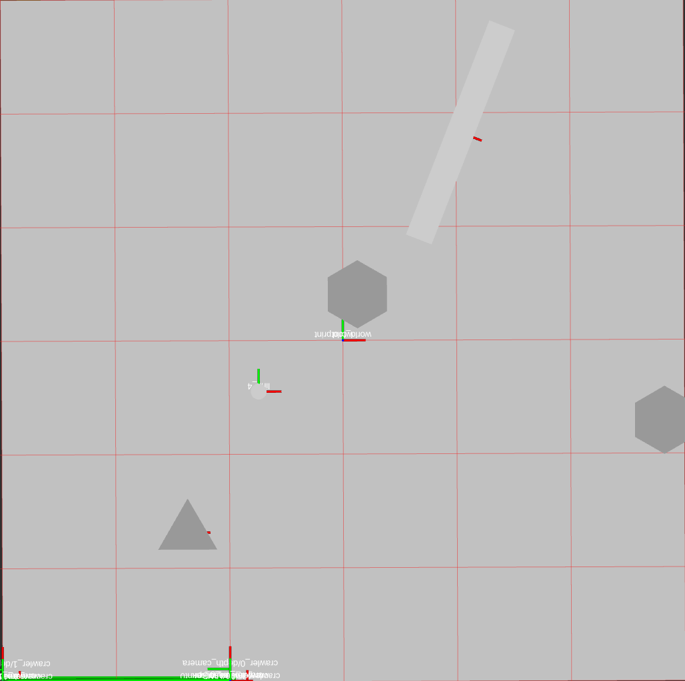
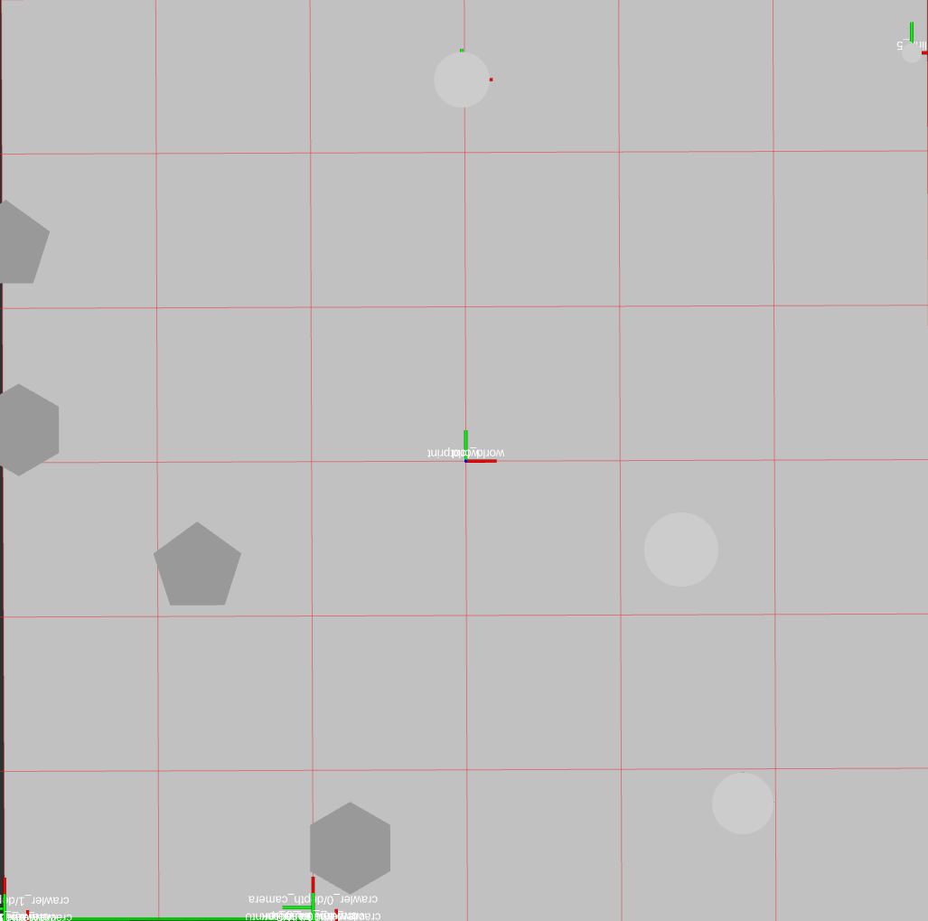
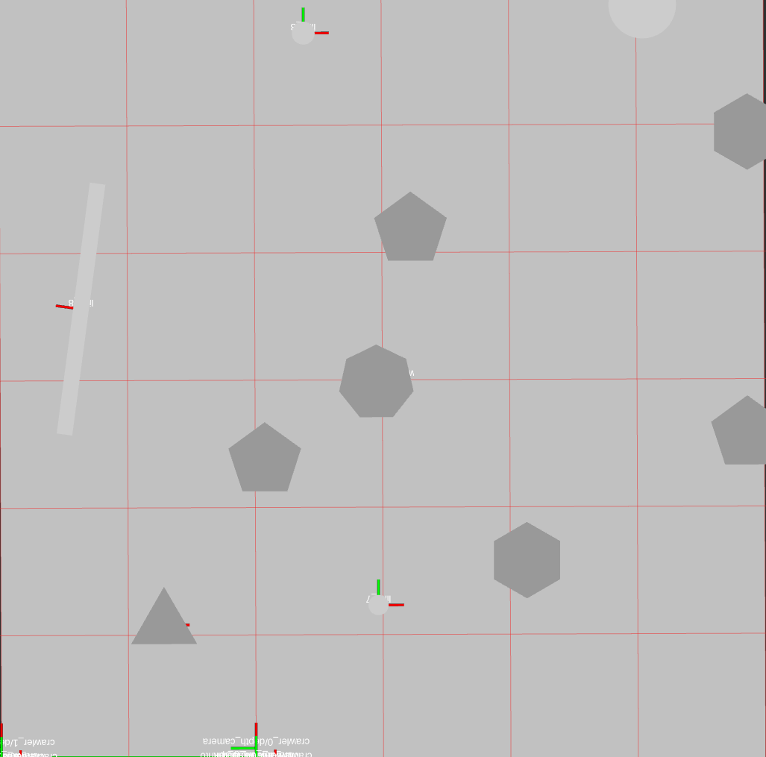
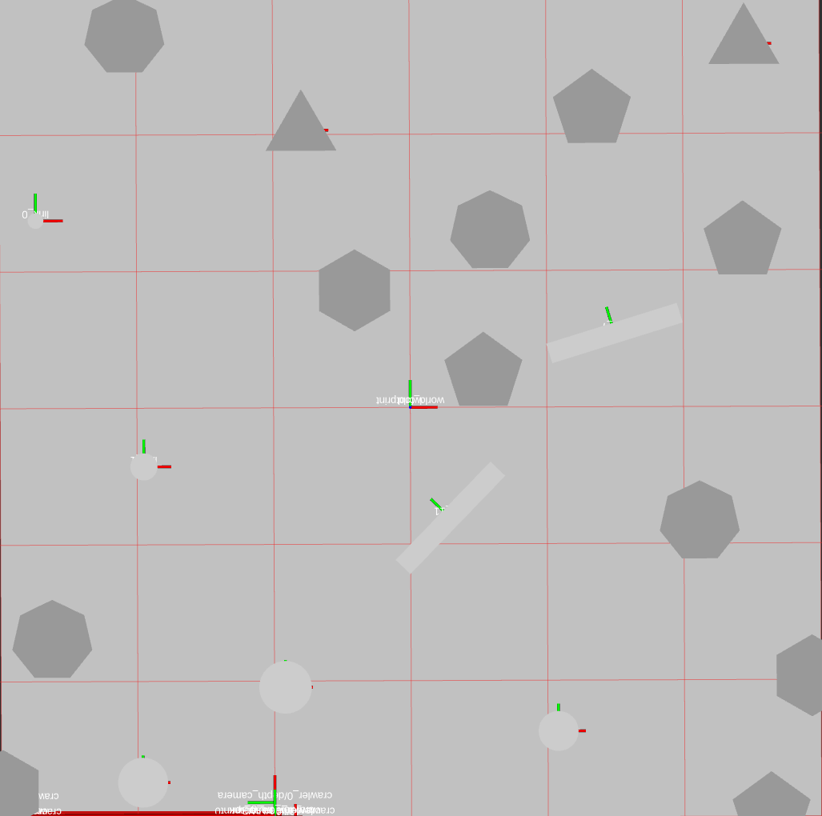
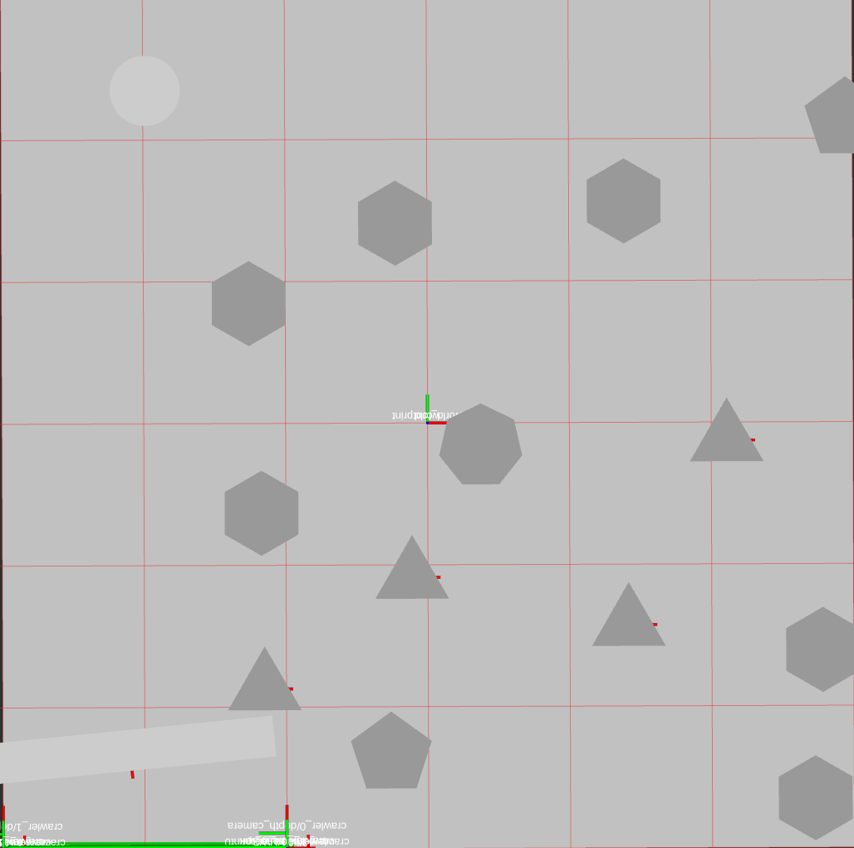
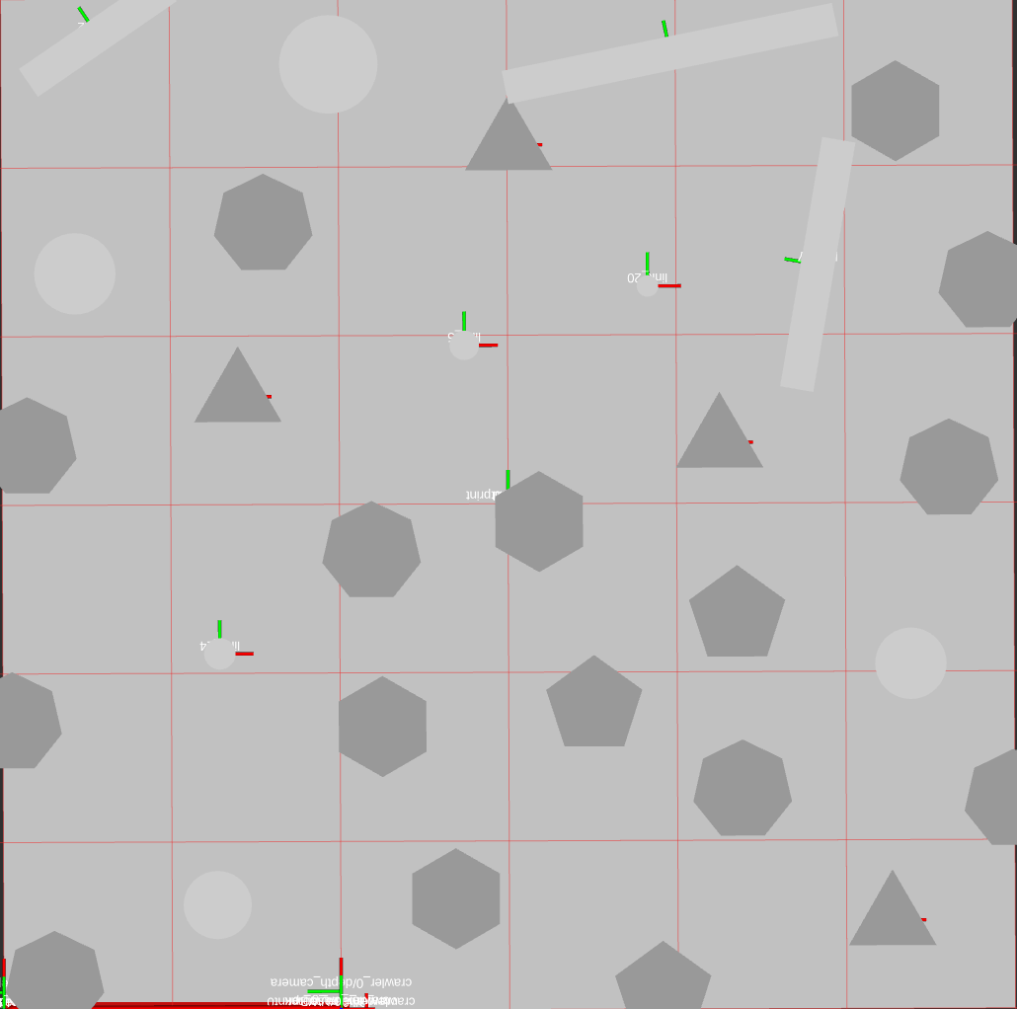
Simulation
Environnements de test
D = [1, 2, 4]
Overlap = 0.1
n_points = [4, 5, 6, 7]

Slide 4
TSP
Problème = GMDMTSP
  Multi depot
  Mutiple traveling salesman
But no depot return needed

Slide 5
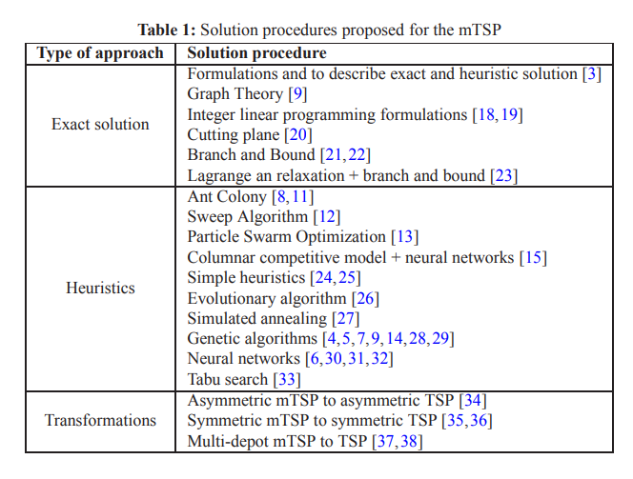
TSP
Existing algorithms:

