Slide 1
Semaine 3
Projet de Fin d’Etude / Master Thesis

Slide 2
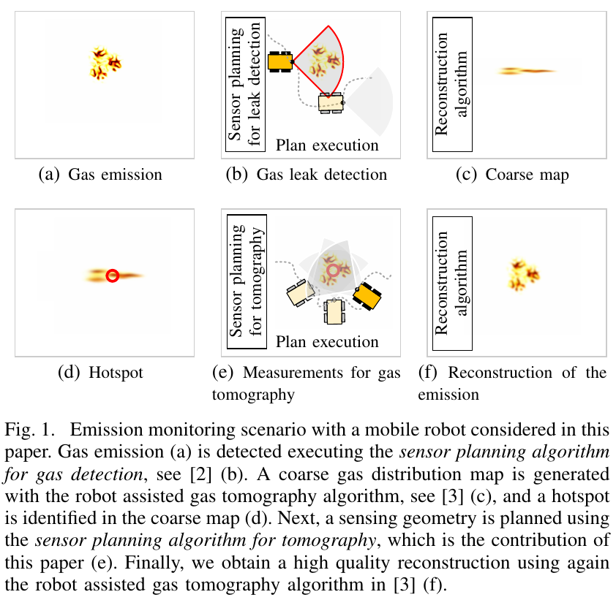
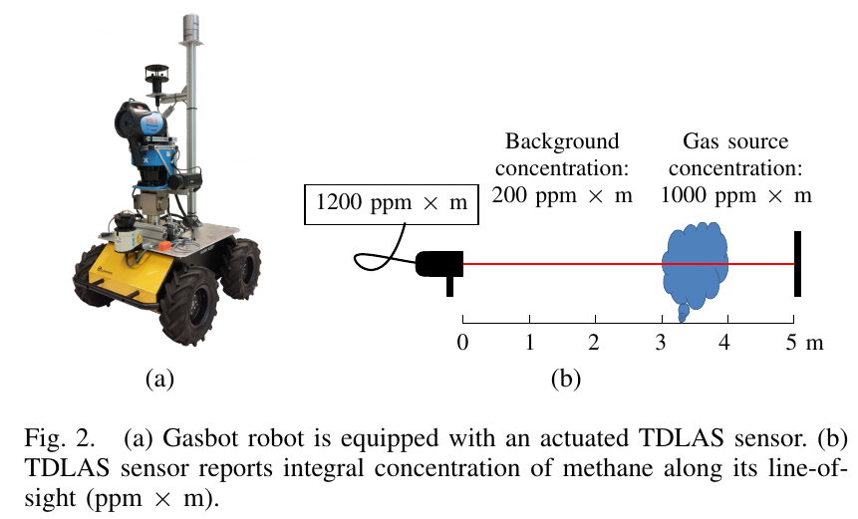
The Right Direction to Smell: Efficient Sensor Planning Strategies for Robot Assisted Gas Tomography (Muhammad Asif Arain, Erik Schaffernicht, Victor Hernandez Bennetts and Achim J. Lilienthal, Jan. 2019)
Objective: detect gas leaks, build gas distribution map
Process: Fig.1
TDLAS sensor: do not get distribution of gas along line-of-sight: Fig.2

Slide 3
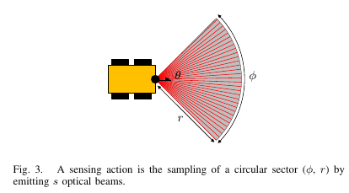
The Right Direction to Smell: Efficient Sensor Planning Strategies for Robot Assisted Gas Tomography (Muhammad Asif Arain, Erik Schaffernicht, Victor Hernandez Bennetts and Achim J. Lilienthal, Jan. 2019)
Contribution: optimization algorithm for sensor planning considering sensing geometries
Sensing geometry = number of measurement locations + sensor pose = set of sensing configurations performed by a robot at a given area: $c_i = (p_i, \phi_i, r_i)$: Fig.3

Slide 4
The Right Direction to Smell: Efficient Sensor Planning Strategies for Robot Assisted Gas Tomography (Muhammad Asif Arain, Erik Schaffernicht, Victor Hernandez Bennetts and Achim J. Lilienthal, Jan. 2019)
Sensing geometries simulation: 3 sensing geometries: $||n_c1 = 2||, n_c2 = 3||, n_c3 = 4||$
Sensing geometries surrounding area of interest
$\phi = [90°, 180°], r = 15m and ∆s = 1°$
Varying parameters: distance from area of interest (5m, 7m, 15m), $||n_c||$, angular distance between 2 sensing configurations, gas concentration model (1st: high concentration in center of area of interest, other different).

Slide 5
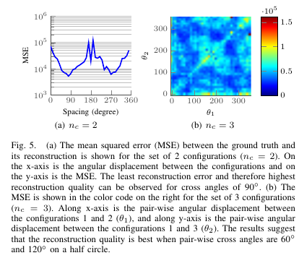
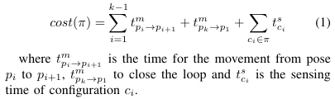

The Right Direction to Smell: Efficient Sensor Planning Strategies for Robot Assisted Gas Tomography (Muhammad Asif Arain, Erik Schaffernicht, Victor Hernandez Bennetts and Achim J. Lilienthal, Jan. 2019)
$||n_c|| = 4$ does not improve results
Exploration time = sensing time + traveling time
Cost of set of $k$ configurations:
Optimal set of configurations:
ERQ = Expected Reconstruction Quality

Slide 6
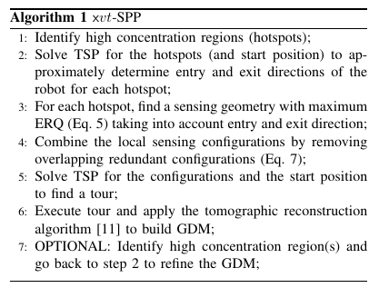

The Right Direction to Smell: Efficient Sensor Planning Strategies for Robot Assisted Gas Tomography (Muhammad Asif Arain, Erik Schaffernicht, Victor Hernandez Bennetts and Achim J. Lilienthal, Jan. 2019)
Gas detection prior step to get high concentration regions on a map (inaccurate)
ERQ G:
Hotspot used to define cross angles. But also sensing coverage of areas with gas concentration above threshold, visible from configuration $c$

Slide 7
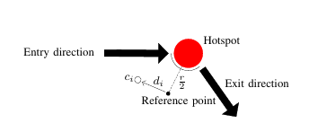
The Right Direction to Smell: Efficient Sensor Planning Strategies for Robot Assisted Gas Tomography (Muhammad Asif Arain, Erik Schaffernicht, Victor Hernandez Bennetts and Achim J. Lilienthal, Jan. 2019)
$C$ = vector of candidate configurations
$D$ = vector of distances of the travel time from the reference point to each sensing configuration.
ERQ for the cross angles is $C’GC$ and the sensing coverage is $VC$

Slide 8
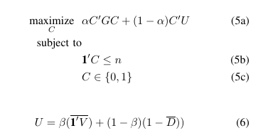
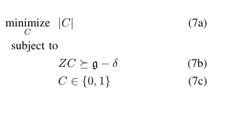
The Right Direction to Smell: Efficient Sensor Planning Strategies for Robot Assisted Gas Tomography (Muhammad Asif Arain, Erik Schaffernicht, Victor Hernandez Bennetts and Achim J. Lilienthal, Jan. 2019)
Optimisation problem:
Different parameters not discussed
What is C’?
If hotspots are far from each other, connect them with TSP. Else high probability of similar configurations for different hotspots → fusion → optimisation problem:

Slide 9
Strategies for Optimal Placement of Surveillance Cameras in Art Galleries (Marcelo C. Couto, Cid C. de Souza, Pedro J. de Rezende, Jun. 2014)
AGP - NP-Hard
Polygon P with n vertices
N/3 cameras are sufficient
Cameras on vertices, 360° field of view
Discretisation of P into a finite set of points D(P)
Solve SCP (Integer Programming)

Slide 10
Strategies for Optimal Placement of Surveillance Cameras in Art Galleries (Marcelo C. Couto, Cid C. de Souza, Pedro J. de Rezende, Jun. 2014)
Discretisation startegies:
  Regular Grid
  Induced Grid: grid induced by the edge extensions that intersect in the polygon.
  Just Vertices: grid consisting only of the vertices of P
  Reduced Atomic Visibility Polygons: reduction of Atomic Visibility Polygons

Slide 11
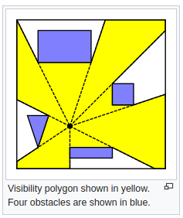
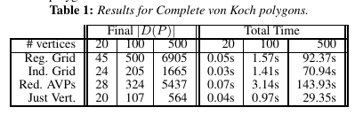
Strategies for Optimal Placement of Surveillance Cameras in Art Galleries (Marcelo C. Couto, Cid C. de Souza, Pedro J. de Rezende, Jun. 2014)

