Slide 1
Projet de Fin d’Etude / Master Thesis
Semaine 4

Slide 2
Efficient Measurement Planning for Remote Gas Sensing with Mobile Robots, Muhammad Asif Arain, Marcello Cirillo, Victor Hernandez Bennetts,
Erik Schaffernicht, Marco Trincavelli and Achim J. Lilienthal, Jun. 2015
Convex relaxation: problem becomes convex when applying relaxation (dropping constraints)
Purposes: formalize the remote gas sensing coverage problem for mobile robotics, quickly find an exploration plan that guarantees a complete coverage of the environment
Map on the environment discretized in set A of n cells. O in A = cells of obstacles (beam blocked), S in A = cells traversable
Solution of problem = tour within the map, obstacle free, + set of sensing actions along the tour that senses evrey cell in S.
Pose p_j of robot, a_j in S, theta_j in Theta
Theta = finite set of allowed orientations, equally spaced between 0 and 2pi.
Robot position within cell is center of the cell.
Movement of the rebot are forward motion and rotations.

Slide 3
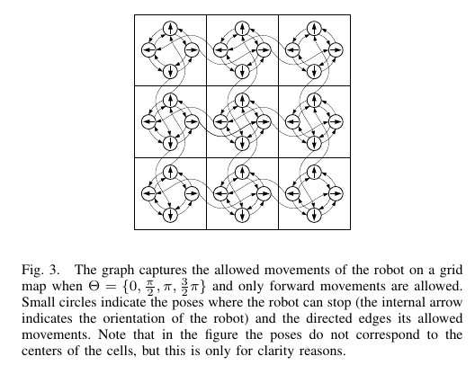
Efficient Measurement Planning for Remote Gas Sensing with Mobile Robots, Muhammad Asif Arain, Marcello Cirillo, Victor Hernandez Bennetts,
Erik Schaffernicht, Marco Trincavelli and Achim J. Lilienthal, Jun. 2015

Slide 4

Efficient Measurement Planning for Remote Gas Sensing with Mobile Robots, Muhammad Asif Arain, Marcello Cirillo, Victor Hernandez Bennetts,
Erik Schaffernicht, Marco Trincavelli and Achim J. Lilienthal, Jun. 2015
Time is used as measure of cost
t^c = time to move to adjacent cell
t^r = time to rotate
t^m_{p_i->p_j} = movement time

Slide 5
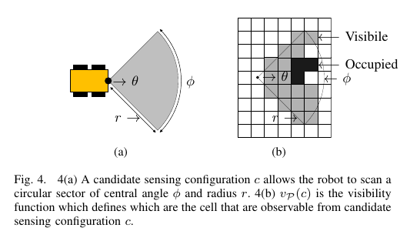
Efficient Measurement Planning for Remote Gas Sensing with Mobile Robots, Muhammad Asif Arain, Marcello Cirillo, Victor Hernandez Bennetts,
Erik Schaffernicht, Marco Trincavelli and Achim J. Lilienthal, Jun. 2015
C_P = set of candidate sensing configurations for a set of poses P
Visibility function: v_P(c) : set of cells in S visible from c
t_c^s = cost to perform sensing action in a candidate sensing configuration c

Slide 6
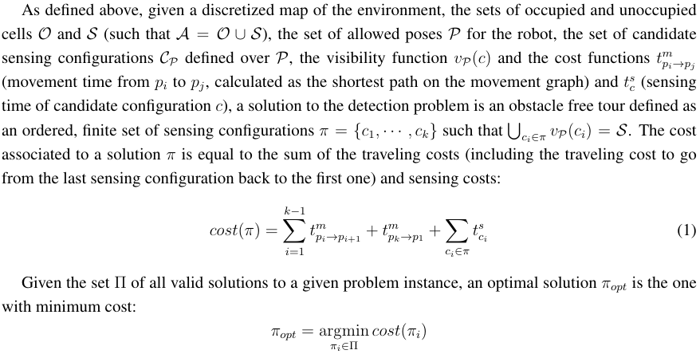
Efficient Measurement Planning for Remote Gas Sensing with Mobile Robots, Muhammad Asif Arain, Marcello Cirillo, Victor Hernandez Bennetts,
Erik Schaffernicht, Marco Trincavelli and Achim J. Lilienthal, Jun. 2015

Slide 7

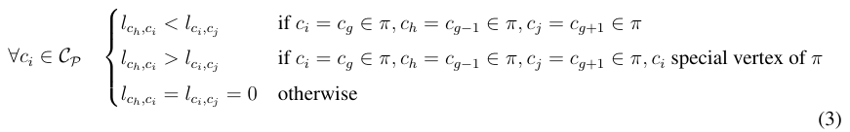
Efficient Measurement Planning for Remote Gas Sensing with Mobile Robots, Muhammad Asif Arain, Marcello Cirillo, Victor Hernandez Bennetts,
Erik Schaffernicht, Marco Trincavelli and Achim J. Lilienthal, Jun. 2015
Formulation inspired by [Tomioka, Y.; Takara, A.; Kitazawa, H. Generation of an Optimum Patrol Course for Mobile Surveillance Camera. IEEE Trans. Circuits Syst. Video Technol. 2012, 22, 216–224.]
Flow variables and label variables over the movement graph of the robot

Slide 8
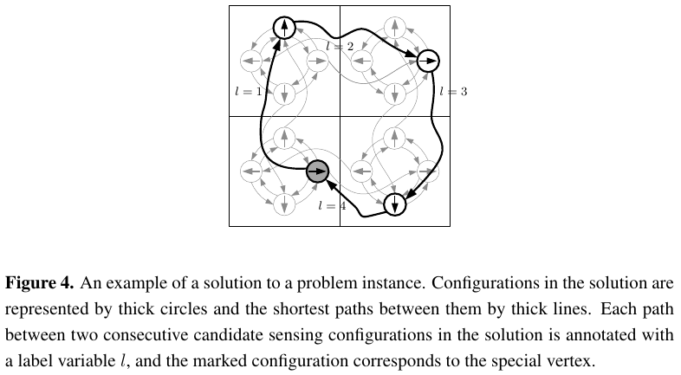
Efficient Measurement Planning for Remote Gas Sensing with Mobile Robots, Muhammad Asif Arain, Marcello Cirillo, Victor Hernandez Bennetts,
Erik Schaffernicht, Marco Trincavelli and Achim J. Lilienthal, Jun. 2015

Slide 9

Efficient Measurement Planning for Remote Gas Sensing with Mobile Robots, Muhammad Asif Arain, Marcello Cirillo, Victor Hernandez Bennetts,
Erik Schaffernicht, Marco Trincavelli and Achim J. Lilienthal, Jun. 2015
F = matrix of flow variables: F[i, j] = f_{c_i, c_j}
L = matrix of label variables: L[i, j] = l_{c_i, c_j}
S = boolean vector: S[i] if c_i special vertex
T_m = matrix of traveling costs: T_m[i, j] = t^m_{p_i, p_j}
T_s = vector of sensing costs: T_s[i] = t^s_{c_i}

Slide 10
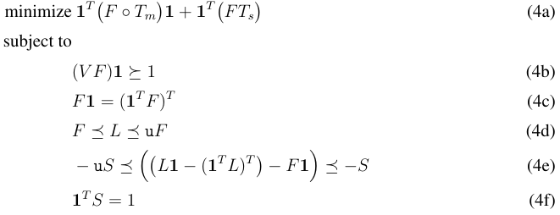
Efficient Measurement Planning for Remote Gas Sensing with Mobile Robots, Muhammad Asif Arain, Marcello Cirillo, Victor Hernandez Bennetts,
Erik Schaffernicht, Marco Trincavelli and Achim J. Lilienthal, Jun. 2015

Slide 11
Efficient Measurement Planning for Remote Gas Sensing with Mobile Robots, Muhammad Asif Arain, Marcello Cirillo, Victor Hernandez Bennetts,
Erik Schaffernicht, Marco Trincavelli and Achim J. Lilienthal, Jun. 2015
(4b) Coverage constraints: require that each cell a_i in S is visible from at least one of the candidate sensing configurations selected in the solution π.
(4c) Flow conservation constraints: ensure that the solution will consist of one or more closed paths among the selected candidate sensing configurations.
(4d-e) Traveling route constraints: ensure that each candidate sensing configuration is visited only once in a solution, and, therefore, a solution consists of a single closed path. u is an upper limit constant for label variables.
(4f) Special vertex constraint: restricts the number of special vertices to one and only one for each solution.

Slide 12
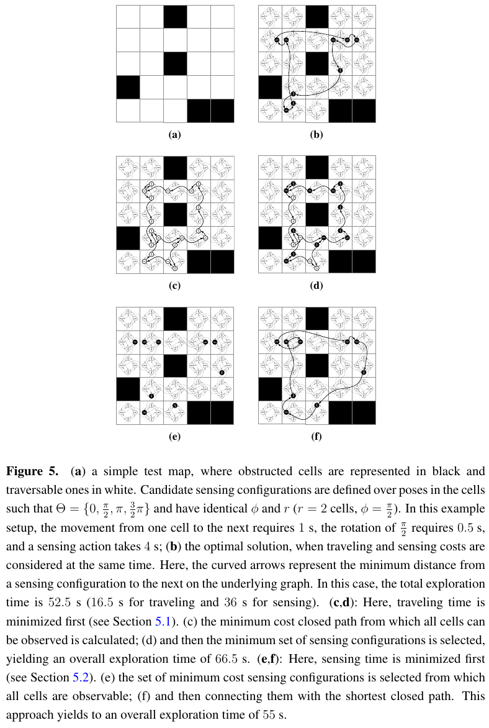
Efficient Measurement Planning for Remote Gas Sensing with Mobile Robots, Muhammad Asif Arain, Marcello Cirillo, Victor Hernandez Bennetts,
Erik Schaffernicht, Marco Trincavelli and Achim J. Lilienthal, Jun. 2015

Slide 13
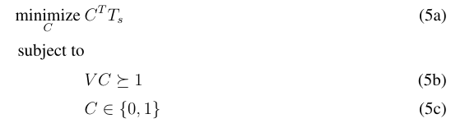
Efficient Measurement Planning for Remote Gas Sensing with Mobile Robots, Muhammad Asif Arain, Marcello Cirillo, Victor Hernandez Bennetts,
Erik Schaffernicht, Marco Trincavelli and Achim J. Lilienthal, Jun. 2015
Decomposition of the problem:
  Minimizing the Traveling Time first, Minimizing the Sensing Time then.
  Minimizing the Sensing Time first, Minimizing the Traveling Time then.
    C = vector whose elements are binary variables representing if a given candidate sensing configuration is selected or not.

Slide 14
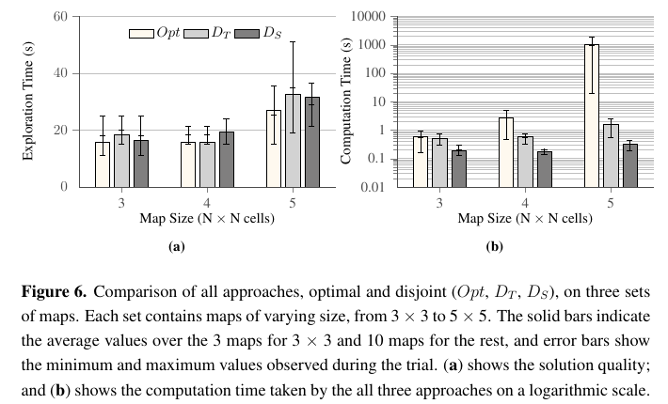
Efficient Measurement Planning for Remote Gas Sensing with Mobile Robots, Muhammad Asif Arain, Marcello Cirillo, Victor Hernandez Bennetts,
Erik Schaffernicht, Marco Trincavelli and Achim J. Lilienthal, Jun. 2015

Slide 15
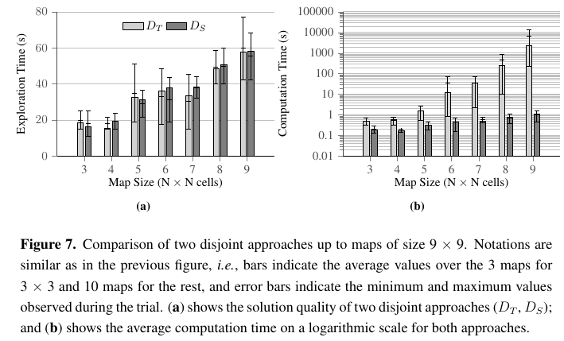
Efficient Measurement Planning for Remote Gas Sensing with Mobile Robots, Muhammad Asif Arain, Marcello Cirillo, Victor Hernandez Bennetts,
Erik Schaffernicht, Marco Trincavelli and Achim J. Lilienthal, Jun. 2015

Slide 16
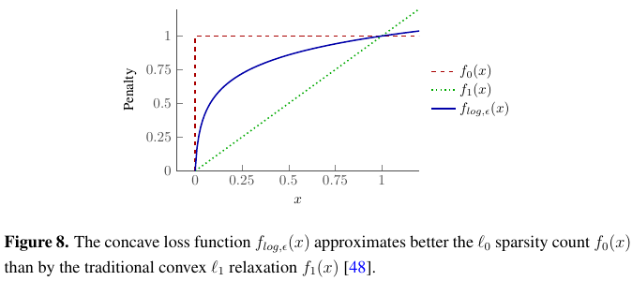
Efficient Measurement Planning for Remote Gas Sensing with Mobile Robots, Muhammad Asif Arain, Marcello Cirillo, Victor Hernandez Bennetts,
Erik Schaffernicht, Marco Trincavelli and Achim J. Lilienthal, Jun. 2015

Slide 17
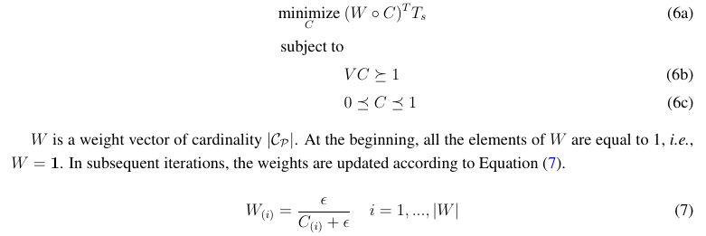

Efficient Measurement Planning for Remote Gas Sensing with Mobile Robots, Muhammad Asif Arain, Marcello Cirillo, Victor Hernandez Bennetts,
Erik Schaffernicht, Marco Trincavelli and Achim J. Lilienthal, Jun. 2015
Epsilon = convergence rate:
high at beginning, decreases
exponentially

Slide 18
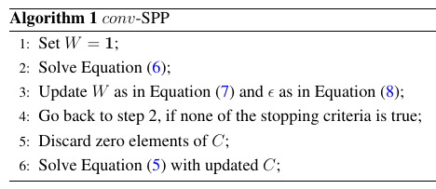
Efficient Measurement Planning for Remote Gas Sensing with Mobile Robots, Muhammad Asif Arain, Marcello Cirillo, Victor Hernandez Bennetts,
Erik Schaffernicht, Marco Trincavelli and Achim J. Lilienthal, Jun. 2015
Stopping criteria: cfr paper

Slide 19
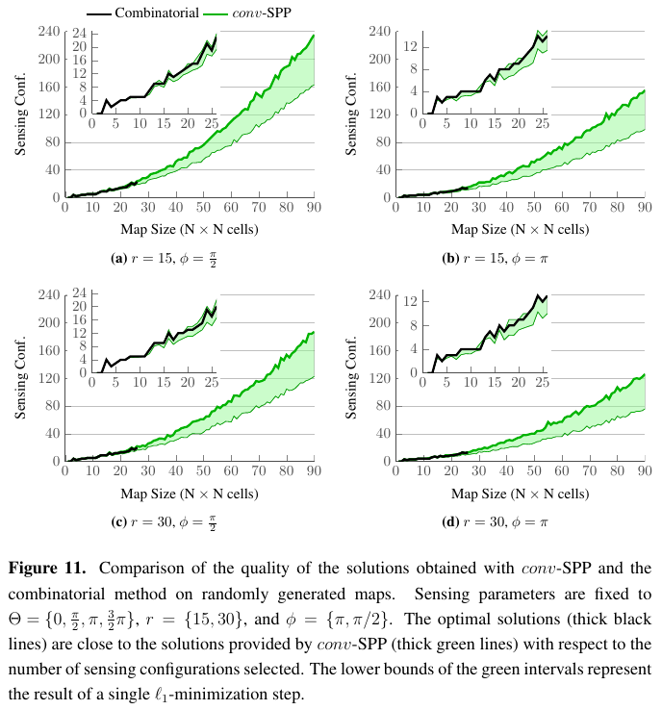
Efficient Measurement Planning for Remote Gas Sensing with Mobile Robots, Muhammad Asif Arain, Marcello Cirillo, Victor Hernandez Bennetts,
Erik Schaffernicht, Marco Trincavelli and Achim J. Lilienthal, Jun. 2015

Slide 20
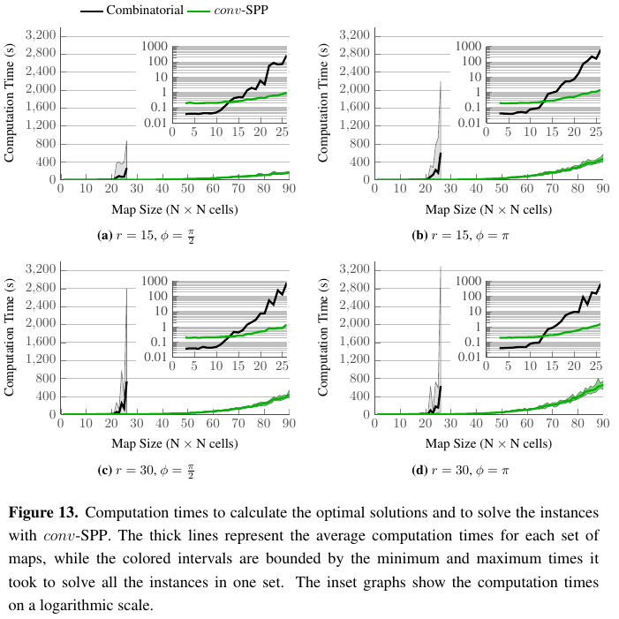
Efficient Measurement Planning for Remote Gas Sensing with Mobile Robots, Muhammad Asif Arain, Marcello Cirillo, Victor Hernandez Bennetts,
Erik Schaffernicht, Marco Trincavelli and Achim J. Lilienthal, Jun. 2015

