Slide 1
tstory01
Init/Init01CDerivedStates
EnableRoomLocation(Marsara,true)
Room Support/Room location/RoomLocationIsEnabled
Room Support/Room Is Enabled
True
True
Room Support/RoomChangeDialog
Button Show
AddRoomPanelButton(roomIndex=Marsara)
Button Unlock

Slide 2
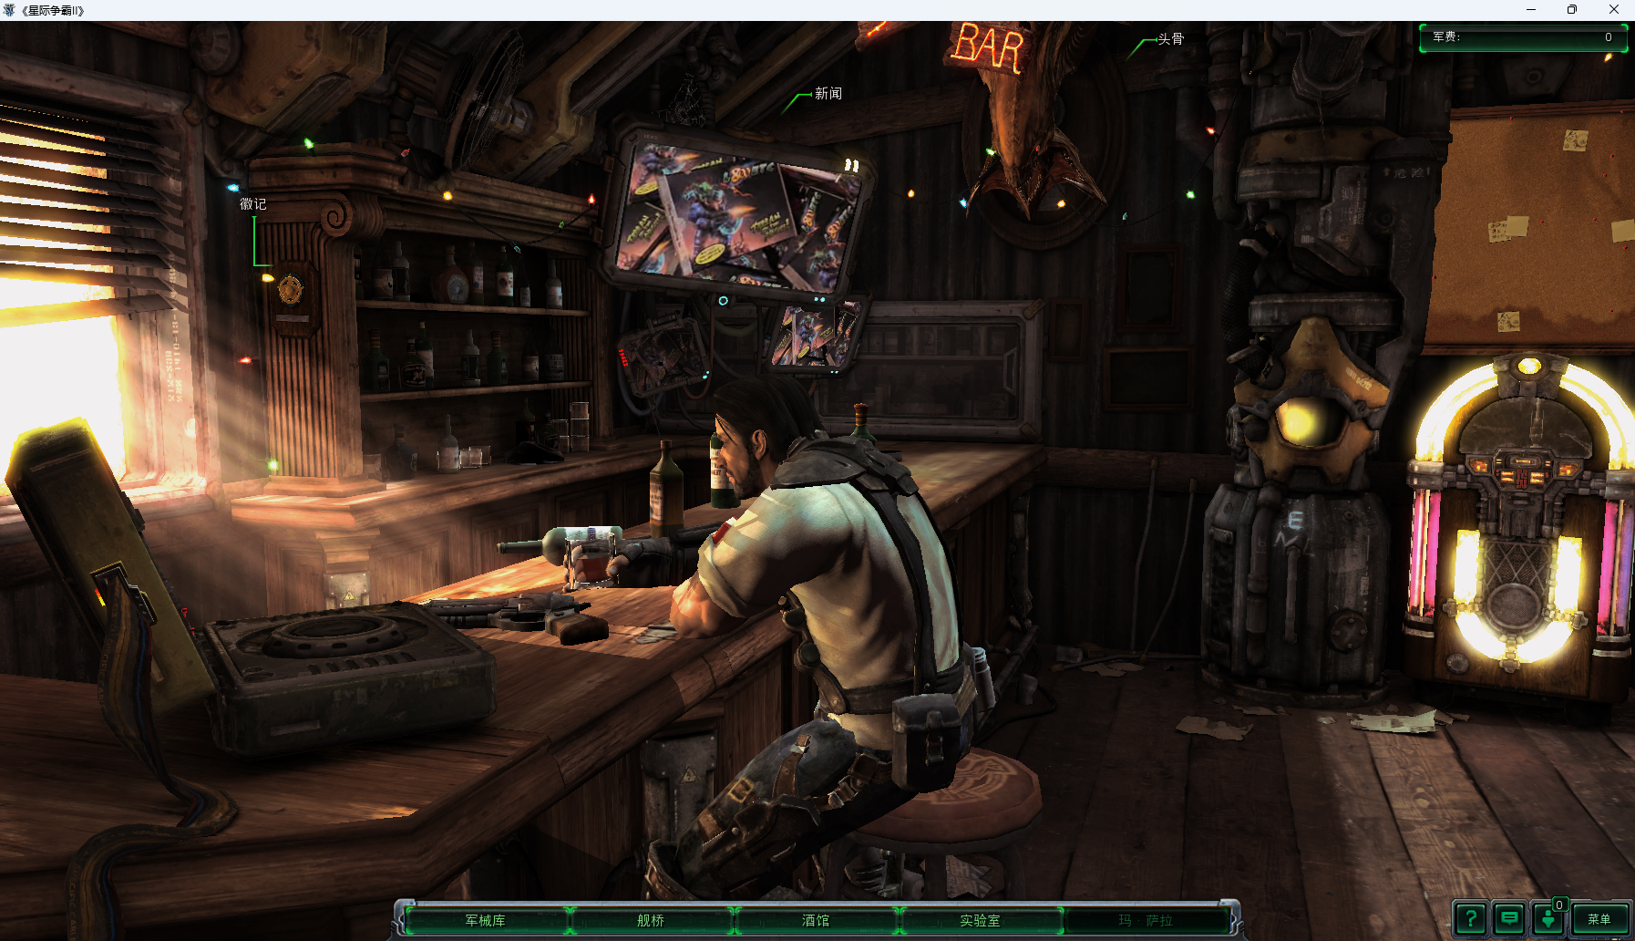

Slide 3
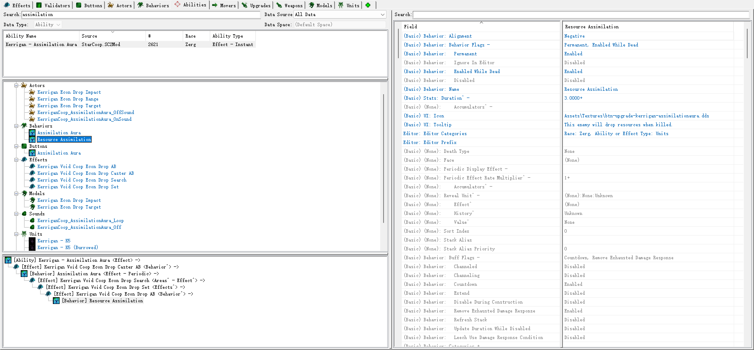
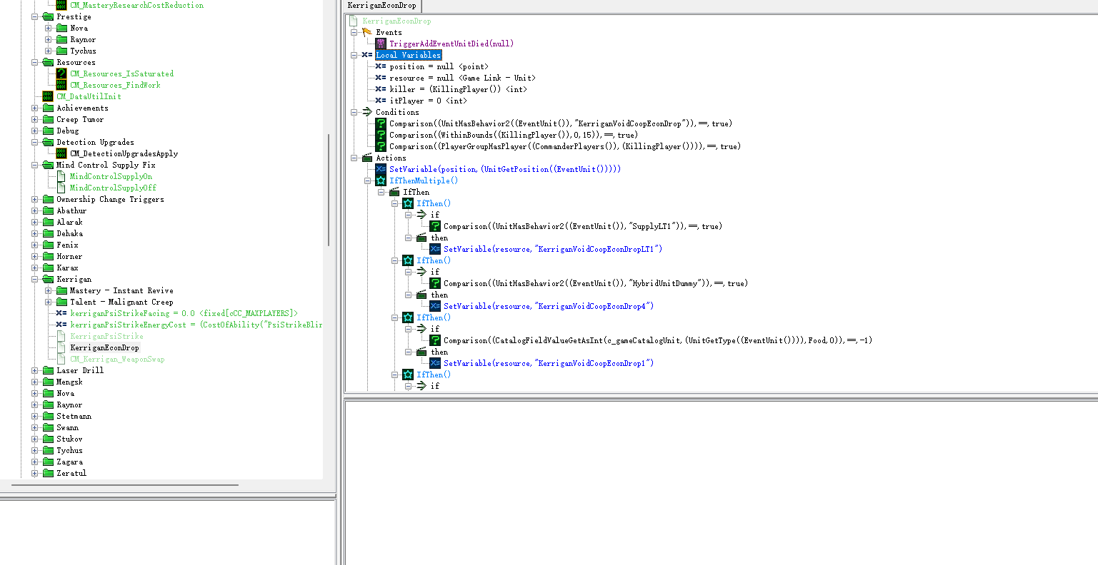
凯瑞甘吸收光环通过施加一个行为，当具有该行为的单位死亡，通过触发器生成资源

