Slide 1
The game of TV-Tennis
Project group 6
22 May 2021

Slide 2
Contents
Videosystem
Kinematic controller
Artificial intelligence
Project innovations
Further development plan
Demo

Slide 3

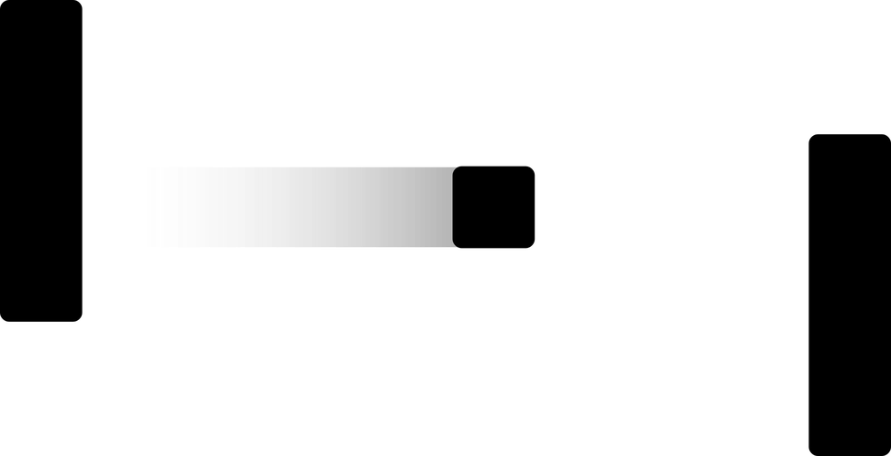
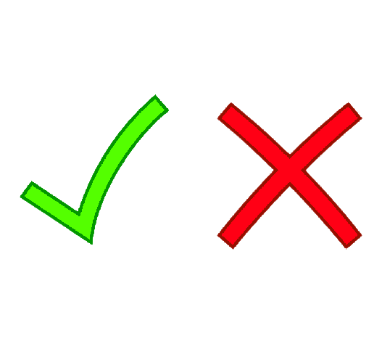
Notes:
We decided to choose project B, as it seemed to us the most interesting to implement.
I think rules of this game are clear for everyone

Slide 4
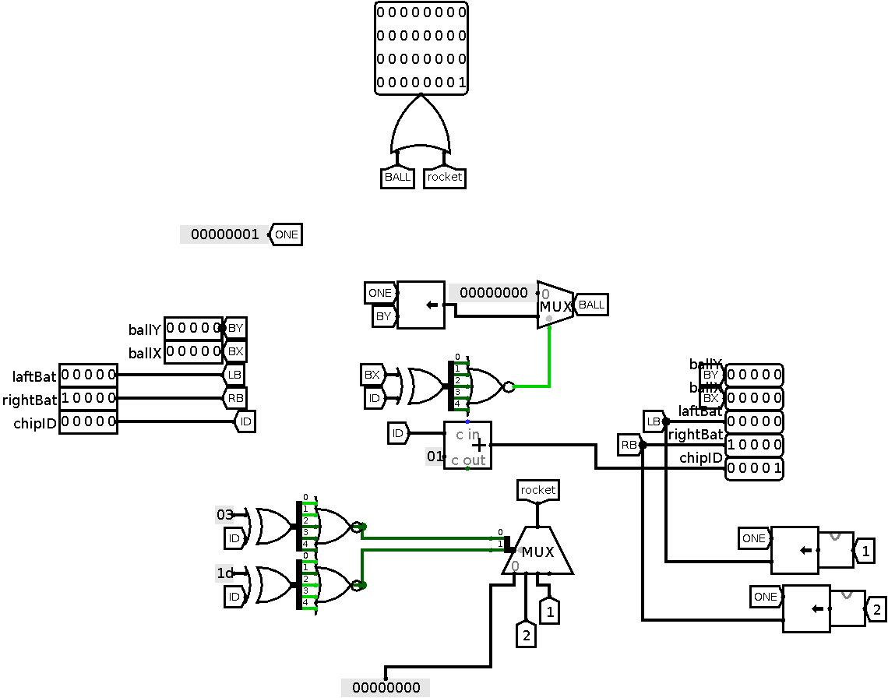
Videosystem
Notes:
The diagram above shows the chip for the matrix column. In each such chip, we know the chip ID, which has a value of 1 more than the previous chip, starting from 0. We also get the X and Y coordinates of the ball, and the Y coordinates of the two rackets.When the chip ID matches the X coordinate of the ball, we push the Y coordinate of the ball on that chip, converting it from 5-bit to 32-bit representation. We do the same with rackets, but when converting to a 32-bit representation we draw a pixel at the top and bottom of the racket, and compare the ID with constant values. We have 32 such chips, one for each column of the screen.

Slide 5
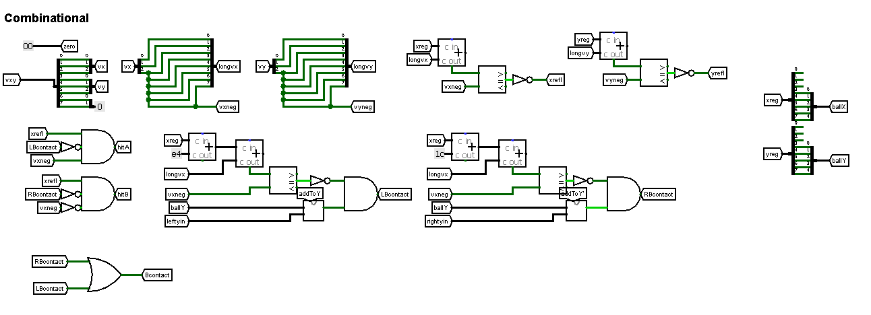
Kinematic Controller
Combinational block
Notes:
This chip is used to move the ball and bats, keeping scores and wall and bat collision detection. We decided to use tunnels as they make our scheme look good and neat. So, we don’t have chaos of wires, schemes and so on. Moreover we could divide controller on 4 blocks:
I will skip input and output blocks, so there is Combinational block. There we have all hit detectors: hitting an edge, hitting a bat.

Slide 6
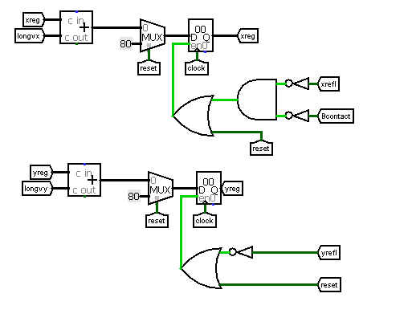
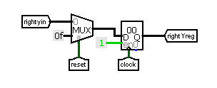
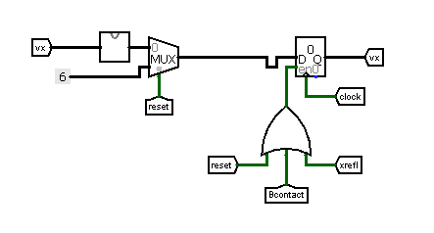
Kinematic Controller
Behavior block
Update all coordinates
Update vertical coordinate of R bat
Update horizontal speed
Notes:
It’s behavior block. There we move the ball and two bats by updating it’s coordinates. Also, there we update horizontal speed

Slide 7
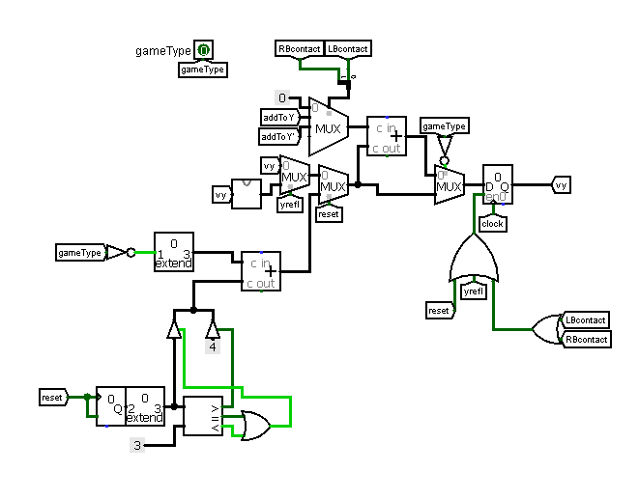
Kinematic Controller
Updating the vertical speed of the ball
Notes:
There you can see scheme of updating vertical velocity. It looks bigger and more scary than scheme for updating vertical speed. So we will tell more about that extension later.

Slide 8
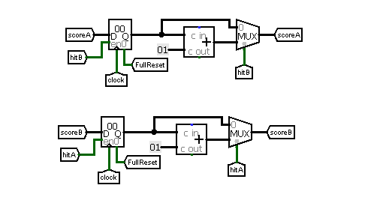
Kinematic Controller
These two schemes are for counting scores
Notes:
And finally, score counters schemes.

Slide 9
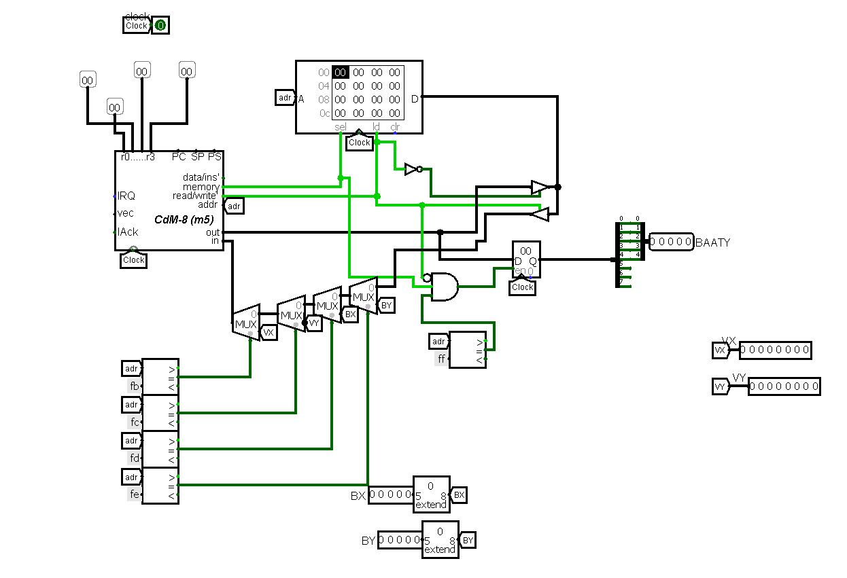
Artificial intelligence
Processor connection

Slide 10
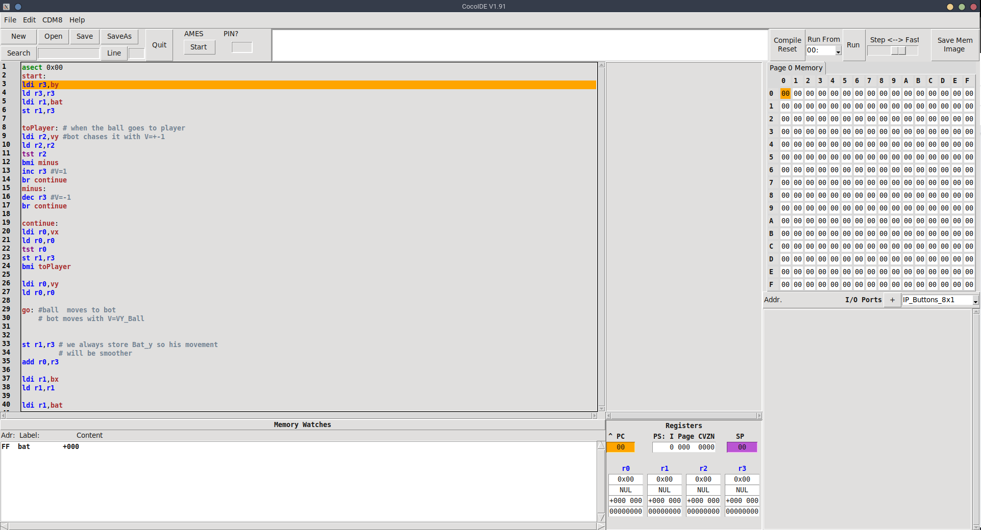
Artificial intelligence
Making the bot for controlling right bat

Slide 11
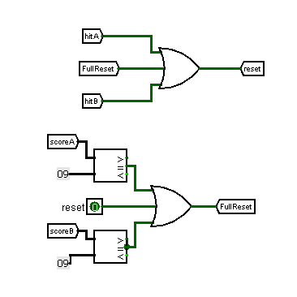
Project innovations
Reset ball position after goal or pressing reset button

Slide 12
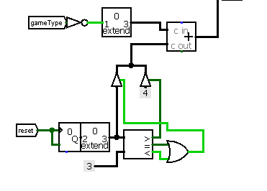
Project innovations
Random vertical speed after restart

Slide 13
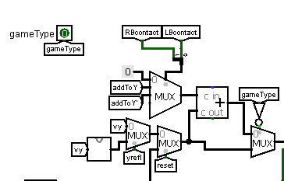
Project innovations
Two different game modes

Slide 14
Further development plan
Add “real” angles
Add multiple difficulty levels for the bot
Add animations and sounds

Slide 15
Thank you for your attention
Panfilov Vyacheslav - group 20213
v.panfilov@g.nsu.ru
Malov Alexey - group 20214
a.malov1@g.nsu.ru
Ivanov Oleg - group 20215
o.ivanov@g.nsu.ru
Идите домой

